Slide 1

SMART INDIA HACKATHON 2026
TITLE PAGE
AgniDrishti
Catch the drifting in-spec part at hour 24, not 168.
Decision support for ISRO burn-in QA: at the 24 h reading, each part
is compared with its own lot and a 168 h forecast. Every decision
shows its numbers and the rule that fired.
Problem Statement ID – 26170
Problem Statement Title- AI-Driven Anomaly Detection in Component Burn-In & Screening
Theme- Smart Automation
PS Category- Software
Team ID- (to be assigned on the SIH portal)
Team Name- Regnum Carya
Notes:
AgniDrishti, team Regnum Carya, SIH 2026 PS 26170 (ISRO).
10-second pitch: static limits pass an in-spec part even when it is abnormal for its lot or drifting — the PS's 'latent defect'. AgniDrishti flags it at hour 24 and sends doubtful parts to an engineer; every decision, PASS included, shows the rule that fired, and bad or missing data is never PASSed.
Before upload: replace the Team ID text once the portal assigns it; export to PDF.

Slide 2
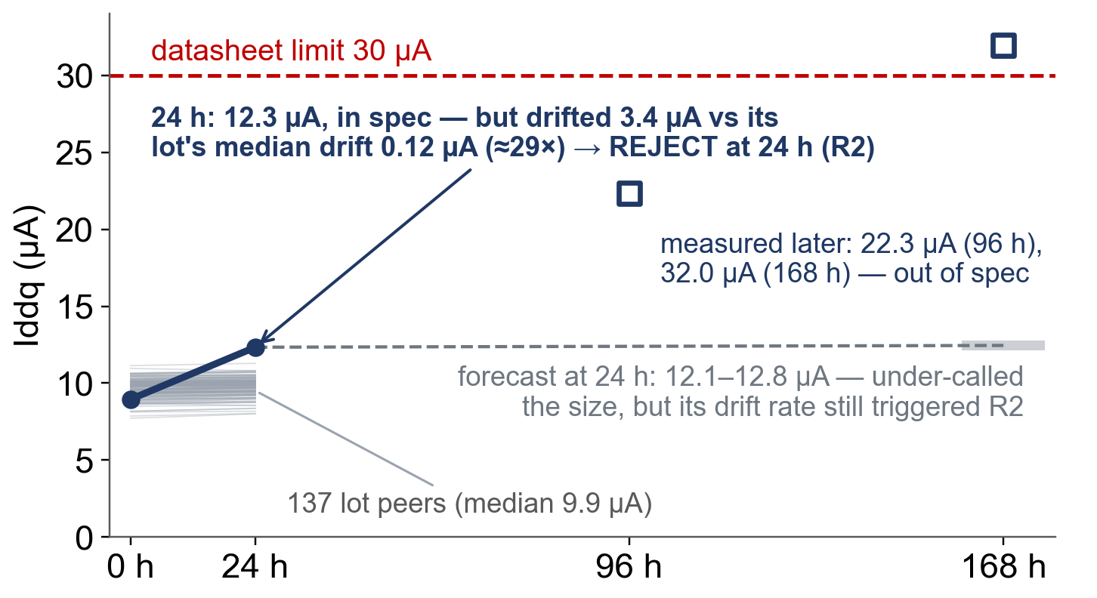
In spec is not the same as healthy
Regnum Carya
Proposed Solution (Describe your Idea/Solution/Prototype)
Detailed explanation of the proposed solution
Latent defects stay inside the datasheet limit but drift. At hour 24, AgniDrishti compares each part with its own lot and a 168 h forecast. Every decision, PASS included, shows its numbers and the rule that fired; bad or missing data is never PASSed.
PIPELINE OUTPUT · synthetic held-out lot (not ISRO data) · datasheet check: PASS
How it addresses the problem
Module A level and 0→24 h drift vs the part's own lot (robust z)
Module B V0h + V24h → V168h forecast learned from past lots, with a 90 % range; early rejection if the drift rate exceeds the safety slope
Decision ordered rules R0–R6; the rule that fired is the explanation; doubtful parts go to an engineer (REVIEW)
Innovation and uniqueness of the solution
Drifting part-parameters caught at hour 24, of 30 (held-out synthetic lots; part-parameter = one part × one parameter)
4 / 30
datasheet limit at 24 h
4 / 30
+ DPAT lot level (AEC-Q001)
20 / 30
+ lot-relative drift
24 / 30
full AgniDrishti · 11 % flagged
Notes:
ONE MESSAGE: in spec is not the same as healthy.
Chart: one real row of the frozen pipeline on held-out SYNTHETIC test lots (artifacts/metrics/E1-E6_test/20260926-144448_c8ca99b): SYN-L026-C0010 Iddq, 12.34 uA at 24 h (limit 30 uA). Drift 0-24 h 3.38 uA vs the lot's median drift 0.116 uA (29x; 42.7 robust sigma) -> REJECT, rules R2;R3;R5. 96 h and 168 h values (22.3, 32.0 uA) were revealed only after the decision, for evaluation.
R2 needs both the point and the optimistic end of the range above the safety slope 0.0080 uA/h (15 % of V0 / 168 h): optimistic (12.14 - 8.955)/168 = 0.0190 uA/h = 2.4x; point 0.0208 = 2.6x. The forecast under-predicted the size.
Tiles: recall on the primary proxy label (drift > 15 % of V0 by 168 h, or 168 h outside the limit), 30 positive part-parameters (one part x one parameter), REVIEW counted as flagged. E6 recall 0.80, 95 % Wilson CI 0.63-0.91. 11 % = 247 REVIEW + 14 REJECT of 2,368.
The evidence card for this part is on slide 4.

Slide 3
TECHNICAL APPROACH
Regnum Carya
Every layer is tested against a simpler baseline on held-out lots — the results include what did not help.
PS metric 1 · missed defects (test lots)
recall 0.80 (95 % CI 0.63–0.91); 11 % flagged
PS metric 2 · 168 h MAE (validation lots)
Iddq 0.297 vs 0.338 µA · tpd 0.047 vs 0.050 ns*
PS metric 3 · explainability
each decision shows its numbers + the rule fired
Technologies to be used (e.g. programming languages, frameworks, hardware)
Module B: 4 forecasters compared on validation MAE; a learned population increment (V24 + median 24→168 h rise) beat least-squares regression; 90 % split-conformal range.
Module A: robust lot statistics · Decisions: ordered rules, every output explainable · Python, web UI + CLI, offline, CPU only.
Methodology and process for implementation (Flow Charts/Images/ working prototype)
✓ all built and tested (commit 1f5d29a)
Tester export
any column layout
Column map
site config
Quality gate
bad → REVIEW
Spec check
datasheet limit
Lot level + drift
robust z
168 h forecast
+ 90 % range
Ordered rules
R0–R6
Evidence card
+ audit record
Decision rules — first match wins
Measured: held-out test lots, SYNTHETIC, evaluated once
R0
bad or missing data
REVIEW
Cumulative layers | Recall | Precision | REVIEW % | False rej.
E1 datasheet limit | 0.133 | 0.125 | 1.2 % | 0.0 %
E2 + DPAT lot level | 0.133 | 0.085 | 1.9 % | 0.0 %
E3 + lot-relative drift | 0.667 | 0.213 | 3.5 % | 0.3 %
E4 + 168 h forecast | 0.667 | 0.213 | 3.3 % | 0.3 %
E5 + 90 % range | 0.667 | 0.213 | 3.4 % | 0.3 %
E6 full ordered rules | 0.800 | 0.092 | 10.4 % | 0.3 %
R1
outside the datasheet limit now
REJECT
R2
drift rate > safety slope at optimistic end (Module B)
REJECT
R3
point or pessimistic end reaches slope or limit (B)
REVIEW
R4
level and drift both ≥ 6 robust σ (Module A, DPAT)
REJECT
R5
level or drift ≥ 2.5 robust σ (Module A)
REVIEW
R6
none of the above
PASS
robust z = (x − median)/(IQR/1.35) · 6 σ DPAT, 2.5 σ tuned on validation
safety slope s = Δallow/168 h, Δallow = 15 % V0 · drift r = (Ŷ168 − V0)/168 h
Where the gain comes from: lot drift (4 → 20 of 30); ordered rules add +4 but raise REVIEW 3.4 % → 10.4 %. Precision falls as doubt goes to REVIEW, yet the flagged queue is ≈ 7× richer in drifting parts than the lot. The forecast adds no detection alone; it feeds R2/R3.
* vs persistence (predict V168 = V24). Flagged = REVIEW 10.4 % + REJECT 0.6 %.
Notes:
ONE MESSAGE: each PS metric answered at the top; below it, a simple layered pipeline in which each layer's contribution was measured, including the ones that did not help.
Runs: test artifacts/metrics/E1-E6_test/20260926-144448_c8ca99b (frozen specs from validation run 20260926-144425_c8ca99b). MAE figures are on validation lots (ablation-plan section 3). Label: primary proxy label, Delta_allow 0.15 relative (ADR-002/004).
The PS names three evaluation metrics (Anomaly Detection Score, Drift Prediction Accuracy = MAE, Explainability) but gives no formula for the score; we count REVIEW + REJECT as flagged and report recall at a stated review share.
Why E6 rather than E3: E3 precision 0.213 at 3.5 % REVIEW; E6 0.092 at 10.4 %. The PS treats a miss as costlier than a review, so E6 is the recall-first point (+4 catches for about 165 more reviews). The review threshold is re-chosen per site fit to meet the configured target recall.
Test coverage of the 90 % range 0.887; per-lot 0.668-0.980 on validation. Not a failure probability.
Module B model choice: persistence (V168 = V24), linear extrapolation, population increment (V24 + median training-lot 24->168 h increase) and least-squares linear regression on (V0, V24) were compared; validation MAE Iddq 0.338 / 1.174 / 0.297 / 0.408 uA. The PS asks for a regression model; ours was tried and lost to the simpler learned increment, so the simpler one is used.
Why no LSTM: 2-4 readings per part; sequence models add opacity, not accuracy.

Slide 4
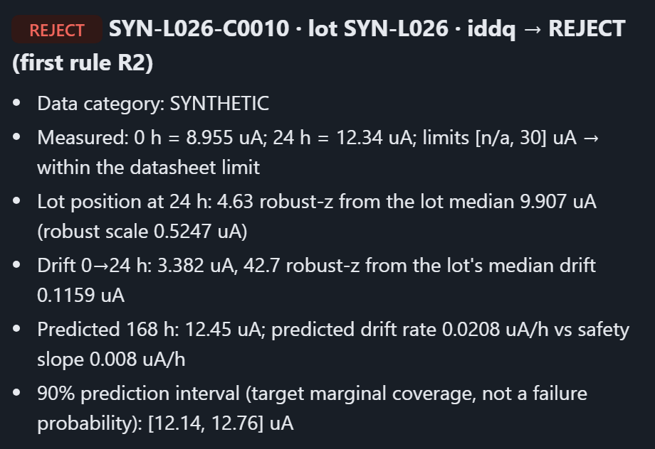
FEASIBILITY AND VIABILITY
Regnum Carya
Potential challenges and risks | Strategies for overcoming these challenges
No official dataset for PS 26170 | Synthetic PS-shaped lots, always labelled; site-fit script recalibrates on ISRO history (built; untested on real ISRO data)
PS names three metrics but no formula | Report all three: recall at a stated review share, 168 h MAE vs persistence, a rule-based explanation per part
“You detect the defects you injected” | Two extra behaviour families written outside the repo, sealed by SHA-256 on 26 Sep 2026, not yet opened — the final unseen test. Now: test lots scored once; leakage tests
Whole lot degrades / contaminated lot | Median / IQR statistics, plus absolute-limit and safety-slope backstops
Safety slope not defined in the PS | One Δallow per site config (15 % of V0 in the prototype); per-parameter ESCC detail-spec Δ limits are the next step
Late-onset defects look healthy at 24 h (6 of 30 test escapes) | Stated limit; re-screen when the 96 h reading arrives (next)
Single glitchy 24 h reading → false REJECT: 8 of 14 REJECTs correct (6 false = 0.3 % of part-parameters) | REJECT is advisory: the engineer confirms (human-in-the-loop). v2: single-jump cases → REVIEW, tested on fresh pre-registered data
Analysis of the feasibility of the idea
What the QA engineer sees · prototype, slide 2's part
Scale 2,368 → 118,400 part-parameters: 0.35 s → 14.2 s, linear (one PC; test lots replicated 50×).
Built and verified · offline, CPU only
✓ 8 stages ✓ web UI + CLI ✓ any column layout (site config)
✓ 111 tests ✓ audit record + replay → identical decisions
github.com/Mrudula211/AgniDrishti/tree/p1-synthetic-data
Notes:
ONE MESSAGE: every known risk is stated at its true status, and the product output is shown.
Data flow in a facility: QA exports the 24 h readings as CSV -> upload in the web UI or CLI -> ranked REVIEW queue with evidence cards.
Escapes and false rejects: final test run, ablation-plan section 5 F5/F6; REJECT 14 = 8 true + 6 false (primary label); 6 / 2,338 negatives = 0.3 %.
Held-out families: written by the team outside the repository; only the SHA-256 commitment is in the repo. Not yet opened; opening date is a team decision.
Scale: service runs on the frozen pipeline, 3 runs each, median: 2,368 part-parameters 0.35 s; 23,680 (10x) 2.6 s; 118,400 (50x, 500 lots) 14.2 s. Test lots copied with new lot IDs; decisions scale exactly. One PC, 2026-09-29.
Replay: GET /api/runs/<id>/replay returned identical: true for the test-lot run (20260929-035534_1f5d29a).

Slide 5
IMPACT AND BENEFITS
Regnum Carya
Same burn-in. The engineer sees risk at hour 24, with the evidence.
Potential impact on the target audience
For: QA and reliability engineers screening space-grade electronics
CONVENTIONAL
Burn-in 0 → 168 h — no view of which parts are heading for trouble
PASS / FAIL at 168 h
AGNIDRISHTI
24 h reading
Lot, drift, 168 h range
PASS 89.0 %
REVIEW 10.4 %
REJECT 0.6 %
Engineer reviews flagged · all advisory
Decision shares measured on the held-out SYNTHETIC test lots (2,368 part-parameters).
At the 24 h checkpoint the QA engineer gets a ranked REVIEW queue — each part with its numbers, its lot, its forecast range and the rule that fired — and records a decision with a reason. Decision support, not automation.
Benefits of the solution (social, economic, environmental, etc.)
RELIABILITY Mission
Latent-defect candidates surface before flight integration, not after: parts in spec but abnormal for their lot or drifting.
FOCUS Operational · economic
The 11 % sent to an engineer holds 24 of 30 drifting part-parameters — about 7× the base rate. Attention goes where the risk is.
TRUST Operational · security
Every decision is reproducible from its record and runs offline, on-site — burn-in data never leaves the facility.
Focus figures: synthetic test lots. Possible chamber-time saving: a confirmed reject could exit 144 h early, if the facility can reload that slot — not measured.
Future progression
PHASE 1 ✓
Synthetic prototype — done
PHASE 2
ISRO lot history; go if range holds on ≥ 90 % of lots
PHASE 3
96 h re-screen · more parameters
PHASE 4
Tester-log ingestion · model monitoring
Gains on ISRO hardware will be measured after validation on representative ISRO data.
Notes:
ONE MESSAGE: the same burn-in, but the engineer sees risk at 24 h with the evidence.
Focus: 261 flagged part-parameters (247 REVIEW + 14 REJECT) = 11.0 % of 2,368 hold 24 of 30 positives: 9.2 % in the queue vs 1.27 % base rate, 7.3x. Synthetic held-out test run c8ca99b; not an ISRO result.
Phase 2 gate: the 90 % range must reach its target coverage on at least 90 % of ISRO lots before the forecast is used there.
Chamber time: 168 - 24 = 144 h only if a rejected part's slot can be reloaded; burn-in usually runs as batches. Not measured.
All decisions are advisory: the pipeline decision is recorded, the engineer's decision is logged beside it and never overwrites it.

Slide 6
RESEARCH AND REFERENCES
Regnum Carya
Details / Links of the reference and research work
OFFICIAL
SIH 2026 PS 26170 — AI-Driven Anomaly Detection in Component Burn-In & Screening (ISRO). sih.gov.in/sih2026PS
PRIOR ART
Burn-in ML: I. Ahmed, P. Baraldi, E. Zio, H. Lewitschnig, Comput. Ind. Eng. 204, 111115, 2025 · doi:10.1016/j.cie.2025.111115
Lot health for burn-in: L. Langenberg, R. Pätzold, A. Khalid, “Process Data Analysis for Improved Burn-In Strategies Based on Complementary AI Models”, ESREL 2023
Burn-in outliers: US 8,010,310 B2, Method and apparatus for identifying outliers following burn-in testing, 2011
RELIABILITY PRACTICE (informed the design — no compliance claimed)
AEC-Q001 Rev-D, Guidelines for Part Average Testing, AEC, 2011 — our Module A baseline (DPAT)
ESCC Generic Specification No. 9000, Issue 10, ESA, 2018 — burn-in drift limits
ESCC Detail Specification No. 9202/045, Issue 6, ESA, 2020 — example per-parameter drift limits (IDD ±75 nA; IOL ±15 %)
METHOD
Conformal prediction: J. Lei et al., JASA 113(523), 2018 · doi:10.1080/01621459.2017.1307116
Grouped (lot) data: R. Dunn, L. Wasserman, A. Ramdas, JASA 118(544), 2023 · doi:10.1080/01621459.2022.2060112
Degradation: C. J. Lu, W. O. Meeker, Technometrics 35(2), 1993 · doi:10.1080/00401706.1993.10485038
Reject option (REVIEW): C. K. Chow, IEEE Trans. Inf. Theory 16(1), 1970 · doi:10.1109/TIT.1970.1054406
Planned: methodology check on NASA PCoE MOSFET/IGBT ageing data (external, not ISRO)
What we add to this prior art: a decision at the 24 h checkpoint (not after burn-in) from lot-relative drift, a calibrated 168 h range, and a REVIEW route with per-part evidence.
OUR OWN EVIDENCE — CHECK IT
Code: github.com/Mrudula211/AgniDrishti/tree/p1-synthetic-data · commit 1f5d29a · 111 tests · E1–E6 frozen before test lots were scored once
Final unseen test: two behaviour families sealed 26 Sep 2026 (SHA-256 1a7de276…), not yet opened.
Notes:
ONE MESSAGE: every design choice traces to an official source, an established reliability practice or published method research — and our own evidence can be checked in the repository.
DOIs resolved via doi.org on 2026-09-29; ESREL 2023 title and authors checked against the proceedings page. AEC-Q001 and ESCC informed the design; no compliance is claimed. NASA PCoE data is external public data, planned for a methodology check (R-01..R-04 not yet executed).
Pre-registration: commit 9f52521 (E1-E6 values) precedes the first detector commit 31da148 (same evening); the frozen specs were applied once to the test lots (run 20260926-144448_c8ca99b). Held-out commitment 8ed3789 precedes the generator.

