Slide 1
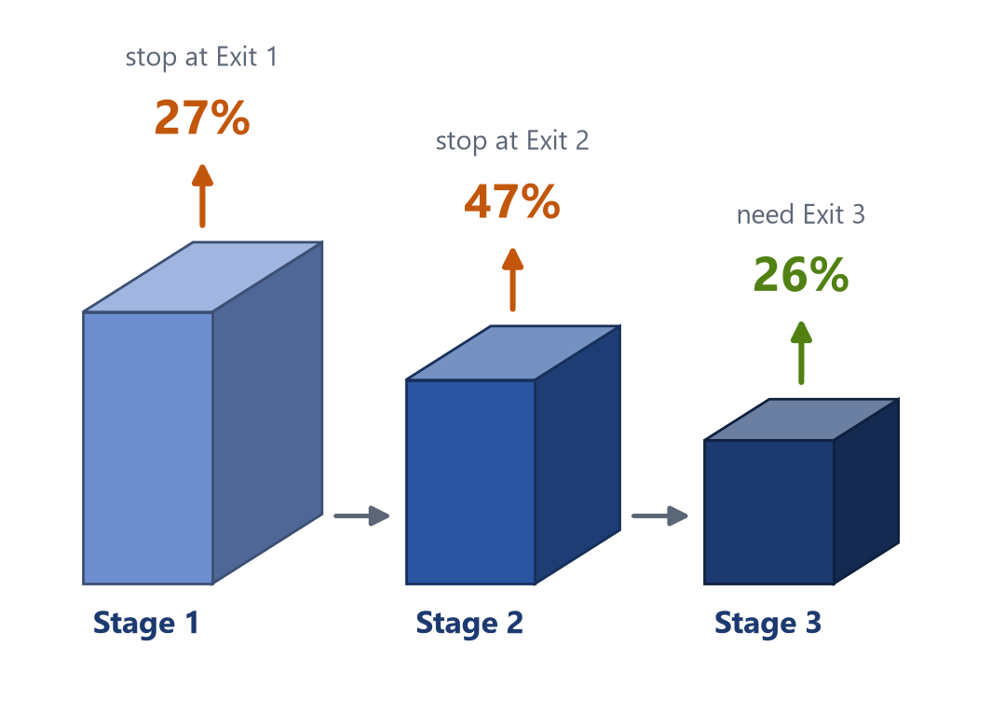
Think-or-Stop: An Adaptive Early-Exit CNN
Design and Evaluation for Efficient Image Classification
SUBJECT
Deep Learning – Mini Project
UNIVERSITY
TOOLS
Universal Ai University, Mumbai
Python · PyTorch · CUDA (RTX 5060)
THE STORY OF THIS TALK
Problem
CNN basics
Data
Architecture
Training
Think or Stop
Results
Notes:
Good morning sir. My mini project is called "Think-or-Stop: An Adaptive Early-Exit CNN".
The idea in one line: a normal convolutional neural network does the same amount of work for every image, even easy ones. Think-or-Stop gives the network the option to STOP early when it is already confident, and to keep THINKING (go deeper) only for hard images.
The 3D picture on the right is the actual result on the CIFAR-10 test set: about 27% of images stop after Stage 1, 47% after Stage 2, and only 26% need the full network.
Important: early exiting is an established research idea (BranchyNet 2016, MSDNet 2018, Shallow-Deep Networks 2019). I am not claiming a new method. My work is: implementing it from scratch in PyTorch, training it on my GPU, and evaluating it carefully - accuracy, computation, real GPU speed, calibration and robustness - including the cases where it does worse.
The chain at the bottom is the order of this talk: the problem, the CNN basics I used, the data, the architecture, training, the Think-or-Stop inference rule, and finally the results.

Slide 2


Why Think-or-Stop? The Problem
A normal CNN spends the same effort on every image - even when the answer is obvious after a few layers.
EASY
Conventional CNN
Clear ship on blue water
Stage 1
Stage 2
Stage 3
100%
work for every image
Exit 1 is already 94% sure → STOP after Stage 1. Only ~26% of the network's work is needed.
Every image runs through all layers; one answer at the end.
HARD
Think-or-Stop (this project)
Cat that looks like a dog
Stage 1
Stage 2
Stage 3
≈63%
average work
Exits 1 and 2 are not sure enough → continue to Exit 3 (full network) → cat, 99.9%.
stop?
stop?
Classifier after each stage; stop as soon as one is confident.
Real CIFAR-10 test images (32×32 pixels, enlarged) and the model's real decisions.
Notes:
This slide explains the problem.
On the left are two real images from the CIFAR-10 test set, with the real decisions my model made. The ship on blue water is easy: colour and shape are enough, so the first exit is already 94% sure and the network stops after Stage 1. That needs only about a quarter of the computation. The cat is hard because it looks like a dog, so the early exits are not confident and the image goes all the way to the final exit.
A conventional CNN (top right) treats both images the same: every image goes through all three stages, 100% of the work every time.
Think-or-Stop (bottom right) puts a small classifier after each stage. After each stage it asks "am I confident enough to stop?". Easy images stop early; hard images continue. On CIFAR-10 this used about 63% of the work on average.
My research questions were:
1. How does a normal CNN compare with a CNN that has extra exits?
2. How does the confidence threshold change accuracy and computation?
3. Can early exits reduce average computation?
4. Does that actually make it faster on a real GPU?
5. Are early exits still reliable on noisy or blurred images?
6. How do calibration, latency and exit rates change under different conditions?
I did not assume the adaptive model would win - the experiments were designed to show it if it is slower or less accurate.

Slide 3










Key Terms: Building Blocks of the CNN
1
2
3
4
5
Convolution
Batch Normalization
ReLU
Max Pooling
Fully Connected
Small 3×3 filters slide over the image and detect patterns: edges → textures → parts.
Rescales each layer's outputs to a stable range, so training is faster and steadier.
max(0, x): keeps positive values, sets negatives to 0. Adds non-linearity.
Keeps the largest value in each 2×2 window. Halves width and height.
Every input links to every output. Turns features into 10 class scores.
6
7
8
9
10
Dropout
Softmax
Cross-Entropy Loss
Backpropagation
Adam Optimizer
Randomly switches off 30% of neurons during training so the net cannot memorise.
Converts 10 scores into probabilities that add up to 100%.
Loss = −log(probability of the true class). Small when right and confident.
Chain rule sends the error backwards to get every weight's gradient.
Updates each weight using its gradient with its own adaptive step size.
Blue = layers of the network. Green = how the network learns.
Notes:
Before the architecture, here are the ten terms I use throughout.
Blue cards are the layers:
1. Convolution: a small 3×3 filter of learnable weights slides over the image; at every position it computes a weighted sum. Each filter becomes a detector for one pattern. Early layers find edges and colours, deeper layers find textures and object parts. The same filter is reused everywhere, so it needs far fewer weights than a fully connected layer.
2. Batch normalization: normalises each channel using the batch mean and variance, then applies a learnable scale and shift. It stabilises training. In evaluation it uses stored running averages, so one image's result does not depend on other images in the batch - this matters for my early-exit batching.
3. ReLU: max(0, x). Cheap, adds non-linearity, avoids vanishing gradients for positive values.
4. Max pooling: keeps the maximum in each 2×2 window, halving the size. Reduces computation and gives tolerance to small shifts.
5. Fully connected layer: connects all features to the 10 class scores (logits).
Green cards are how the network learns:
6. Dropout: during training, randomly zeroes 30% of activations in the classifier heads, so the network cannot rely on single neurons; it is switched off at test time.
7. Softmax: p_k = exp(z_k) / sum of exp(z_j). Gives probabilities that sum to 1. The biggest probability is what I later use as "confidence".
8. Cross-entropy loss: minus log of the probability of the correct class. If the model gives the true class 0.9, loss is 0.105; if it gives 0.1, loss is 2.3.
9. Backpropagation: the chain rule computes the gradient of the loss with respect to every weight, going backwards layer by layer.
10. Adam: an optimiser that keeps running averages of gradients and squared gradients and gives each weight its own step size. I used learning rate 0.001.

Slide 4






Datasets and Data Preparation
MNIST smoke test / debugging
How CIFAR-10 is split
Train 45,000 learns the weights
70,000 grayscale handwritten digits, 28×28 px, 10 classes (0-9). Split 55,000 train / 5,000 validation / 10,000 test.
Validation 5,000 picks best epoch + threshold τ
CIFAR-10 main benchmark
Test 10,000 final report only - never for tuning
Preparation steps
Normalise: (x − mean) / std per channel
airplane · automobile · bird · cat · deer · dog · frog · horse · ship · truck
60,000 colour photos, 32×32 px, 10 classes. Much harder: small objects, different poses and backgrounds.
Random crop: pad 4 px, crop 32×32
Horizontal flip: 50% chance, train only
Rule: the validation split is fixed with its own seed (42) for every run; the test set is touched only once, for the final numbers. Augmentation is applied to training images only.
Notes:
I used two official datasets, downloaded with torchvision.
MNIST: 70,000 handwritten digits, 28 by 28, grayscale. It trains in seconds, so I used it to debug the whole pipeline first - a "smoke test".
CIFAR-10 is the main benchmark: 60,000 colour photos, 32 by 32 pixels, in 10 classes. The images are tiny and objects appear in different poses and backgrounds, so it clearly shows the difference between shallow and deep exits.
The split is important. The official 50,000 training images are divided into 45,000 for training and 5,000 for validation, using a fixed random seed of 42 - the same split for every run so seeds are comparable. The validation set is used for exactly two decisions: which epoch's checkpoint to keep, and which confidence threshold to use. The 10,000 official test images are used only once for the final report. If I tuned the threshold on the test set and then reported test accuracy, the result would be optimistically biased - that is called data leakage.
Preparation:
- Normalisation: subtract the per-channel mean and divide by the standard deviation (CIFAR mean 0.4914, 0.4822, 0.4465; std 0.2470, 0.2435, 0.2616). This keeps inputs centred around zero, which helps optimisation.
- Data augmentation on training images only: random crop (pad 4 pixels, crop back to 32×32) and random horizontal flip. A flipped horse is still a horse, so the network learns position- and direction-invariant features and overfits less.
- MNIST is not flipped because flipping can change a digit's meaning.

Slide 5
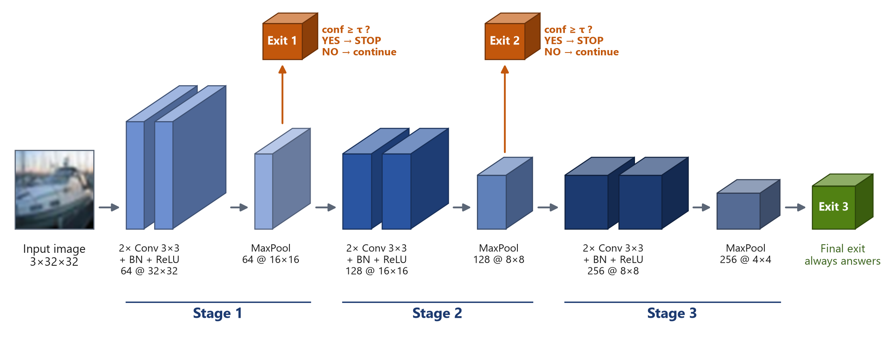
Architecture: 3 Stages, 3 Exits
1.38 M
parameters (multi-exit)
26%
of compute to reach Exit 1
63%
of compute to reach Exit 2
100%
full network = 153 M MACs
+0.07%
compute added by the 2 extra heads
Notes:
This is the architecture in 3D, with the real CIFAR-10 shapes.
The backbone has three stages. Each stage has two convolution layers (3×3, each followed by batch normalisation and ReLU) and then a 2×2 max pooling. Channels double each stage - 64, 128, 256 - while the image size halves: 32 → 16 → 8 → 4. Early stages see fine detail at high resolution; later stages see more abstract features at low resolution. This is a VGG-style design.
After Stage 1 and Stage 2, I attach a small exit head (orange). Each head is: adaptive average pooling to 2×2, flatten, fully connected to 128, ReLU, dropout 0.3, fully connected to 10 classes. Adaptive pooling makes the head independent of input size, so the same code works for MNIST (28×28) and CIFAR-10 (32×32). Exit 3 (green) is the final classifier and always answers.
Key numbers at the bottom:
- 1.38 million parameters. The baseline standard CNN has the identical backbone and final head but no exits 1 and 2: 1.28 million parameters. So the comparison is fair - the only difference is the extra heads and the training loss.
- MACs means multiply-accumulate operations, a hardware-independent measure of arithmetic work (FLOPs ≈ 2 × MACs). Reaching Exit 1 costs 26% of the full network's work, Exit 2 costs 63%, the full network 153 million MACs.
- Why does Stage 1 cost 26% when it has only 3% of the parameters? Because it works at full 32×32 resolution - computation depends on image size, parameters do not.
- The two extra heads add only 0.07% computation, because they are tiny compared with the convolutions.

Slide 6

Training: One Loss, Three Exits
Multi-exit loss (all exits learn together)
L_{total} = w₁·L_{exit1} + w₂·L_{exit2} + w₃·L_{exit3}
Each L is cross-entropy; weights w = (1, 1, 1). Stage 1 gets feedback from all three heads, Stage 3 only from the final head.
Optimizer Adam
Learning rate 0.001
LR schedule cosine → 0
Batch size 128
Epochs 30
Dropout 0.3
Weight decay 1e-4
Seeds 0, 1, 2
Best checkpoint = highest Exit-3 validation accuracy (same rule for both models). Trained on RTX 5060: ~6-12 s per epoch, < 1 GB GPU memory.
x-axis: epoch
Notes:
All three exits are trained together with one combined loss: L total = w1 × L exit1 + w2 × L exit2 + w3 × L exit3, where each L is the cross-entropy of that exit. I used equal weights (1, 1, 1) - the most neutral choice, every exit gets an equal share of the gradient. Because the stages are shared, Stage 1 receives gradient from all three heads, Stage 2 from two, Stage 3 from one. A unit test checks that every head and every layer receives a gradient.
Why train jointly? So the early layers learn features that are useful for an immediate decision, not only as input for later layers. The risk is that the shared layers must satisfy three objectives - I measured this cost later: it was very small.
Hyperparameters: Adam optimiser with learning rate 0.001; cosine schedule that smoothly lowers the learning rate to zero over 30 epochs; batch size 128; dropout 0.3 in the heads; weight decay 1e-4 (a mild L2 penalty); three random seeds 0, 1 and 2 so I can report mean ± standard deviation.
Checkpoint selection: after every epoch, the model is saved if Exit-3 validation accuracy improved. The baseline uses exactly the same rule.
The chart shows the real training run (seed 0): validation accuracy per exit over 30 epochs. All exits improve and flatten by epoch 30. Exit 1 plateaus around 69% (only two convolution layers), Exit 2 near 87%, Exit 3 near 91%.
Terms: an epoch is one full pass over the 45,000 training images. A seed fixes the random initialisation and shuffling so a run can be reproduced. Training ran on my RTX 5060 laptop GPU in about 6 to 12 seconds per epoch using less than 1 GB of GPU memory.

Slide 7

Adaptive Inference: Think … or Stop?
Stage 1
Exit 1 + softmax
conf ≥ τ ?
YES
STOP ✓
answer
Real examples (τ = 0.84)
Ship
NO
Exit 1: ship 94.4% ≥ 0.84
→ STOP at Exit 1
Stage 2
Exit 2 + softmax
conf ≥ τ ?
YES
STOP ✓
answer
NO
Ship
Exit 1: below 0.84 → continue
Exit 2: ship 99.8% → STOP
Stage 3
Exit 3 + softmax
Always answers (final exit)
Cat
confidence = highest softmax probability (e.g. ship 0.94). τ (tau) = threshold we choose.
Batches: images that stop are removed, so deeper stages only process the rest: 10,000 → 7,317 → 2,597 images (τ = 0.84). Verified: 100% identical to checking images one by one.
Exits 1 and 2: below 0.84
Exit 3: cat 99.9% (final)
Notes:
This is the core of the project: the Think-or-Stop rule.
For each image:
1. Run Stage 1, then the Exit 1 classifier. Softmax converts its 10 scores into probabilities.
2. The confidence is the highest probability - for the ship, 0.944 for the class "ship".
3. Compare with the threshold τ (tau). If confidence ≥ τ, we STOP and output that class (green YES path).
4. If not (orange NO path), we continue: run Stage 2 and Exit 2, and apply the same test.
5. If still not confident, run Stage 3; Exit 3 always gives the final answer.
The right side shows real examples with τ = 0.84 (the threshold selected on validation data): one ship stopped at Exit 1 at 94.4%, another ship needed Exit 2 (99.8%), and the cat needed the full network (99.9% at Exit 3).
Important caution: maximum softmax probability is only a PROXY for correctness - a network can be confidently wrong. I measure how often that happens later.
Batches: on a GPU we process 128 images at once, but different images stop at different exits. My implementation removes the images that stopped and only sends the remaining ones to the next stage, keeping track of each image's original position so answers come back in the right order. On the test set with τ = 0.84: Stage 1 processed all 10,000 images, Stage 2 only 7,317 and Stage 3 only 2,597. I verified with unit tests and on the full test set that this batched version gives 100% the same predictions as processing images one by one. Also, BatchNorm in evaluation mode uses stored statistics, so an image's answer does not depend on other images in the batch.

Slide 8
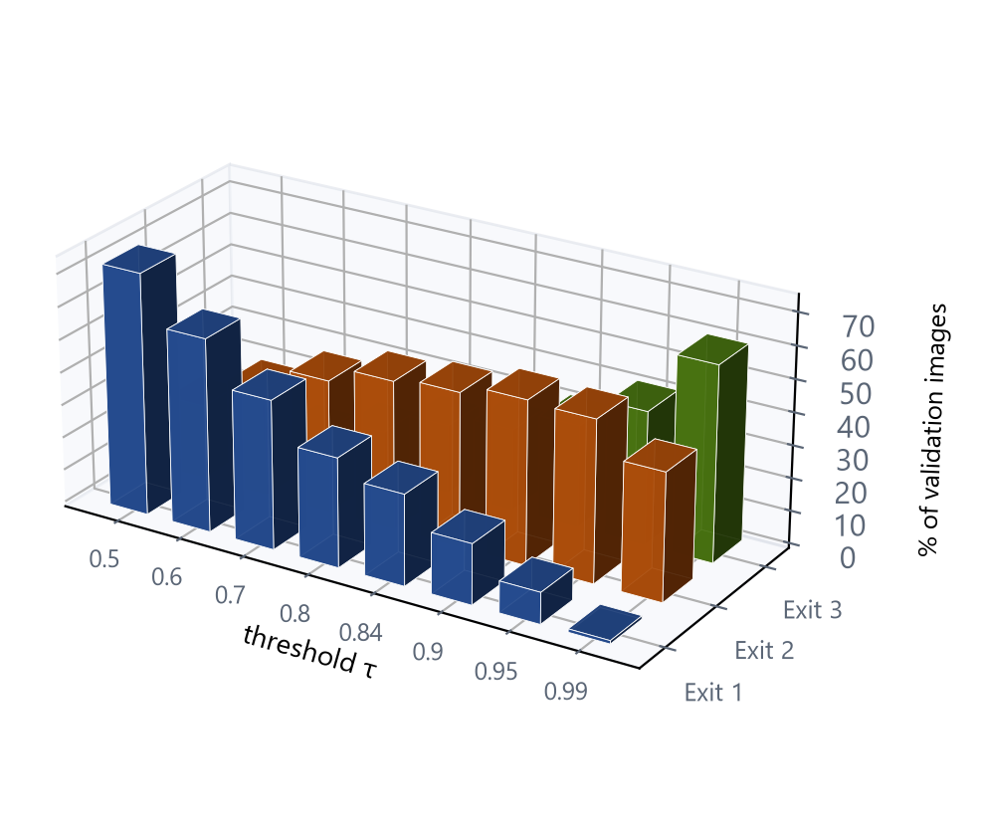

Choosing τ Without Cheating
1
Try every τ
from 0.00 to 1.00 on the 5,000 validation images (never the test set).
2
Keep safe values
validation accuracy must stay within 1 point of the full network (relative rule).
3
Pick the cheapest
among safe values, choose the τ with the lowest average compute (MACs).
4
Freeze and test once
apply that τ unchanged to the test set and to noisy test images.
Higher τ → fewer images stop early (validation, seed 0)
Why not tune on the test set? That leaks test information into the model's settings, so the reported accuracy would look better than it really is (data leakage).
seed 0 τ = 0.84
seed 1 τ = 0.86
seed 2 τ = 0.85
Three independently trained models chose almost the same τ → the selection is stable.
Notes:
The threshold τ controls the whole trade-off: low τ means many images stop early (fast but less accurate), high τ means most images go deep (accurate but more work). The 3D chart shows this on the validation set: as τ increases (left to right), the blue Exit-1 bars shrink and more images move to Exit 2 (orange) and Exit 3 (green).
How I chose τ, using validation data only:
1. Try thresholds from 0.00 to 1.00 in steps of 0.01 (plus fine steps near 1) on the 5,000 validation images.
2. Keep only thresholds whose validation accuracy is at least the full network's validation accuracy minus 1 percentage point. This is the "relative" constraint. (An "absolute" version, e.g. accuracy ≥ 88%, is also implemented. If no threshold meets it, the code falls back to never exiting early and reports that the constraint was not met.)
3. Among those safe thresholds, pick the one with the lowest average computation.
4. Freeze it and apply it once to the test set, and unchanged to the corrupted test images.
Why not choose τ by looking at test accuracy? Because then the test set influences the model's settings, and the reported test accuracy is no longer an unbiased estimate - that's data leakage. In my code the selection function does not even accept test data.
Result: the three seeds chose τ = 0.84, 0.86 and 0.85 - very close, so the procedure is stable.
Terms: validation set = data held out from training for decisions; MACs = multiply-accumulate operations, my measure of computation.

Slide 9
Results: Accuracy vs Computation (CIFAR-10)
90.37%
Standard CNN accuracy
uses 100% compute
89.28%
Think-or-Stop accuracy
uses only 63.5% compute
+3.4 pts
vs. always stopping at Exit 2
at the same ≈63% compute
Method | Accuracy % | Compute %
Standard CNN | 90.37 ± 0.10 | 100.0
Multi-exit: Exit 3 only | 90.11 ± 0.20 | 100.0
Multi-exit: Exit 2 only | 85.89 ± 0.33 | 62.9
Multi-exit: Exit 1 only | 67.44 ± 0.14 | 25.9
Think-or-Stop, τ = 0.9 | 89.72 ± 0.30 | 68.6
Think-or-Stop, val-selected τ | 89.28 ± 0.24 | 63.5
Mean ± std over 3 seeds, CIFAR-10 test set (10,000 images). No significance test was run.
Notes:
Now the results on the CIFAR-10 test set, averaged over three seeds.
Three headline numbers:
- The standard CNN reached 90.37% using 100% of the computation.
- Think-or-Stop with the validation-selected threshold reached 89.28% using only 63.5% of the computation - about 36% less work for about 0.8 points less accuracy compared with its own full network.
- At almost exactly the same compute (~63%), simply always stopping at Exit 2 gives only 85.89%. So deciding depth per image is about 3.4 points better than using a fixed smaller network. This is the strongest result.
The chart: the green curve is Think-or-Stop for every threshold; blue dots are the fixed exits; the grey square is the standard CNN; the orange diamond is the selected threshold. The green curve lies well above the straight path between the fixed exits - that gap is the benefit of adaptive depth.
The table answers research question 1: the standard CNN (90.37%) and the multi-exit model's final exit (90.11%) are practically the same - the 0.26 point difference is about the size of the run-to-run variation, so adding exits costs almost nothing. Fixed Exit 1 is cheap (26%) but much worse (67%).
Honest note: I report mean ± standard deviation of 3 seeds; I did not run a statistical significance test, so small differences should be read as "no clear difference".

Slide 10



Results: Is It Faster on the GPU?
Fewer MACs ≠ less time. 36% less arithmetic, but ≈58% slower per image.
Why the GPU did not speed up
Extra work: 2 extra heads + softmax + comparison per image.
Waiting (sync): At each exit the CPU must wait for the GPU to count who stopped.
Splitting batches: Copying the remaining images into smaller, less efficient batches.
Small network: Each layer is already very fast, so fixed costs dominate.
Batch 128: 21,714 vs 27,725 images/s (Think-or-Stop vs full network: 22% lower).
MNIST counter-example: 84% of digits stop at Exit 1, and adaptive was slightly faster (0.56 vs 0.62 ms).
Notes:
Research question 4: does less computation mean faster on a real GPU? I measured it carefully.
Method: model in evaluation mode with no gradients; the same 1,024 test images pre-loaded on the GPU so data loading is excluded; 20 warm-up batches; every batch timed with torch.cuda.synchronize() before and after - because GPU calls are asynchronous, without synchronising the timing would be wrong; 5 repetitions; median reported. Batch size 1 gives the true per-image latency; batch size 128 gives throughput.
Result (chart): fixed exits do get faster in proportion to their depth - Exit 1 only takes 0.28 ms, the full network 0.61 ms. But Think-or-Stop took about 0.96 ms - roughly 58% SLOWER than just running the whole network, even though it does 36% less arithmetic. At batch size 128 its throughput was also 22% lower.
Why: (1) extra heads, softmax and comparisons; (2) at each exit the CPU has to wait for the GPU to finish, to know how many images stopped - this synchronisation stalls the GPU pipeline; (3) removing finished images means copying the rest into new, smaller tensors, and small batches use the GPU less efficiently; (4) the network is small, so each layer is already fast and these fixed overheads are larger than the savings.
Counter-example: on MNIST, where 84% of digits stop at Exit 1, adaptive inference was slightly faster at batch size 1 (0.56 vs 0.62 ms). So the outcome depends on how many inputs stop early, the hardware and the model size. On a CPU or a small edge device, where time follows arithmetic more closely, the savings would more likely become real speed - I did not measure that.
Key lesson: FLOPs or MACs are not latency; it must be measured.

Slide 11


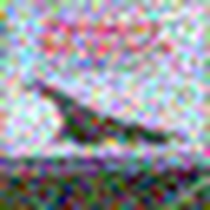

Reliability: Calibration and Noisy Images
Calibration: is 90% confidence really right 90% of the time? ECE = average gap between confidence and accuracy (lower = more honest).
0.019
0.019
0.041
0.027
0.045
Exit 1
Exit 2
Exit 3
Adaptive
Std CNN
The final exit is over-confident (94% average confidence, 90% accuracy); early exits and the adaptive policy are better calibrated.
Synthetic corruptions of the test set (same image)
Adapts: compute rises 63% → ~81% on heavy noise/blur (fewer confident images).
But: confident early exits on corrupted images were wrong ~50% of the time (5% on clean).
clean
noise σ=0.08
noise σ=0.10
blur σ=1.0
Notes:
Research questions 5 and 6: is the confidence trustworthy?
Calibration: a model is calibrated if, among all answers given with 90% confidence, about 90% are correct. I measured Expected Calibration Error (ECE): split predictions into 15 confidence bins, and take the weighted average of |accuracy − confidence| per bin. Lower is better.
- The final exit is the most accurate but the most over-confident: on average 94% confident but 90% correct, ECE 0.041. This matches the known finding (Guo et al. 2017) that deeper, more accurate networks tend to be over-confident.
- The early exits are better calibrated (about 0.019), and the adaptive policy (0.027) is better calibrated than the final exit. The standard CNN has the highest ECE, 0.045.
Robustness: I created reproducible corrupted test sets - Gaussian noise and Gaussian blur at severities 1, 3 and 5, using the same parameters as the CIFAR-10-C benchmark (I re-implemented them; I did not use the real CIFAR-10-C download). The pictures show the same airplane clean, with noise and with blur. Thresholds were still chosen on clean validation data.
Findings:
- The network itself is fragile: even mild noise drops accuracy from 90% to about 73%, for the standard CNN too - it was never trained on noise.
- Think-or-Stop stays close to the full network under every corruption, and automatically spends more compute (63% → about 81%) because fewer images are confident.
- Interesting: under strong noise, Exit 1 is more accurate than Exit 3 - deeper is not always better on shifted data.
- But: when an early exit IS confident on a corrupted image, it is wrong about half the time (vs 5% on clean images). Softmax confidence is unreliable under distribution shift. On MNIST the adaptive model was clearly worse than full depth under heavy noise.

Slide 12



Conclusion, Limitations and Next Steps
Less computation
Smarter than a smaller net
Not faster on this GPU
Confidence under noise
−36% average MACs for only −0.8 points accuracy.
+3.4 points vs fixed Exit 2 at the same cost.
Decision overheads > savings for a small CNN.
Adapts compute, but confident early answers can be wrong.
Limitations
Next steps
Small CNN, small 32×32 images, one laptop GPU
3 seeds, no statistical significance test
One shared threshold; softmax confidence only
Synthetic noise/blur; real CIFAR-10-C not evaluated
Measure on CPU / edge devices (Raspberry Pi, Jetson)
Better confidence: entropy, temperature scaling
Per-exit thresholds or a learned exit decision
Train with noise augmentation; test on CIFAR-10-C
Thank you! Early exiting saves arithmetic, but real speed must be measured, not assumed. Questions?
Notes:
To conclude, here are the answers to my research questions.
1. Less computation - YES. With the validation-selected threshold, Think-or-Stop used about 36% fewer operations while losing only about 0.8 accuracy points versus its own full network.
2. Smarter than a fixed smaller network - YES. At the same computation, choosing depth per image is 3.4 points more accurate than always stopping at Exit 2. Adding the exits cost the final classifier almost nothing (90.11% vs 90.37%).
3. Faster on the GPU - NO, not in my setting. The decision overheads (extra heads, GPU-CPU synchronisation, splitting batches) were larger than the savings for this small network. Fewer FLOPs do not automatically mean less time.
4. Reliability - PARTLY. Under noise and blur the policy automatically spends more compute and stays close to full-depth accuracy on CIFAR-10, but confident early answers on corrupted images are often wrong, and on MNIST it was clearly worse. Softmax confidence is only a proxy.
Limitations: small CNN and small images, one laptop GPU, only 3 seeds without a significance test, one shared threshold and one confidence measure, and synthetic corruptions instead of the real CIFAR-10-C benchmark.
Next steps: measure on CPU and edge devices where time follows arithmetic more closely; try entropy or temperature-scaled confidence; tune a threshold per exit or learn the exit decision; train with noise augmentation and test on CIFAR-10-C.
Everything is reproducible: fixed seeds, 41 automated tests, and one command (run_all.ps1) re-runs the whole pipeline. Thank you - I am happy to take questions.

