Slide 1


Marathwada Mitra mandal's
COLLEGE OF ENGINEERING
Marathwada Mitra mandal's
Karvenagar, Pune
An Autonomous Institute
Presentation
c^rlid fffil |*
On
VIRTUAL TOUR MUSEUM APP

Slide 2
Group Information
Sr.No | Prn No | Name of students
1. | B24IT1115 | Chinmay Kanade
2. | B24IT1087 | Tejas Solanke
3. | B24IT1097 | Mrugadni Kamble
4. | B24IT1088 | Tanmayee Saggam

Slide 3
Introduction
The Virtual Tour Museum App is a next-generation educational tool designed to digitally replicate the museum experience. Leveraging UI/UX design principles and prototyping via Figma, it enables users to navigate through curated exhibits, historical artifacts, and cultural treasures from the comfort of their own homes.
The app is a solution to limitations such as geographical boundaries, physical disabilities, and time constraints that prevent people from accessing real-world museums. It supports virtual learning, cultural exploration, and digital preservation.
The app enables users to explore museum exhibits virtually, making cultural education accessible and interactive.

Slide 4
Objective
• To bridge the gap between physical museums and digital users through an immersive app interface.
• To design an intuitive and aesthetic UI/UX that makes navigation seamless.
• To support interactive learning by embedding audio, video, and pop-up information for each exhibit.
• To provide a cost-effective and scalable solution for institutions wishing to digitize their museum content.
• To simulate a realistic and educational museum visit using interactive UI components.

Slide 5
Feature (Module Description)
1. Home Dashboard
. Highlights featured museums, tours, and recommended categories. . Quick access to recent or saved tours.
2. Museum Gallery List
. Browse by category (History, Art, Science, etc.)
. Sort by location, rating, or popularity.
3. Virtual Tour Interface
. 360° view using simulated motion or images.
. Tap on hotspots to explore artifacts.
. Interactive floor maps for navigation.

Slide 6
4. Exhibit Details Page
. High-resolution image of the artifact.
. Historical description and origin.
. Audio narration or video explanation.
5. User Profile and Settings
. Save progress and revisit old tours.
. Customize preferences (e.g., dark/light mode, language). . Add reviews or ratings for each museum.
6. Feedback and Support
. Submit feedback to improve app quality.
. Chatbot for FAQs and user guidance.

Slide 7
Functional requirements:
• User Registration & Authentication
• Browse, start, and pause museum tours
• Hotspot interaction with informative popups
• Review and Rating system
• Integration of audio/video exhibit guides

Slide 8
Non-functional requirements:
. Usability: Clean, intuitive, and simple UI for all age groups
. Performance: Quick loading of 3D/360 content with smooth transitions
. Reliability: Stable performance under multiple user logins
. Scalability: New museums and exhibits can be added seamlessly
Security: Protected user data and encrypted content access

Slide 9
Task Flows
User Journey Example 1: First-time User
• Open App —Register/Login
• Explore Homepage — Select a Museum
• Begin Virtual Tour —Interact with Exhibits
• Leave Feedback — Save Progress
User Journey Example 2: Returning User
• Open App —Auto-login
• Go to Profile —Resume Saved Tour

Slide 10
Complete Tour - Rate and Share
User Journey Example 3: Guest User (No Sign-up)
• Open App - Skip Login
• Browse Museums -Filter by "Art & Culture"
• Preview Tour -Watch Intro Video
• Start Limited Tour - Interact with a Few Exhibits

Slide 11
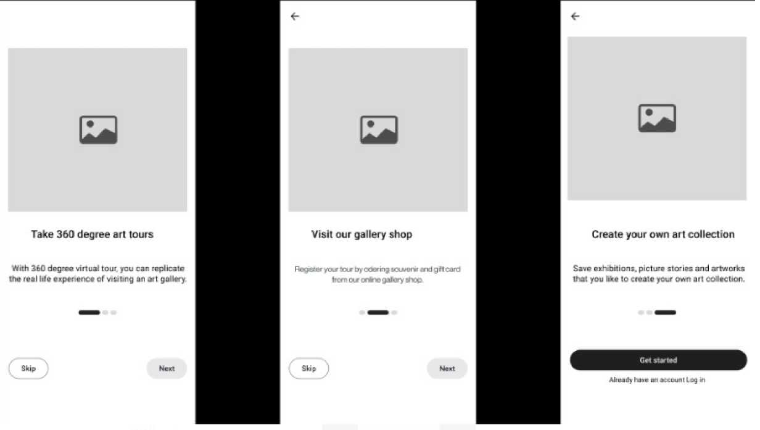
Low-Fidelity Wireframes

Slide 12
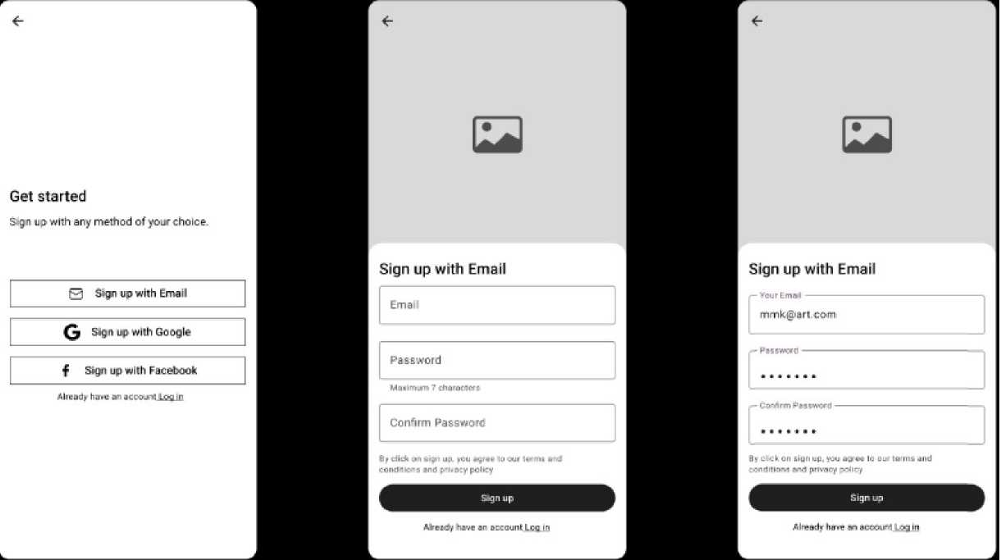

Slide 13
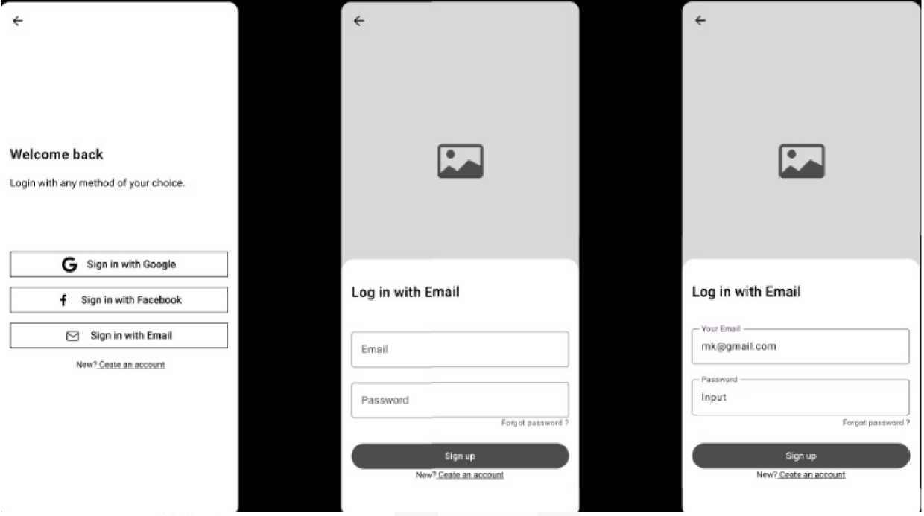

Slide 14
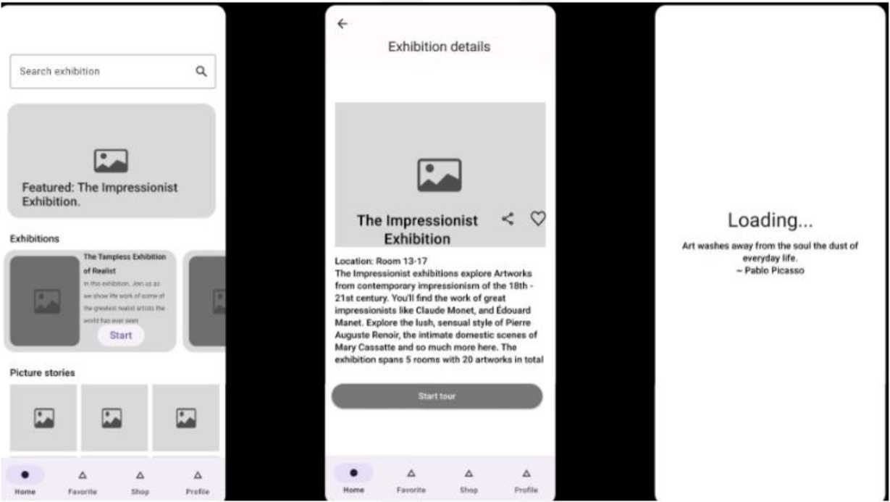

Slide 15
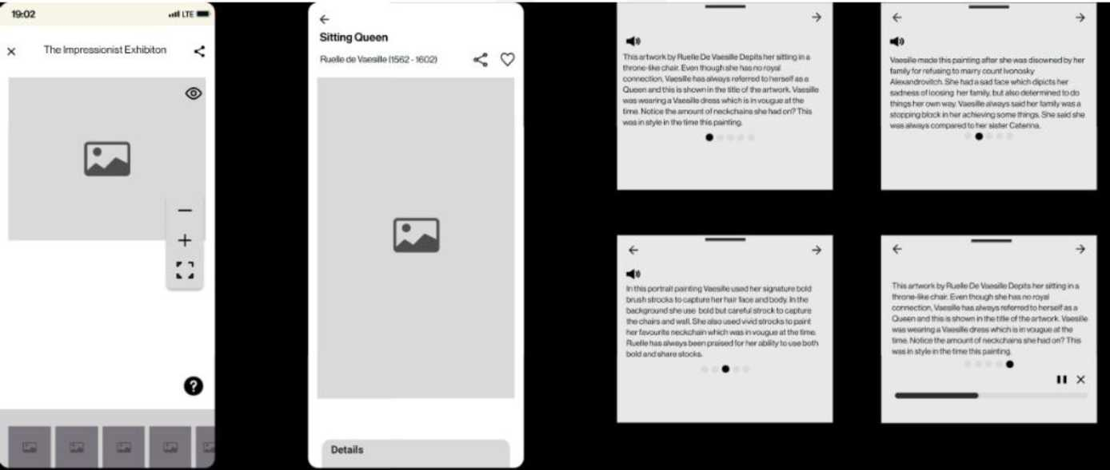

Slide 16
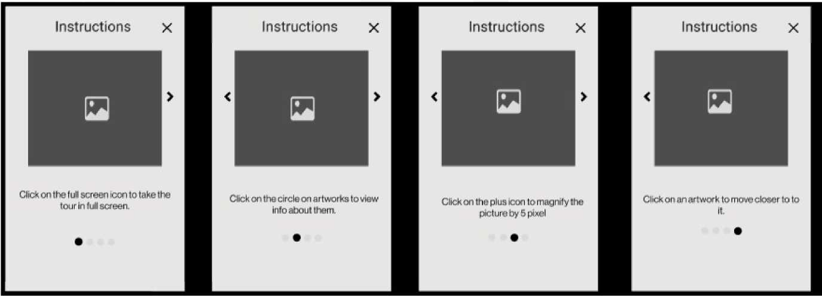

Slide 17
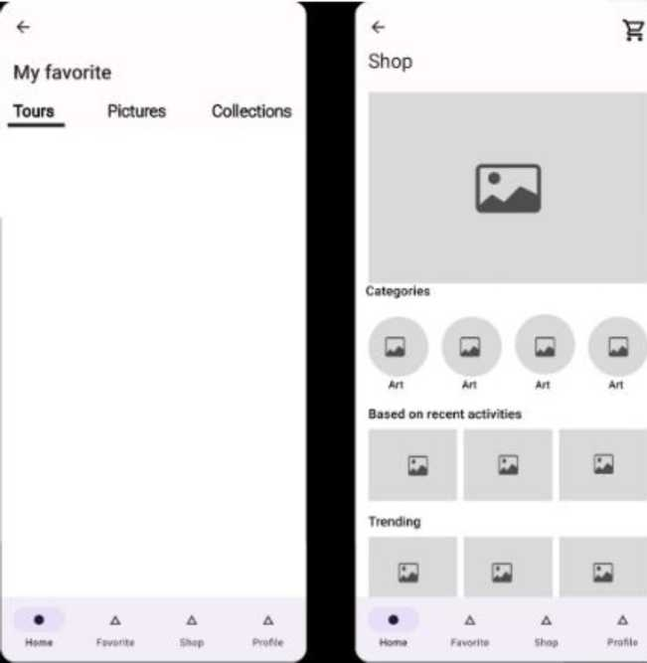
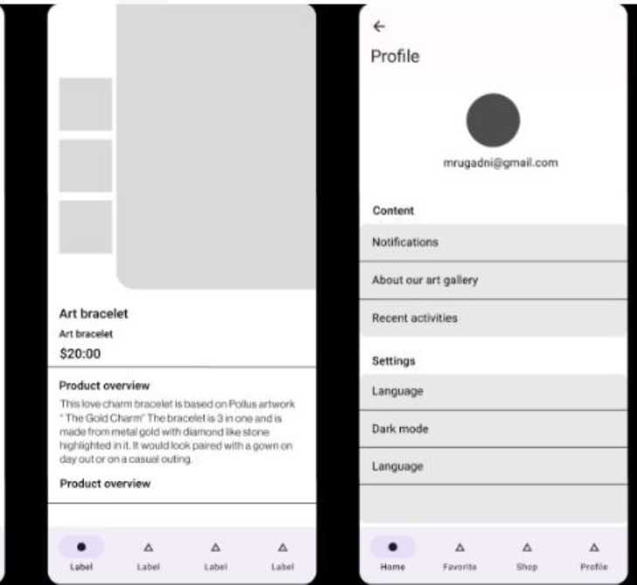

Slide 18
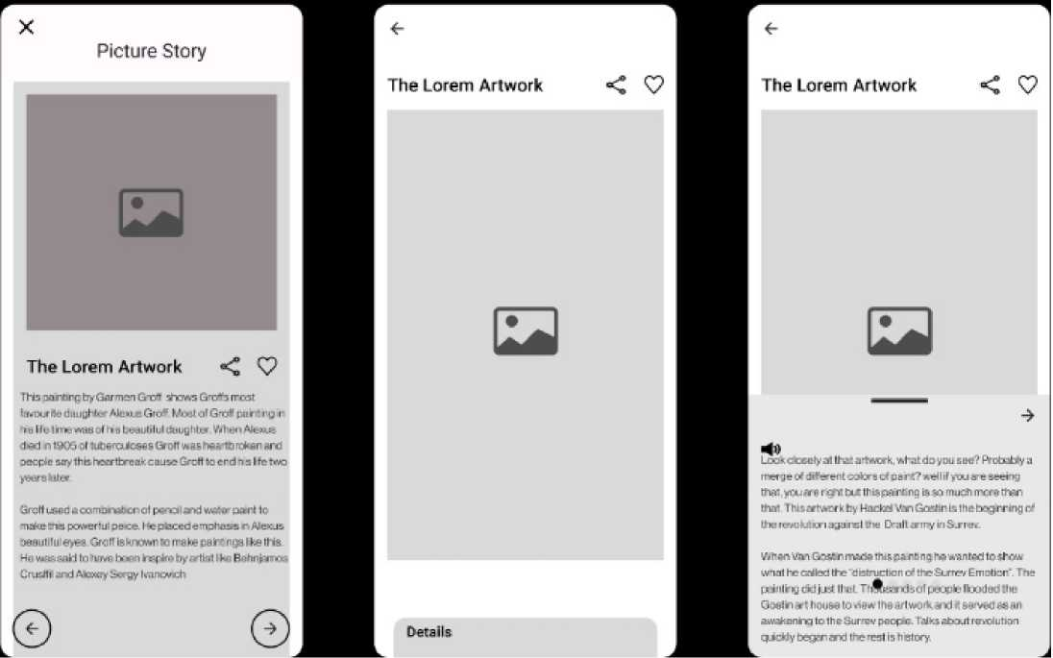

Slide 19
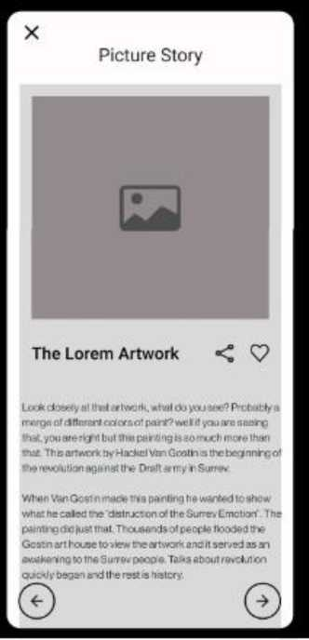

Slide 20
Link of Prototype
Hyperlink

