Slide 1
EDA Case Study
Credit Application & Previous Application Analysis
By: Mrunal Paunikar

Slide 2
Problem Statement
- High rejection rates in credit applications.
- Unclear drivers for defaults and refusals.
- Goal: Identify key patterns and provide actionable insights.

Slide 3
Steps for Analysis
1. Data Cleaning: Handle missing & sentinel values.
2. Univariate Analysis: Histograms, boxplots.
3. Bivariate Analysis: Scatterplots, jointplots.
4. Correlation Analysis: Heatmaps, VIF.
5. Previous Applications: Aggregate & analyze.
6. Modeling & Interpretability.

Slide 4
Visualization Techniques
- Univariate: Histogram, KDE, boxplot.
- Bivariate: Scatterplot, regression, jointplot.
- Multivariate: Heatmap, pairplot.
- Target Analysis: Boxplot AMT_CREDIT by TARGET.
- Missing Data: Matrix/bar plots.

Slide 5
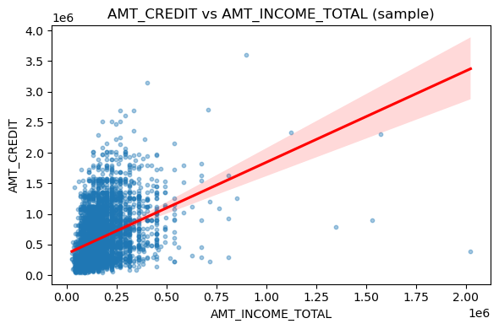
Visualization Insight
Scatterplot: AMT_CREDIT vs AMT_INCOME_TOTAL Shows a positive relationship: higher income tends to support higher credit amounts.

Slide 6
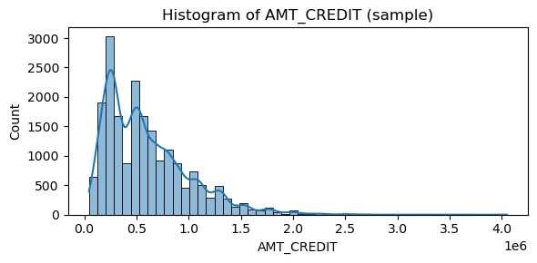
Visualization Insight
Histogram: AMT_CREDIT distribution Credit amounts are right-skewed; most applicants request lower credit, with few very high outliers.

Slide 7
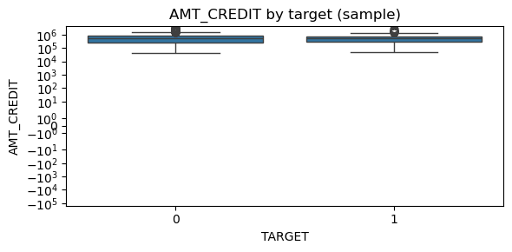
Visualization Insight
Boxplot: AMT_CREDIT by TARGET Rejected (1) vs Accepted (0) applicants show overlapping credit levels but rejected tend to cluster at higher amounts.

Slide 8
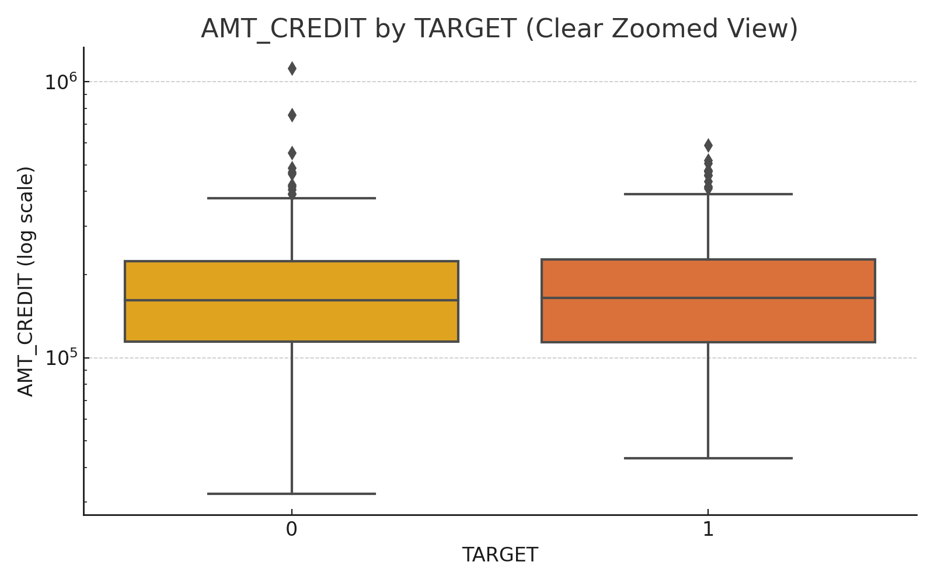
For Understand Purpose
Boxplot: AMT_CREDIT by TARGET Rejected (1) vs Accepted (0) applicants show overlapping credit levels but rejected tend to cluster at higher amounts.

Slide 9
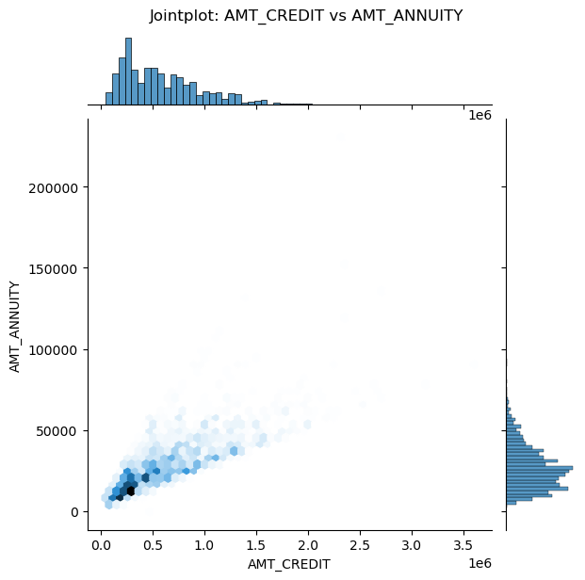
Visualization Insight
Jointplot: AMT_CREDIT vs AMT_ANNUITY Shows proportionality: higher credit leads to higher annuities, with dense clusters at low to mid levels.

Slide 10
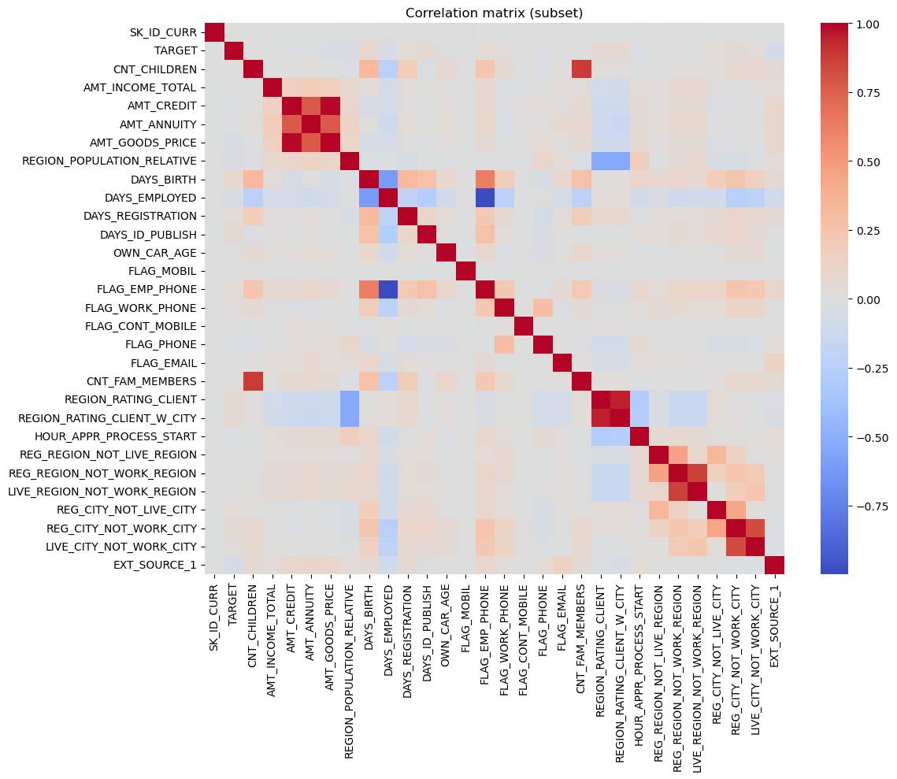
Visualization Insight
Correlation Heatmap
Highlights strong collinearity between income, credit, annuity, and goods price. Useful for feature selection.

Slide 11
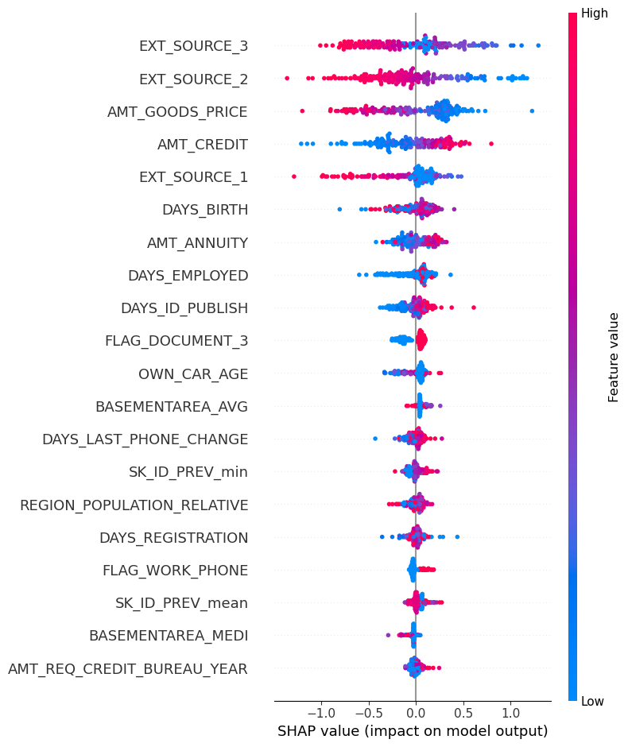
Model Explainability (SHAP)
Heatmap Summary Plot Explains feature impact on model predictions. EXT_SOURCE variables and AMT_GOODS_PRICE
are top predictors. Blue = low feature value, Pink = high feature value.

Slide 12
Root Cause & Findings
- High loan-to-income ratio drives rejection.
- Past refusals increase rejection likelihood.
- Missing demographic info linked to defaults.
- Employment instability increases risk.
- DAYS_EMPLOYED extreme values are sentinel placeholders.

Slide 13
Assumptions
- TARGET = 1 → rejected/defaulted, 0 → accepted.
- Sentinel values represent missing entries.
- Previous status values are accurate.
- Sampling ~5k rows is representative.

Slide 14
Solutions & Precautions
- Engineer features: credit_to_income, annuity_to_income.
- Cap extreme outliers.
- Encode categorical variables properly.
- Apply rejection rules for high-risk ratios.
- Monitor drift and retrain models.
- Ensure explainability (SHAP/feature importances).

Slide 15
Conclusion
- Credit and income strongly impact rejection.
- Past refusals and unstable employment predict risk.
- Combine rules + ML models for fair decisions.
- Clean, aggregated data supports reliable modeling.
- Recommend ongoing monitoring & retraining.

