Slide 1

EXT JS – GRID FEATURES
Ext JS is a JavaScript framework used for building rich, data-intensive web applications. It provides a comprehensive set of tools and components for developing interactive web applications with features like data grids, forms, charts, menus, and more.

Slide 2
Key features of Ext JS:
UI Components
Data Management
Cross-Browser Compatibility
Responsive Layouts
Rich Interactivity
MVC/MVVM Architecture

Slide 3

Introduction to Sencha Ext JS:
Sencha Ext JS is a JavaScript framework for building enterprise web applications.
Provides a structured MVC/MVVM architecture for scalable applications.
Offers rich UI components like grids, charts, and forms.
Supports cross-browser compatibility and responsive design.
Ideal for data-heavy applications requiring high performance and customization.

Slide 4

Introduction to Ext JS Grids:
Ext JS Grids are powerful for displaying tabular data.
Commonly used in enterprise applications.
Provides features include sorting, filtering, and editing etc.

Slide 5
Importance of Ext JS Grids:
Enhances user experience.
Supports large datasets efficiently.
Provides built-in functionalities to reduce development time.
Enhances user experience with interactive tables.
Supports large datasets efficiently with pagination and buffering.
Customizable UI with themes and layouts.
Reduces development time with built-in functionalities.

Slide 6

Setting Up an Ext JS Grid:
Set Up ExtJS Project: Include the ExtJS library in your HTML file.
Create Data Store: Define a store with data (either local or remote).
Create Grid Panel: Use “Ext.grid.Panel” and link it to the store with defined columns.
Enable Sorting: Columns are sortable by default (`sortable: true`).
Add Paging: Use “pagingtoolbar” in the `bbar` for pagination.
Inline Editing: Add “cellEditing” plugin for editing cells inline.
Render Grid: Render the grid to an HTML element (Ext.getBody()).
Advanced Features: Add row grouping, row expanding, and other interactive features as needed.

Slide 7
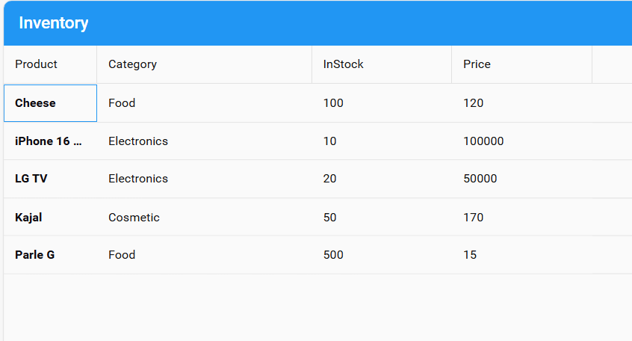
Basic Grid Operations:
Rendering a grid with columns and data.
Loading data dynamically using stores.
Setting up basic configurations (headers, widths, etc.).

Slide 8
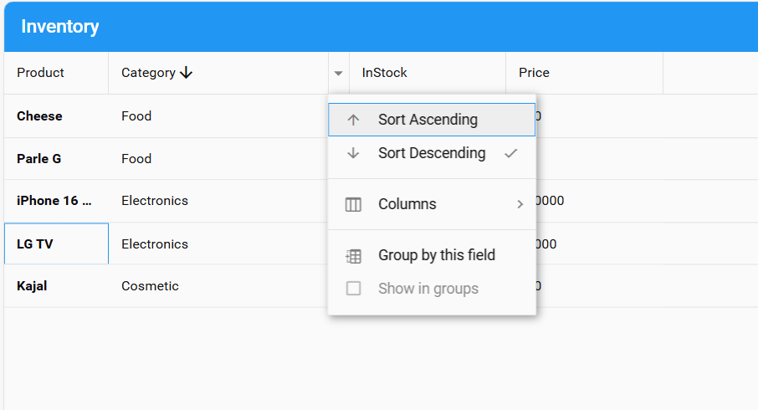
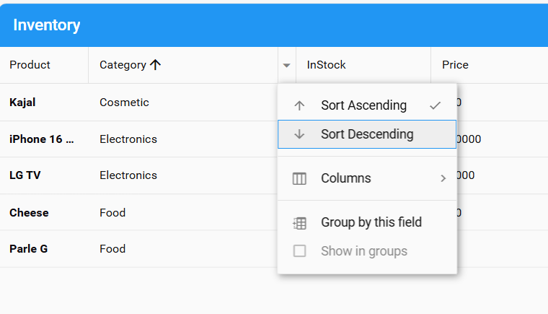
Sorting and Filtering in Grids:
Enable column sorting by clicking on headers.
Implement filters for refining data display.
Use remote filtering for large datasets.

Slide 9
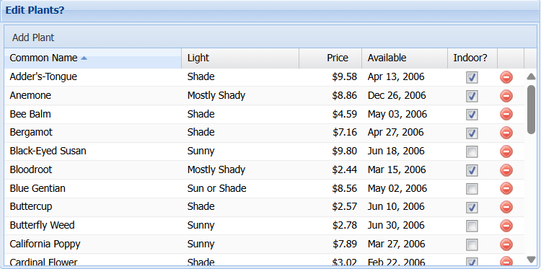
Editing and Inline Editing:
Enable row or cell editing.
Implement validation rules to ensure data integrity.
Save edited data to the server using AJAX.

Slide 10
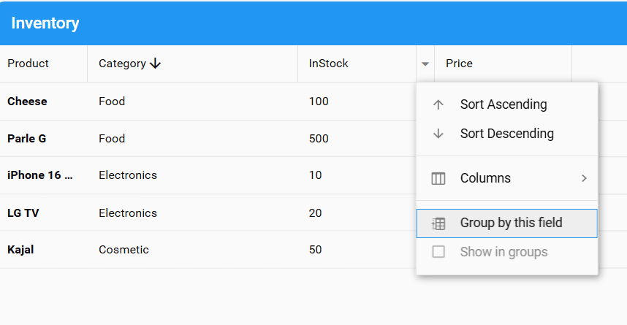
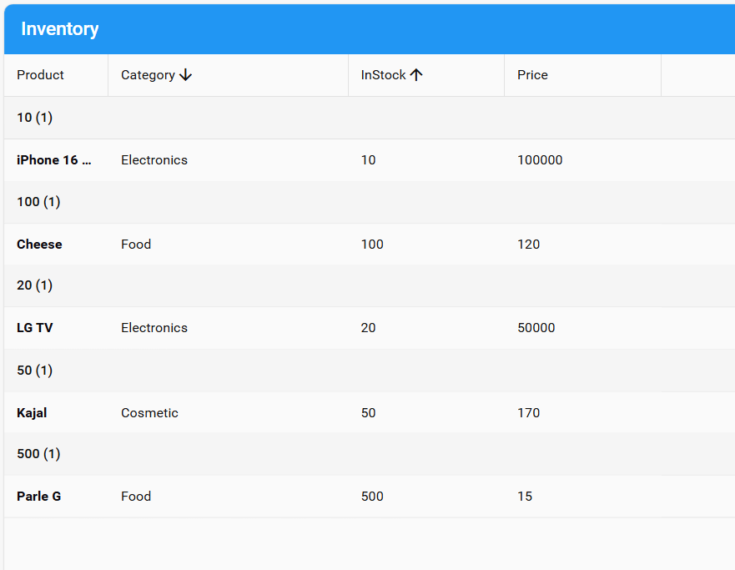
Grouping and Aggregation:
Group data based on a column.
Display summaries (total, average, etc.).
Expand/collapse groups dynamically.

Slide 11
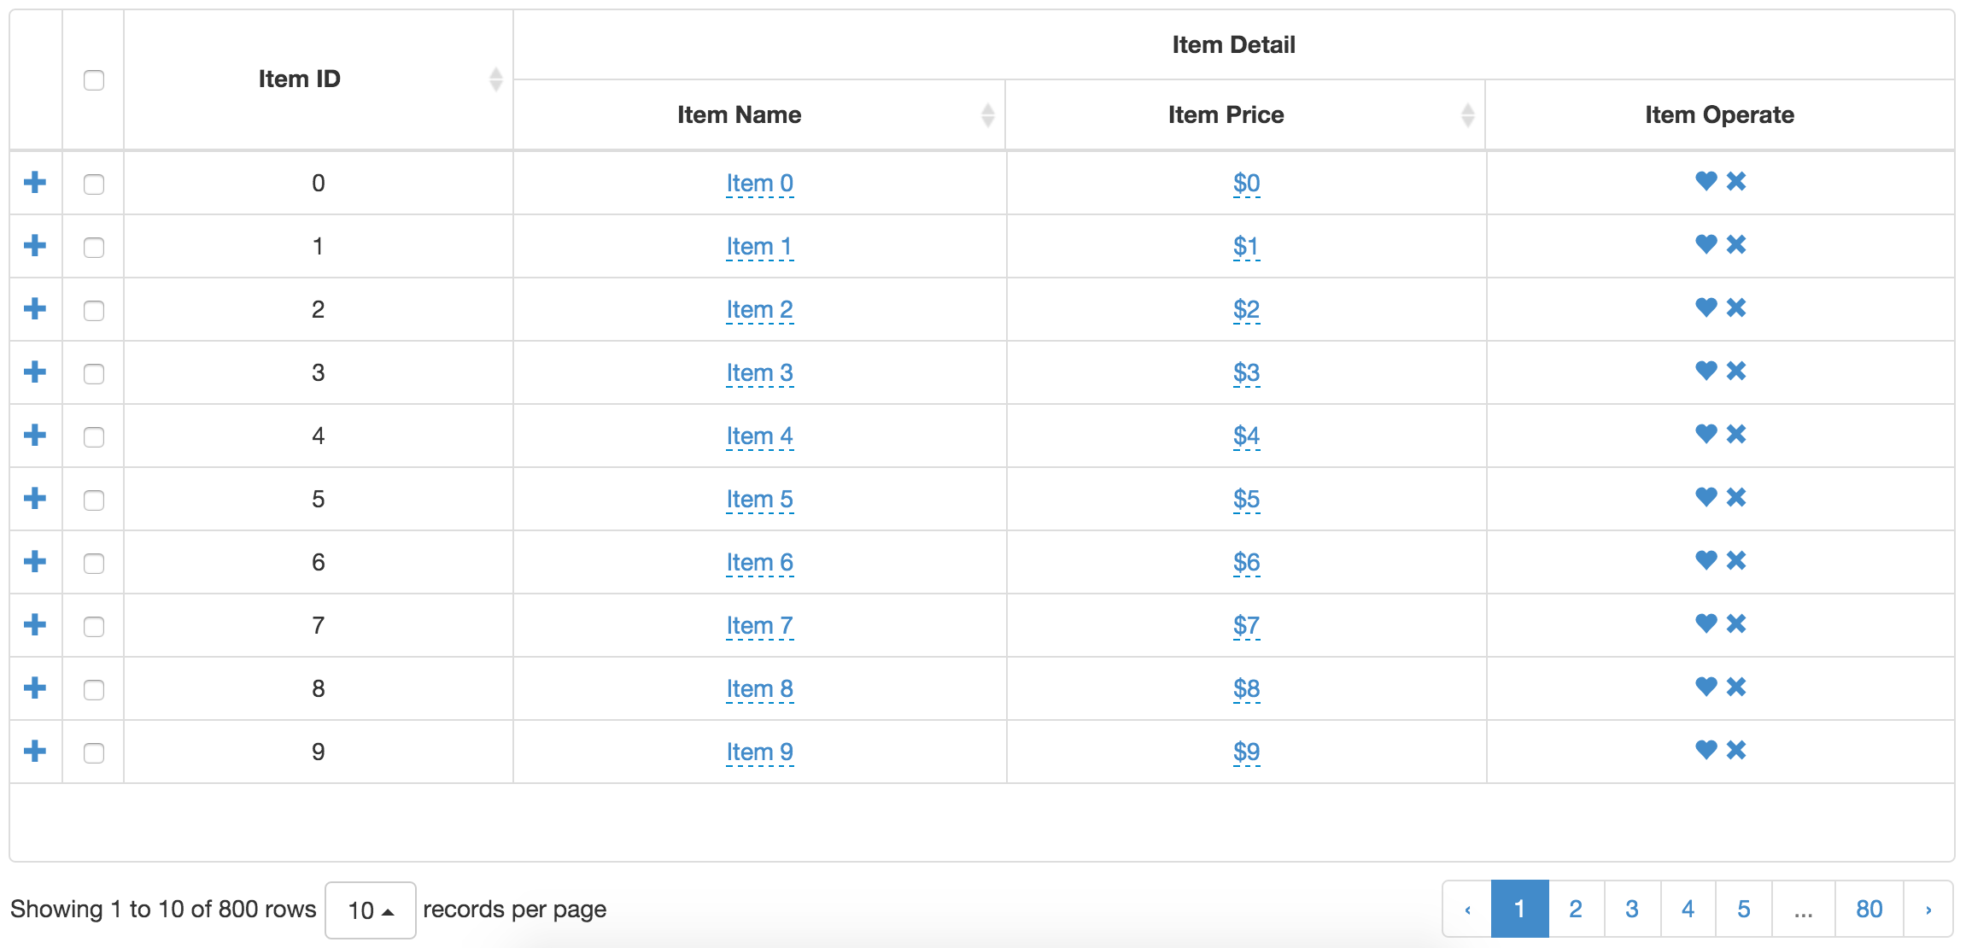
Pagination and Infinite Scrolling:
Use paging toolbar for navigation.
Implement infinite scrolling for seamless data loading.
Optimize performance using buffered rendering.

Slide 12
Customizing Grids:
Apply different themes and styles.
Add custom renderers for enhanced data display.
Use action columns for buttons and links.

Slide 13
Conclusion and Best Practices:
ExtJS is a robust JavaScript framework for building data-driven, interactive applications.
ExtJS offers high-performance features for enterprise-level applications.
Grids in ExtJS help efficiently manage and display large sets of data.
Sencha plays a crucial role in maintaining and supporting ExtJS.
The ExtJS Grid is an essential component with powerful features for data display and interaction.

