Slide 1

Seasonal Agriculture Performance Analysis
Name : Mrunal Kanade College Name: Modern Education Society’s Wadia College of Engineering, Pune
AICTE STU ID :STU682b3f7e428531747664766

Slide 2

PROBLEM STATEMENT
Agricultural activities are influenced by seasonal variations in environmental conditions, farming practices, resource availability and market conditions. As a result, agricultural performance may differ from one season to another. However, raw agricultural data does not clearly explain how agricultural performance changes across seasons or what patterns can be observed in different seasonal conditions. The problem is to analyze the given agricultural dataset and investigate seasonal differences in agricultural performance by identifying meaningful patterns, trends, relationships and variations within the available data.

Slide 3
Project Description
Dataset: 4,000 agricultural records covering multiple crops, states and seasons.
Data preparation: checked duplicates, missing values, negative values and formula consistency before analysis.
Seasonal analysis: compared yield, production, profit, water efficiency, environmental conditions and disease/pest risk.
Deeper analysis: crop–season patterns, irrigation mix, state performance, correlations, outliers and statistical significance.
Goal: identify which seasons perform better and explain the patterns without treating correlation as causation.

Slide 4

WHO ARE THE END USERS?
Farmers & Farm Managers Use seasonal yield, profit and water insights to support planning.
Agricultural Advisors Compare crops, risks and resource patterns across seasons.
Researchers & Policy Planners Use evidence on seasonal variation for further study and interventions.

Slide 5

Technology Used
Python Data analysis & automation
Pandas Data cleaning & aggregation
NumPy Numerical operations
Matplotlib / Seaborn Visualization
SciPy ANOVA & Kruskal–Wallis
Scikit-learn Scaling for composite score
Jupyter Notebook Analysis & reproducibility

Slide 6
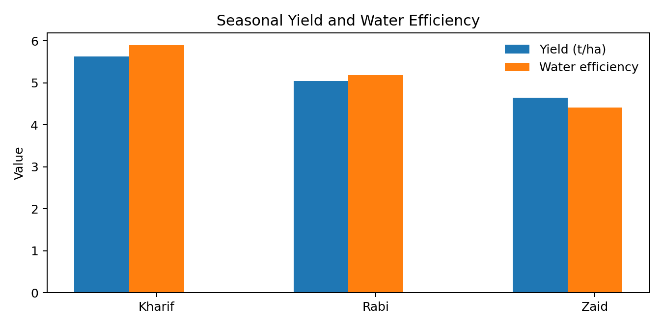
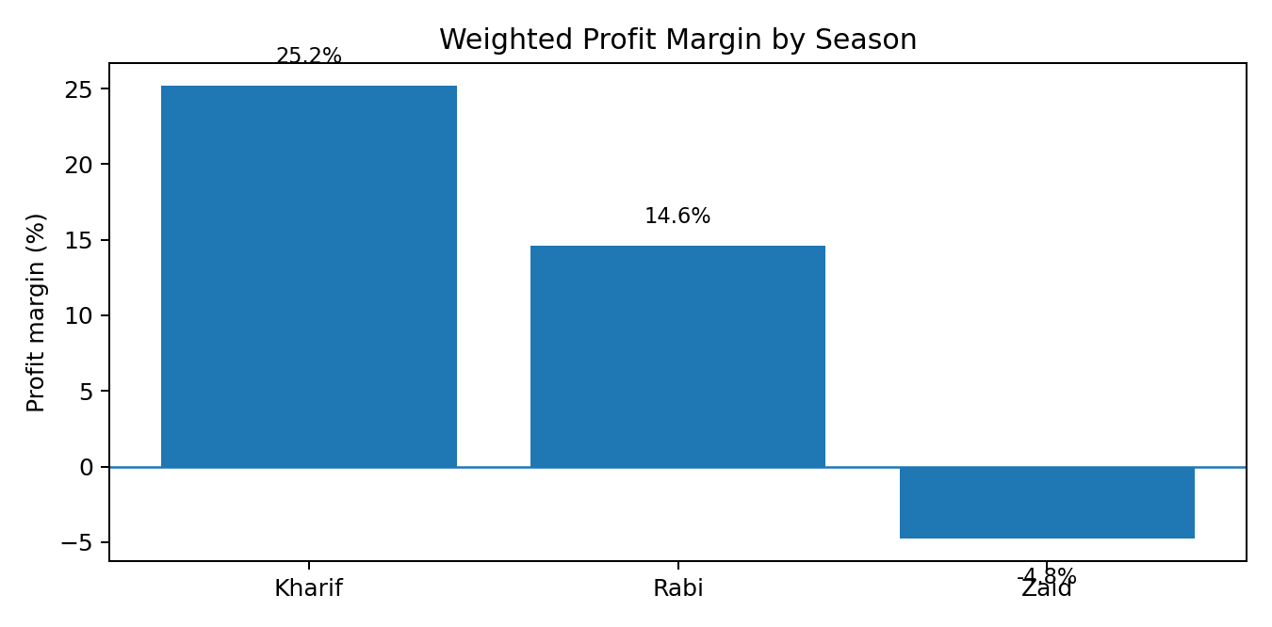
RESULTS
Highest average yield Kharif — 5.63 t/ha
Best weighted margin Kharif — 25.2%
Highest water efficiency Kharif — 5.89 t/1000m³
Overall pattern: Kharif leads on yield, profitability and water efficiency; Zaid is the weakest on these measures.

Slide 7
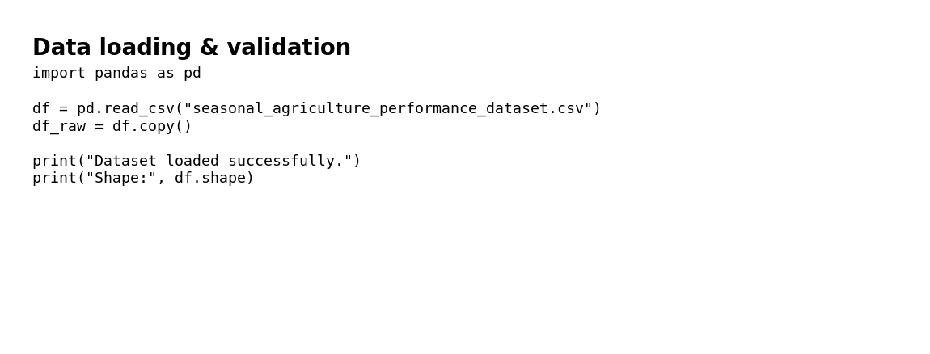
RESULTS
Kharif: 5.63 t/ha average yield.
Rabi: 5.04 t/ha; Zaid: 4.64 t/ha.
Seasonal averages are useful for comparison, but crop mix differs by season, so results should not be read as a pure weather effect.

Slide 8
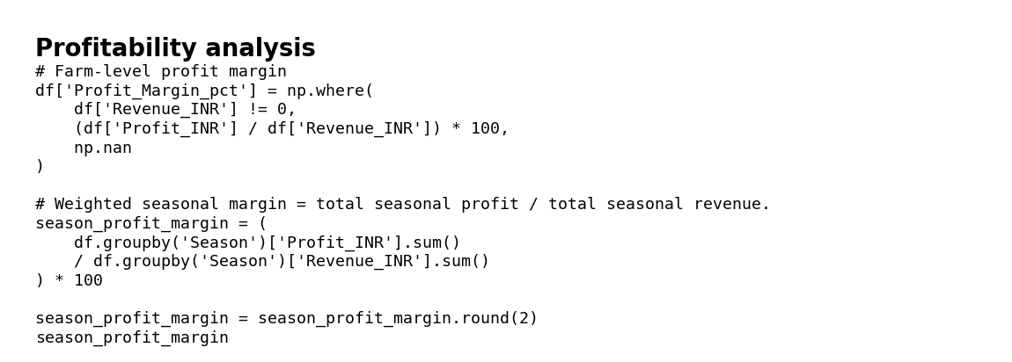
RESULTS
Weighted profit margin: Kharif 25.2%, Rabi 14.6%, Zaid -4.8%.
Average profit: Kharif ₹178,915; Zaid shows an average loss of ₹24,805.
Loss-making records: Kharif 42.2%, Rabi 51.1%, Zaid 64.5%.

Slide 9
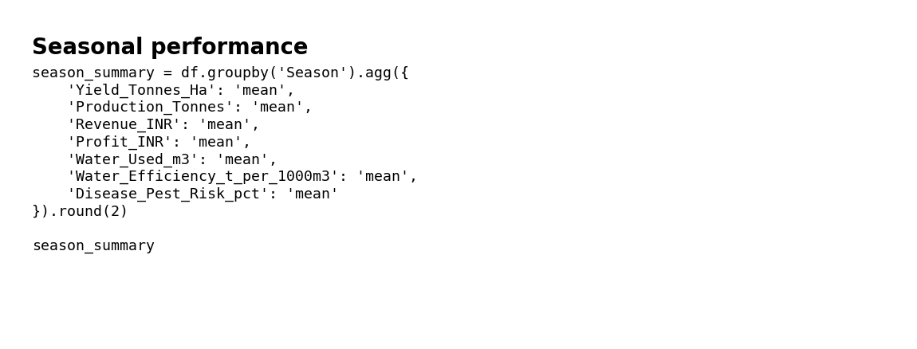
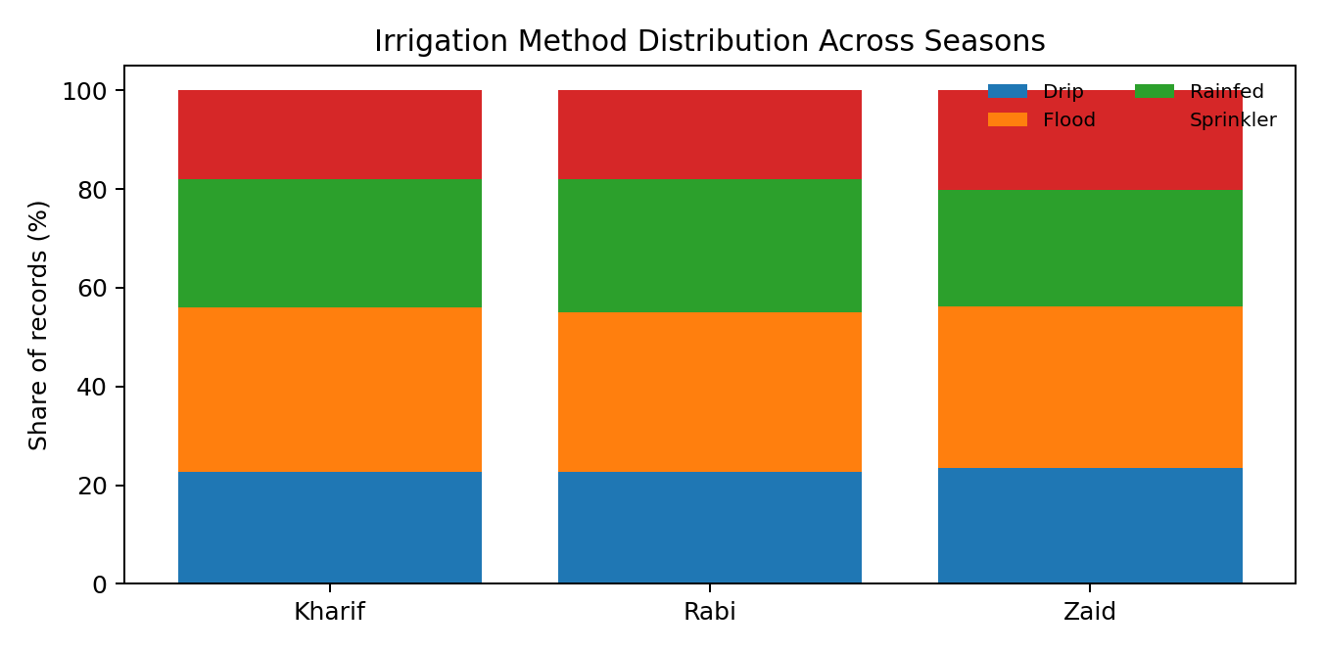
RESULTS
Average water efficiency: Kharif 5.89, Rabi 5.19, Zaid 4.41 tonnes per 1000 m³.
Kharif has the strongest combined yield and water-efficiency performance in this dataset.
Irrigation methods vary across seasons, providing context for resource-use differences.

Slide 10
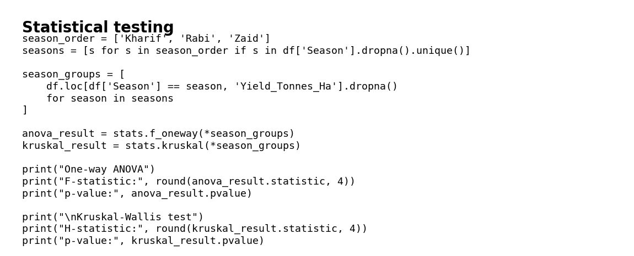
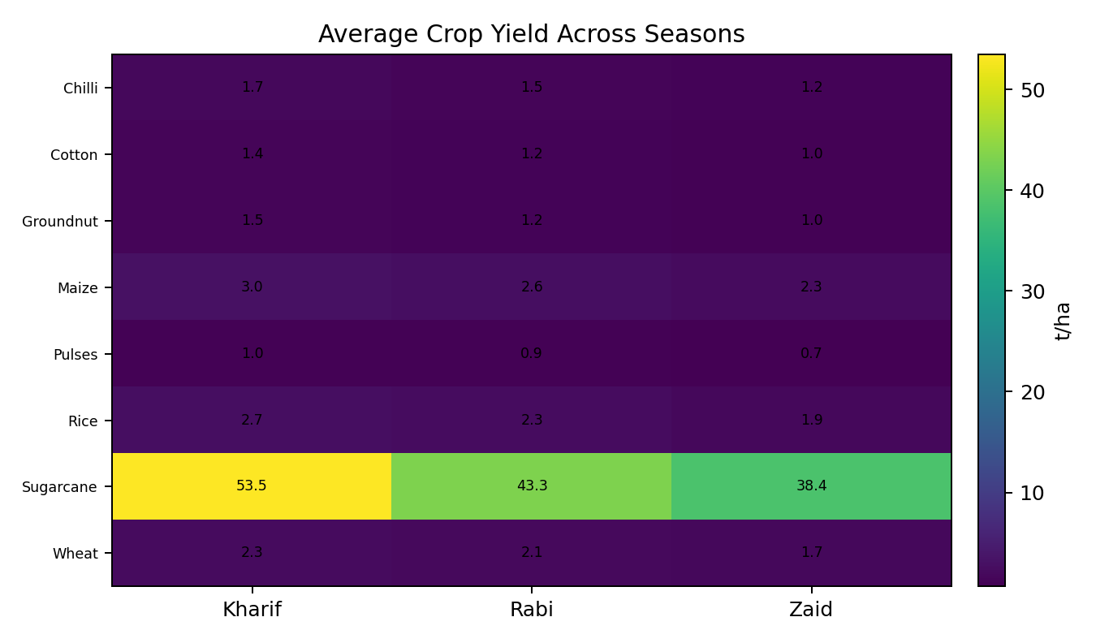
RESULTS
Yield ANOVA: p = 0.214 (not significant at 5%).
Kruskal–Wallis yield test: p < 0.001, indicating a significant difference in yield distributions across seasons.
Profit differences are also statistically significant (ANOVA p < 0.001).
Correlation analysis shows water used has the strongest direct association with yield (r ≈ 0.39); this is an association, not proof of causation.

Slide 11
Future scope
Build an interactive dashboard in Power BI or Tableau for season, crop and state-level filtering.
Add multi-year historical data to study trends rather than a single dataset snapshot.
Use weather forecasts and soil sensors for near-real-time decision support.
Develop predictive models for yield, profitability and water requirement.
Include market-price forecasting and crop-selection recommendations.
Validate findings with field-level domain expertise before operational use.

Slide 12
GitHub Link
Project repository:
MrunalKanade/Seasonal-Agriculture-Performance-Analysis: Data analytics project analyzing seasonal agricultural performance using Python, statistical analysis and data visualization.

Slide 13

VOIS Course Completion Certificate Course name – Data Visualization

Slide 14
Thank you
.

