Slide 1
GRE Vocab master
- By Mrunal S. Phadke

Slide 2
Stevens education services
Established Products
Pre-K solutions
K-12 solutions
STEM Studies
(In progress)
GRE Prep
(Proposed)

Slide 3
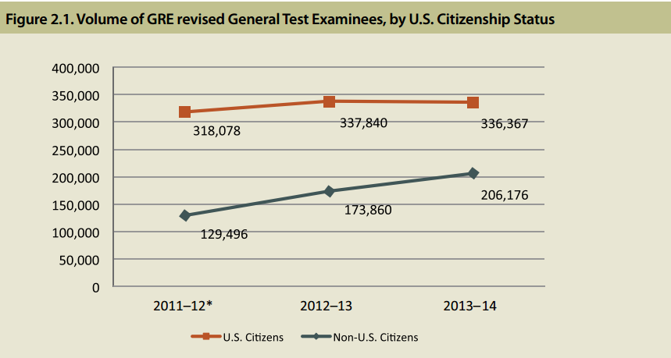
Business opportunity
Number of test takers increasing year over year
Particularly, non-US citizens.
That is our target customer base as there are not many training centers outside US.
With active marketing and SEO techniques we can make our product more popular.
The prospective customers for this application will be the students who wish to achieve maximum marks in GRE’s Vocabulary section.
Image taken from official GRE website

Slide 4
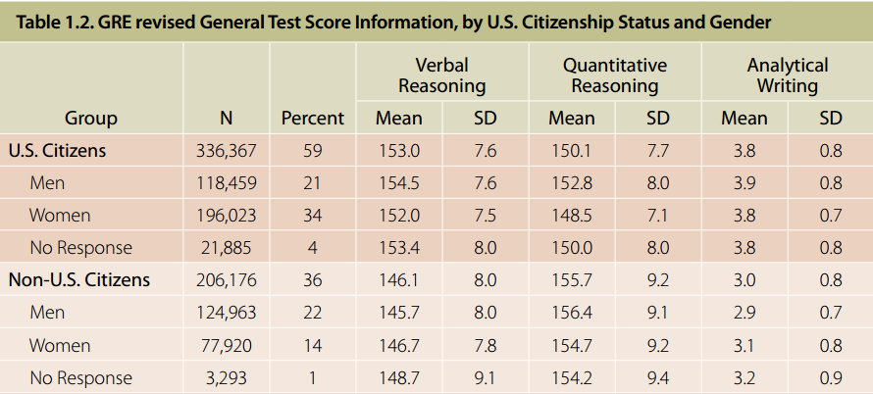
Business Opportunity
Comparing the means of U. S. Citizens and Non U. S Citizens, it is clear that Non U. S. Citizens need more practice to excel in Verbal Reasoning.
This is exactly where our product will prove very useful.

Slide 5
Product idea
Test Center:
Timed based tests
Easy Forward and backward navigation in test questions.
Real exam pattern
Training Center:
Training through Flashcards.
Flash cards will have the meanings of the words and their usage in sentences
Result Analysis and Feedback.
Answer key
Detailed Score stats.
Train through Flashcards
Test
Get Results
Train through Feedback for weak words.

Slide 6
Technologies Used to implement the Product:
User Interface
CSS
HTML
ClientSide Javascript
JQuery for Interaction with Document
Window API
AJAX to submit HTTP Requests
ServerSide Javascript
Node.js
Express Router
MongoDB
Storing following Collections into the DB:
Users,
Vocab,
Questions

Slide 7
Demo!!

