Slide 1
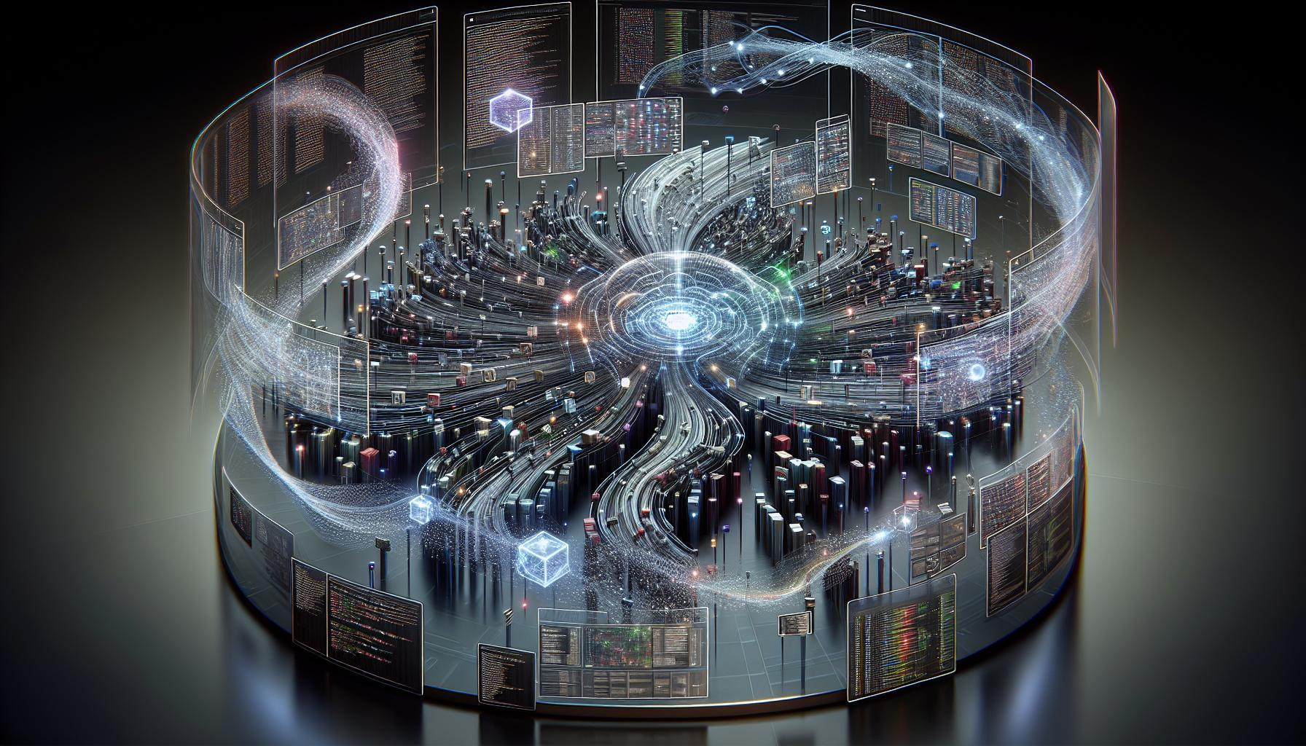
AI × PERSONAL KNOWLEDGE MANAGEMENT
Retrieval-Augmented
Personalization of
AI Agents
Transforming Personal Knowledge into Intelligent,
Context-Aware AI Assistants via Obsidian Vaults
March 2026 • Technical Deep Dive

Slide 2
PRESENTATION ROADMAP
Agenda
01
The Personalization Challenge
04
Memory Architecture
Why generic AI agents fail to deliver meaningful assistance and the critical gap between public LLM training data and personal context
Multi-layered memory systems: session vs global memory, distillation, consolidation, and injection patterns
02
RAG Technical Foundation
05
Integration Patterns
Core architecture of Retrieval-Augmented Generation: embeddings, vector search, semantic similarity, and context injection
Technical pathways: MCP Tools, Local REST API, Claude Code integration, and security considerations
03
Obsidian Vault Architecture
06
Applications & Future
Why Obsidian's markdown-based, local-first vault structure is ideal for AI personalization
Real-world use cases, plugin ecosystem comparison, and the future of personal AI assistants

Slide 3
SECTION 01
The Personalization Challenge:
Why Generic AI Falls Short
The Core Problem
The Knowledge Gap
AI agents without personal context produce generic responses that fail to understand individual work styles, preferences, and domain expertise. Each session starts from zero, creating frustrating, repetitive interactions.
Public LLM Training Data
General Knowledge
Broad but shallow coverage of public information
0%
Generic
High
Session Continuity
Response Quality
User Friction
Your Personal Knowledge
Missing Context
Key Limitations of Generic AI
Deep, specialized knowledge in your Obsidian vault
No Memory Across Sessions
Every conversation starts fresh. The agent cannot remember your preferences, past decisions, or established context from previous interactions.
The Solution
Lack of Domain Context
Retrieval-Augmented Personalization bridges this gap by grounding AI responses in your curated knowledge base.
Trained on public data, LLMs miss your specialized knowledge: project details, research notes, personal insights, and organizational context.
Retrieve relevant context from your vault
Inability to Learn Preferences
Inject personal knowledge into AI context
Cannot adapt to your communication style, formatting preferences, or evolving requirements over time.
Generate personalized, context-aware responses

Slide 4
SECTION 02
Retrieval-Augmented Generation:
The Technical Foundation
RAG Architecture Pipeline
1. Ingest
2. Chunk
3. Embed
4. Store
5. Retrieve
6. Generate
Documents → Text extraction
500-1000 chars + overlap
300-1500D vectors
Vector database
Semantic search
Context + LLM → Answer
Vector Embeddings
Cosine Similarity Search
Text is converted into high-dimensional vectors (300-1500 dimensions) that capture semantic meaning. Similar concepts cluster together in vector space.
Queries are embedded and compared to document chunks using cosine similarity. Top-k results (typically k=5) with highest similarity scores are retrieved.
Example: "car" vs "automobile"
95% similarity
Similarity Threshold
≥ 0.7
Top-k Retrieval
k = 3-8
Search Latency
200-500ms
Hybrid Search
Smart Chunking
Combines semantic similarity with keyword matching for optimal retrieval accuracy.
Documents are split at semantic boundaries (sentences, paragraphs) with overlap to preserve context across chunks.
Primary: Vector semantic search
500-1000
50-100
Fallback: Keyword matching
chars/chunk
char overlap
Result: 85%+ relevance accuracy

Slide 5
SECTION 03
Obsidian Vaults:
Structured Personal Knowledge Repositories
Why Obsidian is Ideal for RAG
Markdown + Frontmatter
Pure Markdown
Local-First
---
title: "Project Alpha"
Human-readable, machine-parseable, future-proof format
Privacy, ownership, offline access, zero data retention
status: "active"
priority: "high"
tags: ["dev", "ai"]
created: "2026-03-20"
---
Wikilinks
Rich Metadata
# Project Overview
Key requirements for...
Bidirectional linking [[Note]] creates knowledge graphs
YAML frontmatter enables structured data extraction
- Feature A
- Feature B
See also: [[related-project]]
Vault Structure Example
Knowledge Graph View
MyVault/
Obsidian's graph view visualizes note connections, revealing relationships and clusters in your knowledge base.
├── 📁 01_Inbox/
│ └── quick-captures.md
├── 📁 02_Projects/
Nodes
Edges
│ ├── project-alpha/
│ │ ├── requirements.md
Notes = Entities
Links = Relations
│ │ ├── [[meeting-notes]]
│ │ └── decisions.md
├── 📁 03_Research/
│ ├── papers/
AI-Ready Features
│ └── insights.md
├── 📁 04_Daily/
Plain text = easy parsing
│ └── 2026-03-25.md
Structured metadata extraction
└── 📄 templates/
Link graph for context
Folder hierarchy = categories

Slide 6

SECTION 04
Memory Architecture:
Building Blocks of AI Personalization
Short-Term
Session Memory
Long-Term
Global Memory
Memory
Types
Captures immediate context, temporary preferences, and transient information during active conversations.
Stores durable user preferences, facts, and behavioral patterns that persist across all sessions.
Episodic
Specific experiences, events
Lifespan
Semantic
Lifespan
Persistent
General facts, knowledge
Single Session
Content
Procedural
Content
Preferences, facts, patterns
How-to knowledge, workflows
Temporary overrides, immediate context
Memory Lifecycle: From Capture to Injection
1
Distillation
2
Consolidation
3
Injection
During conversation, AI captures candidate memories using a dedicated tool when high-signal information emerges.
Session ends → memories are merged into global memory with deduplication and conflict resolution.
New session starts → relevant memories are injected into the system prompt for context.
Example: "User prefers aisle seats" → saved to session memory
Remove duplicates
Resolve conflicts (recency wins)
Format: YAML frontmatter + Markdown list
Prune stale memories

Slide 7
SECTION 05
Context Window Optimization:
Managing Limited Attention
The "Lost in the Middle" Problem
Optimization Techniques
As context length increases, accuracy degrades because LLMs struggle to attend to information in the middle of long contexts. Performance drops significantly beyond certain thresholds.
Sliding Window
Keep only the last 5-7 conversation turns in full context. Older turns are discarded or summarized.
Context: 4K tokens
95% accuracy
78% accuracy
Hierarchical Summarization
Context: 16K tokens
Compress older conversations into progressive summaries. Recent = verbatim, older = condensed.
Context: 32K tokens
62% accuracy
Selective Injection
Optimization Trade-offs
Analyze queries to inject only relevant context from memory and history, not everything.
Latency
Cost
Accuracy
Longer context = slower
Tokens scale linearly
Degrades with length
Production Strategy Matrix
Sub-second latency
Cached + Aggressive filter
Budget-constrained
Small window + RAG
Multi-turn (50+ calls)
External memory + selective

Slide 8
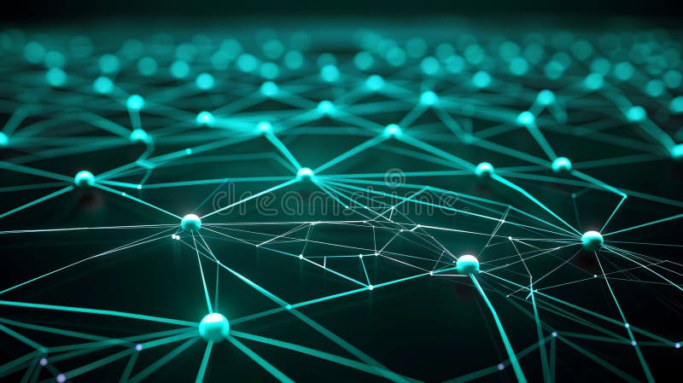
SECTION 06
Integration Patterns:
Connecting Obsidian to AI Agents
MCP Tools
Plugin
Local REST
API
Claude Code
Integration
Creates a local server that exposes Obsidian vault via Model Context Protocol, enabling AI agents to query and modify notes.
Exposes vault via RESTful endpoints that any application can query. Requires Local REST API community plugin.
Direct filesystem access with custom skills that teach Claude how to interact with your vault structure and conventions.
Setup Steps
// Example API calls
Key Components
1.
Install MCP Tools plugin
GET /vault/
CLAUDE.md: Instructions file
/notes/{filename}
2.
Download MCP server
POST /vault/
Skills: obsidian-cli, markdown
3.
Configure AI agent connection
/notes/{filename}
Custom skills: User-defined workflows
GET /search
?query={term}
Capabilities
Workflow Example
Read/search notes
Best For
1. Claude reads CLAUDE.md
Create/modify files
Custom integrations
2. Understands vault structure
Manage folders
Multi-app workflows
3. Uses skills for operations
Developer flexibility
4. Executes custom workflows
Security & Privacy Considerations
Local-only: Communication stays on device
Encrypted: HTTPS with valid certificates
ZDR: Zero Data Retention possible
Controlled: User manages access scope

Slide 9
SECTION 07
Knowledge Graphs:
Beyond Simple Retrieval
What are Knowledge Graphs?
Benefits of Knowledge Graphs
Knowledge graphs represent information as interconnected entities and relationships, enabling semantic reasoning and complex queries beyond simple text retrieval.
Uncover Hidden Connections
Discover relationships between concepts that aren't explicitly linked in text
Complex Queries with SPARQL
RDF Triples: Subject-Predicate-Object
Query multi-hop relationships: "Find all projects using AI techniques that Alice works on"
Alice
worksOn
Project Alpha
Semantic Reasoning
Project Alpha
uses
RAG
Infer new knowledge from existing relationships through logical deduction
RAG
isA
AI Technique
Navigable Knowledge Web
Explore your knowledge base as an interconnected semantic network
Automatic Entity Extraction
Vector Retrieval vs Knowledge Graphs
AI agents can automatically extract entities and relationships from Obsidian notes:
Vector Retrieval
Best for: Semantic similarity, finding related content, surface-level connections
People
Organizations
Knowledge Graphs
Best for: Structured relationships, complex queries, reasoning, multi-hop connections
Concepts
Locations
Ideal: Combine both approaches for maximum power

Slide 10
SECTION 08
The Plugin Ecosystem:
Tools for AI-Enhanced Knowledge
Smart
Connections
Copilot for
Obsidian
Smart
Composer
Core Features
Core Features
Core Features
Semantic search for related notes
Vault-wide Q&A (premium)
Fastest chat performance
Local embeddings (offline)
Inline note editing
MCP server support
AI chat with vault context
Custom prompt templates
Inline editing like Copilot
Note similarity scoring
Multiple AI model support
Ollama local model support
Pros & Cons
Pros & Cons
Pros & Cons
Free, fast, private
Polished, powerful models
Speed, MCP, flexible
Limited editing features
Cloud-dependent, costs
Newer, less mature
Best For
Best For
Best For
Note discovery & semantic search
AI-assisted editing & Q&A
Speed & advanced integrations
Decision Guide: Which Plugin to Choose?
Priority: Privacy
Priority: Editing
Priority: Speed
Best Combo
Smart Connections
Copilot
Smart Composer
Connections + Composer
Local-first, offline
Best AI writing assist
Fastest performance
Search + Speed

Slide 11
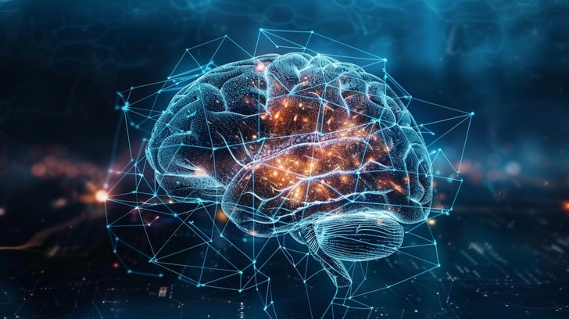
SECTION 09
Real-World Applications:
From Theory to Practice
Intelligent Study Guides
Automated Weekly Reflections
AI creates personalized study materials referencing your own notes, highlights, and learning history.
AI synthesizes new notes, suggests organization, and creates personalized weekly summaries.
Example: "Create a review guide for my Machine Learning notes, focusing on concepts I struggled with"
Example: "Review my week's notes and suggest where to file each one"
Project Knowledge Management
Personalized Writing Assistants
Automatic project summaries, decision tracking, and intelligent updates as new information arrives.
AI understands your writing style, voice, and previous work to provide contextually appropriate suggestions.
Example: "Update the project summary with today's meeting decisions"
Example: "Continue this blog post in my usual technical writing style"
Personalized Customer Support
Research Companions
AI agents remember past interactions, preferences, and context for truly personalized service.
Connect insights across papers, projects, and research notes with intelligent cross-referencing.
Example: "Based on their history, suggest solutions for this customer's issue"
Example: "Find all notes related to transformer architectures from my reading list"
The Common Thread
Every application leverages your own knowledge base for contextually relevant, personalized assistance. The AI doesn't just respond—it understands your context, remembers your preferences, and builds on your accumulated knowledge.

Slide 12
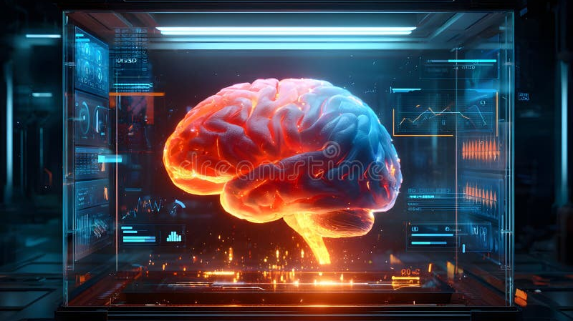
THE FUTURE OF PERSONAL AI
Your Knowledge,
Your Agent
The convergence of RAG, personal knowledge management, and AI agents represents a paradigm shift from generic assistants to truly personal collaborators.
By grounding AI in your Obsidian vault—your curated knowledge, preferences, and thinking patterns—you create agents that don't just respond, but understand.
Intelligent
Personal
Transformative
Leverages vast LLM reasoning capabilities
Grounded in your intimate knowledge context
Changes how you interact with AI forever
Start building your retrieval-augmented personalization system today
Transform how you work, learn, and create with AI that truly knows you.

