Slide 1
EXCEL-BASED DATA ANALYTICS DASHBOARD
FINANCIAL
FRAUD ANALYSIS
Excel
Pivot Tables
Pivot Charts
Slicers
Dashboard
Prepared by: Mrunali Shinde
Fraud Analytics • 10,500 Transactions Across 10 Banks and 14 States

Slide 2
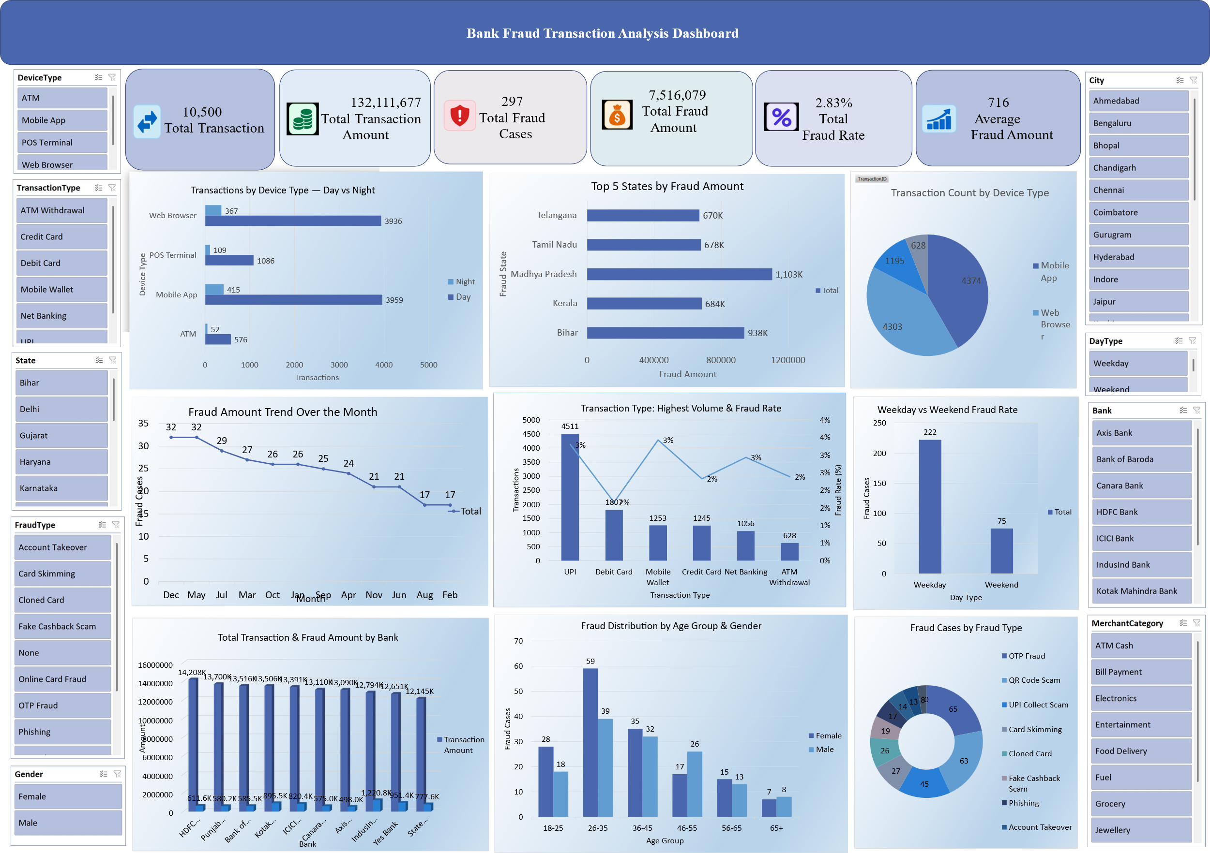

Slide 3






INTRODUCTION
Project Overview
This project studies 10,500 digital payment transactions (Sep 2025 – Aug 2026) to find where, when and how fraud happens, and which customers and banks are most exposed.
10,500
₹13.21 Cr
297
TOTAL TRANSACTIONS
TOTAL AMOUNT
FRAUD CASES
₹75.2 L
2.83%
₹25,307
FRAUD AMOUNT
FRAUD RATE
AVG. PER FRAUD CASE
SNAPSHOT
Fraud cost ₹75.2 lakh in total (₹7,516,079). Half of the fraud cases (151 of 297) were blocked, but 146 went through as completed transactions.
DIGITAL PAYMENT FRAUD ANALYSIS DASHBOARD
2

Slide 4
GOALS
Project Objectives
01
02
03
04
Bank Exposure
Fraud Patterns
Customer Risk
Timing & Risk
Compare transaction and fraud amounts across banks and states.
Find the most common fraud types, transaction types and devices.
See which age group and gender are most vulnerable.
Check fraud by month, weekday, day or night and risk flag.
DIGITAL PAYMENT FRAUD ANALYSIS DASHBOARD
3

Slide 5
METHODOLOGY
Data Preparation
Raw Job Data
▶
Power Query
▶
Cleaned Data
▶
Pivot Analysis
▶
Dashboard
KEY DATA PREPARATION ACTIVITIES
Cleaned and standardized raw Fraud data records
Identified fraud patterns and high-risk transaction categories
Removed duplicate and unnecessary records
Classified transactions by type, device, and time
Standardized transaction types, locations, and device categories
Structured cleaned data for Pivot Table analysis
INDIAN IT JOB MARKET & CAREER INSIGHTS DASHBOARD
4

Slide 6
ANALYSIS 1 OF 9
Which Banks Lose the Most to Fraud?
KEY INSIGHT
IndusInd Bank has the highest fraud loss: ₹12.2 lakh, which is 9.5% of its transaction value.
HDFC has the most transaction value (₹1.42 Cr) but only 4.3% of it is fraud.
Axis Bank has the lowest fraud loss (₹5.0 lakh).
DIGITAL PAYMENT FRAUD ANALYSIS DASHBOARD
4

Slide 7
ANALYSIS 2 OF 9
Top 10 States by Fraud Amount
KEY INSIGHT
Madhya Pradesh (₹11.0 lakh) and Bihar (₹9.4 lakh) are the top two states.
Together they make up 27% of all fraud money lost.
The top 10 states account for 85% of the total fraud amount.
DIGITAL PAYMENT FRAUD ANALYSIS DASHBOARD
5

Slide 8
ANALYSIS 3 OF 9
How Does Fraud Change by Month?
KEY INSIGHT
Fraud peaks in May and December with 32 cases each.
February and August are the lowest with 17 cases each.
There is no steady rise or fall, so fraud checks are needed all year.
DIGITAL PAYMENT FRAUD ANALYSIS DASHBOARD
6

Slide 9
ANALYSIS 4 OF 9
Transaction Type: Volume vs Fraud Rate
KEY INSIGHT
UPI is the biggest channel: 4,511 transactions and 149 of the 297 fraud cases (50%).
Mobile Wallet has the highest fraud rate (3.43%), then UPI (3.30%).
Debit Card is the safest at 1.66%.
DIGITAL PAYMENT FRAUD ANALYSIS DASHBOARD
7

Slide 10
ANALYSIS 5 OF 9
Fraud Cases by Fraud Type
KEY INSIGHT
OTP Fraud (65) and QR Code Scam (63) are the top two types.
They make up 43% of all fraud cases.
Scams that trick the customer (OTP, QR, UPI Collect) are far more common than card-based fraud.
DIGITAL PAYMENT FRAUD ANALYSIS DASHBOARD
8

Slide 11
ANALYSIS 6 OF 9
Devices Used for Transactions
KEY INSIGHT
Mobile App (4,374) and Web Browser (4,303) carry about 83% of all transactions.
Web Browser has the highest fraud rate at 3.09%.
POS Terminal is the safest at 2.09%.
DIGITAL PAYMENT FRAUD ANALYSIS DASHBOARD
9

Slide 12
ANALYSIS 7 OF 9
Which Age Group and Gender Are Most Vulnerable?
KEY INSIGHT
Ages 26-35 are hit hardest: 98 cases (33%), and this group also makes most transactions.
Women have more fraud cases (161 vs 136) and a higher rate (3.06% vs 2.60%).
Women aged 26-35 are the single most affected group (59 cases).
DIGITAL PAYMENT FRAUD ANALYSIS DASHBOARD
10

Slide 13
ANALYSIS 8 OF 9
When Does Fraud Happen?
KEY INSIGHT
Night transactions are only 9% of all transactions, but their fraud rate (5.51%) is more than double the day rate (2.56%).
Weekdays have 222 fraud cases and weekends 75, but the rate is similar (2.94% vs 2.55%).
DIGITAL PAYMENT FRAUD ANALYSIS DASHBOARD
11

Slide 14
ANALYSIS 9 OF 9
Does the Risk Flag Work?
KEY INSIGHT
Yes. High Risk transactions have a 14.75% fraud rate, about 6 times the Low Risk rate (2.34%).
Still, 219 of the 297 fraud cases were flagged Low Risk, so the flag alone is not enough.
151 frauds were blocked, but 146 completed.
DIGITAL PAYMENT FRAUD ANALYSIS DASHBOARD
12

Slide 15
SUMMARY
Key Insights & Conclusion
Banks & States
Channel
Fraud Type
Customers
Timing
IndusInd Bank and Madhya Pradesh lose the most to fraud.
UPI has half of all fraud cases; Mobile Wallet has the top rate.
OTP Fraud and QR Code Scam make up 43% of cases.
Ages 26-35 and women are most affected.
Night fraud rate (5.51%) is double the day rate.
CONCLUSION
Fraud is concentrated in UPI and wallet payments, customer-tricking scams, night hours and a few banks and states. Stronger night-time checks, OTP/QR awareness campaigns and closer review of High Risk and Low Risk flagged transactions can reduce losses.
DIGITAL PAYMENT FRAUD ANALYSIS DASHBOARD
13

