Slide 1

Project Name:- Amazon_Customer_Behavior_Analysis_Project
Name:- Mrunali Sandip Sonar
Course Name:- Data Science
Batch:- 15-November 2025

Slide 2

Project Overview:-
This project was developed on Customer insights Analyst for Amazon, in which it is leading to global e-commerce platform. The analysis includes customer demographics, shopping frequency, product preferences, recommendation systems, review reliability, and customer satisfaction. Also, this project helps to understand customer needs and improve shopping experiences and recommendation systems.
Project Dataset:-
In this Project the dataset contains customer-related information such as age, gender, shopping frequency, product categories, browsing behavior, recommendation preferences, review reliability, and satisfaction ratings.

Slide 3
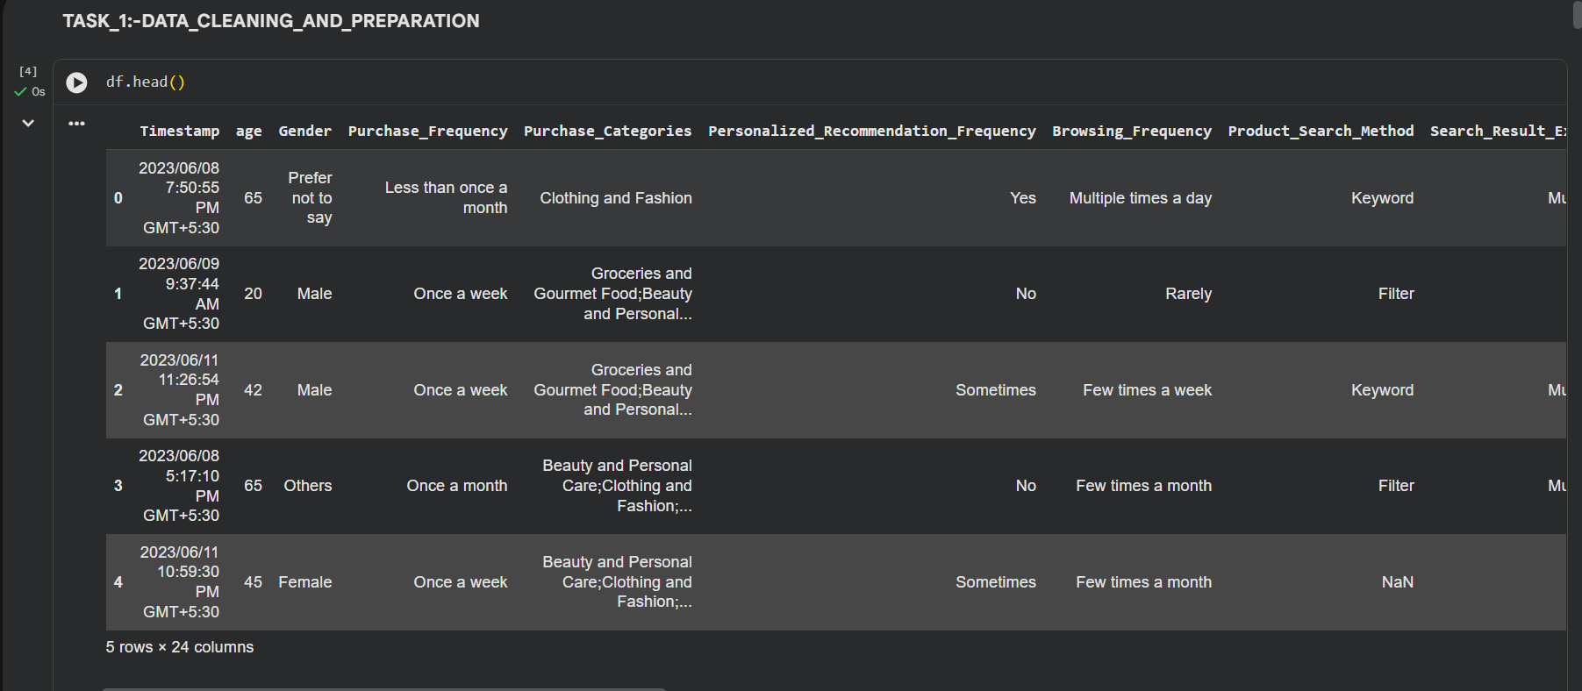
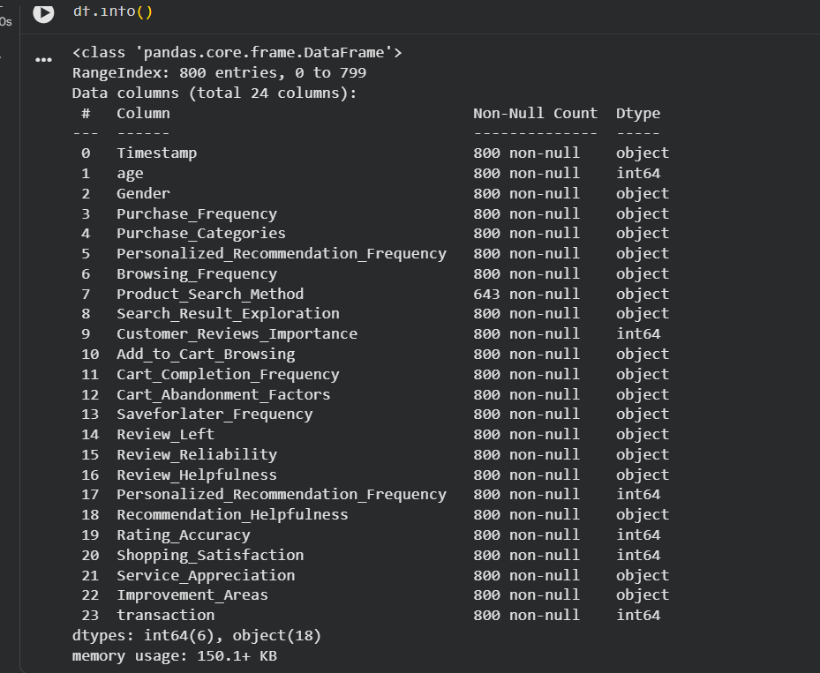
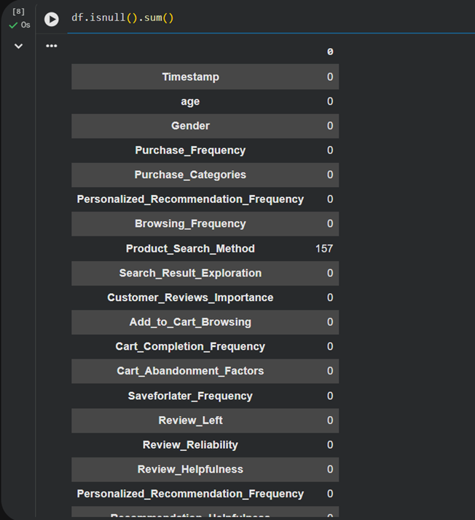
Task_1:-Data_Cleaning_and_Preparation
In Task 1, the dataset was cleaned and prepared for analysis. Duplicate records were removed to avoid repeated information. Missing values were identified and handled properly. Column names were cleaned and standardized for easier analysis. Some categorical values such as recommendation helpfulness and review reliability were converted into numeric.

Slide 4
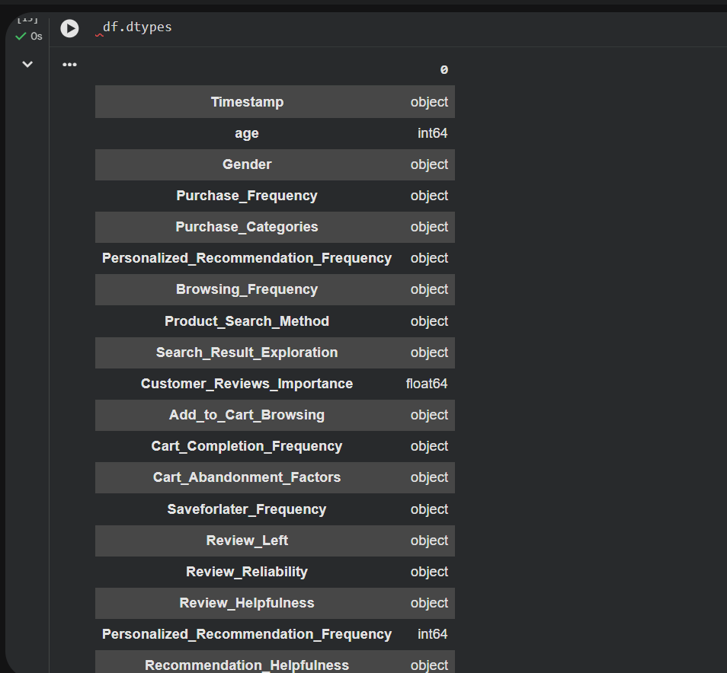
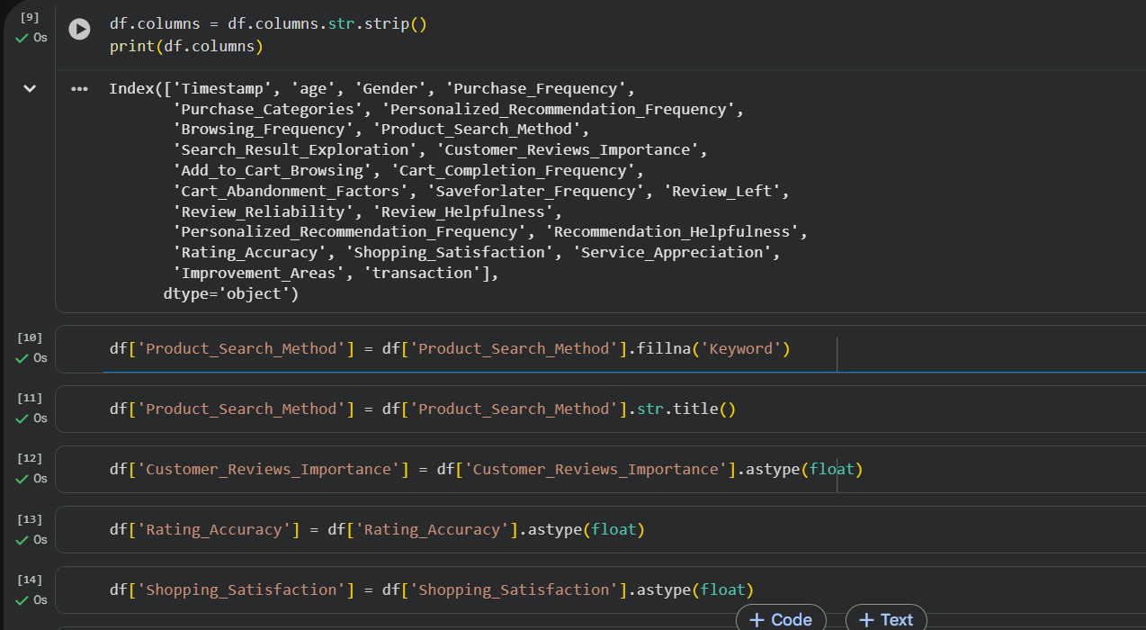

Slide 5
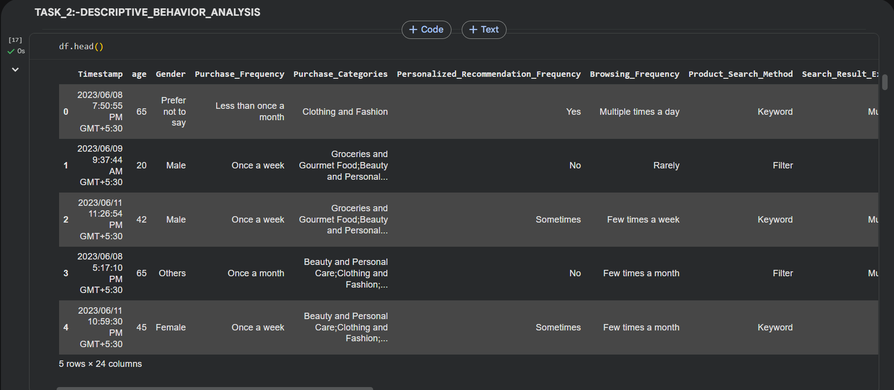
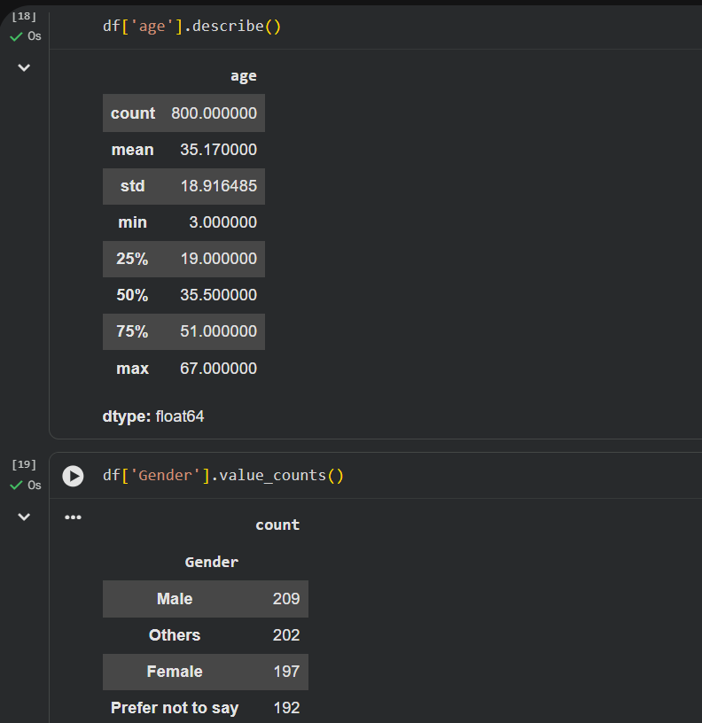
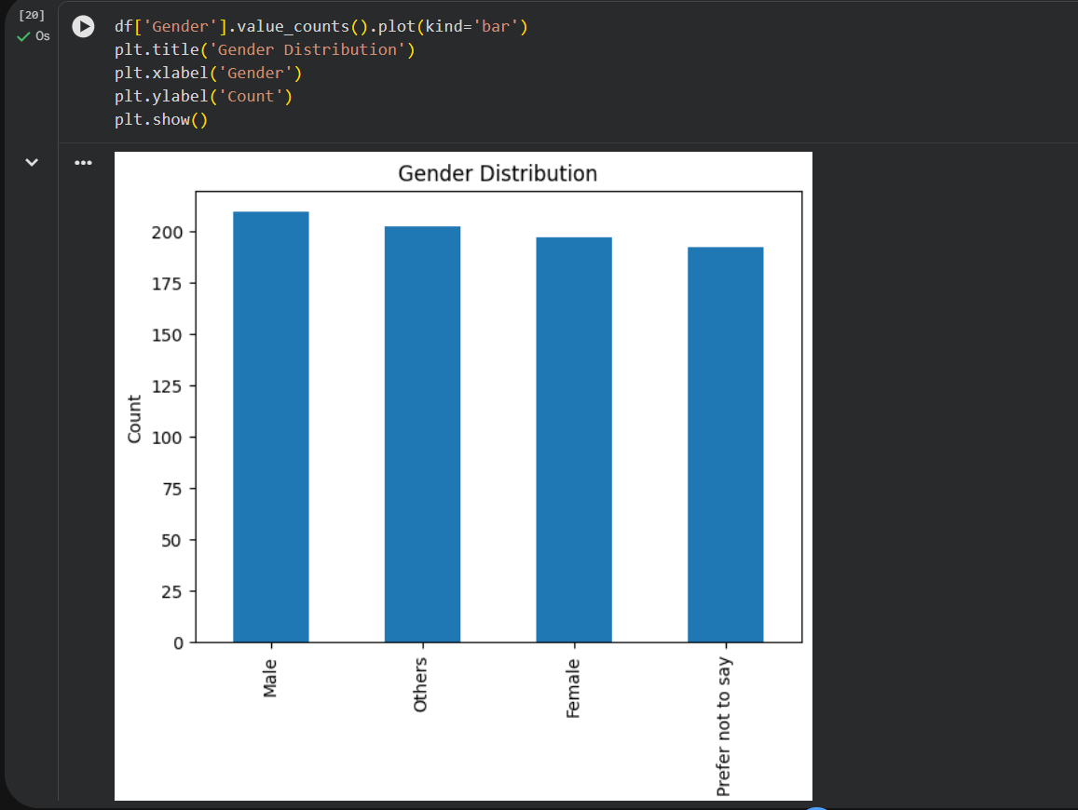
Task_2:-Descriptive_Behavior_Analysis
In this task 2, customer demographics and shopping behavior were analyzed. It showed customer age distribution and gender participation. Purchase frequency analysis helped to identify that how often customers shop on Amazon. Here, Popular product categories were also identified using charts and graphs. Mean and median values were calculated for shopping satisfaction, recommendation helpfulness, and rating accuracy to understand overall customer experience.

Slide 6

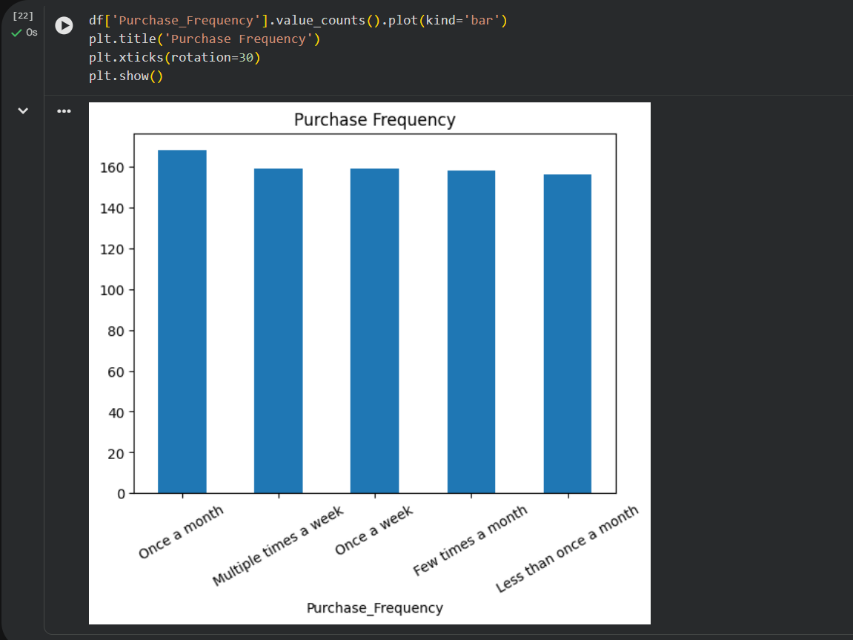
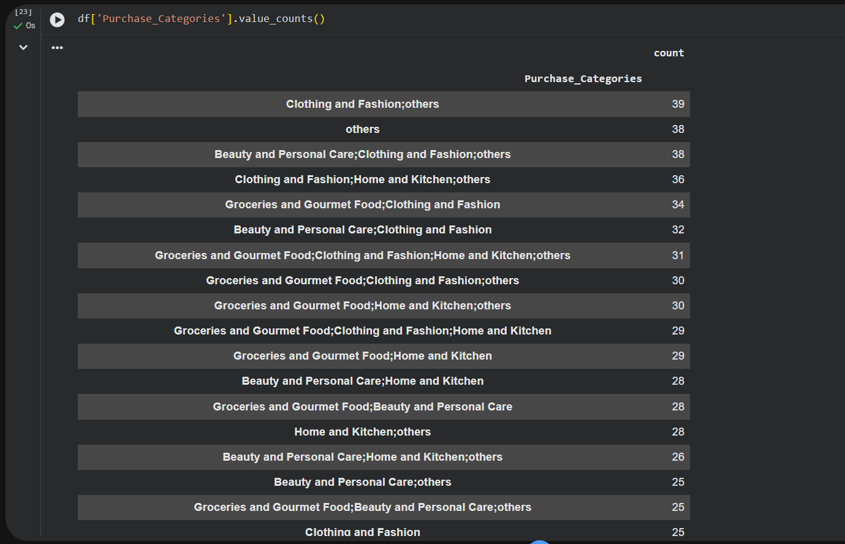
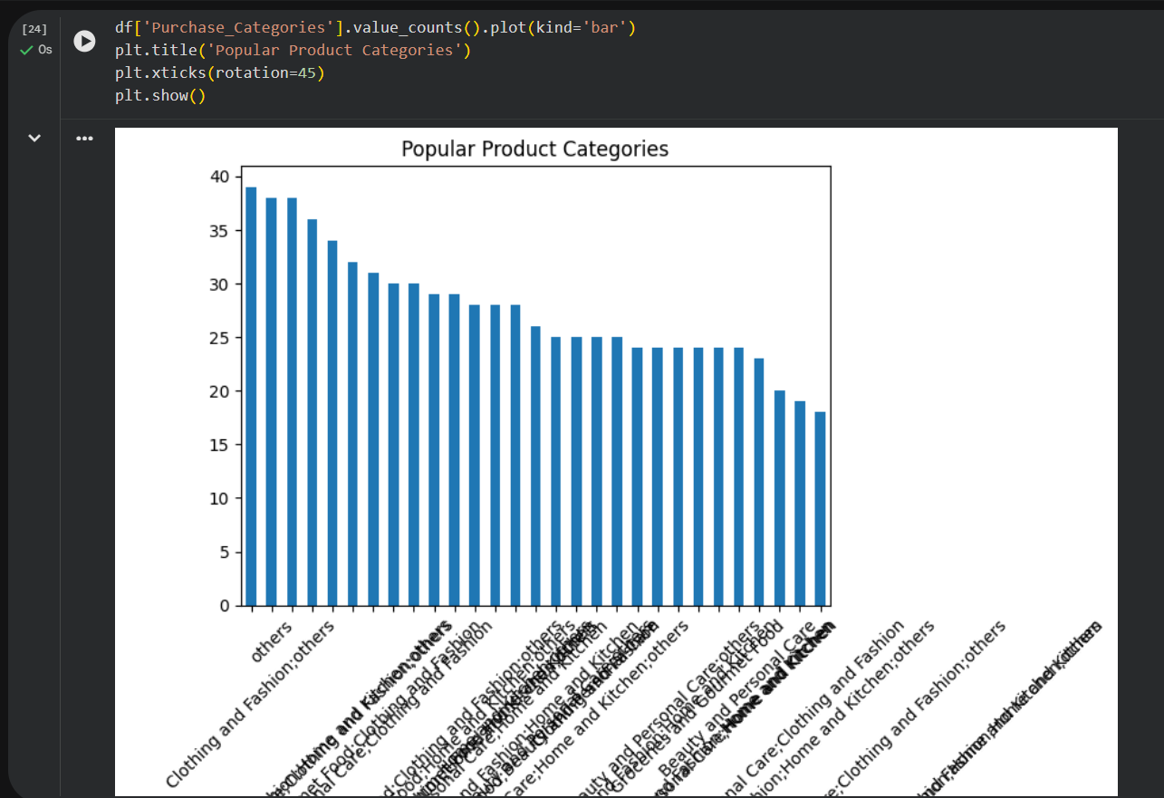
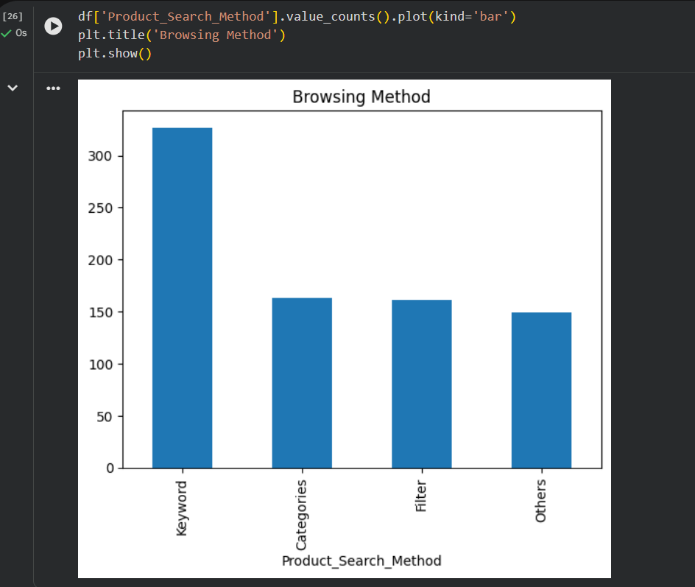
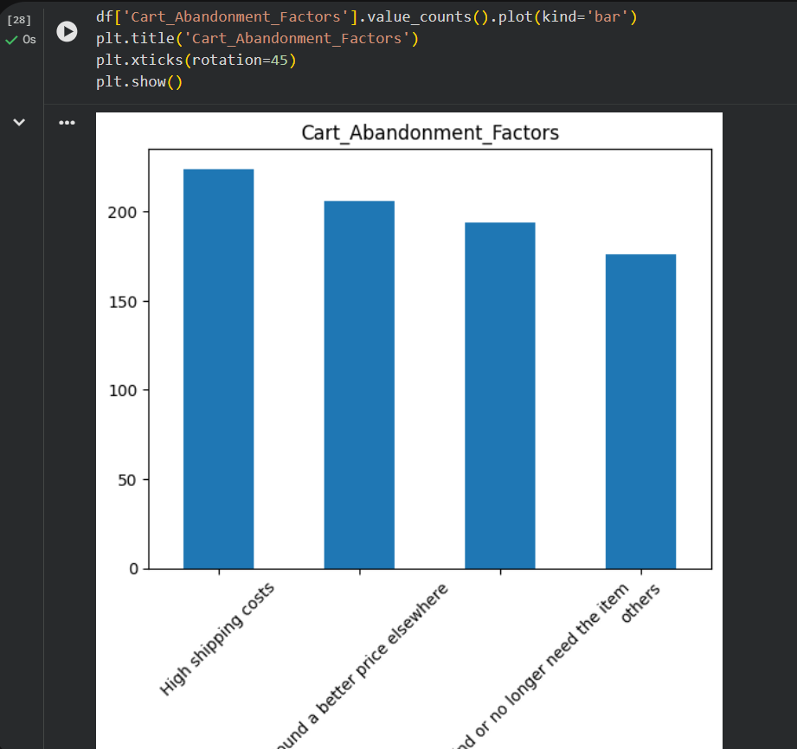

Slide 7

Customer_Purchase_and_Browsing_insights
The analysis had some product categories such as electronics and fashion were more popular among customers. Also most customers preferred using keyword-based searches while browsing products. It also showed that factors such as shipping costs, complicated checkout processes, and better pricing on other platforms where customer decisions to leave products without purchasing them.

Slide 8
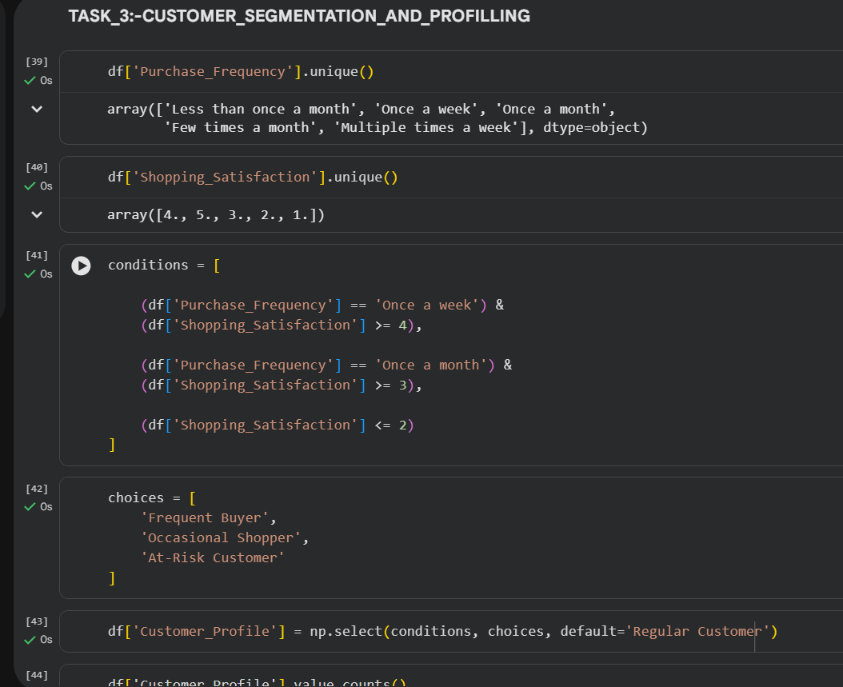
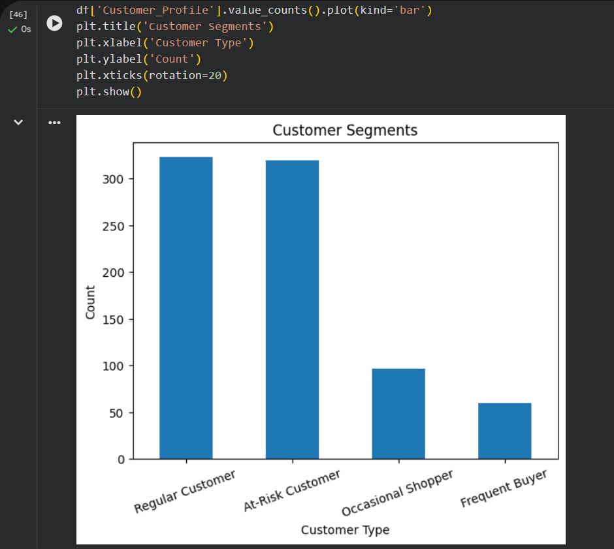
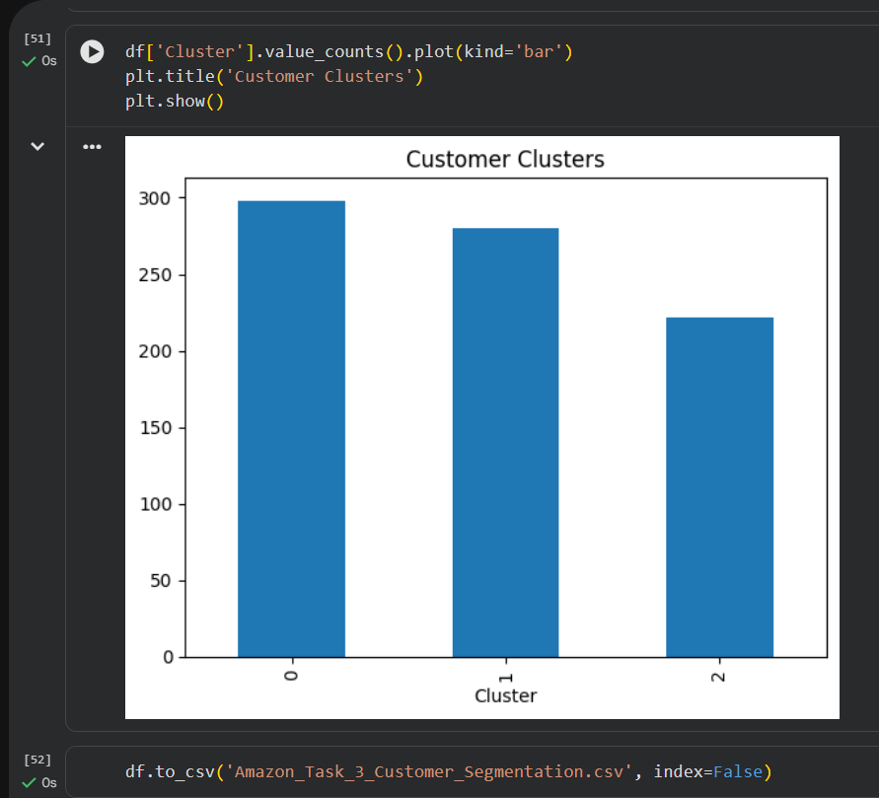
Task_3:-Customer_Segmentation_and_Profilling
In Task 3, customers were divided into different groups based on their shopping behavior and satisfaction levels. Customers who purchased products frequently and showed high satisfaction were classified as Frequent Buyers. Again, Customers with low satisfaction or high cart abandoned behavior were classified as At-Risk Customers.

Slide 9
Clustering_Analysis
K-Means clustering technique was used to group customers based on behavioral similarities. Numeric variables such as shopping satisfaction and rating accuracy were used for clustering. The clustering process automatically grouped customers into different behavioral segments. This helped identify customers with similar shopping habits and preferences.

Slide 10
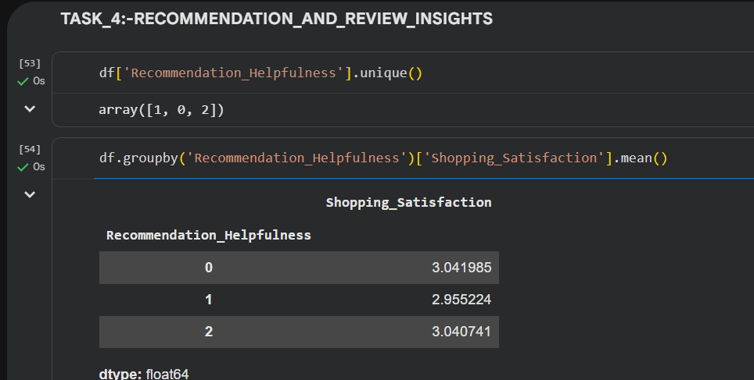
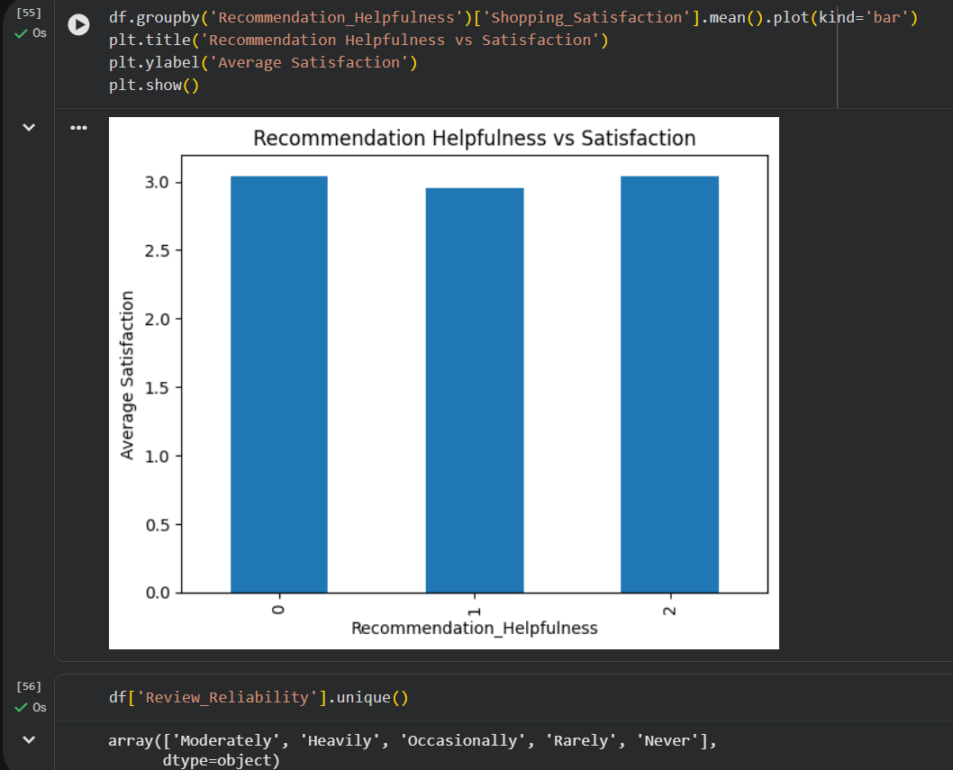
Task_4:-Recommendation_and_Review_Insights
This task focused on analyzing how recommendations and reviews influence to the customer satisfaction. This analysis showed that customers who found recommendations helpfulness generally had higher shopping satisfaction levels. Thus, Customers were more likely to engage with recommendations when they were relevant and personalized according to their interests.

Slide 11
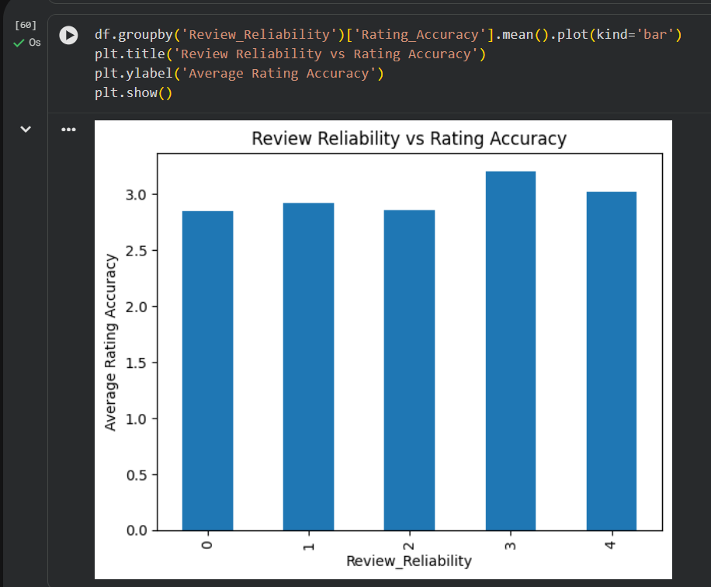
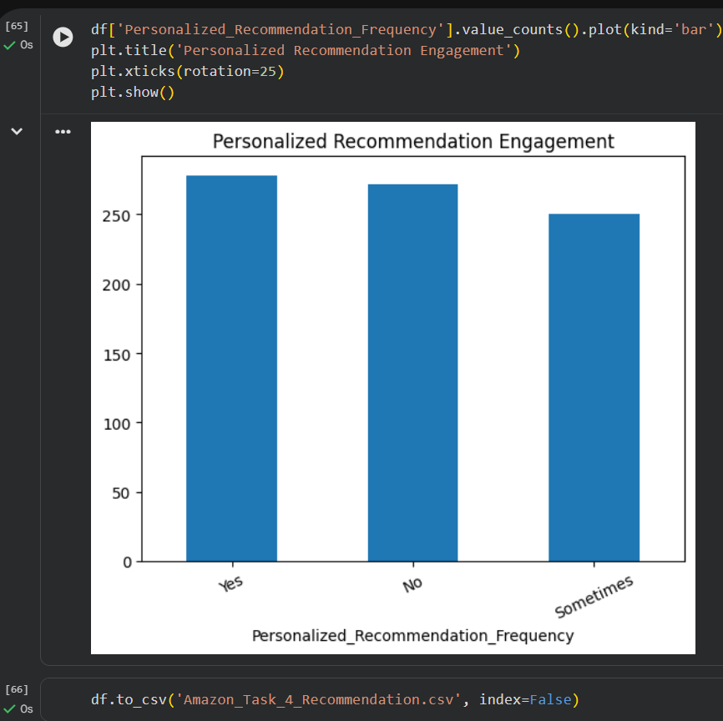

Slide 12
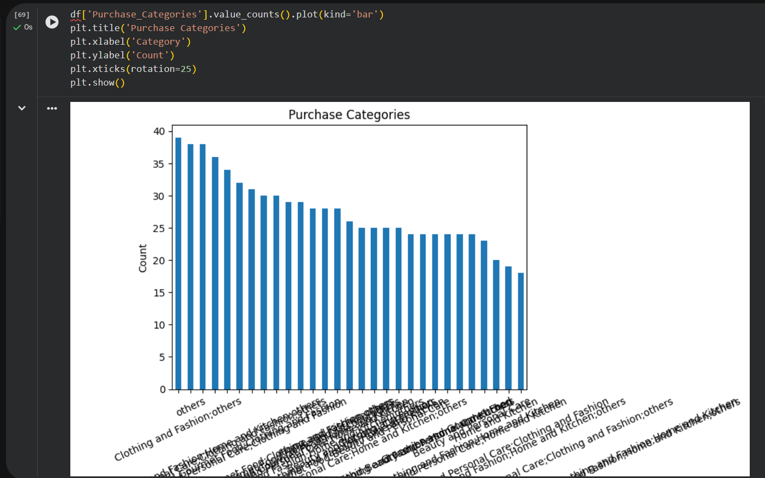
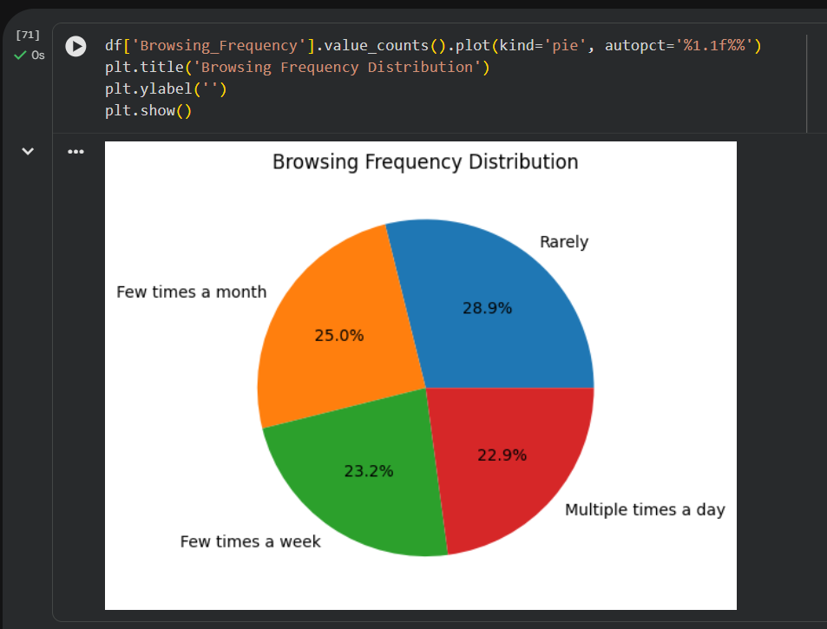
Task_5:-Visualization_and_Reporting
In this task 5, The Different visualizations such as bar charts, pie charts, and heatmaps were created to present the analysis in a clear and visually attractive manner. These visualizations helped better understand customer behavior, satisfaction levels, recommendation effectiveness, and product preferences. The heatmap highlighted relationships between important variables such as ratings, recommendations, and customer satisfaction.

Slide 13
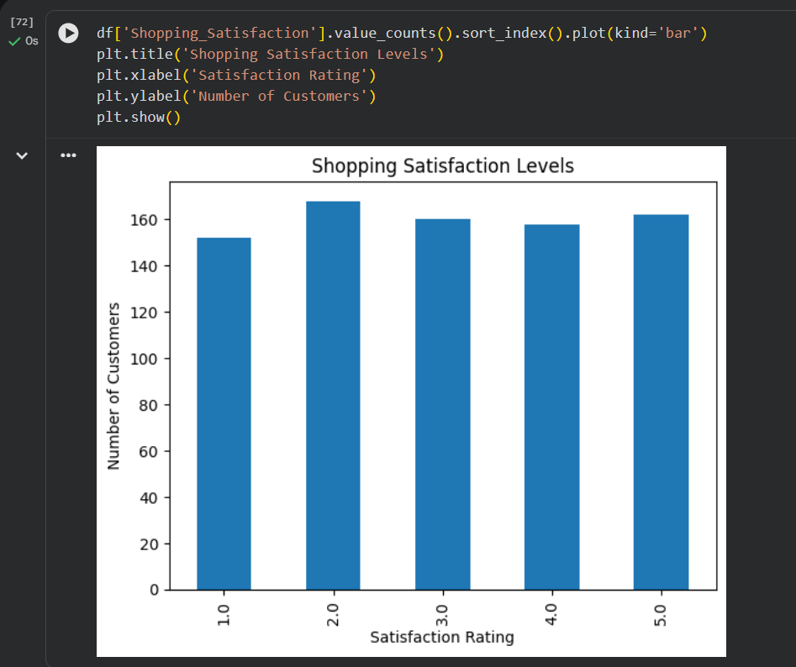
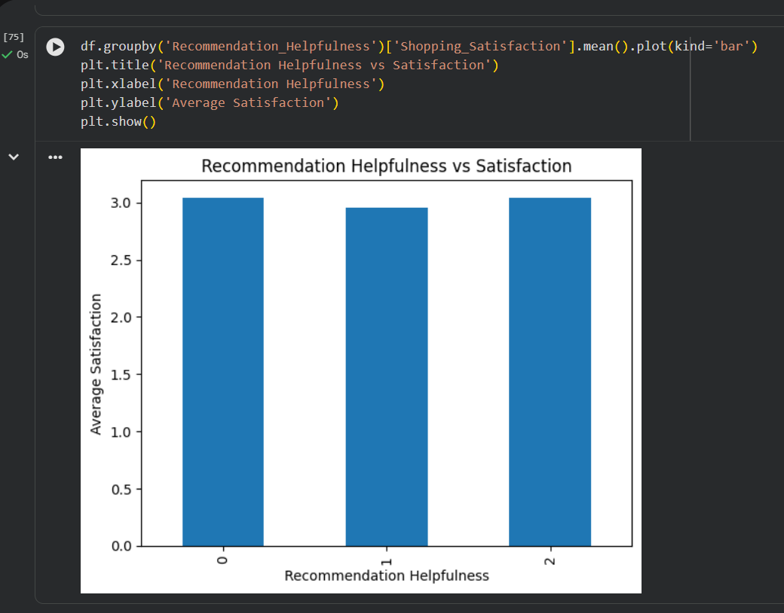
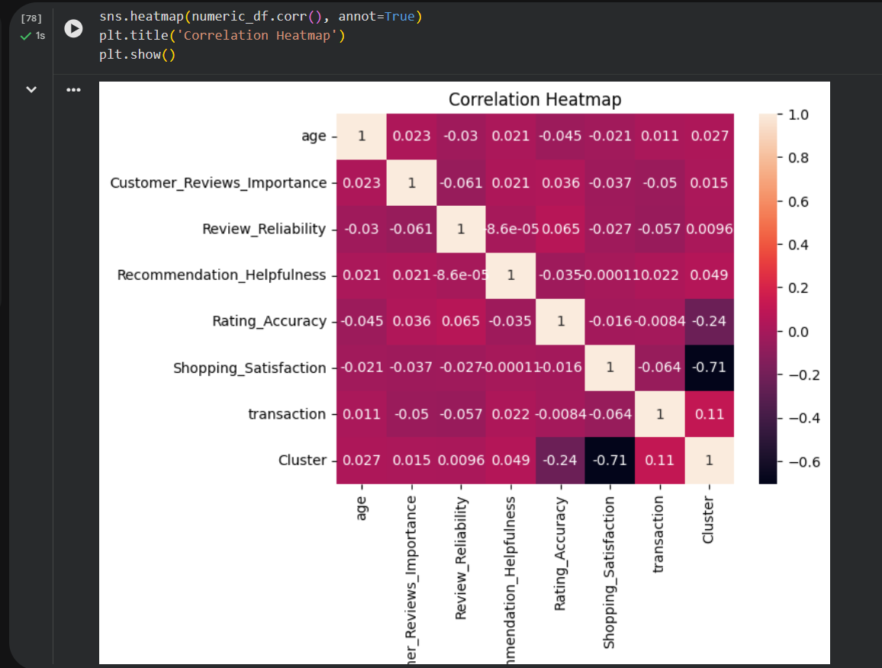

Slide 14
Project Drive Link:-
https://drive.google.com/file/d/1B-sidI4bawvi1vglrDKb-9OeEfovU-VR/view?usp=drive_link

Slide 15
Conclusion:-
This concluded that the project successfully analyzed Amazon customer behavior using Python-based data analysis and visualization techniques. The project provided valuable insights into customer satisfaction, recommendation systems, shopping preferences, and behavioral patterns. The findings can help improve recommendation systems, customer engagement strategies, and overall shopping experience on e-commerce platforms.

Slide 16


