Slide 1
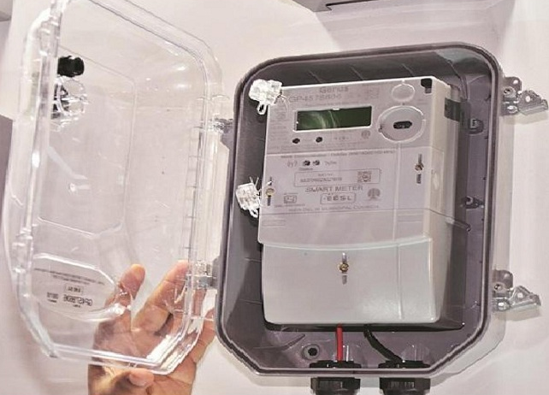
Automated Electric Grid Cutoff System for Non-Paid Customer
Project guide : Prof. Amol Pardhi
Group members : Mrunmay Chichkhede, 49
Aditya Meshram, 34
Nikhil Patil, 50
Nilay Kanire, 51
Rajat Thote, 57
Swaraj Deshmukh, 65

Slide 2
ABSTRACT
Our project introduces an innovative solution to combat non-payment issues in the electric grid sector. Through smart sensor technology and a user-friendly website interface, we automate monitoring, billing, and grid cutoff processes.
The system aims to reduce non-payment rates, enhance grid efficiency, and improve customer experience while ensuring data security and scalability. This project promises increased revenue and better energy distribution.
In an era marked by technological advancement and evolving energy demands, the power distribution sector faces an enduring challenge: non-payment by consumers. Non-payment not only poses financial hurdles for utility providers but also disrupts the equitable distribution of electricity resources. In response to this persistent issue, we embark on a transformative journey – the development of an Automated Electric Grid Cutoff System for Non-Paid Customers.
Our project is a forward-thinking solution aimed at revolutionizing the energy distribution landscape. At its core, it marries cutting-edge sensor technology with an intuitive web-based interface to automate the monitoring, billing, and grid cutoff processes. This automation is designed to foster efficiency, fairness, and accountability within the energy sector.

Slide 3
objectives
Improved Revenue Collection: Develop an automated system to identify and prioritize non-paid customers. Implement an efficient cutoff process to minimize revenue loss due to unpaid bills. Streamline billing and disconnection procedures to enhance overall revenue collection.
Enhanced Operational Efficiency: Automate the grid cutoff process, reducing the need for manual interventions. Minimize downtime during cutoff operations to maintain the quality and reliability of electric services. Optimize resource allocation for disconnection activities, reducing operational costs.
Real-time Monitoring and Reporting: Implement a system for real-time monitoring of payment statuses and compliance. Generate automated reports and alerts to utility personnel regarding non-paid accounts and disconnection activities.
Customer Engagement and Communication: Develop a communication strategy to inform customers about payment deadlines, impending disconnections, and reconnection procedures. Facilitate communication channels for customers to address payment issues and seek assistance.
Sustainability and Environmental Impact: Optimize the disconnection process to minimize environmental impact, such as reducing unnecessary power fluctuations. Promote sustainability by encouraging timely payments and responsible energy consumption.

Slide 4
Problem statement
“In the utility industry, there exists a significant problem concerning non-payment of electricity bills and electricity theft by customers. This issue results in such as revenue loss, grid instability, and unfair cost distribution. Current manual methods of addressing non-payment and electricity theft are the limitations and inefficiencies of existing methods, such as time-consuming and resource-intensive. To overcome these challenges and ensure the reliability of the electric grid while maintaining fairness in cost distribution, there is a critical need for the development and implementation of an automated electric grid cutoff system for non-paid customers.”

Slide 5
Literature survey
This literature review on automated electric grid cutoff systems and related technologies reveals the historical development of these systems, stemming from early efforts to manage and control electricity distribution and metering. In the early 1990s, technological advancements ushered in sophisticated metering infrastructure capable of recording detailed usage data (Federal Energy Regulatory Commission, 2006). This period also saw the inception of the "smart grid" concept, emphasizing the utilization of information technology to enhance grid reliability and capacity (Vu et al., 1997). Gustavsson's 1999 research underscored the pivotal role of communication technology in enabling forthcoming value-added services.
Furthermore, the fusion of energy market liberalization and communication technology was identified as a driver for innovative business models (Gustavsson, 1999). In the year 2000, the Telegestore Project in Italy achieved a significant milestone by connecting a substantial number of households, approximately 27 million, with smart meters via low-bandwidth power line connections. This literature survey highlights the interconnectedness of technological advancements, market dynamics, and the evolution of automated grid cutoff systems.

Slide 6
Literature survey
A novel power theft detection algorithm for low voltage distribution network" (IECON 2017): This paper presents a novel algorithm for identifying power theft in low voltage distribution networks. It involves injecting a low magnitude high-frequency signal into the distribution line to detect power theft incidents where unauthorized individuals tap into the lines.
"Smart Power Theft Detection System" (DevIC 2019): This paper discusses a power theft detection system that detects theft by tapping into the power lines. It also communicates with the relevant authorities using a GSM module and provides the location of the area where power theft is occurring. This system seems to integrate both detection and reporting capabilities.
"Power Theft Identification System Using IoT" (ICACCS 2019): This paper introduces a power theft identification system that utilizes IoT (Internet of Things) technology. It employs a Raspberry Pi-based system to identify power theft by monitoring voltage levels and current. When the voltage levels exceed a predefined threshold, it triggers the identification of power theft incidents.

Slide 7
Reasons to select this project
Social Impact: Implementing an automated grid cutoff system can have a significant social impact by ensuring that electricity is fairly distributed and paid for. It can help prevent power theft and ensure that all customers are treated fairly.
Cost Savings: By automating the grid cutoff process for non-paid customers, utility companies can potentially save on operational costs. Manual cutoffs and reconnections can be labor-intensive and costly.
Efficiency: Automation can make the cutoff process more efficient. It can reduce the response time for disconnecting and reconnecting non-paid customers, improving overall grid management.
Technology Integration: Implementing such a system requires the integration of technology, which can be a driver for innovation and modernization within the utility sector.
Environmental Impact: Efficient grid management can also have positive environmental implications. By reducing energy theft and ensuring more efficient use of resources, there can be less wastage of electricity, which is environmentally friendly.
Learning Experience: Developing and implementing an automated system like this can provide a valuable learning experience for those involved, including engineers, technicians, and project managers. It can also serve as a case study for future projects in the energy sector.

Slide 8
need for the project
Revenue Loss Prevention: Utility companies rely on timely payment from customers to cover operational costs, maintain infrastructure, and invest in improvements. Non-payment by a significant number of customers results in substantial revenue loss, which can hinder the ability of these companies to provide reliable services.
Fairness and Accountability: Non-payment of electricity bills and electricity theft can lead to an unfair distribution of costs. Paying customers may end up shouldering the financial burden of those who do not pay, leading to dissatisfaction and a lack of accountability within the system.
Grid Stability: When non-payment and electricity theft are prevalent, utility companies may struggle to maintain the stability and reliability of the electric grid. Grid overloads, power outages, and equipment damage can occur, affecting all customers, including those who pay their bills.
Operational Efficiency: Managing non-paid accounts and identifying electricity theft manually is resource-intensive and can be inefficient. An automated system can streamline these processes, reducing operational costs and freeing up resources for other critical tasks.
Data-Driven Decision-Making: An automated system can provide real-time data and analytics on non-paid accounts and electricity consumption patterns. This data can be invaluable for making informed decisions about grid management, revenue collection, and resource allocation.
Societal Impact: The project addresses a social issue by encouraging responsible energy consumption and discouraging illegal activities like electricity theft. It promotes ethical and responsible energy use.
Environmental Considerations: Encouraging responsible energy use can indirectly contribute to environmental sustainability by reducing wasteful consumption and encouraging the adoption of energy-efficient technologies.
Regulatory Compliance: In many regions, utility companies are required to maintain certain standards of revenue collection and grid management. An automated system can help companies comply with these regulations more effectively.

Slide 9
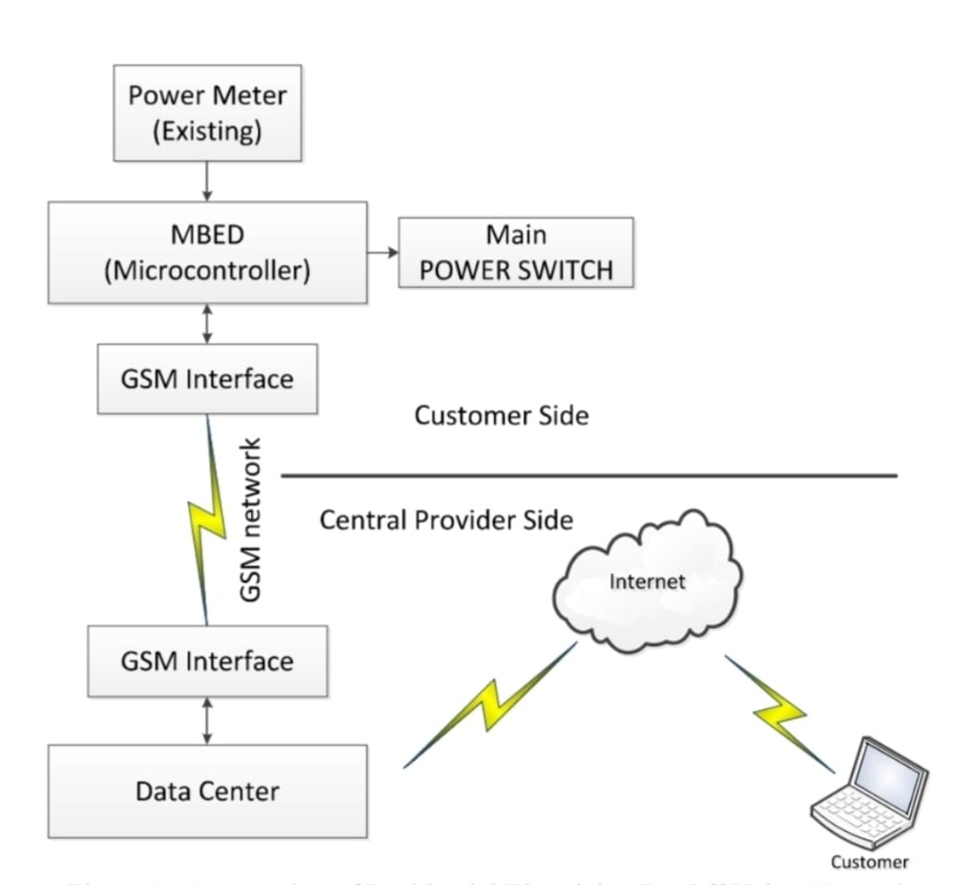
Block diagram
ESP32

Slide 10
working
The automated electric grid cutoff system for non-paid customers is designed to disconnect electricity supply to a particular location, either through the control of a local pole (POL) or distribution point (DP), by utilizing a web-based interface. Additionally, the system incorporates IoT technology to accurately measure and collect data on electricity consumption for billing purposes.
This system allows for the remote management of electricity disconnection and reconnection, with the control mechanism situated either at the pole or distribution point. Users can initiate the disconnection process through a website interface, which sends commands to the designated POL or DP, effectively cutting off the electricity supply to the non-paying customer.
In parallel, IoT sensors are employed to monitor and record the electricity consumption at the customer's location. These sensors collect data on the amount of electricity consumed, ensuring accurate billing information. This data is subsequently transmitted to the central billing system, where calculations are made to determine the exact amount owed by the non-paying customer.

Slide 11
Tentative price of components
1. Breadboard - ₹100 8. Bulb , LED - ₹70
2. ESP-550 9. Resistor, capacitor - ₹100
3. Potentiometer - ₹40 10. Service wire - ₹60
4. SCT-013 - ₹550 11. PCB - ₹100
5. LCD - ₹300 12. Relay module - ₹150
6. Connecting wires - ₹100 13. GSM module (tentative) - ₹400
7. ZMPT101B (Voltage sensor) - ₹300
The total tentative price of the components that are required in this project will be: ₹2070

Slide 12
Industrial applications
Billing and Revenue Management: Utility companies can use this system to automatically disconnect electricity supply to customers who have not paid their bills on time. This helps in ensuring that only paying customers receive uninterrupted service.
Grid Reliability: By ensuring that only paying customers are connected to the grid, the overall reliability and stability of the electric grid can be improved.
Remote Monitoring and Control: Utility companies can remotely monitor and control the status of customer connections, making it easier to disconnect and reconnect non-paying customers without the need for field personnel.
Customer Notifications: Automated notifications can be sent to non-paying customers before disconnection, giving them an opportunity to settle their bills and avoid service interruptions.

Slide 13
references
Title: "Smart Grid Solutions for Revenue Recovery and Reduction of Energy Theft“ Authors: Anant Sudarshan, Vivek Padmanabhan Publication: IEEE Transactions on Smart Grid, Year: 2016
Title: "An Automated System for Electricity Theft Detection and Overload Monitoring“ Authors: Diego R. M. Oliveira, Samuel S. Silva, et al. Publication: IEEE Transactions on Power Systems, Year: 2019
Title: "A Comprehensive Review on Non-Technical Loss Detection in Smart Grids“ Authors: Juan A. Gomez, Jesus Fraile - Ardanuy, et al. Publication: Energies, Year: 2020
Title: "Smart Grids for Revenue Protection and Revenue Collection: A Survey“ Authors: Md Lutfor Rahman, Md Rabiul Islam, et al. Publication: IEEE Access, Year: 2020
Title: "Advanced Metering Infrastructure (AMI) for Non-Technical Loss Reduction: A Review“ Authors: Francisco Tovar-Camargo, Vicente Galiano- Garrigós, et al. Publication: Energies, Year: 2021

Slide 14
Rejected projects due to disadvantages and complexities
While the "Intelligent Road Safety Enhancement System using Smart Zebra Crossing" project offers several advantages, it also has its disadvantages and challenges:
Cost: Implementing such a system can be expensive. The costs associated with developing and installing the smart zebra crossing, as well as setting up the infrastructure for real-time communication with traffic signals, can be significant. This might be a barrier to widespread adoption, especially in less economically developed areas.
Maintenance: Smart zebra crossings would require regular maintenance to ensure sensors, lights, and communication systems are functioning correctly. Maintenance costs can add up over time.
Privacy Concerns: Collecting data on pedestrians, including images or videos, raises privacy concerns. Safeguarding this data and ensuring it is used only for legitimate purposes is essential. Privacy regulations and public perception of surveillance can be challenges to navigate.
False Positives and Negatives: Sensors may not always accurately detect violations. There can be instances of false positives (detecting a violation when there isn't one) or false negatives (not detecting a violation when there is one). Fine-tuning the system to minimize these errors can be challenging.
Technical Challenges: The system's reliability is crucial for its success. Technical issues such as sensor malfunctions, connectivity problems, or software glitches could lead to incorrect enforcement actions or disruptions in traffic flow.
Legal and Ethical Considerations: Implementing automated fine systems must align with local laws and regulations. Defining legal frameworks for automated enforcement and ensuring due process for alleged violators can be complex.

Slide 15
Rejected projects due to disadvantages and complexities
While a project involving “Face recognition and license recognition systems in cars ignition” can be exciting and valuable, there are certain challenges and considerations that might make us reconsider. Here are some reasons why we have to think twice before selecting this project:
Complexity: Building a face recognition and license recognition system can be technically challenging, especially if we're new to computer vision and machine learning. It may require a deep understanding of these fields and substantial development time.
Resource Requirements: Developing such a system can be resource-intensive in terms of computing power, data, and time. We may need access to powerful hardware, large datasets, and software tools, which can be costly.
Privacy Concerns: Face recognition systems raise significant privacy concerns, as they involve capturing and processing personal data without consent. Ethical considerations and legal regulations may restrict or complicate your project.
Accuracy and Reliability: Achieving high accuracy and reliability in face recognition and license recognition can be challenging, especially in real-world conditions with variations in lighting, angle, and quality of images.
Data Availability: Acquiring labeled data for training and testing your models can be difficult, especially for license recognition, which may require access to a wide range of license plate types and formats.
Legal and Ethical Issues: The use of such systems in vehicles may raise legal and ethical questions, such as concerns about surveillance, data security, and data ownership.

Slide 16
Thank you!

