Slide 1







Automated calibration for CALIFA
Mrunmoy Jena
CALIFA WG Meeting
18.10.24
Calibration in the gamma range
Extrapolation to proton range
Gain matching
Supported by BMBF 05P15WOFNA and 05P19WOFN1
Physics with R³B
CALIFA – Design
TUM Members:
Roman Gernhäuser,Philipp Klenze,Tobias Jenegger, Mrunmoy Jena

Slide 2
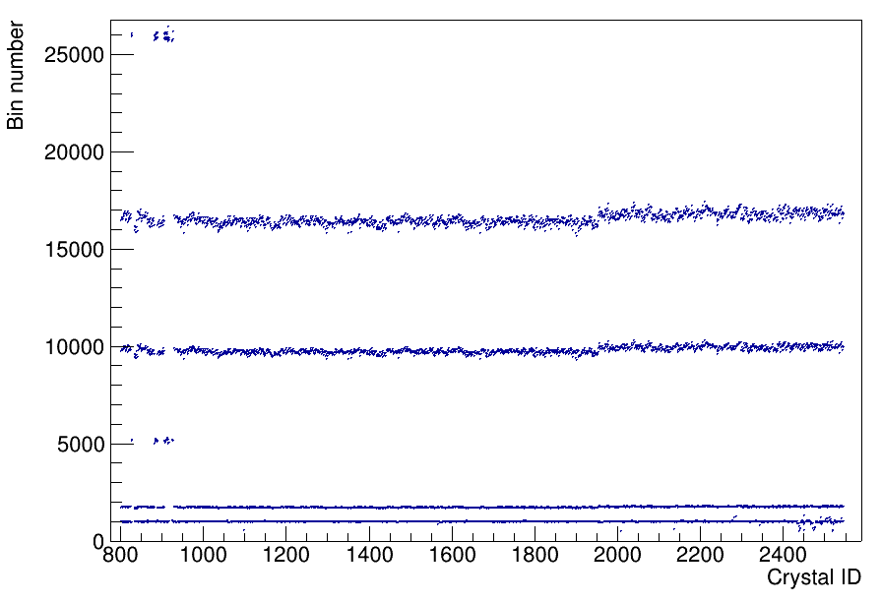
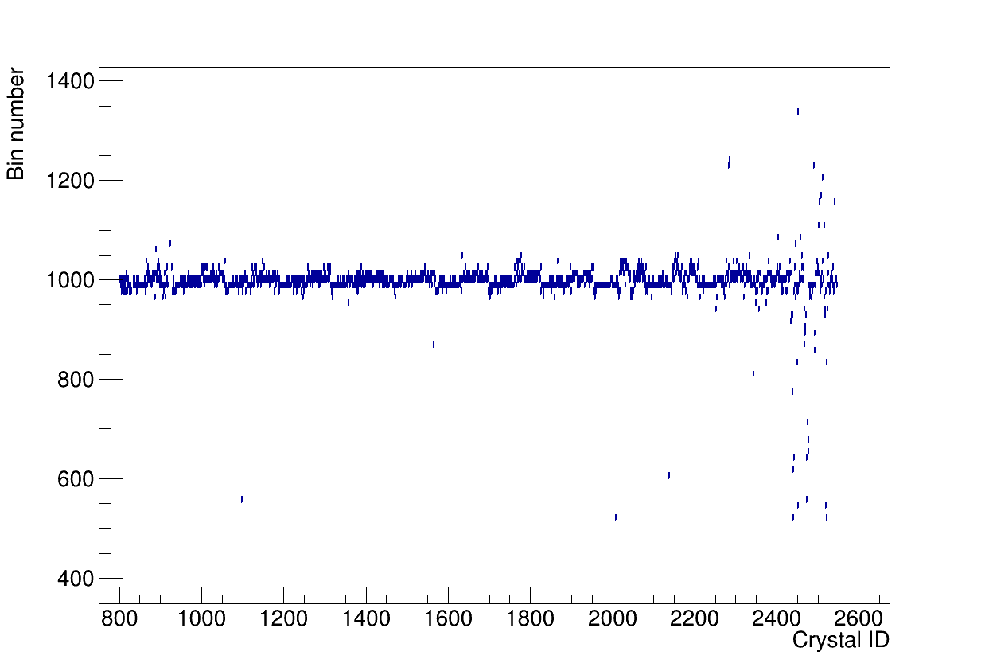
Gamma range: uncalibrated spectra
Back barrel
Barrel
iPhos
CEPA
Starting point: gain matched channels from s118, not perfect
Calibration macro: peak finding, Gaussian fits, linear fit to source + 3 pulsers

Slide 3
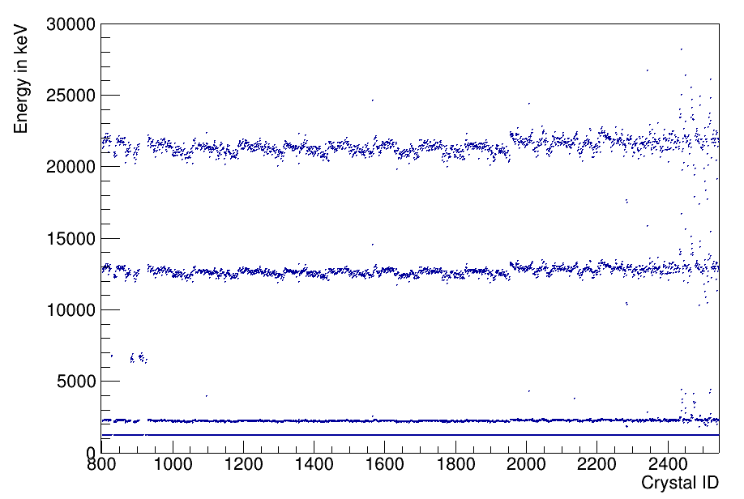
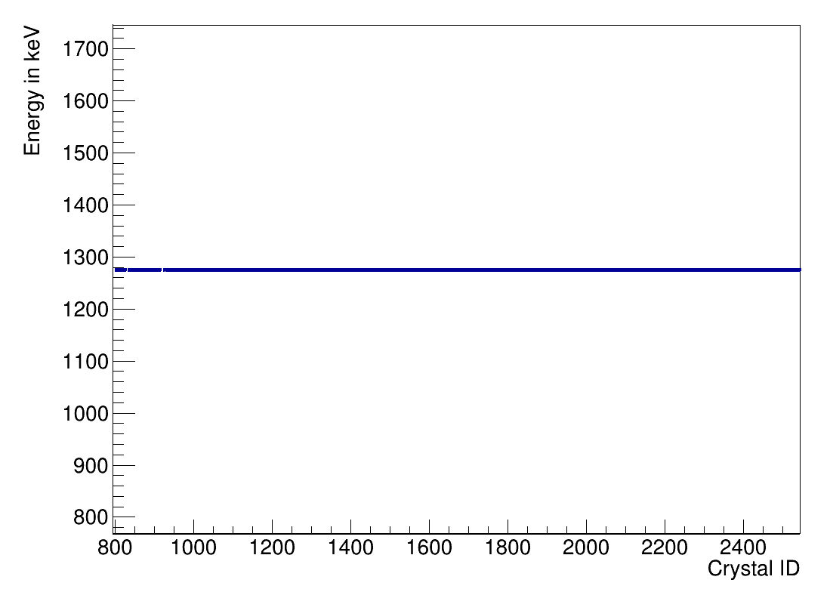
Gamma range: calibrated spectra
CEPA
Back barrel
Barrel
iPhos
Source peak is calibrated, but odd-even staggering in pulser peaks
Need to calibrate coupling capacitors, for each channel !

Slide 4
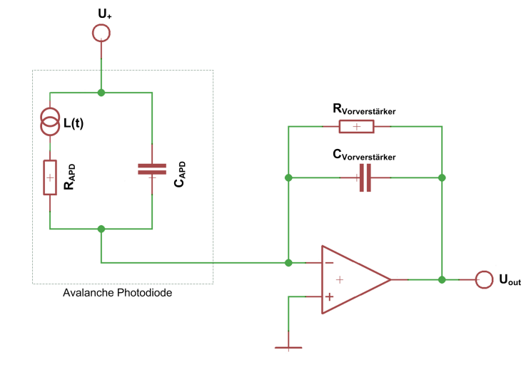
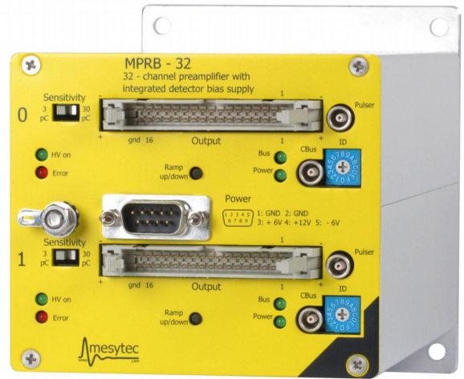
Coupling capacitors inside
Rc
Gain resistors “switch”
Cp
C1/C2
Pulser in

Slide 5
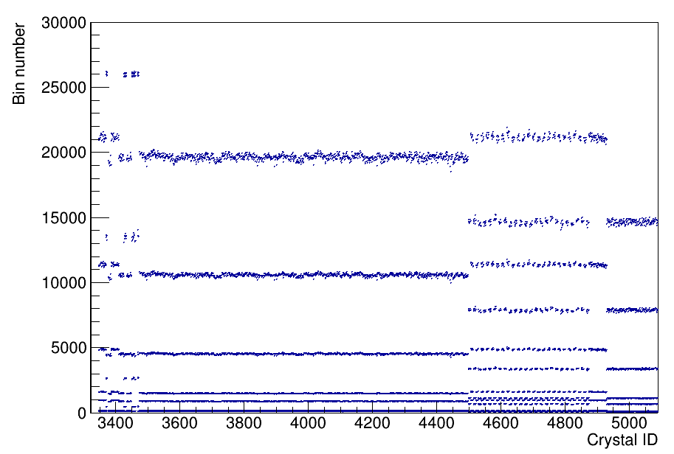
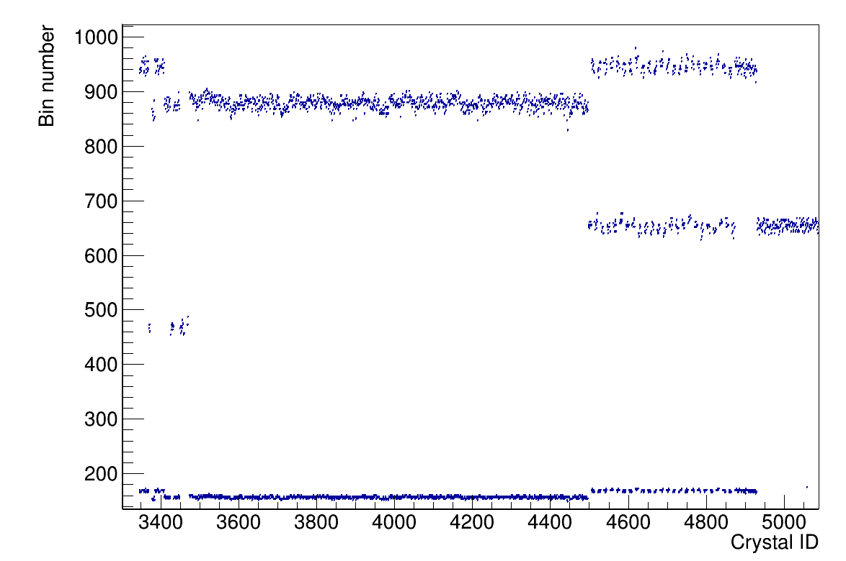
Proton range: uncalibrated spectra
Back barrel
Barrel
iPhos
CEPA

Slide 6
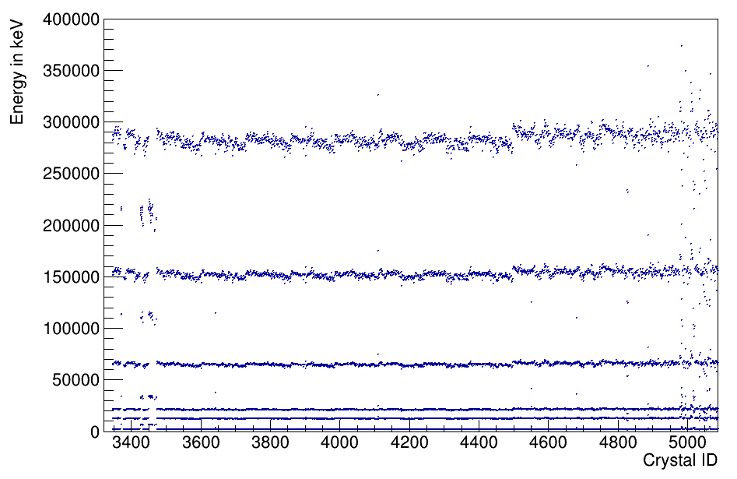
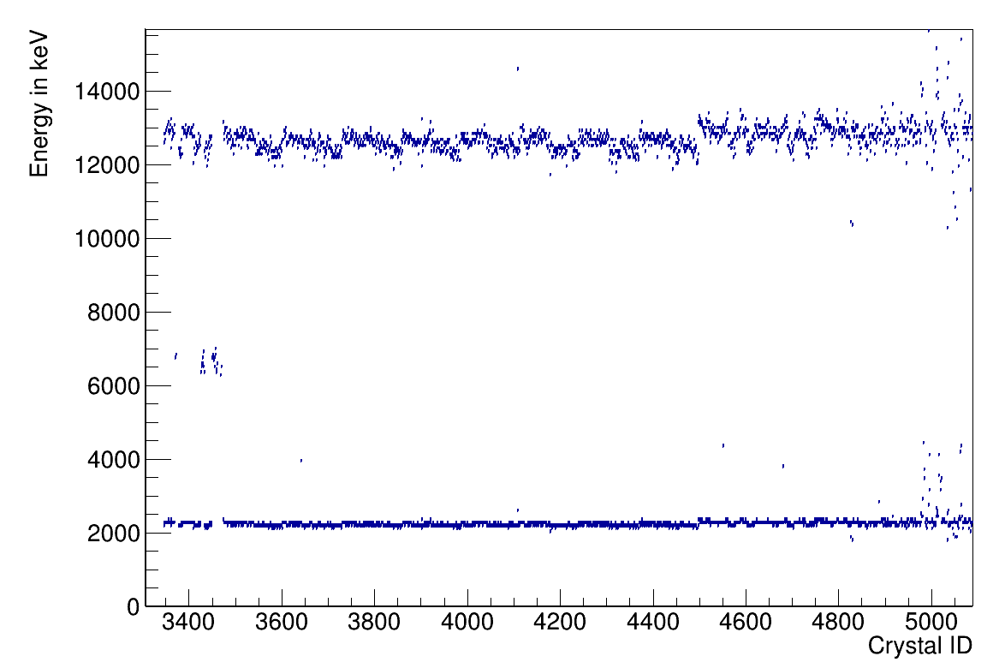
Proton range: calibrated spectra
Back barrel
Barrel
iPhos
CEPA
Similar procedure adpoted, fits made with 6 pulsers
Calibration works in practice, still need for calibrating the coupling capacitors

Slide 7
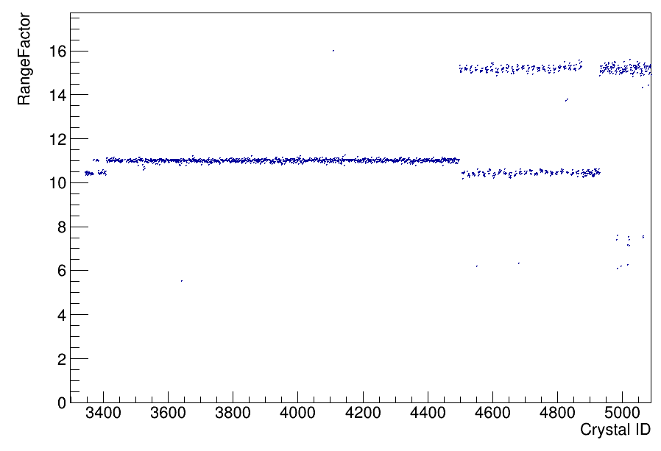
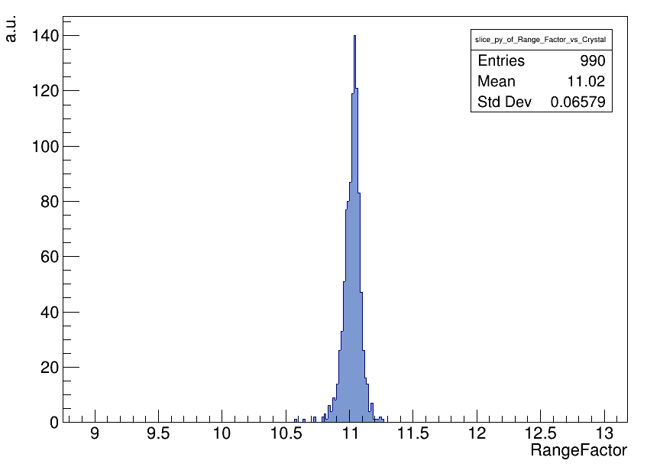
~6 per mil. Tolerance
R=Eγ/Ep = [(Q/C)γ]/[(Q/C)p] ≈ 11
Variation in the capacities of the coupling capacitors effectively cancels out
Calibration can now be extended to full range
Next step: similar speed up for gain matching

Slide 8
Summary
LMD files (90 GB) to unpacked .root files (60 GB): takes 4.2 hrs
Unpacked .root files to spectrum.root (60 MB): 40 mins
Spectra written to calibrated.root (36 MB): only a few mins !
Calibration parameters written to a file
Rather small spectrum file, written only once for the entire procedure
Advantages: automation, peak finding proceeds quickly

