Slide 1







A full range calibration for CALIFA
Mrunmoy Jena
R3B Week
12.11.2024
Overview and structure of macro
Calibration in the gamma range
Extrapolation to proton range
Physics with R³B
CALIFA – Design
TUM Members:
Roman Gernhäuser,Philipp Klenze,Tobias Jenegger, Mrunmoy Jena

Slide 2
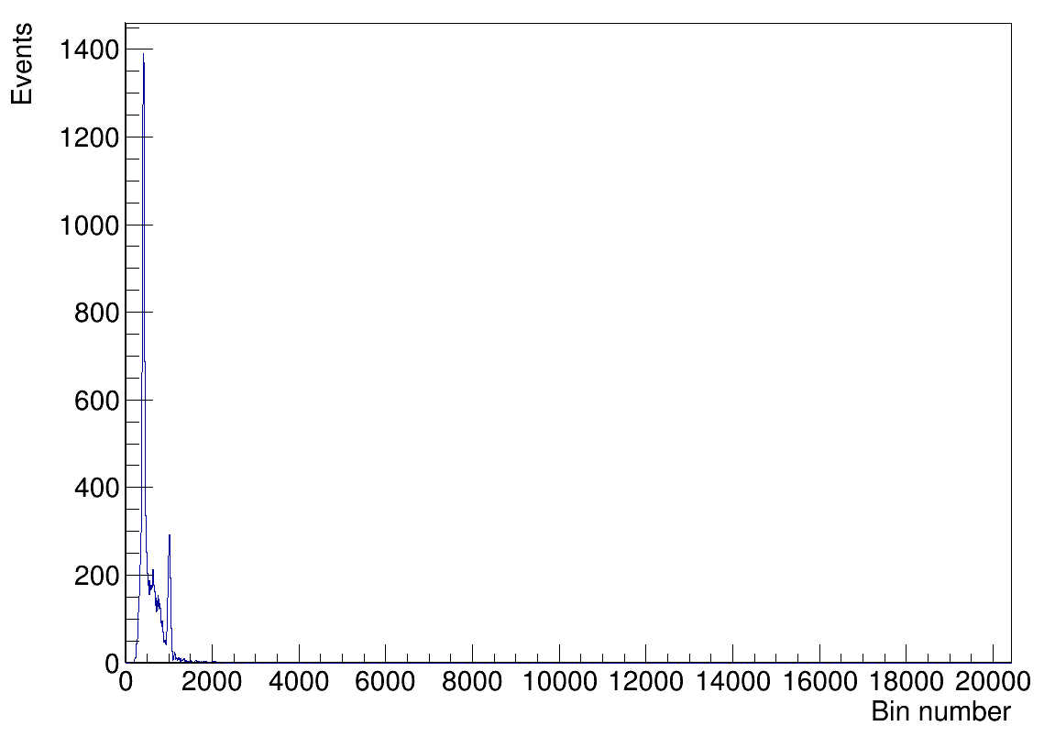
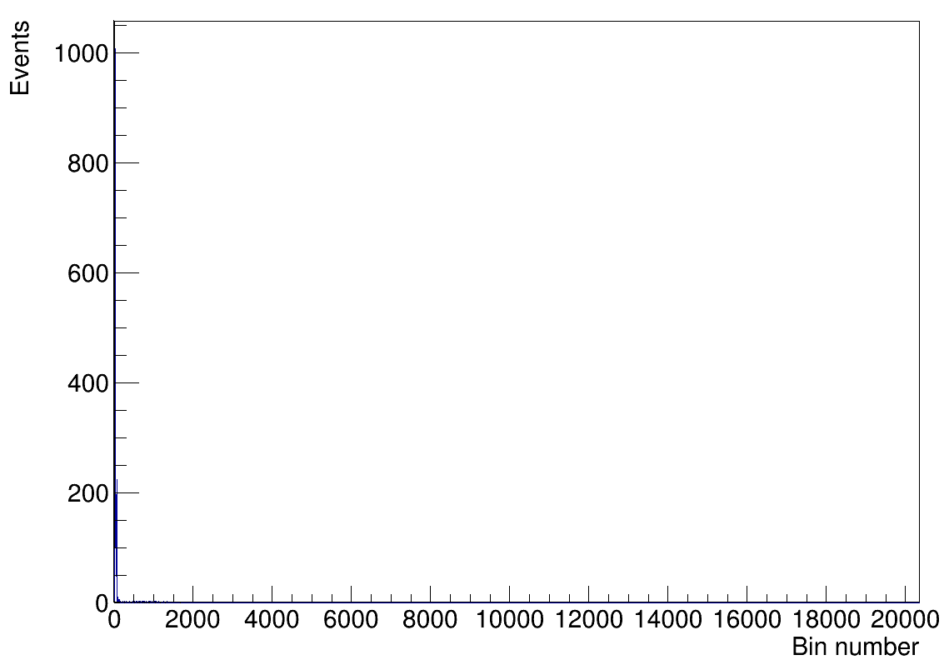
Introduction
511 keV
Gamma range
²²Na source
Proton range
²²Na source
1275 keV
Source peaks
²²Na source hardly useful for performing calibration in the proton range !

Slide 3
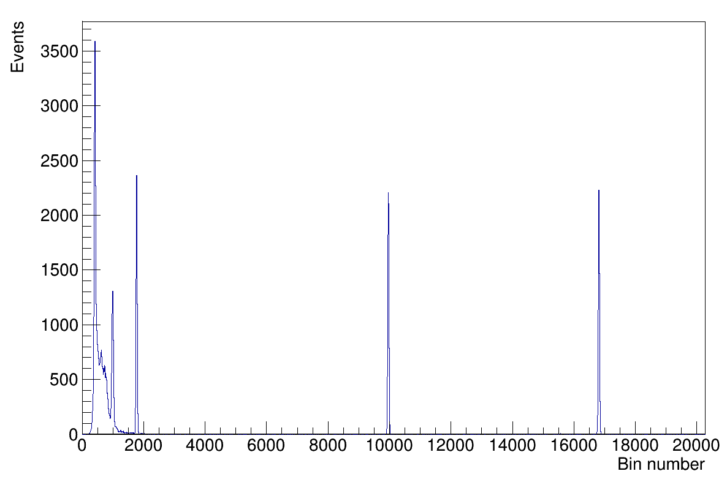
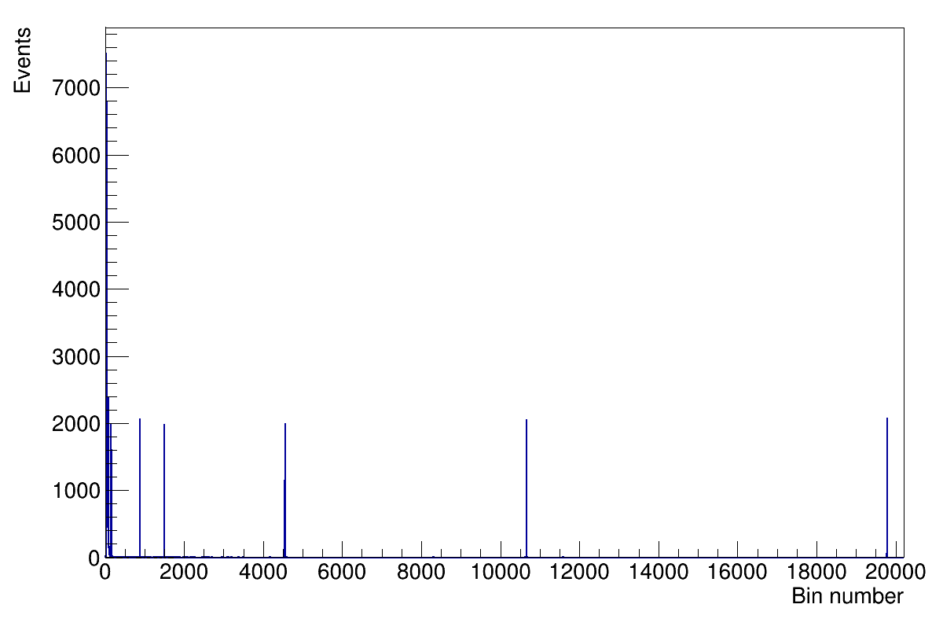
Introduction
511 keV
Gamma range
²²Na + pulser
Proton range
²²Na + pulser
²²Na peaks
1275 keV
P1
P2
P3
P1
P2
P4
P5
P6
P3
Using pulsers is essential for calibration in proton range

Slide 4
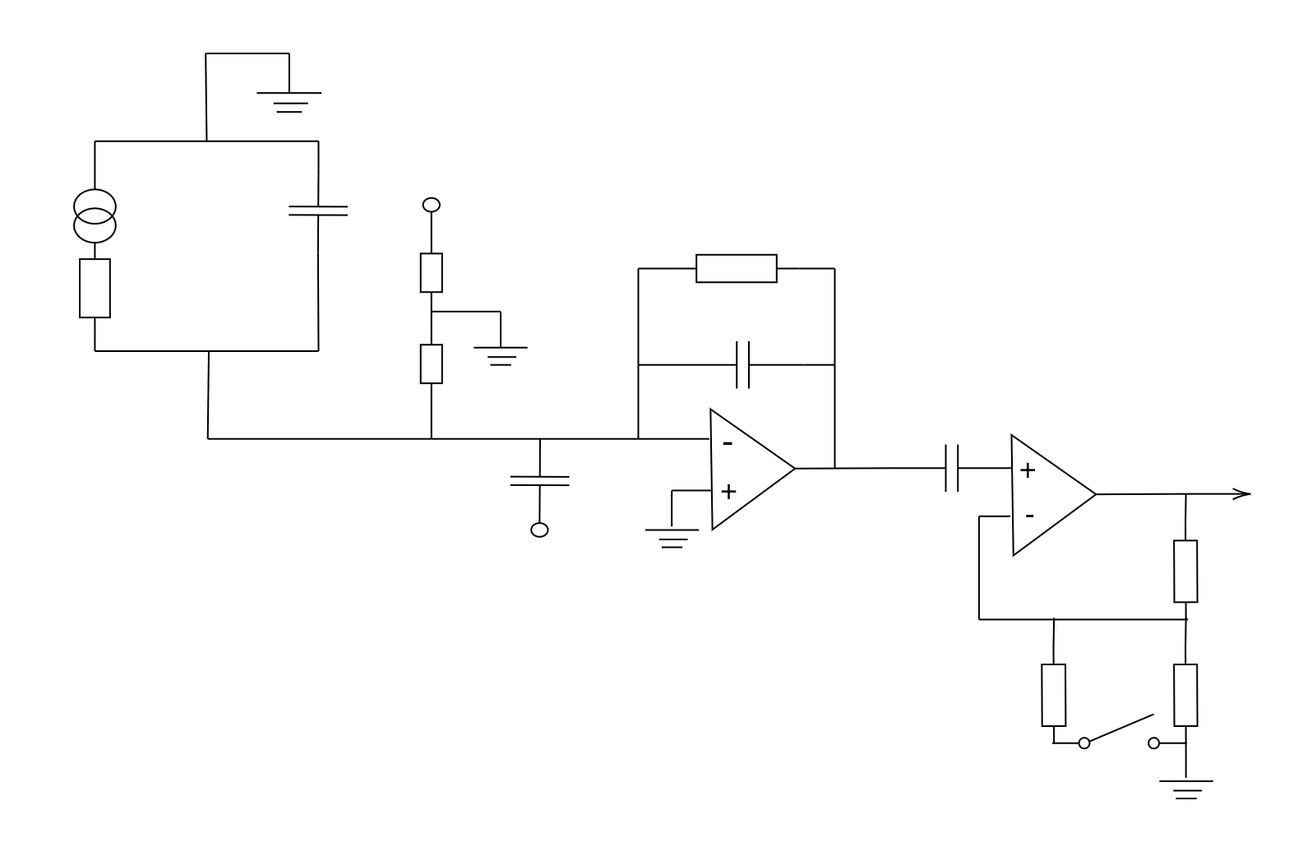
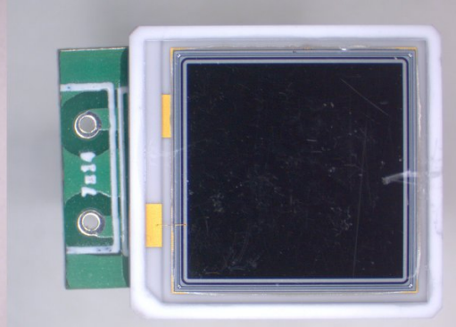
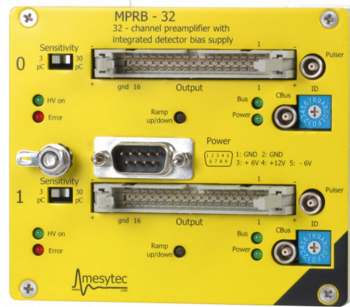
Introduction
HVAPD
Integrator stage
L(t)
CAPD
HVAPD
Rf
RAPD
Cf
Gain stage
CP
Vout
Pulser
R1
L(t)≡ f(Nγ ⋅ cTransp. ⋅ cAbsorp. ⋅ ϵAPD ⋅ gAPD )
R3
R2
Need to calibrate:
S

Slide 5
Calibration overview
4 hrs
40 min
2 min
data.lmd
(90 GB)
unpacked.root
(60 GB)
spectra.root
(60 MB)
QC-CALIFA.root
(30 MB)
Key advantages:
Unpacking, writing spectra done only once !
Calibration takes just 2 min.

Slide 6
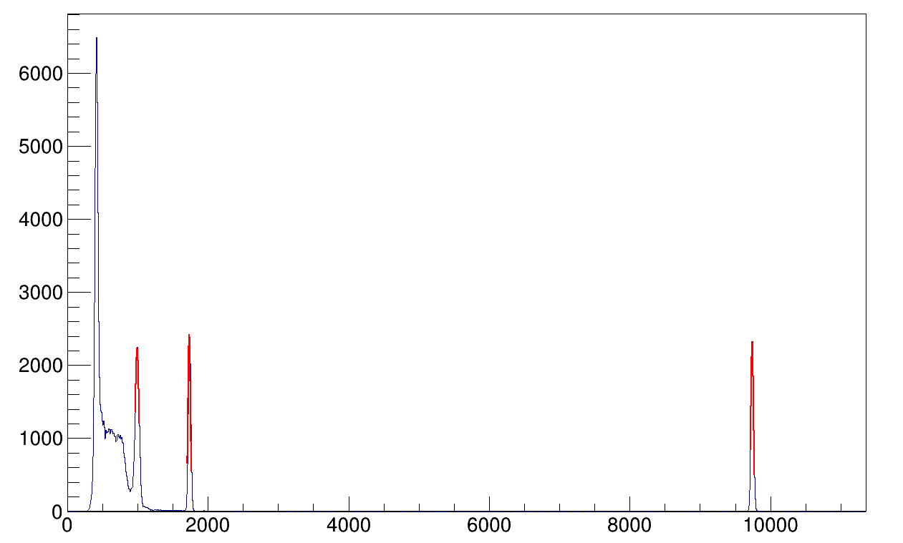
Calibration overview
Unpacking
Calibration macro
Run bash script
(bash_pulser_calibration.sh)
Unpack
using
UCESB
reader
data.lmd
unpacked_gamma.root
unpacked_proton.root
read all events
and fill
Source region
Pulser region
spectra_gamma.root
spectra_proton.root
(5088 1D histograms)
Mean, Sigma, Events
for each histogram
find peaks
Gauss fit each peak
Peak parameters:
number and region for
source and pulser peaks
Fit parameters:
Expected width

Slide 7
Calibration macro
Results
Fit function:
y = c0 + mx
Fit function:
y = c + mx
Write to .par file
For single peak fit/ gain match
For multiple peak fit
QC-CALIFA.root
With 2D histograms of calibrated energy, slope, offset, range factor …
calib.par
With calibration parameters : slope and offset
Source
energies
Gamma gain fit
Slopegamma, offsetgamma
Range factor
Gamma pulser peak positions
Slopeproton, offsetproton
Mean value (σ) of
all peaks
Proton gain fit
Write to .par file
Fit function:
y = c + mx
data.lmd
(90 GB)
4 hrs
unpacked.root
(60 GB)
40 min
2 min
QC-CALIFA.root
(30 MB)
spectra.root
(60 MB)

Slide 8
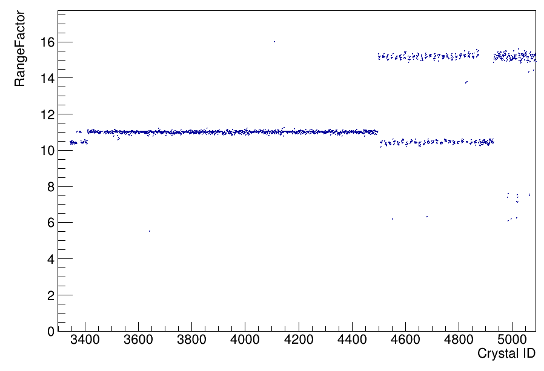
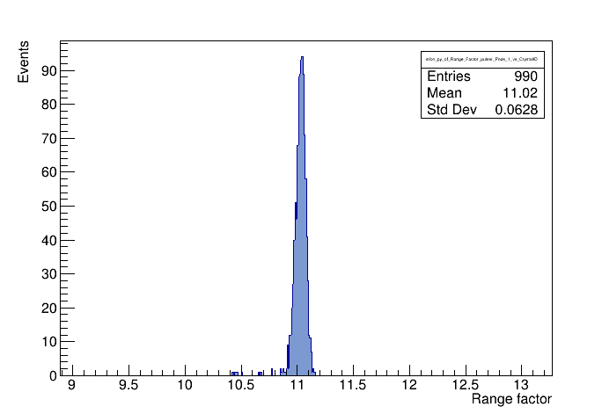
Range factor
3/45 pC
3/45 pC
Back barrel
(single range)
3/30 pC
CEPA
(dual
range)
3/30 pC
3/30 pC
Barrel
(single range)
Tolerance (σ/μ)
= 6 ‰
iPhos
(dual range)
Quality of resistors
in the gain stage
R=Eγ (uncalib.)/Ep (uncalib.) ≈ 11
Serves as a translation factor between
gamma range and proton range

Slide 9
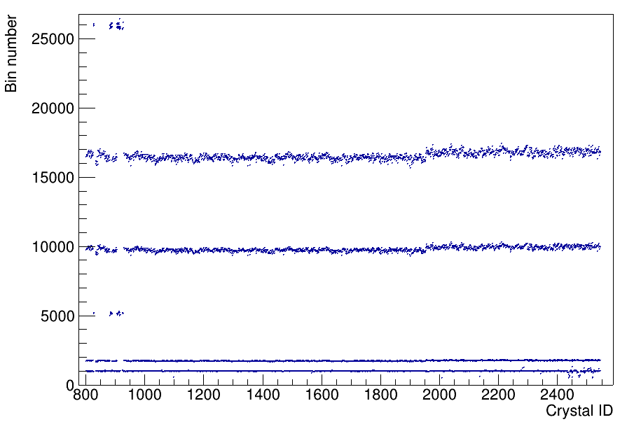
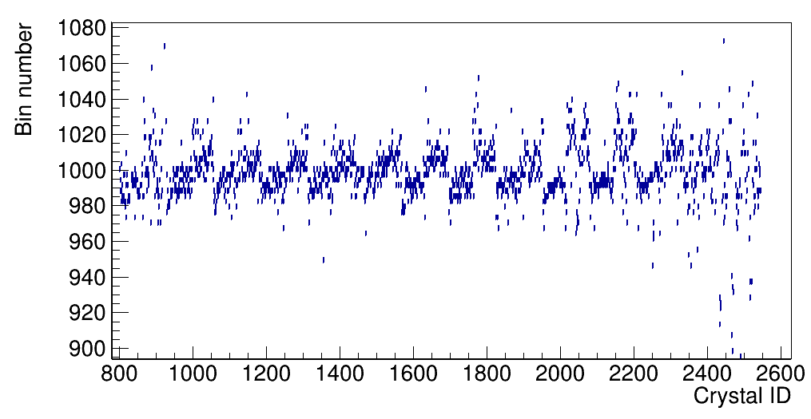
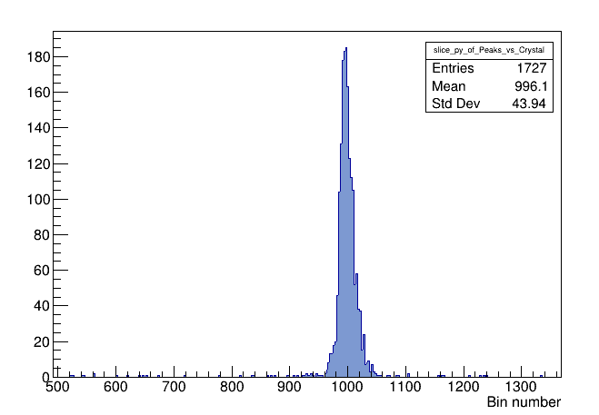
Gamma range: uncalibrated spectra
²²Na – 1275 keV peak
Back barrel
Barrel
iPhos
CEPA
Gain matched channels
²²Na – 1275 keV peak
σ/μ = 4%

Slide 10
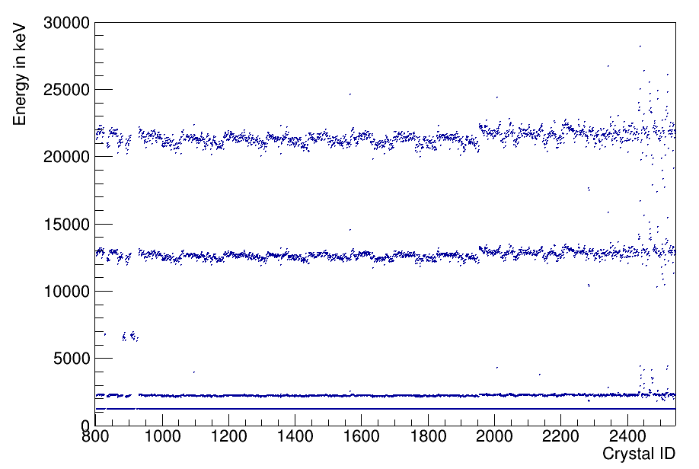
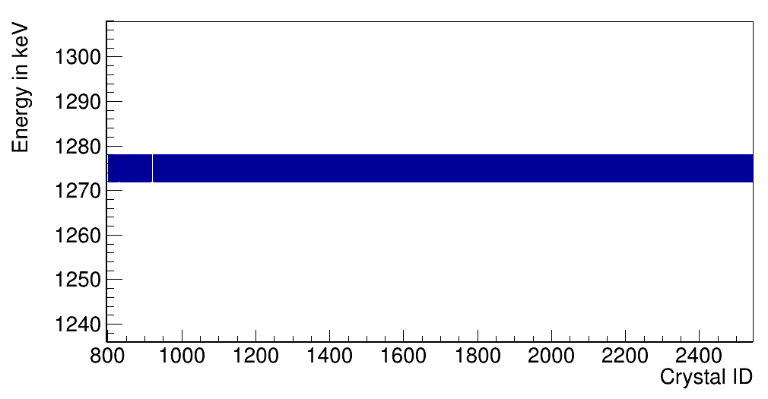
Gamma range: calibrated spectra
CEPA
²²Na – 1275 keV peak
Back barrel
Barrel
iPhos
Applying a linear fit: y=mγ x+cγ
Software works !
Now we also have pulser peaks in keV

Slide 11
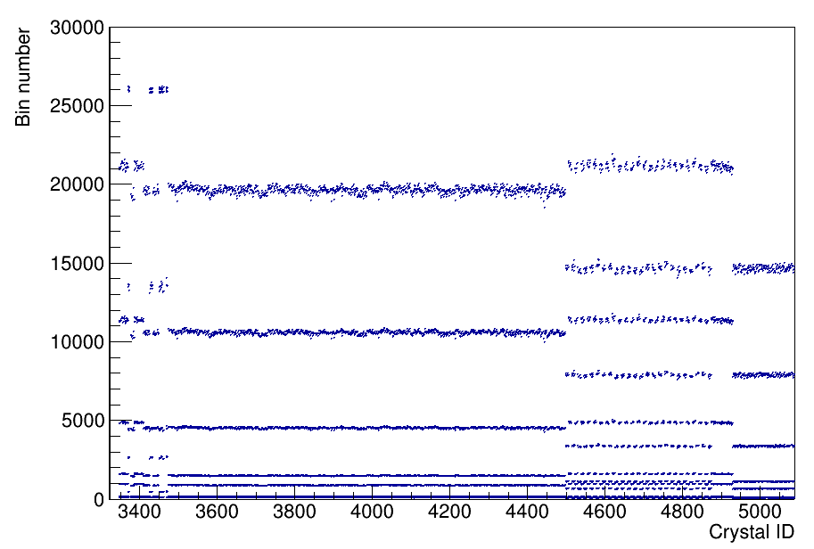
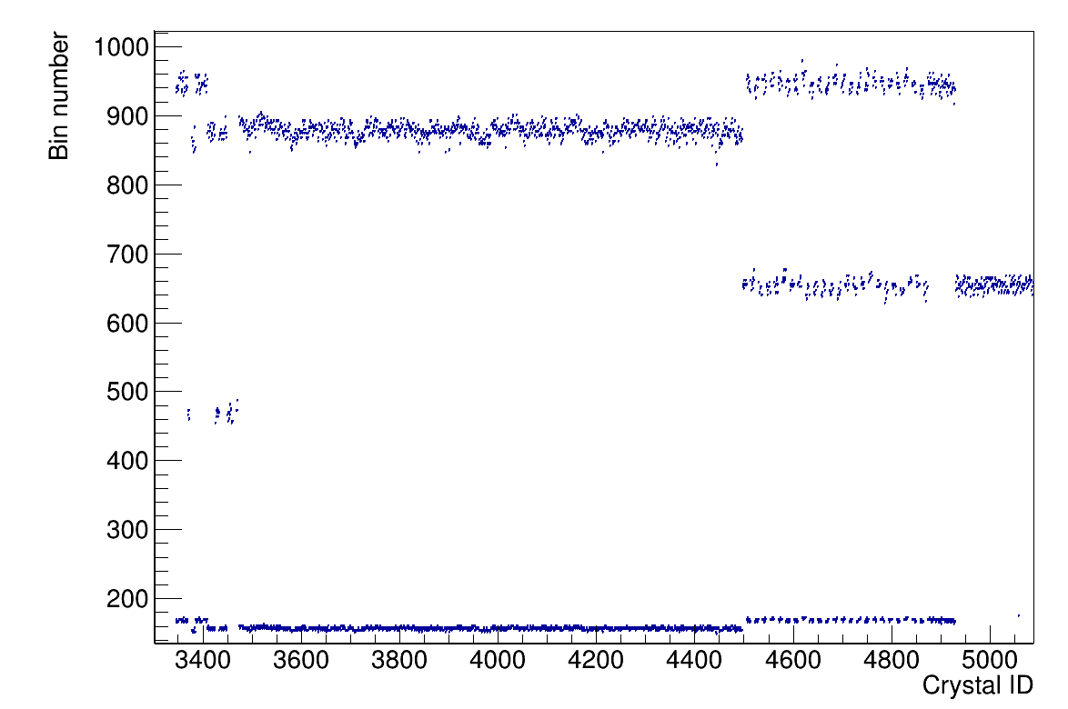
Proton range: uncalibrated spectra
Back barrel
Barrel
iPhos
CEPA
There are (channel to channel) variations in the electronics

Slide 12
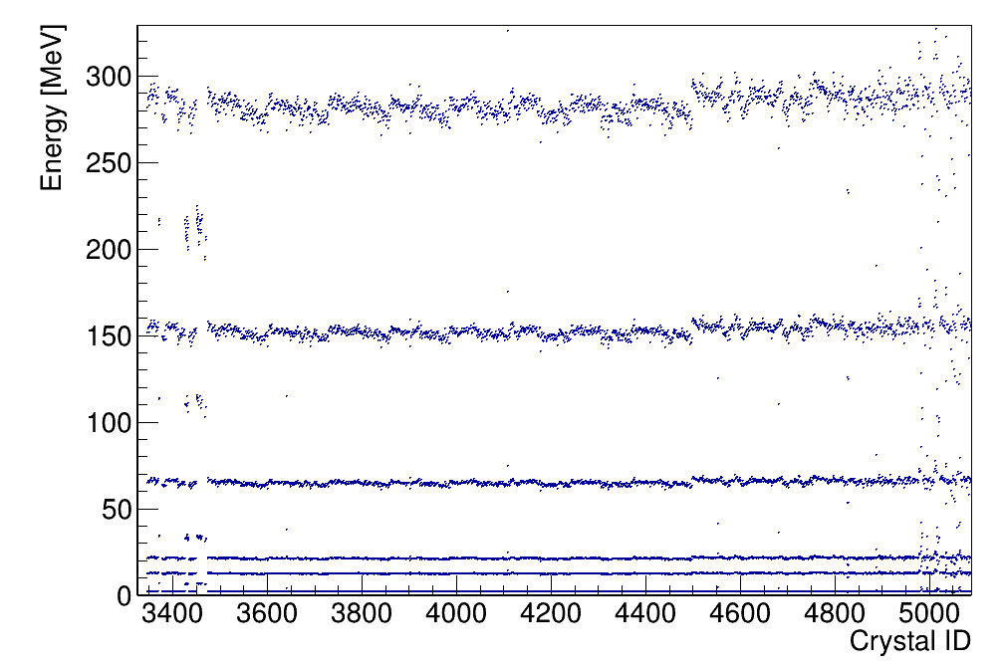
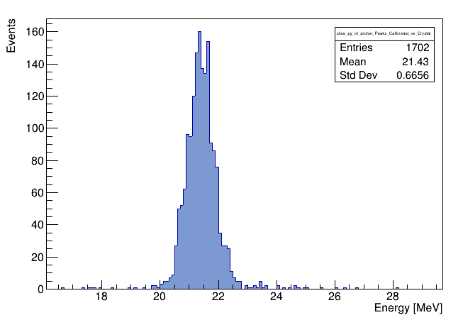
Calibration in proton range
Back
barrel
CEPA
Barrel
iPhos
σ/μ = 3%
Energies for first 3 pulsers obtained from gamma calibration
Then doing a linear fit : y=mpx+cp ⇒ All pulser energies in keV
Variation in pulsers include all uncertainities (depending on L(t), R and Cpulser)

Slide 13
Circuit diagram
HVAPD
Integrator stage
L(t)
CAPD
HVAPD
Rf
RAPD
Cf
Gain stage
CP
Vout
Pulser
R1
L(t)≡ f(Nγ ⋅ cTransp. ⋅ cAbsorp. ⋅ ϵAPD ⋅ gAPD )
R3
R2
S

Slide 14
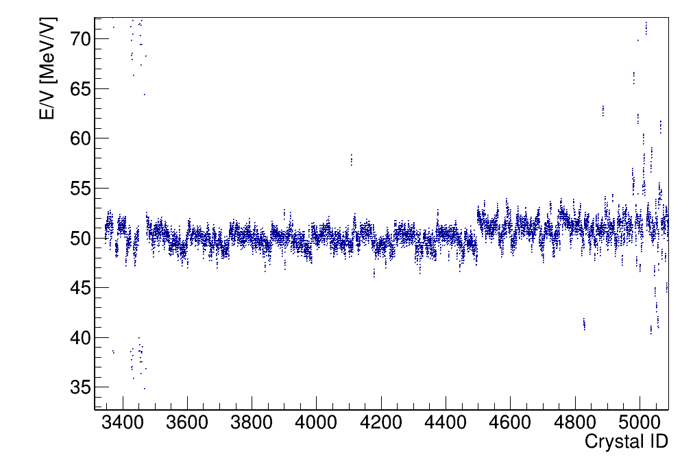
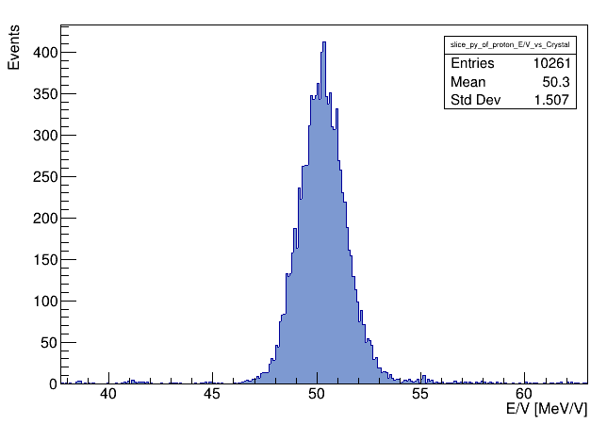
Pulser capacitance
σ/μ = 3%
Variation in E/V for the pulsers again include all uncertainities (L(t), R and Cpulser)

Slide 15
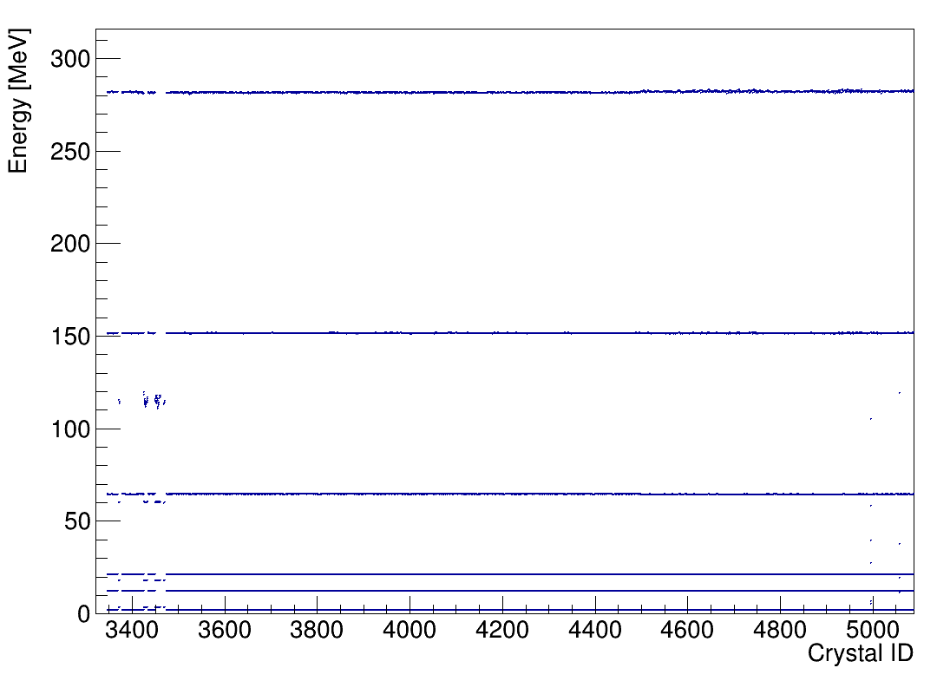
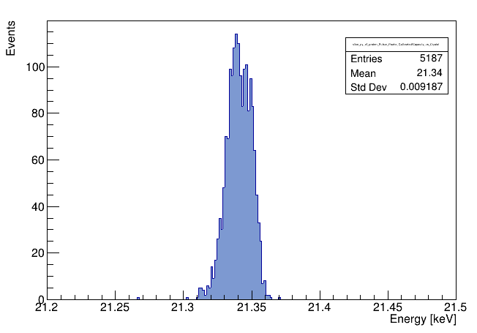
Proton range: calibrated spectra
Back barrel
Barrel
iPhos
CEPA
σ/μ = 0.4 ‰
Software works !

Slide 16
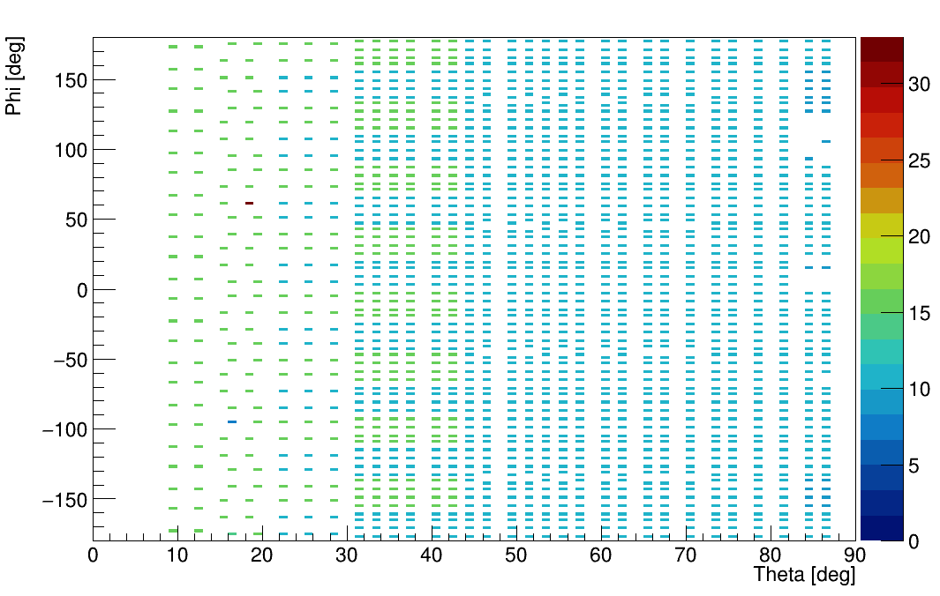
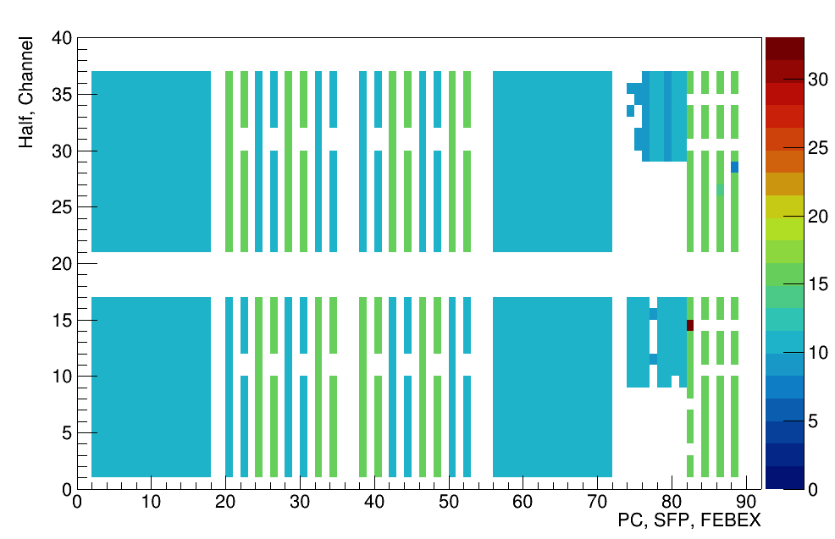
QC Plots
CEPA
iPhos
Barrel
Back
barrel
Barrel
iPhos
Barrel
CEPA
WIX
MES
PC 0
PC 1
Quality Assessment Plot
DAQ Plot (Hardware level)

Slide 17
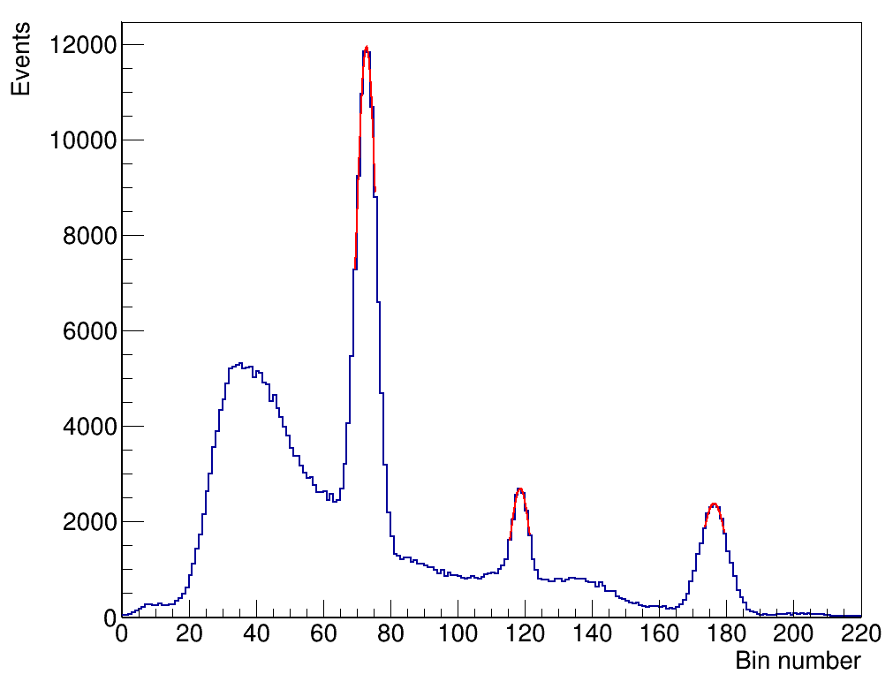
QC Plots
Back
barrel
Barrel
iPhos
Barrel
CEPA
511 keV
WIX
P1
1275 keV
MES
PC 0
Spectrum for bad channel
(incorrect gain matching)
PC 1
DAQ Plot

Slide 18



Thank You !
CALIFA @ Technical University of Munich
Roman Gernhäuser,Philipp Klenze,Tobias Jenegger, Mrunmoy Jena

Slide 19
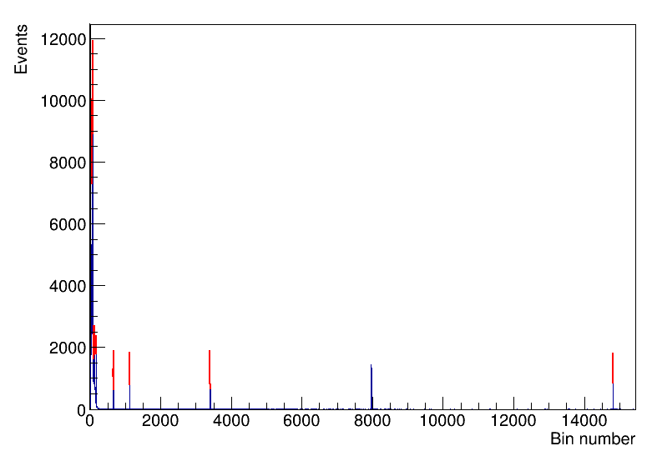
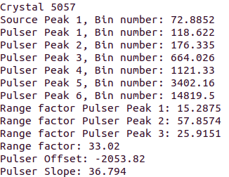
Extras: Bad channel
Crystal ID: 5057, in CEPA

Slide 20
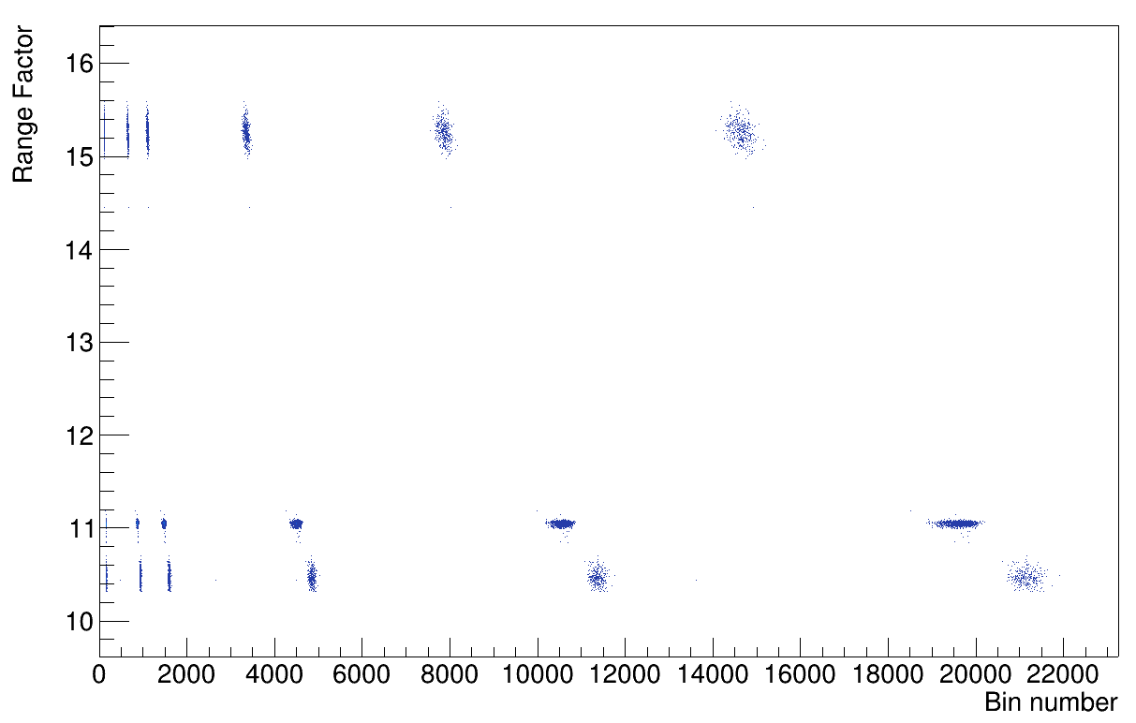
Extras: Range factor vs bin number

