Slide 1







A full range calibration for CALIFA
Mrunmoy Jena
R3B Week November 2024
Overview and structure of macro
Calibration in the gamma range
Extrapolation to proton range
Supported by BMBF 05P15WOFNA and 05P19WOFN1
Physics with R³B
CALIFA – Design
TUM Members:
Roman Gernhäuser,Philipp Klenze,Tobias Jenegger, Mrunmoy Jena

Slide 2
Calibration macro: Overview
If spectra.root files exist
Unpack using UCESB reader
unpacked_gamma.root,
unpacked_proton.root
spectra_gamma.root,
spectra_proton.root
(5088 1D hists each)
Use 1D hists from spectra.root
Find all peaks, Gauss fit each peak
.lmd files
~ 4.2 hrs
~ 40 min
90 files, 90 GB
60.8 GB
62.2 MB
Fit: y = mγx+cγ to Na-22 source peaks
Obtain (mγ,cγ)
Calibrate source + 3 pulsers {P1,P2,P3} with (mγ,cγ)
Write (mγ,cγ) to calib.par file
Advantages: automation, peak finding proceeds quickly
Gamma range
Fit: y = mpx+cp to pulsers {P1,P2,P3}
Obtain (mp,cp)
Calibrate all pulsers {P1...P6} with (mp,cp)
Write (mp,cp) to calib.par file
Proton range
~ 2 min
calibrated.root file
With 2D hists of calibrated energy, slope, offset,
rannge factor ...v/s crysID
36.5 MB

Slide 3
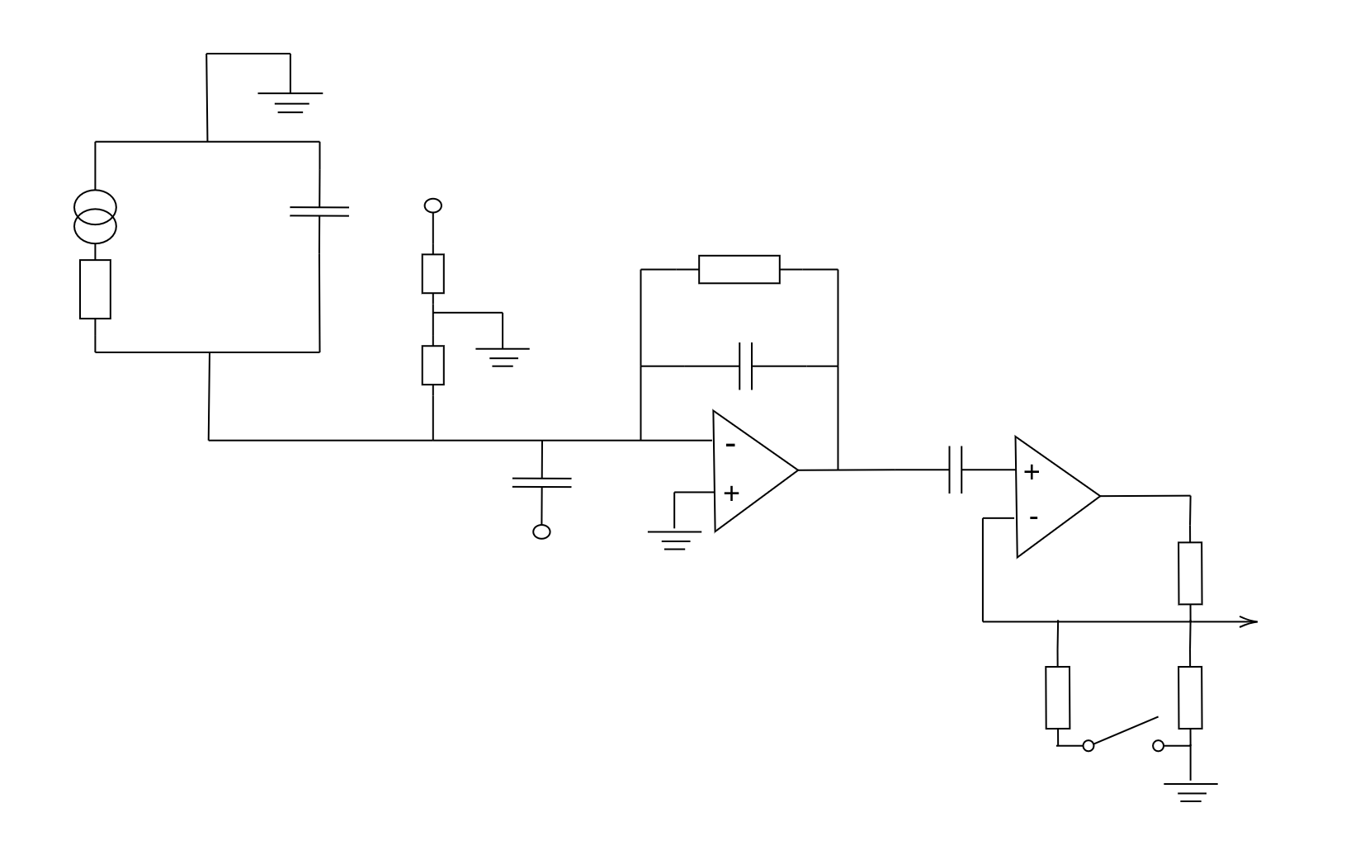
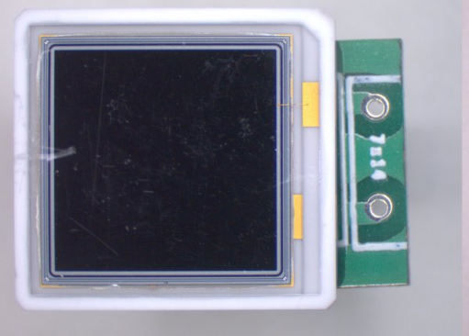
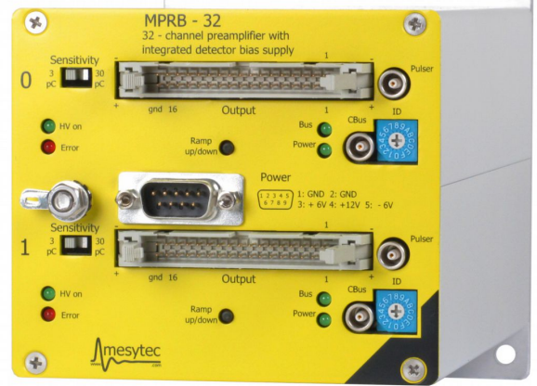
HV
Pre-amp stage
L(t)
CAPD
Rf
RAPD
Cf
Gain stage
CP
Pulser
R1
Brief discussion on working of APD, Preamp
APD: IAPD=g x Sensitivity x Pin
APD+pre-amp stage : VPre = Q/Cf = integral (IAPD(t))/Cf
For Na source, APD+pre-amp+gain stage: Vout,i = integral (IAPD(t))/Cf x R2/(R2+R1)
For pulser +pre-amp+gain stage: Vout,i =(CPVP)/Cf x R2/(R2+R1)
i: i th channel or crystalID
Vout
R2,low
R2,high
S

Slide 4
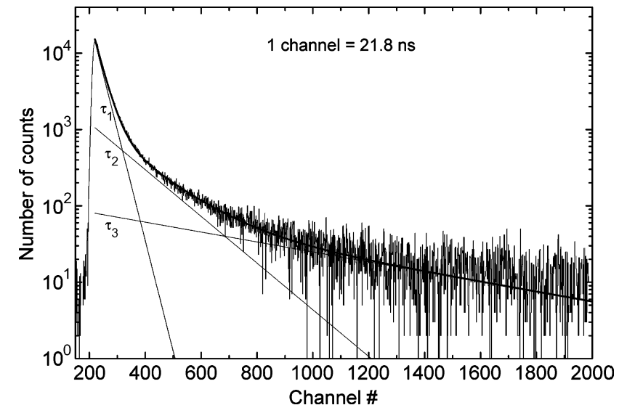
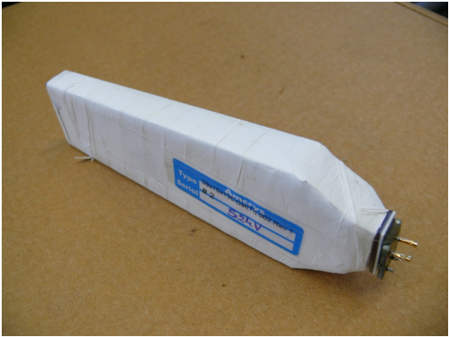
Interlude: Signal from CsI(Tl)
CsI(Tl) chosen because of several factors:
High light yield, Y ≈ 65000 photons/MeV
High density, ρ = 4.51 g/cm³ ⇒ Good stopping power over large range of Eγ
Two components, slow and fast for L(t) ⇒ PID
τf ≈ 600 ns, τs ≈ 3.4 μ s
*W. Klamra, N. Antoni, IEEE Trans. on Nucl. Science 55 (2008) 1246–1250.

Slide 5
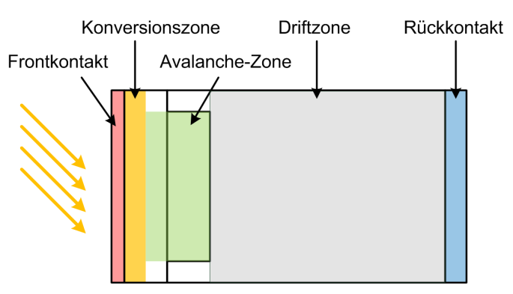
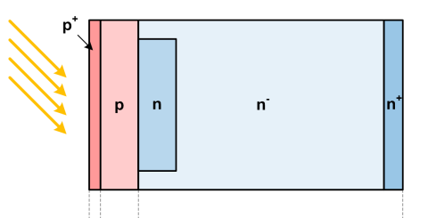
Interlude: Signal from APD
Working:
Conventional photodiode: Photons, e-h pair creation, separation by applied voltage, generate Iph ∝ Eγ
APDs: use avalanche effect, under high reverse bias undergo impact ionisation, create add. charge carriers ⇒ Internal charge amplification

Slide 6
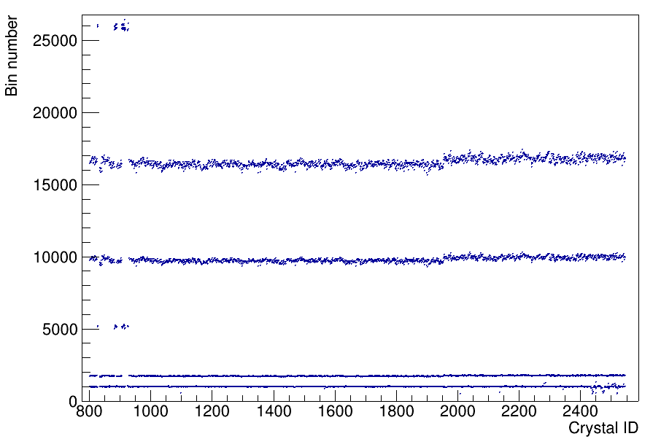
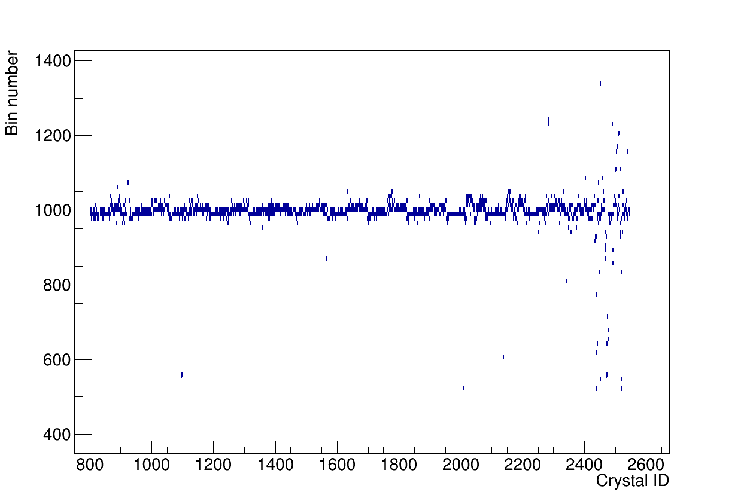
Gamma range: uncalibrated spectra
Back barrel
Barrel
iPhos
CEPA
Here, both Na-22 spectrum and pulser have channel to channel variation
Na-22 : 1275 keV peak zoomed in on right plot

Slide 7
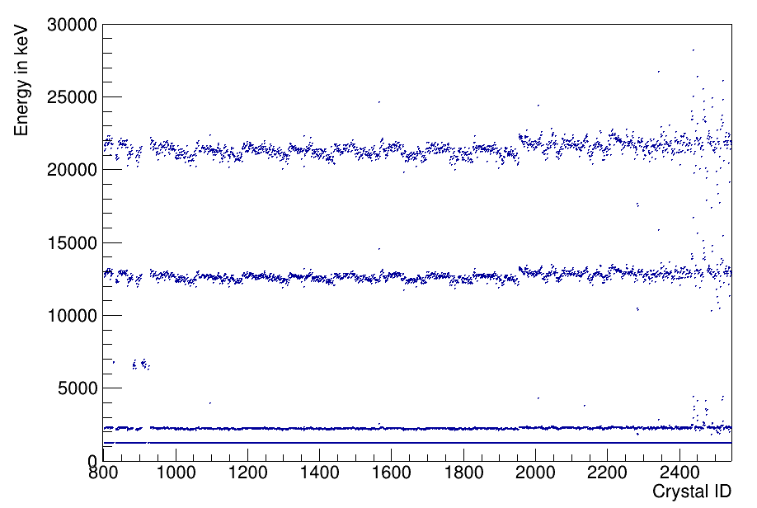
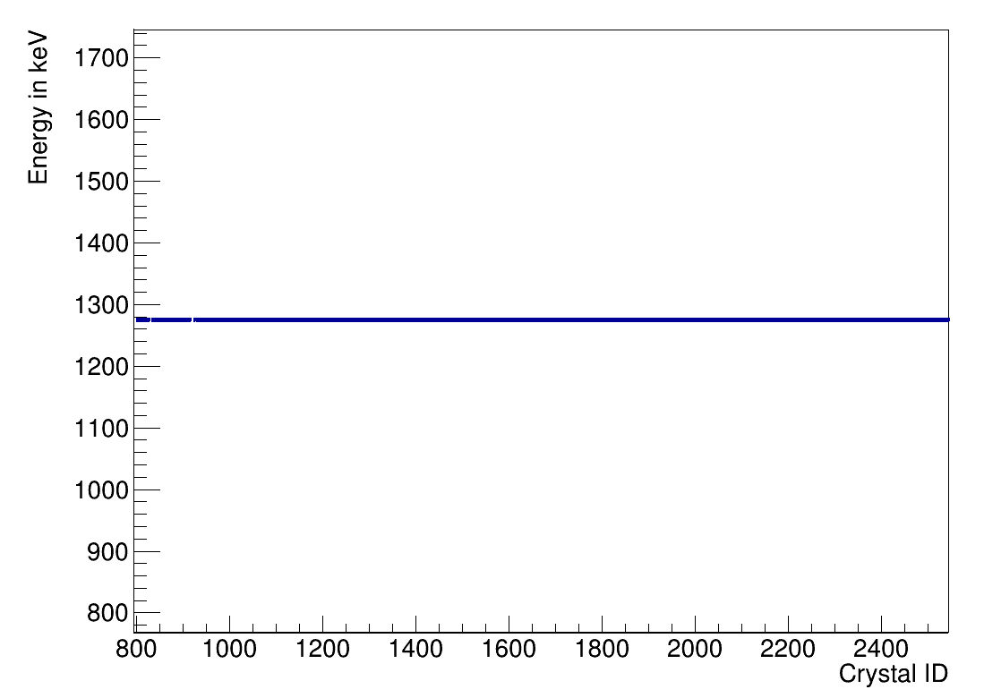
Gamma range: calibrated spectra
CEPA
Back barrel
Barrel
iPhos
Source peak is calibrated, but staggering in pulser peaks
So, effect of ch-to-ch variation for APD+pre-amp stages accounted for ? (in case of Na-22)
Pulser peaks: effect of ch-to-ch variation for pulser (CP) still there ?
Finding CP,i : divide bin nr. of pulser by (known) voltage ? (bin nr. proportional to Q = CV)
Where to use CP,i in the calibration ?

Slide 8
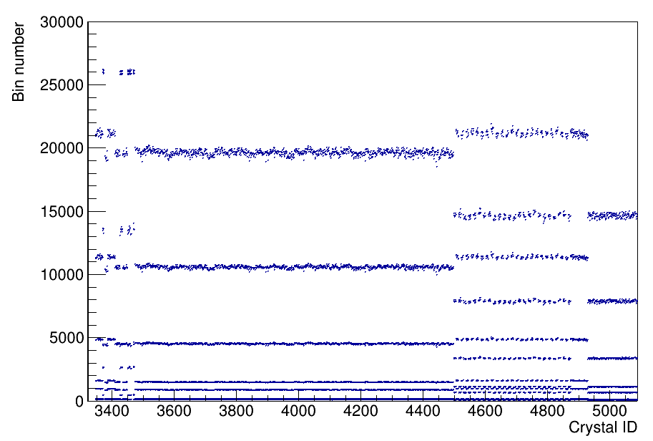
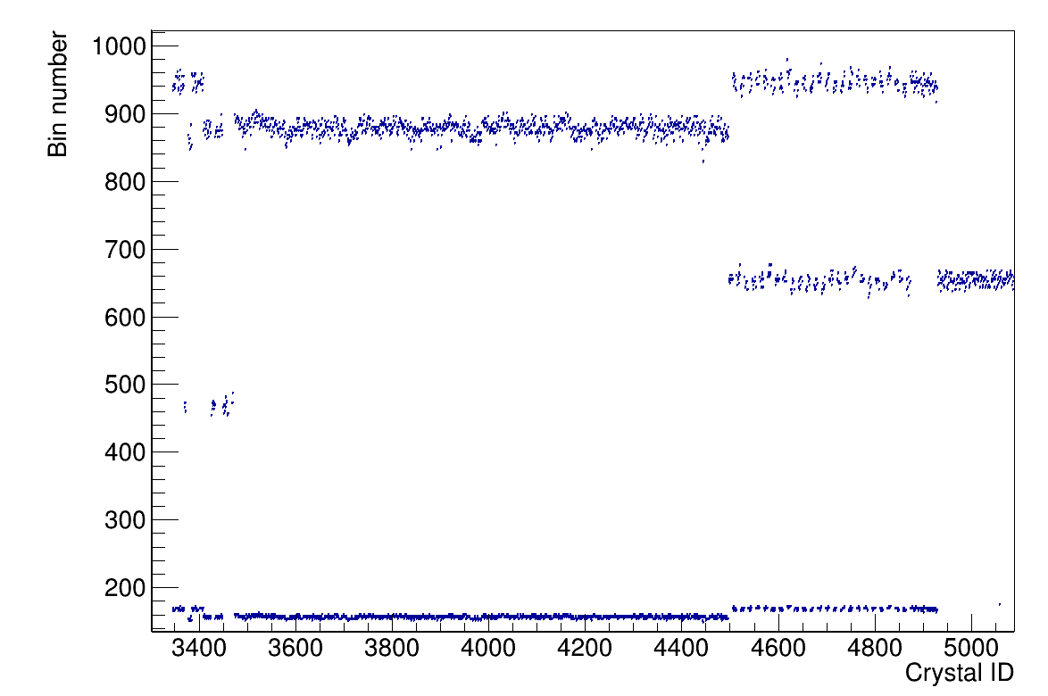
Proton range: uncalibrated spectra
Back barrel
Barrel
iPhos
CEPA

Slide 9
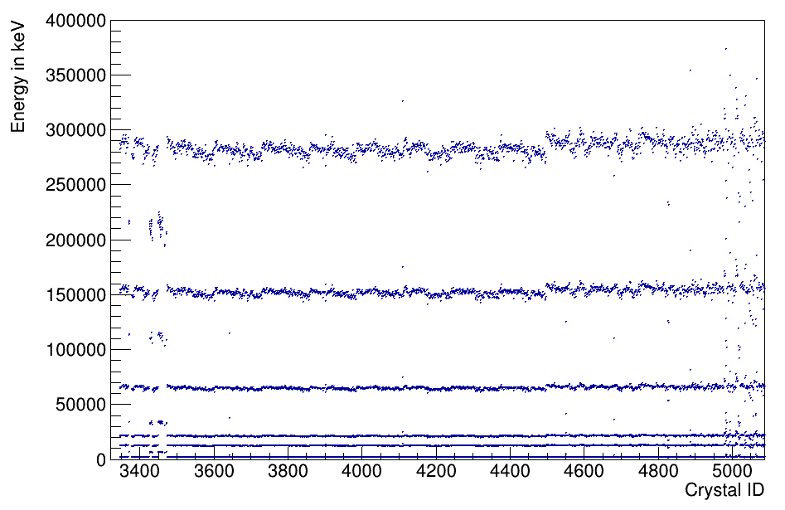
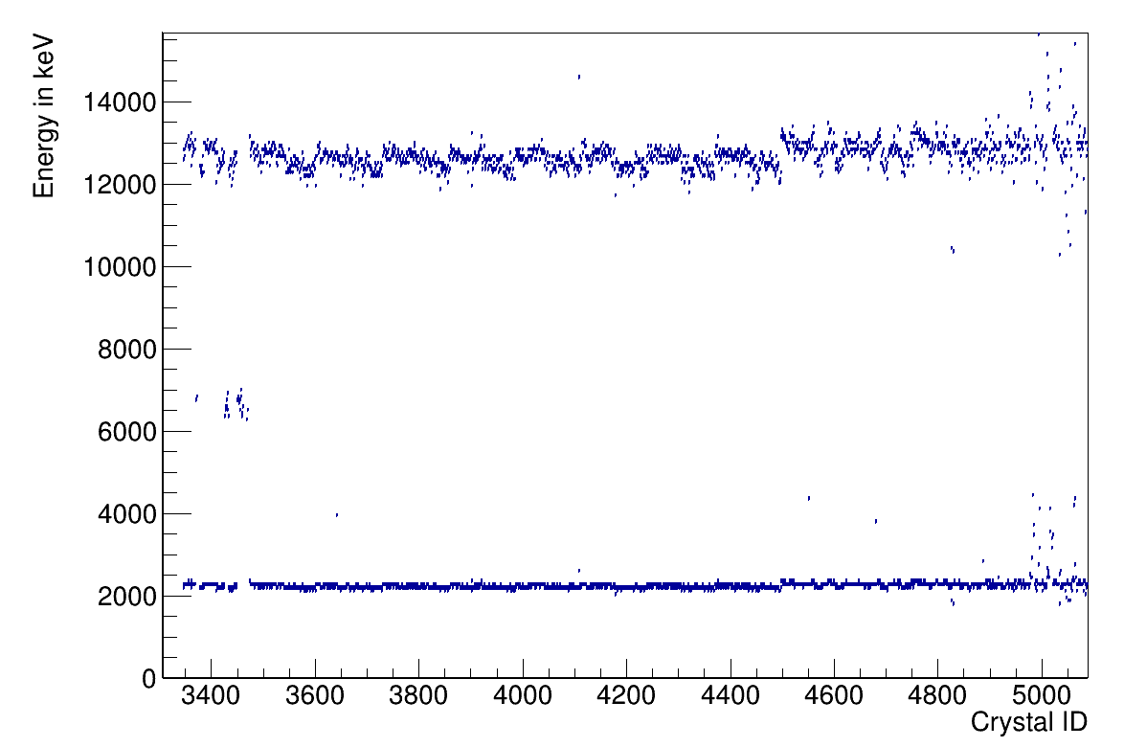
Proton range: calibrated spectra
Back barrel
Barrel
iPhos
CEPA
Final step to correct staggering, divide by CP,i ?

Slide 10
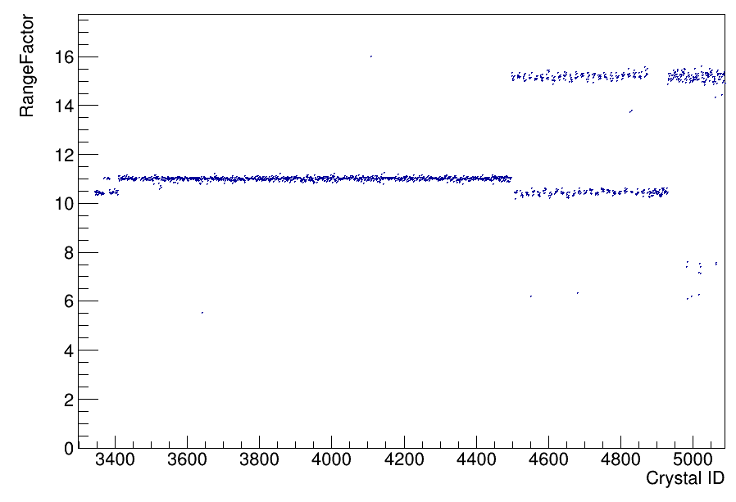
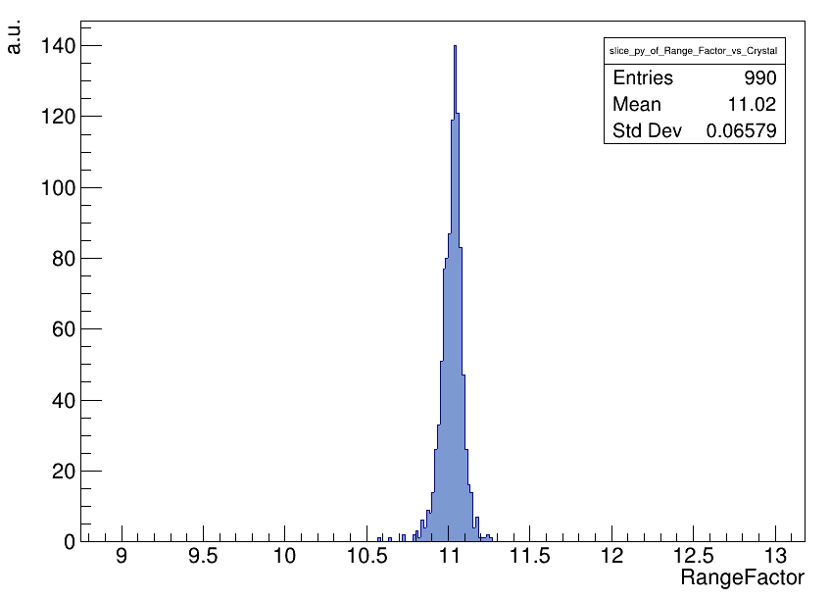
Range factor
T ≈ 0.07/11 ≈ 6 permille
R=Ep (uncalib.)/Eγ (uncalib.) ≈ 11
Serves as a translation factor b/w gamma and proton range ?
i.e. if Egamma=mx+c is determined in gamma range
Can do Ep=R(mx)+c to get calib. pars in proton range ?
So, calibration can now be extended to full range

