Slide 1
pDR1500_Web Portal

Slide 2
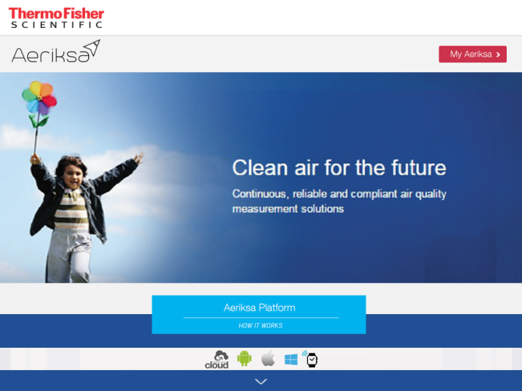
Home Page
Takes to Log-in page
Scroll to know more about Product
Home Page is something which appears as soon as the user opens website.

Slide 3
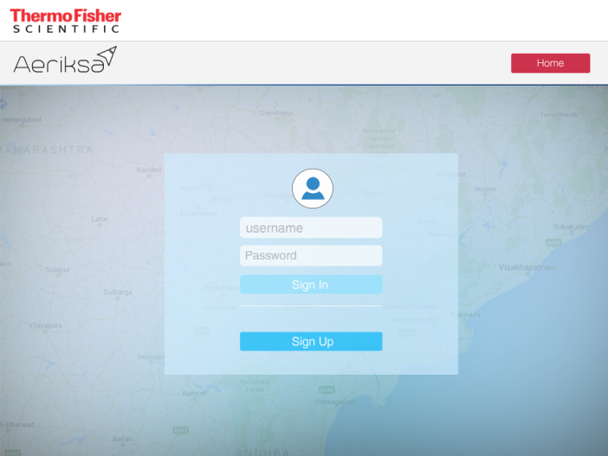
Login Page
Takes to Home page
Takes to Main Screen (Dashboard)
Login page for User to access data, Unless until sign-in , User cannot access data.

Slide 4
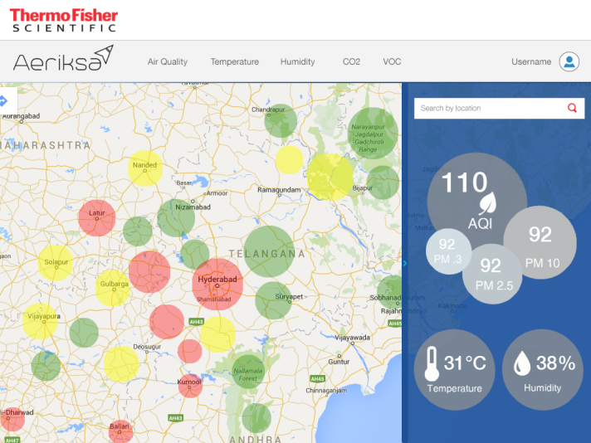
Main Page
Tabs for detailed data of each entity
User profile
Search option for other location
Map shows
AQI status
Main page shows all the data about Air quality, Temperature, humidity and other entities.

Slide 5
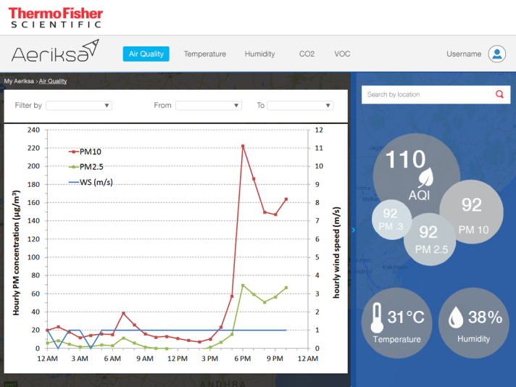
Air Quality Page
Filters ( Hours,
Date, Month)
for historical data
Slide for full graph view
When user clicks Air quality tab, this page shows all the data about Air quality

Slide 6
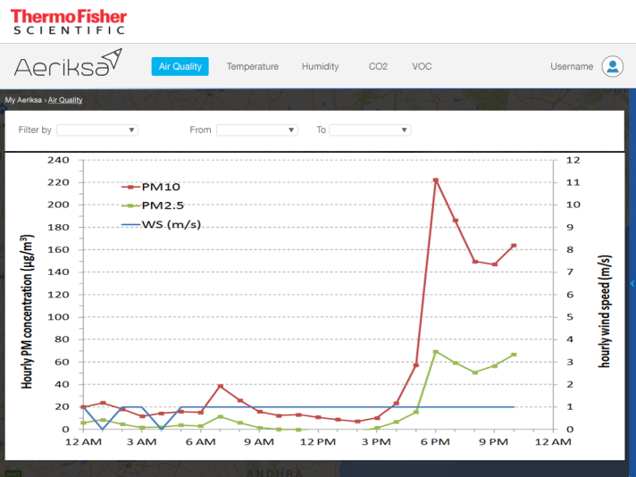
Air Quality Page
Takes back to Main page
Filters for historical data
When user clicks slide, page shows fill view of graph

Slide 7



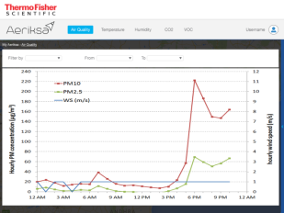

Overview
1
2
49
62
533
347
34
67
34
34
34
49
533
62
3
347
34
67
5
4
All screens for representation purpose only. Detailing need to be done.

