Slide 1
pDR1500_ Aeriksa screens

Slide 2
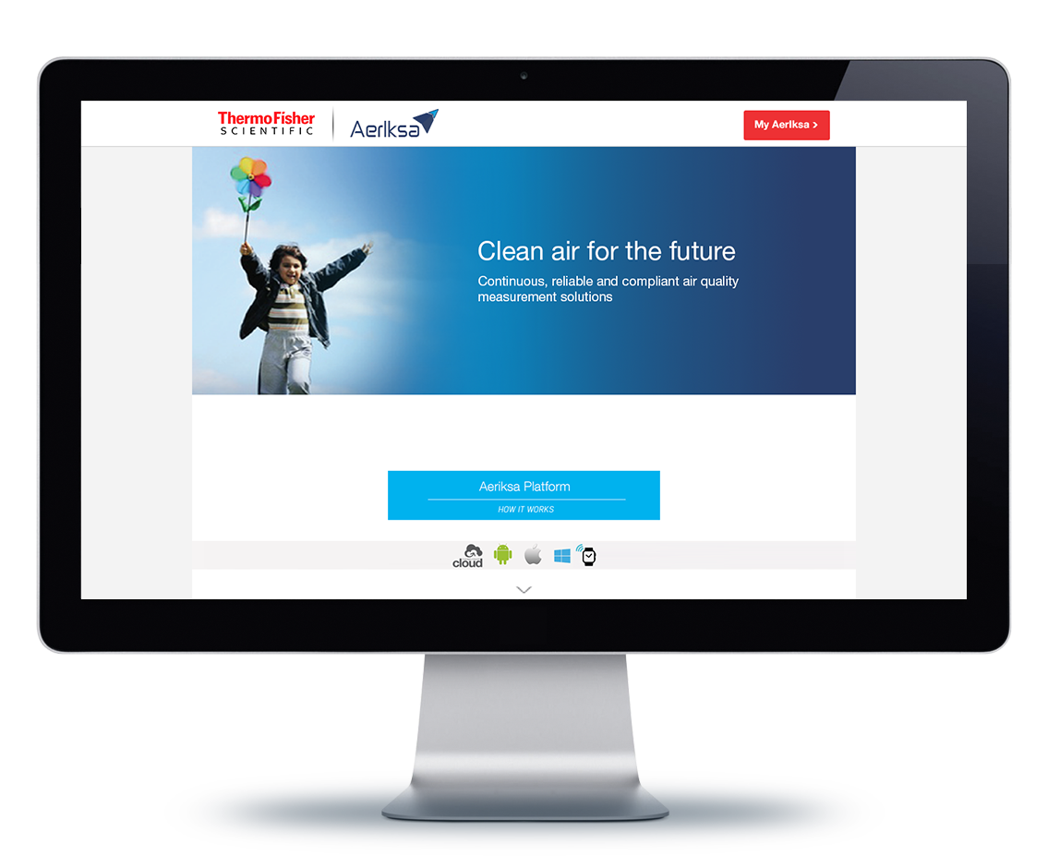
Web Screens
Home page
Thermofisher Scientific Logo
Width : 180px
Height : 40px
Top Margin : 16px
Bottom Margin : 14px
#ffffff
My Aeriksa - Button
Background color : #ee3134
Border: 1 pixel wide and #dd1f25
Hover:
Border : #dd1f25
Background Color : #dd1f25
Typography: #ffffff
Font: 16px, bold
Button Height: 46 px
Left/Right padding: 19 px
Top/bottom padding: 11 px
#f3f3f3
#009EDB
General Typography
Font family Helvetica Neue
Font size 13px
Line height 22px
Letter spacing 1em
Color #333333c

Slide 3
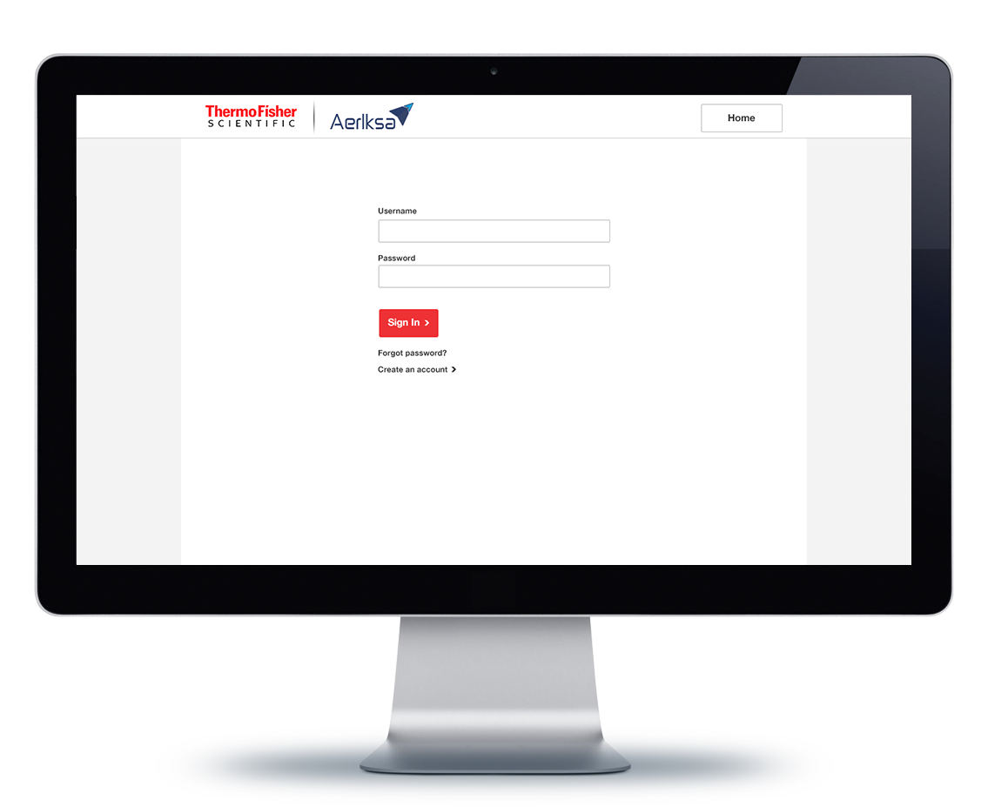
Thermofisher Scientific Logo
Width : 180px
Height : 40px
Top Margin : 16px
Bottom Margin : 14px
#ffffff
Home- Button
Background color: #ffffff
Border: 1 pixel wide and #616265
Typography: 16px, bold and #333333
Button Height: 46 px
Left/Right padding: 19 px
Top/bottom padding: 11 px
Hover:
Border : #333333
Background Color : #f3f3f3
Standard input field:
Field Height: 37 px
Left/Right padding: 6 px
Top/bottom padding: 8 px
Input box shadow: inset,
1px horizontal/vertical,
rgba(0, 0, 0, 0.075)
Text area
Left/Right padding: 6 px
Top/bottom padding: 8 px
Input/text area focus
Border color: #73b8ee
Glow effect: 5 px #73b8ee
Input with error
Border color: #ee3134
#f3f3f3
SignIn- Button
Background color : #ee3134
Border: 1 pixel wide and #dd1f25
Hover:
Border : #dd1f25
Background Color : #dd1f25
Typography: #ffffff
Font: 16px, bold
Button Height: 46 px
Left/Right padding: 19 px
Top/bottom padding: 11 px
General Typography
Font family Helvetica Neue
Font size 13px
Line height 22px
Letter spacing 1em
Color #333333c

Slide 4
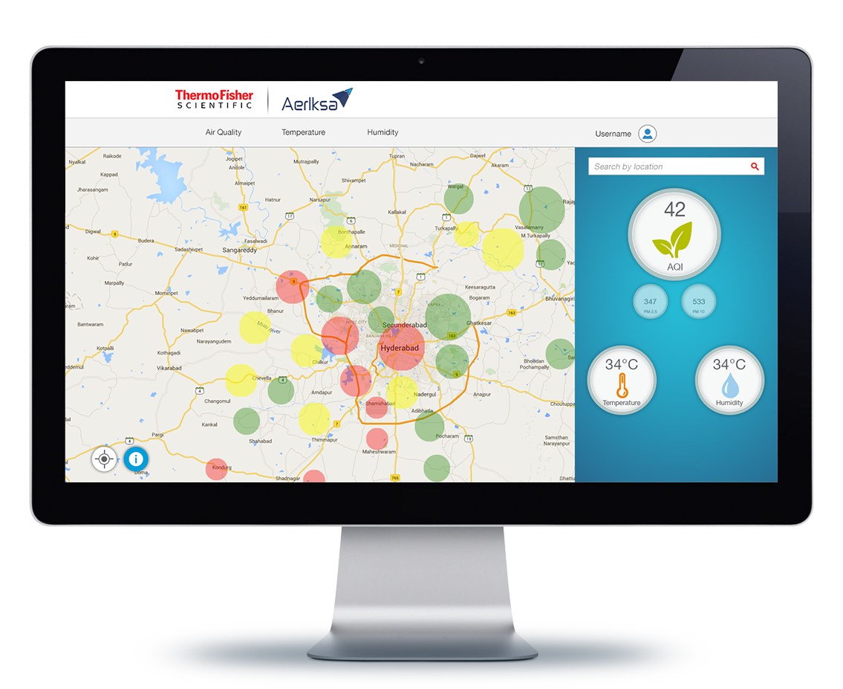
Air Quality, Temp, Humidity & Username
Font family Helvetica Neue
Font size 18px
Line height 22px
Letter spacing 1em
Color #333333c
Standard input field:
Field Height: 37 px
Left/Right padding: 6 px
Top/bottom padding: 8 px
Input box shadow: inset,
1px horizontal/vertical,
rgba(0, 0, 0, 0.075)
Text area
Left/Right padding: 6 px
Top/bottom padding: 8 px
Input/text area focus
Border color: #73b8ee
Glow effect: 5 px #73b8ee

