Slide 1
Digit classification on DIDA (10k) — Model comparison
Results, bias–variance tradeoff, and computational cost

Slide 2
Objectives
Goal: evaluate models for digit recognition (0–9)
Compare accuracy, bias/variance, and compute cost
Use unified preprocessing (resize → grayscale → flatten → standardize)

Slide 3
Data & Preprocessing
DIDA 10k (RGB, variable sizes) → resized to 28×28 → grayscale → flattened (784 features)
Standardized features (zero mean, unit variance)
Stratified train/val/test + k-fold CV

Slide 4
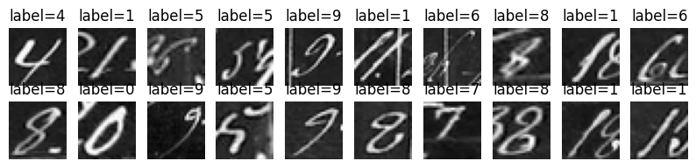
Sample Data

Slide 5
Methods Overview
Models: Direct Linear Regression, Linear (OVA), Logistic (SGD), GaussianNB, MLP (ReLU)
Metrics: Accuracy / Precision / Recall / F1 / Train time / CV mean & std

Slide 6
Direct Linear Regression
Test acc: 13.5% — unusable for classification
Very high bias, low variance, fast train time (~6 s)

Slide 7
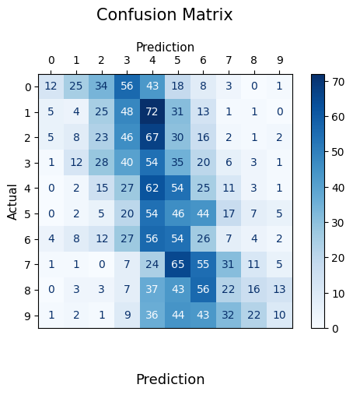

Slide 8
Linear Regression (OVA)
Train: 74.7% — Test: 72.85% (CV test ≈ 72.5% ± 0.77%)
Precision/F1 ≈ 73% — training time ~129 s
Strength: simple, interpretable; Limitation: linear boundaries

Slide 9
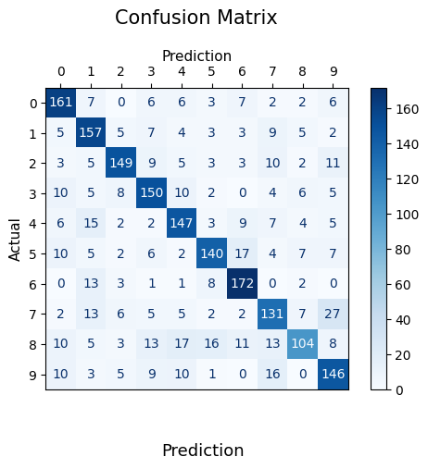
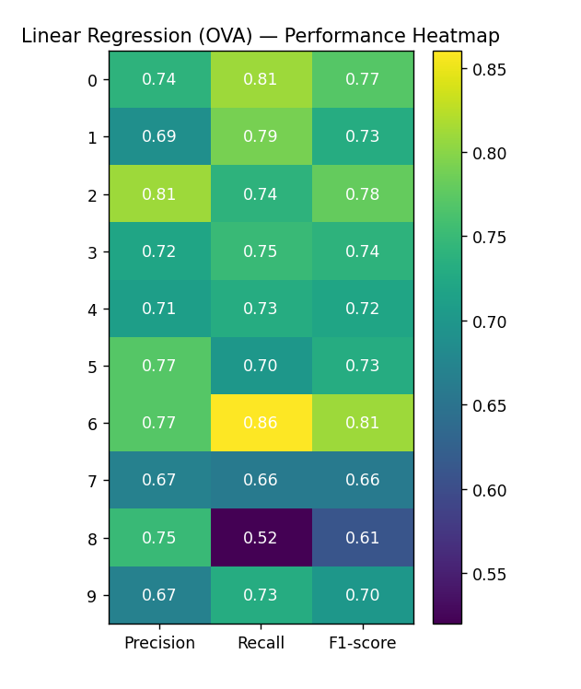

Slide 10
Logistic Regression (SGD)
Train: 80.8% — Test: 75.9% (CV test ≈ 75.1% ± 1.09%)
Macro F1 ≈ 75.8% — train time ~104 s
Discriminative (cross-entropy), better than OVA linear

Slide 11
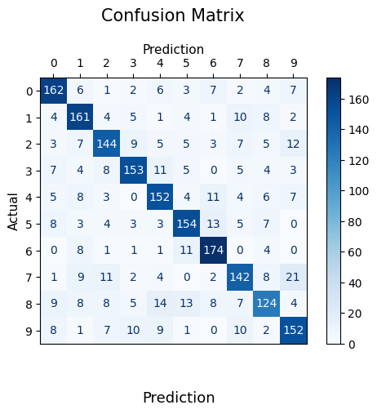
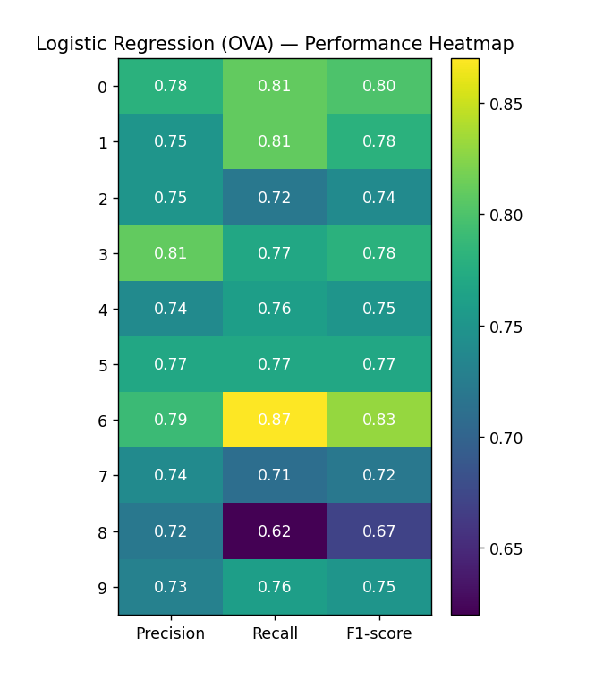

Slide 12
Gaussian Naive Bayes
Train: 53.05% — Test: 51.4% (CV test ≈ 51.2% ± 0.74%)
Very fast (~4.5 s) but low accuracy — independence assumption broken

Slide 13
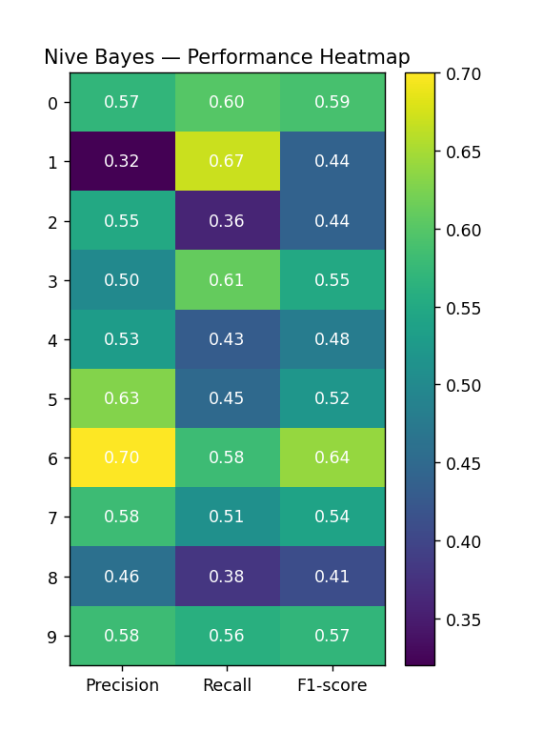
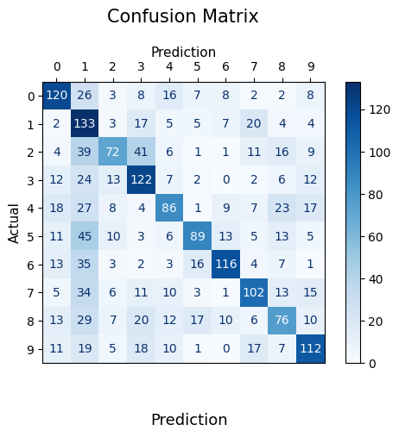

Slide 14
MLP (ReLU)
Best test accuracy: 89.1% (train 98.74%) — CV test ~87.2% ± 1.2%
Train time ≈ 1881 s — low bias, moderate variance (train–test gap ≈ 9–10%)
Configuration: ReLU, hidden=(512,256), SGD, lr_init=0.01, alpha=0.2, early stopping

Slide 15
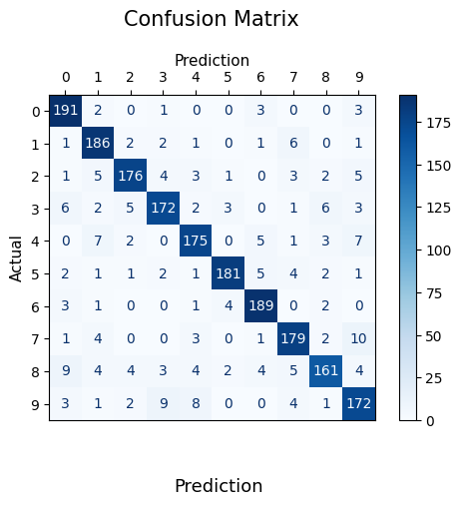
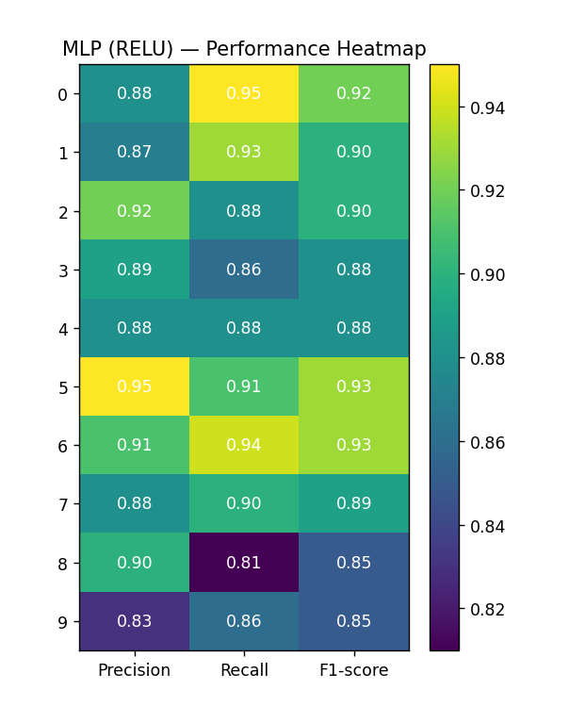

Slide 16
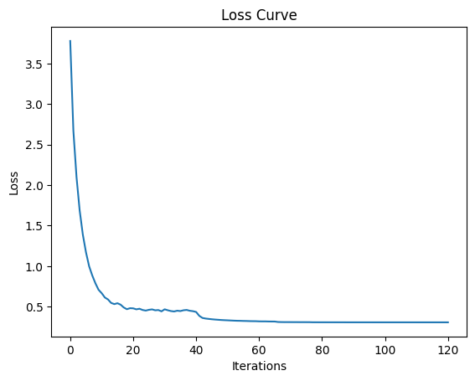
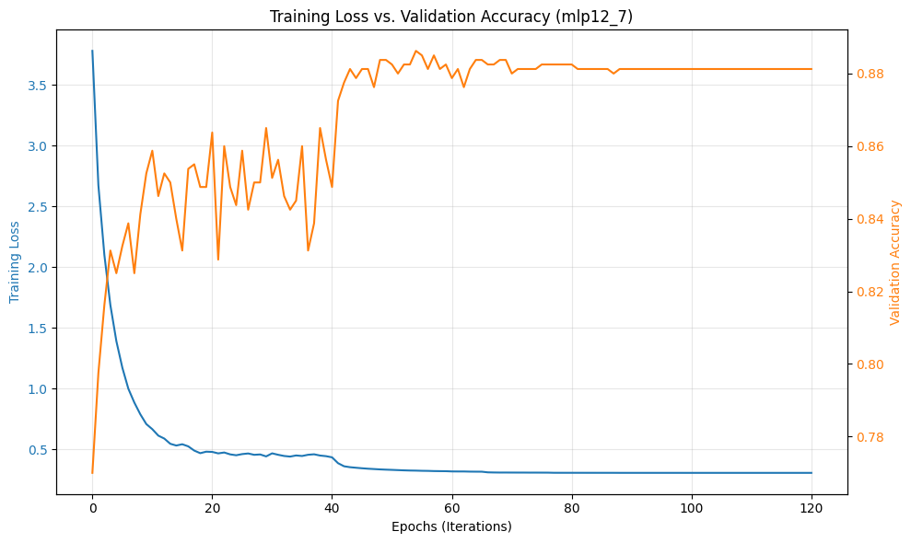
Comparative Charts & Bias–Variance MLP(ReLU)

Slide 17
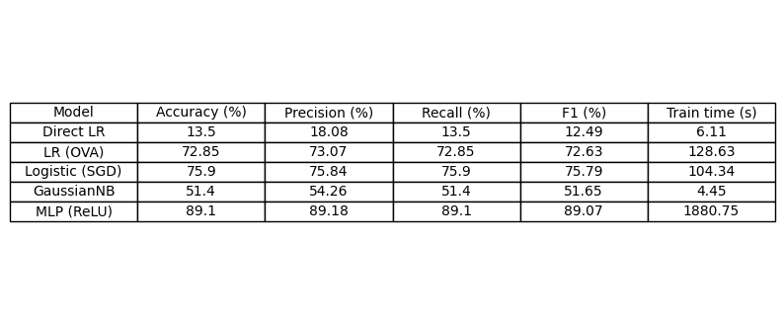
Summary of Results

Slide 18
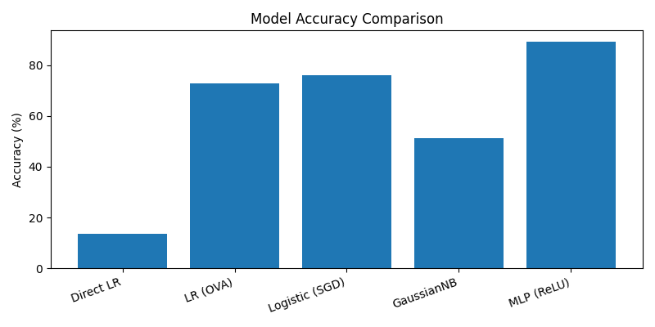
Accuracy Comparison

Slide 19
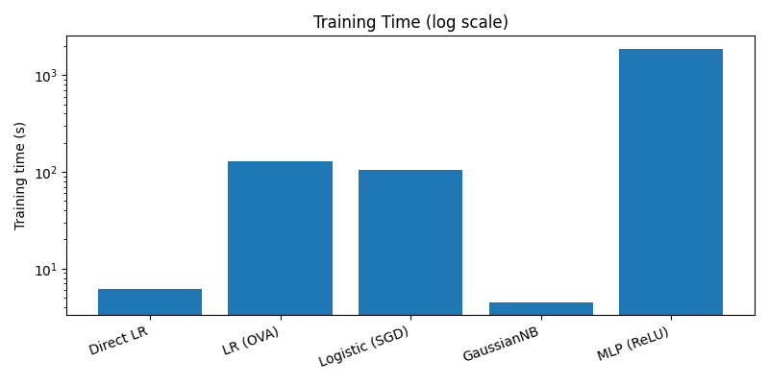
Training Time

Slide 20
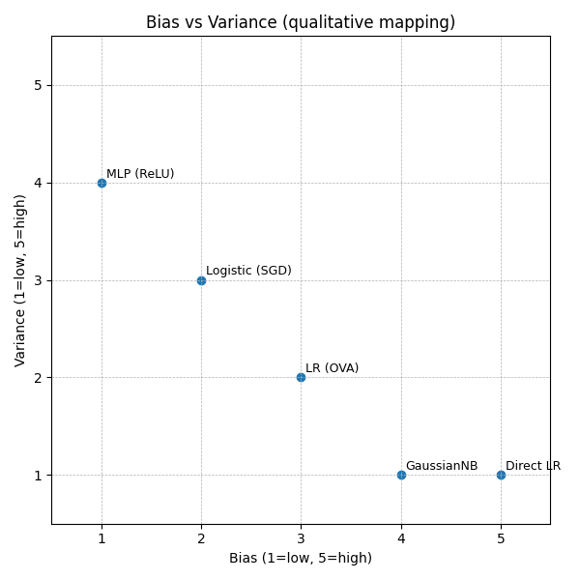
Bias vs Variance

Slide 21
Key Takeaways
Main conclusions
MLP (ReLU) achieves the best accuracy (≈89.1%) but is computationally expensive.
Logistic regression offers a good balance of performance and cost.
GaussianNB is fast but underperforms due to violated independence assumptions.
Direct linear regression is unsuitable; OVA improves it but remains limited.

