Slide 1
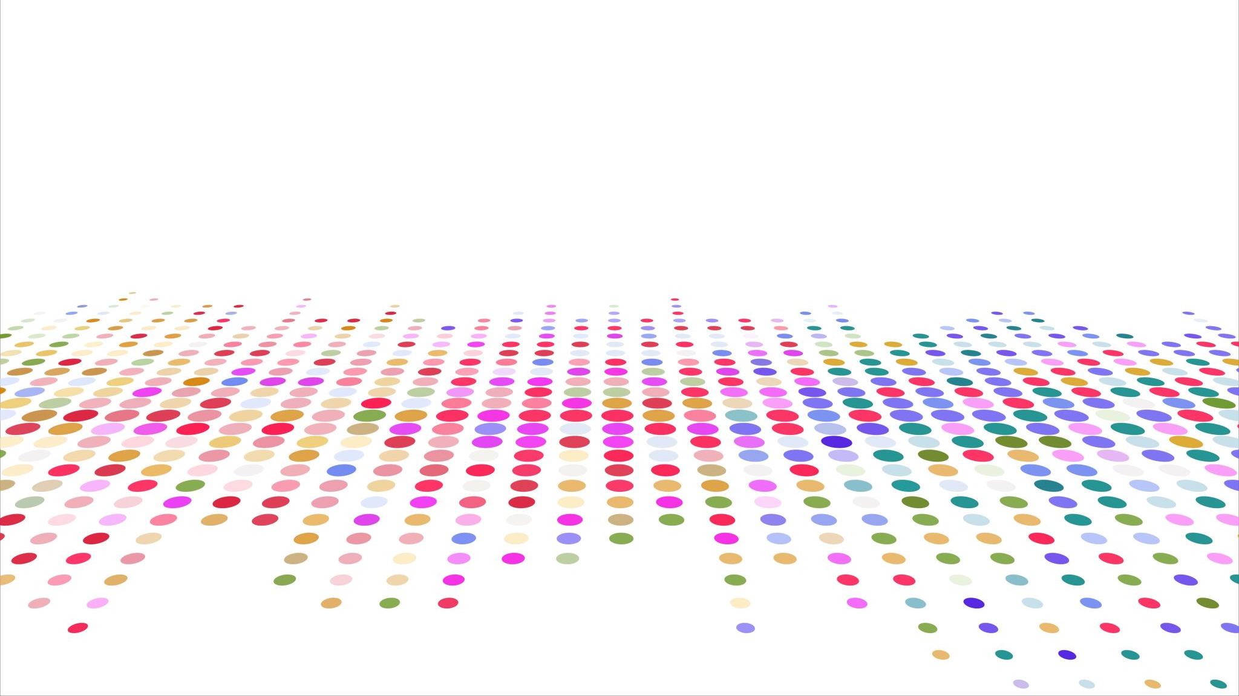
CS 483: Machine Learning
Week 3: Naïve Bayes

Slide 2
Last week
Last week we learned about supervised machine learning
We learned about one form of it: classification
We learned about hypotheses and hypothesis spaces
We learned the Find-S algorithm

Slide 3
This week
We’re going to review Bayes’ theorem
We’re going to learn a new algorithm that’s about as simple as Find-S, but widely used and noise-resistant

Slide 4
But first, the quiz
Pretend it’s a real test
Suggested to use pencil and paper or type on laptop
No need for calculators

Slide 5
The “quiz”
Apply Find-S to the following dataset. Show the hypothesis at each step.
How accurate is that hypothesis?
Write your own hypothesis as a Boolean function that is 100% accurate on the data above. Use standard logical notation.
Fluffy | Hops | BigEars | IsRabbit? (target)
True | True | False | True
False | True | False | False
False | True | True | True

Slide 6
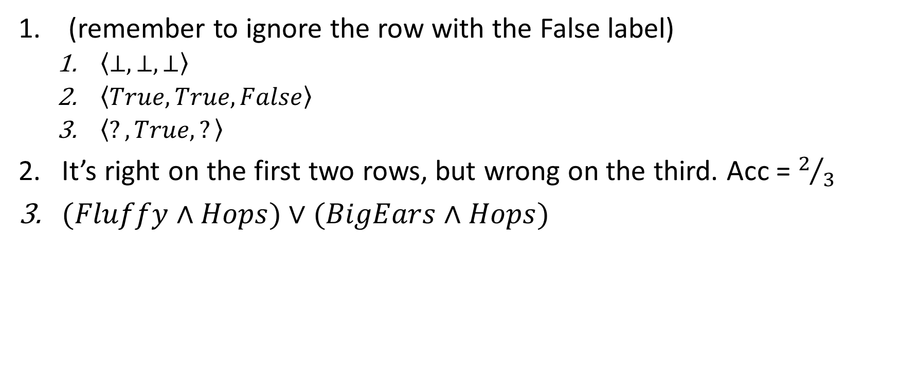
Answers
(remember to ignore the row with the False label)
$\left\langle ⊥,⊥,⊥\right\rangle$
$\left\langle True,True,False\right\rangle$
$\left\langle ?,True,?\right\rangle$
It’s right on the first two rows, but wrong on the third. Acc = $2/3$
$(Fluffy∧Hops)∨(BigEars∧Hops)$

Slide 7

Questions?

Slide 8
The hypothesis space again
Recall that one issue with Find-S is that it cannot learn every function
This is technically true of every machine learning algorithm.
However, many algorithms can learn every function to a predictable amount of error (so they can get arbitrarily close to the truth, given the right training data and training regimen)
Let’s look at this problem from another perspective to see if we can understand another way to represent hypotheses.

Slide 9
Thomas Bayes
A famous Anglican priest and mathematician
He wrote two major books.
One was a theological argument that was intended to prove that god wanted everything to be happy.
The other was a mathematical introduction to Newton’s calculus, and a defense against the book “the Analyst” by George Berkely.
“The Analyst” was a satire that made fun of mathematicians by attacking mathematical axioms the same way that religious truths were attacked. Ironically, his attacks were very good, and actually revealed portions of calculus that really were not rigorous at the time.

Slide 10
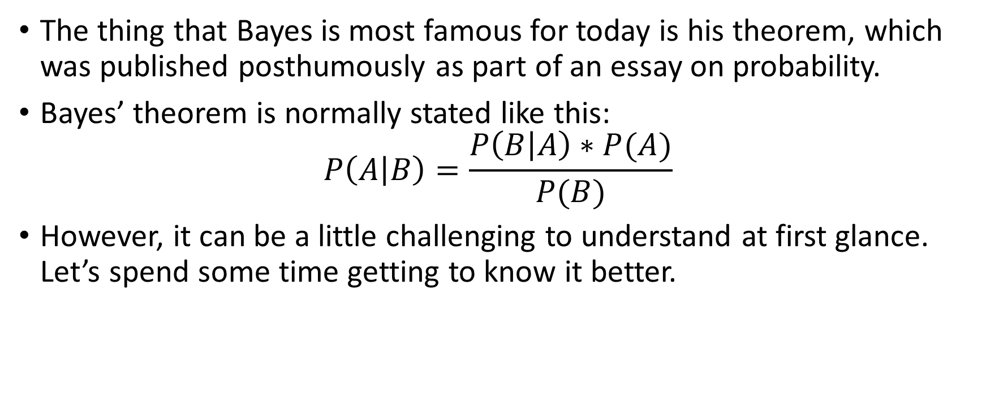
Bayes’ theorem
The thing that Bayes is most famous for today is his theorem, which was published posthumously as part of an essay on probability.
Bayes’ theorem is normally stated like this: $P\left(A | B\right)=\frac{P\left(B | A\right)∗P(A)}{P(B)}$
However, it can be a little challenging to understand at first glance. Let’s spend some time getting to know it better.

Slide 11
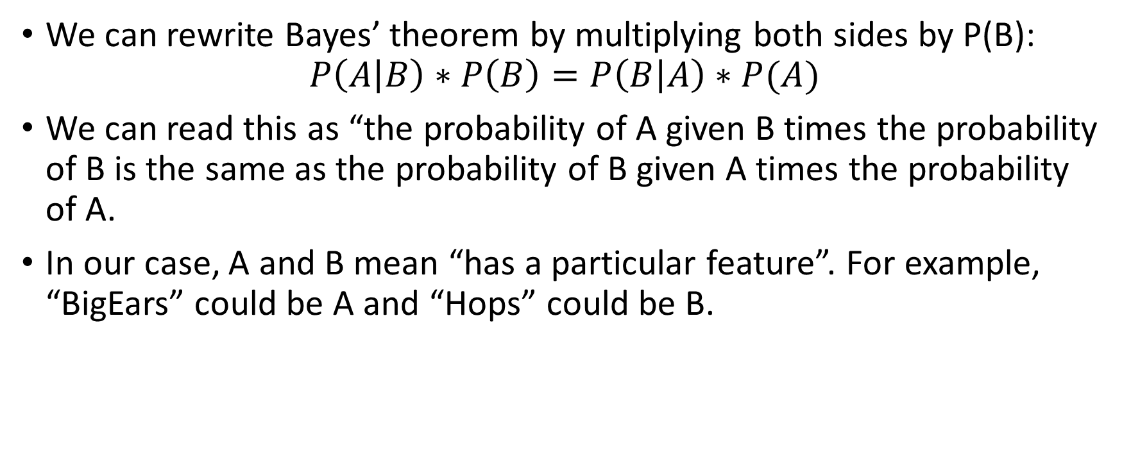
Understanding Bayes’ theorem
We can rewrite Bayes’ theorem by multiplying both sides by P(B): $P\left(A | B\right)∗P\left(B\right)=P\left(B | A\right)∗P(A)$
We can read this as “the probability of A given B times the probability of B is the same as the probability of B given A times the probability of A.
In our case, A and B mean “has a particular feature”. For example, “BigEars” could be A and “Hops” could be B.

Slide 12
What does “given” mean?
What is the probability of “fluffy” given “not big ears”?
To calculate this, we would consider only the rows which have “BigEars = false”. And from those rows, calculate the probability of “fluffy”.
P( Fluffy | !BigEars ) = 50%
Fluffy | Hops | BigEars | IsRabbit?
True | True | False | True
False | True | True | True
False | True | False | False

Slide 13
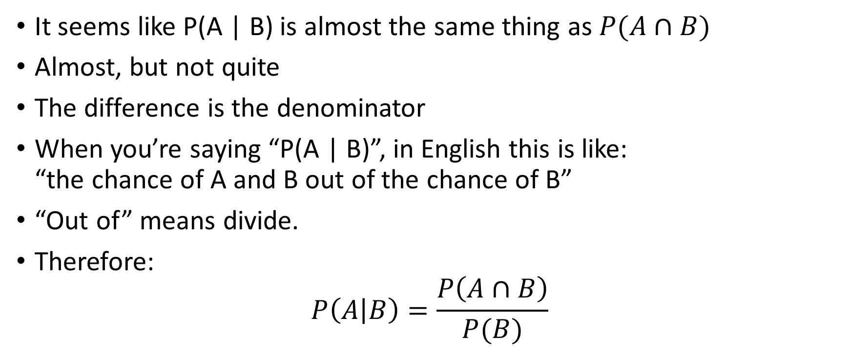
Another way of thinking about this
It seems like P(A | B) is almost the same thing as $P(A∩B)$
Almost, but not quite
The difference is the denominator
When you’re saying “P(A | B)”, in English this is like: “the chance of A and B out of the chance of B”
“Out of” means divide.
Therefore: $P\left(A | B\right)=\frac{P\left(A∩B\right)}{P(B)}$

Slide 14
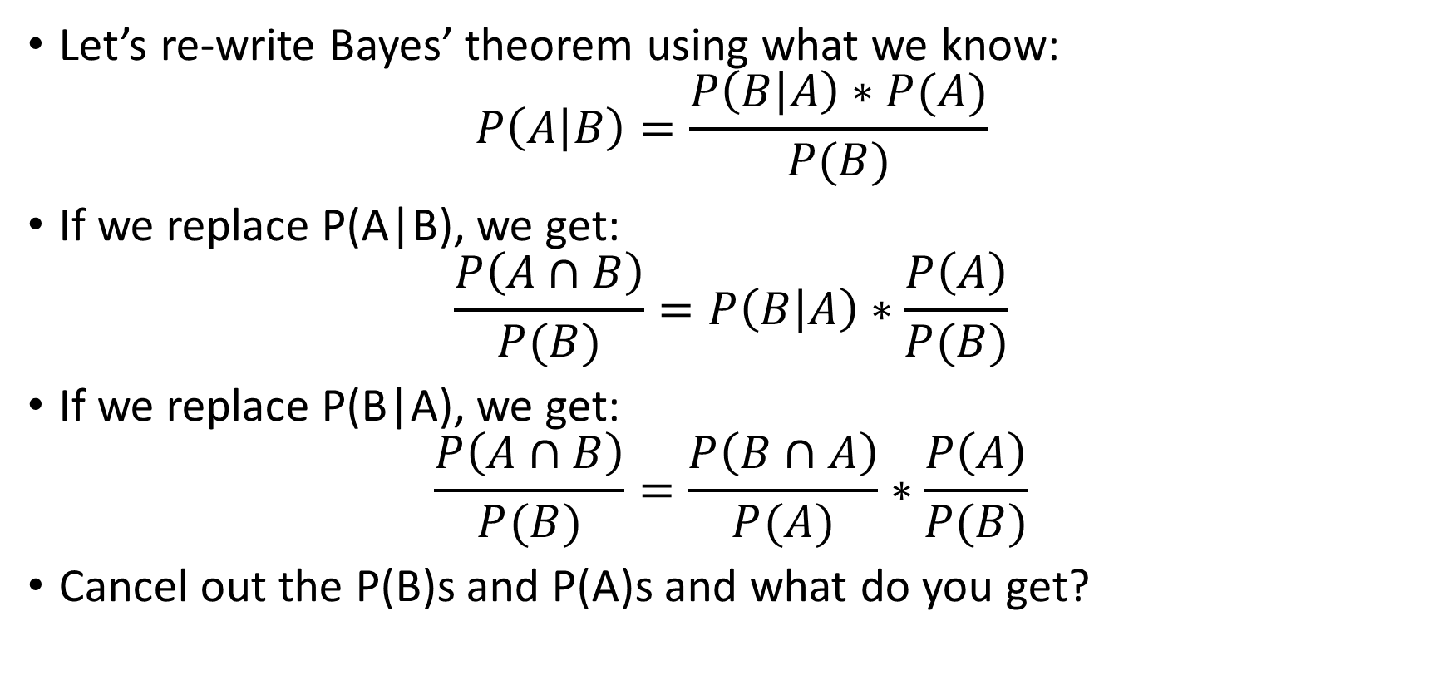
Another way (2)
Let’s re-write Bayes’ theorem using what we know: $P\left(A | B\right)=\frac{P\left(B | A\right)∗P(A)}{P(B)}$
If we replace P(A|B), we get: $\frac{P\left(A∩B\right)}{P(B)}=P\left(B | A\right)∗\frac{P\left(A\right)}{P(B)}$
If we replace P(B|A), we get: $\frac{P\left(A∩B\right)}{P(B)}=\frac{P\left(B∩A\right)}{P(A)}∗\frac{P\left(A\right)}{P(B)}$
Cancel out the P(B)s and P(A)s and what do you get?

Slide 15
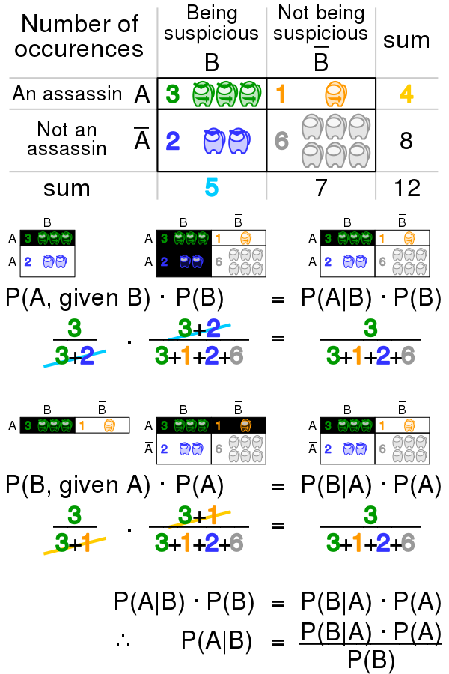
Sorry for the meme, but this is a good visualization
Image: CC-BY-SA 4.0, Cmglee https://en.wikipedia.org/wiki/File:Bayes_theorem_assassin.svg

Slide 16

Another way of thinking about it
P(A|B) has P(B) in its denominator.
If we get rid of that, P(A|B) becomes $P(A∩B)$
$P\left(A∩B\right)=P(B∩A)$, so Bayes’ rule is a trick for changing the direction of the “given”

Slide 17
Questions?

Slide 18
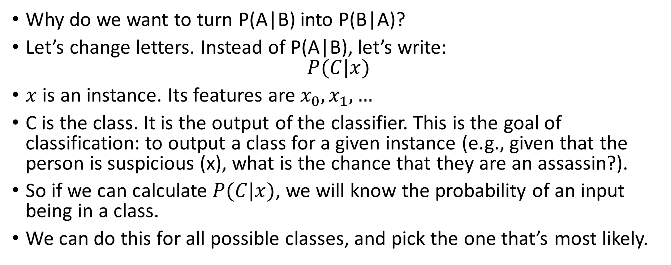
Why do we care?
Why do we want to turn P(A|B) into P(B|A)?
Let’s change letters. Instead of P(A|B), let’s write: $P(C|x)$
$x$ is an instance. Its features are $x_{0},x_{1},…$
C is the class. It is the output of the classifier. This is the goal of classification: to output a class for a given instance (e.g., given that the person is suspicious (x), what is the chance that they are an assassin?).
So if we can calculate $P(C|x)$, we will know the probability of an input being in a class.
We can do this for all possible classes, and pick the one that’s most likely.

Slide 19
What is this called?
Using Bayes’ rule to calculate the chance/odds of a classification, and then using the one with the greatest odds is called “Bayesian Classification”
It’s a simple but effective technique
Let’s work some examples.

Slide 20
Example of Bayesian classification
Consider the following dataset.
[How many features does it have?]
Watered | Wilted (target)
True | False
True | False
True | True
False | False
False | True
False | True
False | True

Slide 21
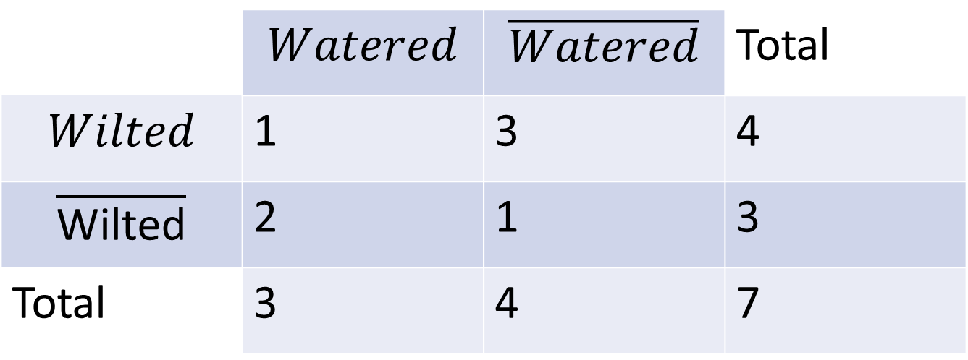
Summarizing the data
We have 2 features.
Let’s represent their counts as a table.
 | $$Watered$$ | $$\overline{Watered}$$ | Total
$$Wilted$$ | 1 | 3 | 4
$$\overline{\text{Wilted}}$$ | 2 | 1 | 3
Total | 3 | 4 | 7

Slide 22
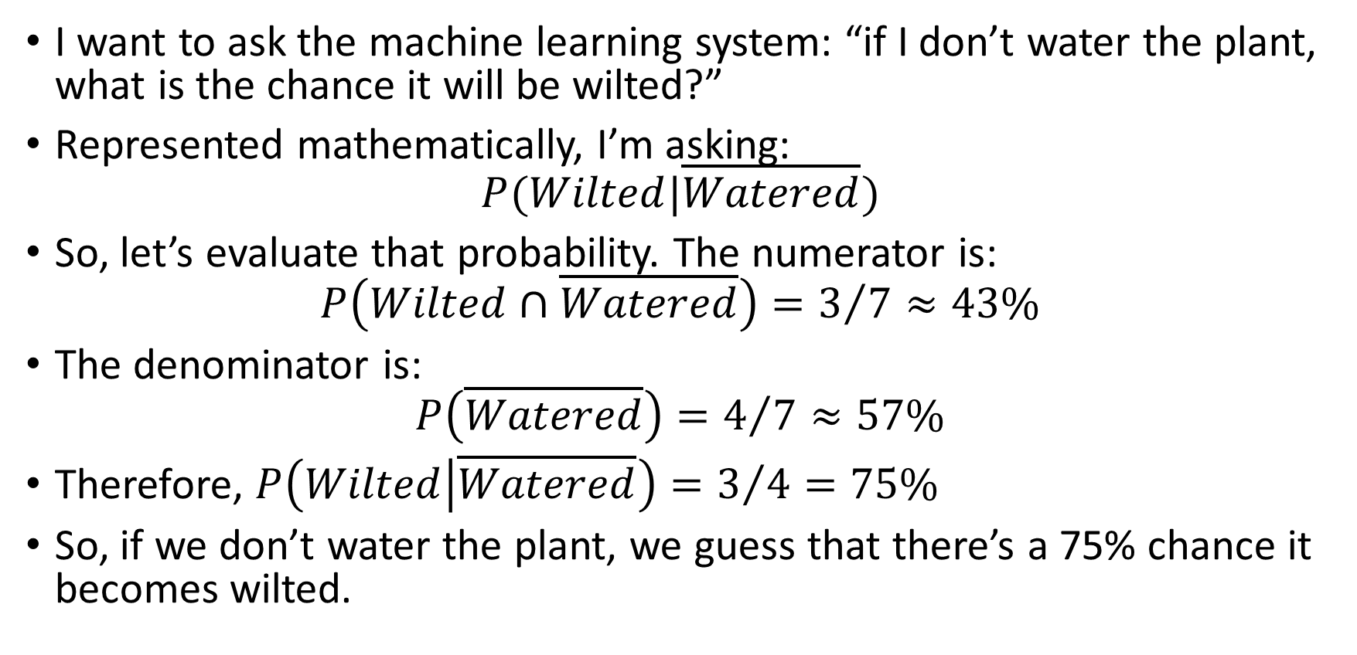
Using the table to make predictions
I want to ask the machine learning system: “if I don’t water the plant, what is the chance it will be wilted?”
Represented mathematically, I’m asking: $P(Wilted|\overline{Watered})$
So, let’s evaluate that probability. The numerator is: $P\left(Wilted∩\overline{Watered}\right)=3/7≈43\%$
The denominator is: $P\left(\overline{Watered}\right)=4/7≈57\%$
Therefore, $P\left(Wilted | \overline{Watered}\right)=3/4=75\%$
So, if we don’t water the plant, we guess that there’s a 75% chance it becomes wilted.

Slide 23
Is this useful?
It turns out, this classifier is as close to perfect as we can get.
In fact, it’s even theoretically optimal: https://en.wikipedia.org/wiki/Bayes_classifier
So, now that we know the perfect classifier, we can wrap it up, right?

Slide 24
Questions?

Slide 25
What if there are more classes?
Suppose there are 3 classes:
Assassin
VIP
Scientist
We receive a single x value with a number of features “has scientist badge”, “wears pocket protector”, “talks about physics a lot”).
We run an analysis on all those feature from the perspective of each class:
P(Assassin| badge, protected_pocket, physics) = 0.0009
P(VIP| badge, protected_pocket, physics) = 0.0001
P(Scientist | badge, protected_pocket, physics) = 0.999
Which one should we pick?

Slide 26
Choose the highest probability class
If we have to pick one class, it makes sense to pick the one with the highest probability
In our case, that was overwhelmingly “Scientist”, with a 99.9% probability, given the features
We could also report to the user what our probability was. We call this “Confidence”.
The confidence is the chance we think that our class is correct
Note: It’s possible to assign more than one class. This is called “multi-class classification.” It’s a bit more complex. We won’t worry about it now.

Slide 27
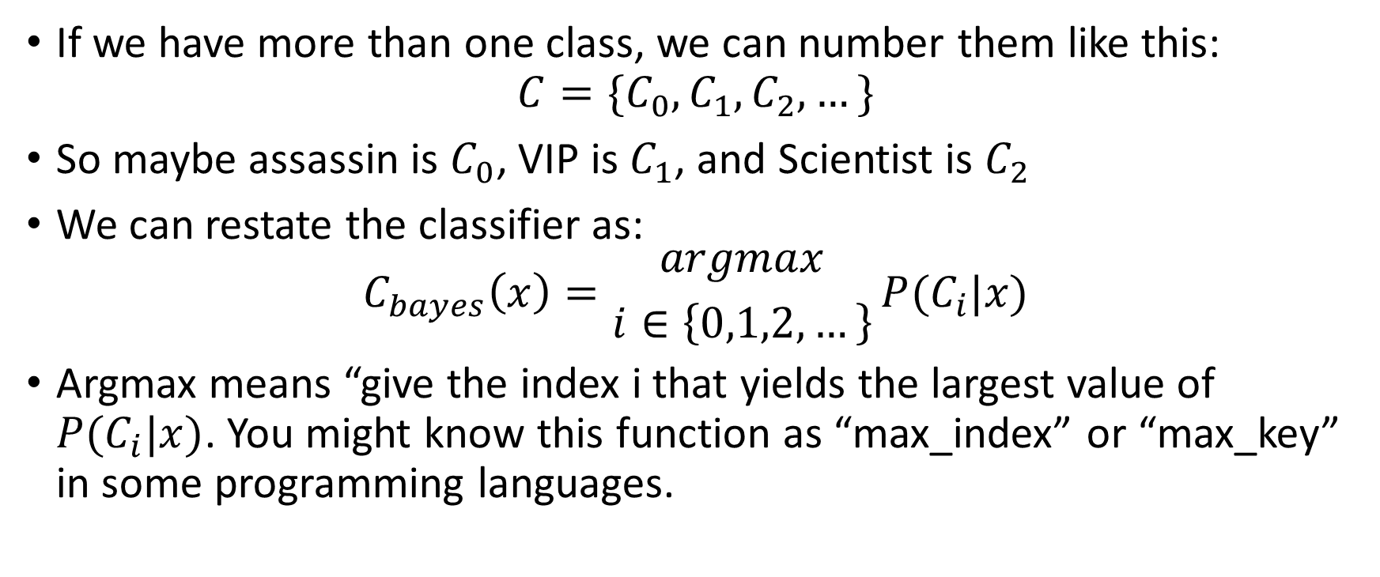
Restating the classifier
If we have more than one class, we can number them like this: $C=\{C_{0},C_{1},C_{2},…\}$
So maybe assassin is $C_{0}$, VIP is $C_{1}$, and Scientist is $C_{2}$
We can restate the classifier as: $C_{bayes}\left(x\right)={argmax \atop i∈\left\{0,1,2,…\right\}}P(C_{i}|x)$
Argmax means “give the index i that yields the largest value of $P(C_{i}|x)$. You might know this function as “max_index” or “max_key” in some programming languages.

Slide 28
What if we add more features
The classifier seems simple, but it starts to become awkward as we add more columns to our dataset.
Let’s say we want to understand why some plants become wilted when we water them, and other plants don’t become wilted even if we don’t.
We might try to determine more about them and record the extra information as features.
For example…

Slide 29
A more featureful dataset
Watered | Cactus | MadeOfPlastic | Wilted (target)
True | False | False | False
True | False | False | False
True | True | False | True
False | False | True | False
False | False | False | True
False | False | False | True
False | False | False | True

Slide 30
The improved dataset
These new features seem to explain some of the anomalies we saw in our original dataset
The plant that wilted even though we watered it was a cactus
The plant that didn’t wilt even though we watered it was made of plastic.
So it seems like being a cactus means that water makes you wilt, and being made of plastic means that no water makes you not wilt.
But what happens if we water a plastic cactus?

Slide 31
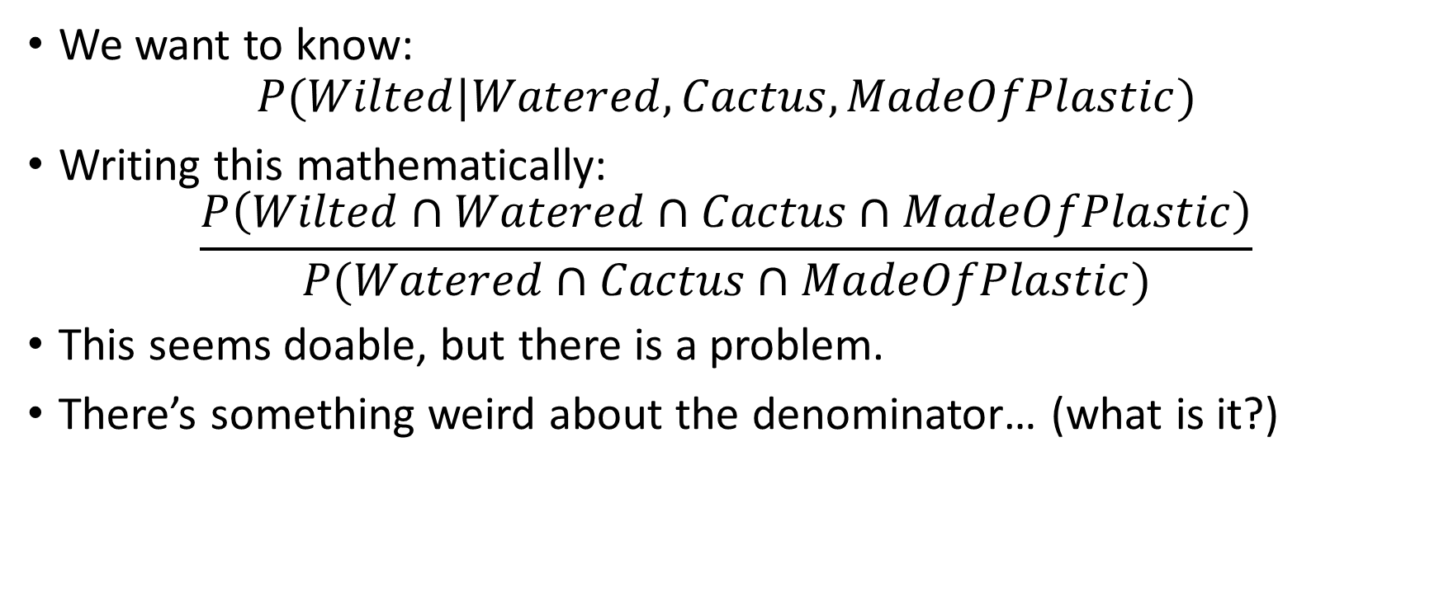
More complex classification
We want to know: $P(Wilted|Watered, Cactus, MadeOfPlastic)$
Writing this mathematically: $\frac{P\left(Wilted∩Watered∩Cactus∩MadeOfPlastic\right)}{P(Watered∩Cactus∩MadeOfPlastic)}$
This seems doable, but there is a problem.
There’s something weird about the denominator… (what is it?)

Slide 32
Questions?

Slide 33
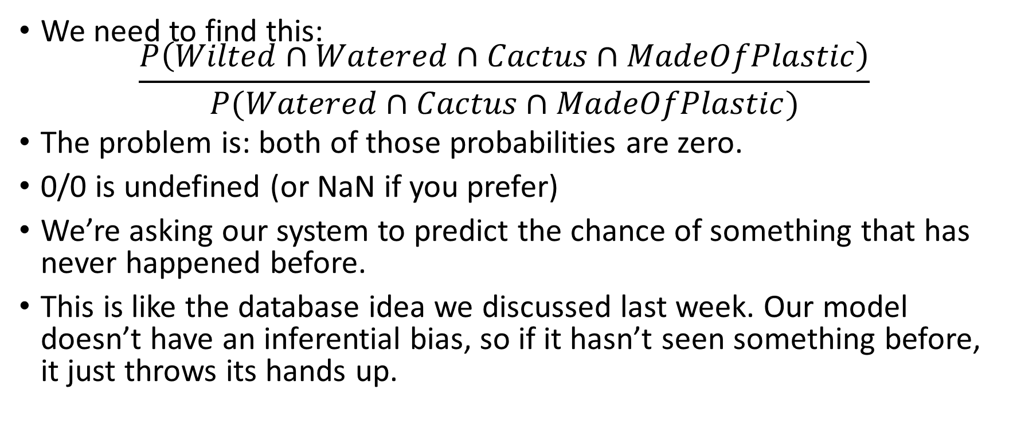
The problem
We need to find this: $\frac{P\left(Wilted∩Watered∩Cactus∩MadeOfPlastic\right)}{P(Watered∩Cactus∩MadeOfPlastic)}$
The problem is: both of those probabilities are zero.
0/0 is undefined (or NaN if you prefer)
We’re asking our system to predict the chance of something that has never happened before.
This is like the database idea we discussed last week. Our model doesn’t have an inferential bias, so if it hasn’t seen something before, it just throws its hands up.

Slide 34
Fixing this problem
We can fix the zero divide by using a technique called LaPlace smoothing.
We will see this technique later. It basically adds a small amount to probabilities to skew them toward the uniform distribution.
This still doesn’t fix the problem though. Naïve bayes will just estimate a random low probability if something hasn’t happened before. It’s not doing any inference. It’s basically a database.

Slide 35
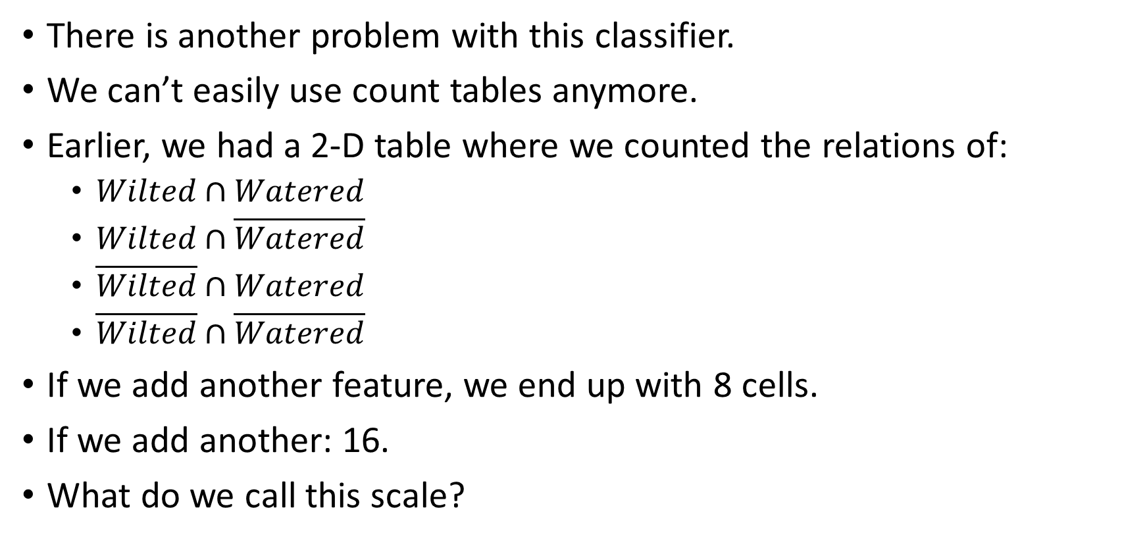
Another problem
There is another problem with this classifier.
We can’t easily use count tables anymore.
Earlier, we had a 2-D table where we counted the relations of:
$Wilted∩Watered$
$Wilted∩\overline{Watered}$
$\overline{Wilted}∩Watered$
$\overline{Wilted}∩\overline{Watered}$
If we add another feature, we end up with 8 cells.
If we add another: 16.
What do we call this scale?

Slide 36
Another Problem (2)
Another problem with an ordinary Bayes’ classifier is that it scales exponentially with the number of features.
If we don’t use a table, we have to filter through the rows more times, which means that the time it takes to output a result slows down as we train it more.
But we’re basically just using a database at that point, further proving our point that the ordinary Bayes’ classifier is basically a database.
Also, the more features you add, the higher the chance that we haven’t seen a particular combination before (so the higher the chance it throws up its hands)

Slide 37
Adding a bias
One way of fixing both of these problems is to make an assumption.
The assumption is this: the features are all completely independent
[What does that mean?]
[How do you think it helps?]

Slide 38
Independent events
Two events are independent if one occurring does not affect the probability of the other occurring.
If two events are not independent, we say they are correlated (or inverse correlated)
Examples:
The event “RainsInTopekaKansas”, and the event “YouWinThePowerball” are (probably) independent.
The event “YouStudiedReallyHard”, and the event “YouDidWellOnTheTest” are positively correlated
The event “YouPartiedReallyHardTheNightBefore”, and the event “YouDidWellOnTheTest” are inversely correlated
[Give me more]

Slide 39
Correlation does not imply a guarantee
(Positive) Correlation just means that two things are more likely to happen together than they are separately.
If you study hard, you are more likely to do well on the test.
Likewise, if you did well on the test, it is more likely that you studied hard.
However, it’s possible to study hard and not do well, and it’s possible to do well without studying.
We have to account for those possibilities when calculating the probability of studying and doing well.

Slide 40
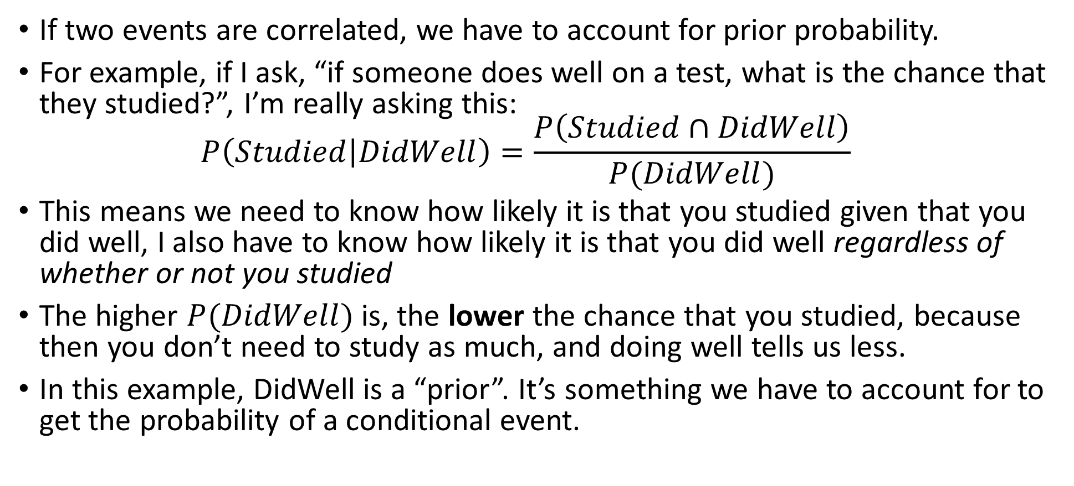
Accounting for prior probability
If two events are correlated, we have to account for prior probability.
For example, if I ask, “if someone does well on a test, what is the chance that they studied?”, I’m really asking this: $P\left(Studied | DidWell\right)=\frac{P\left(Studied∩DidWell\right)}{P(DidWell)}$
This means we need to know how likely it is that you studied given that you did well, I also have to know how likely it is that you did well regardless of whether or not you studied
The higher $P(DidWell)$ is, the lower the chance that you studied, because then you don’t need to study as much, and doing well tells us less.
In this example, DidWell is a “prior”. It’s something we have to account for to get the probability of a conditional event.

Slide 41
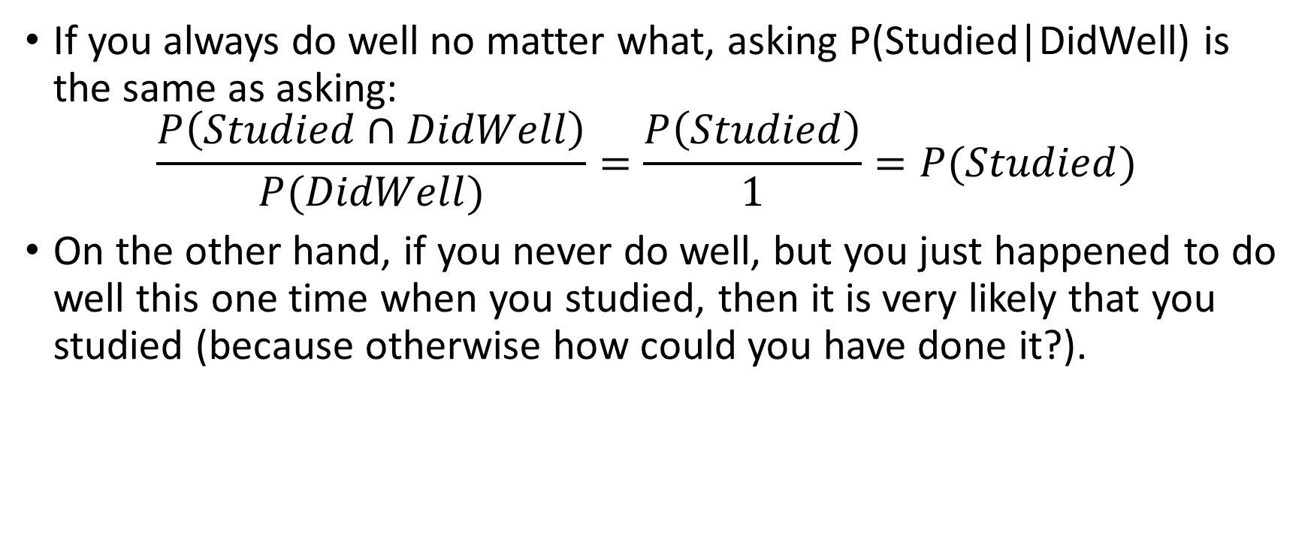
Understanding this in more ways
If you always do well no matter what, asking P(Studied|DidWell) is the same as asking: $\frac{P\left(Studied∩DidWell\right)}{P(DidWell)}=\frac{P\left(Studied\right)}{1}=P(Studied)$
On the other hand, if you never do well, but you just happened to do well this one time when you studied, then it is very likely that you studied (because otherwise how could you have done it?).

Slide 42
Questions?

Slide 43
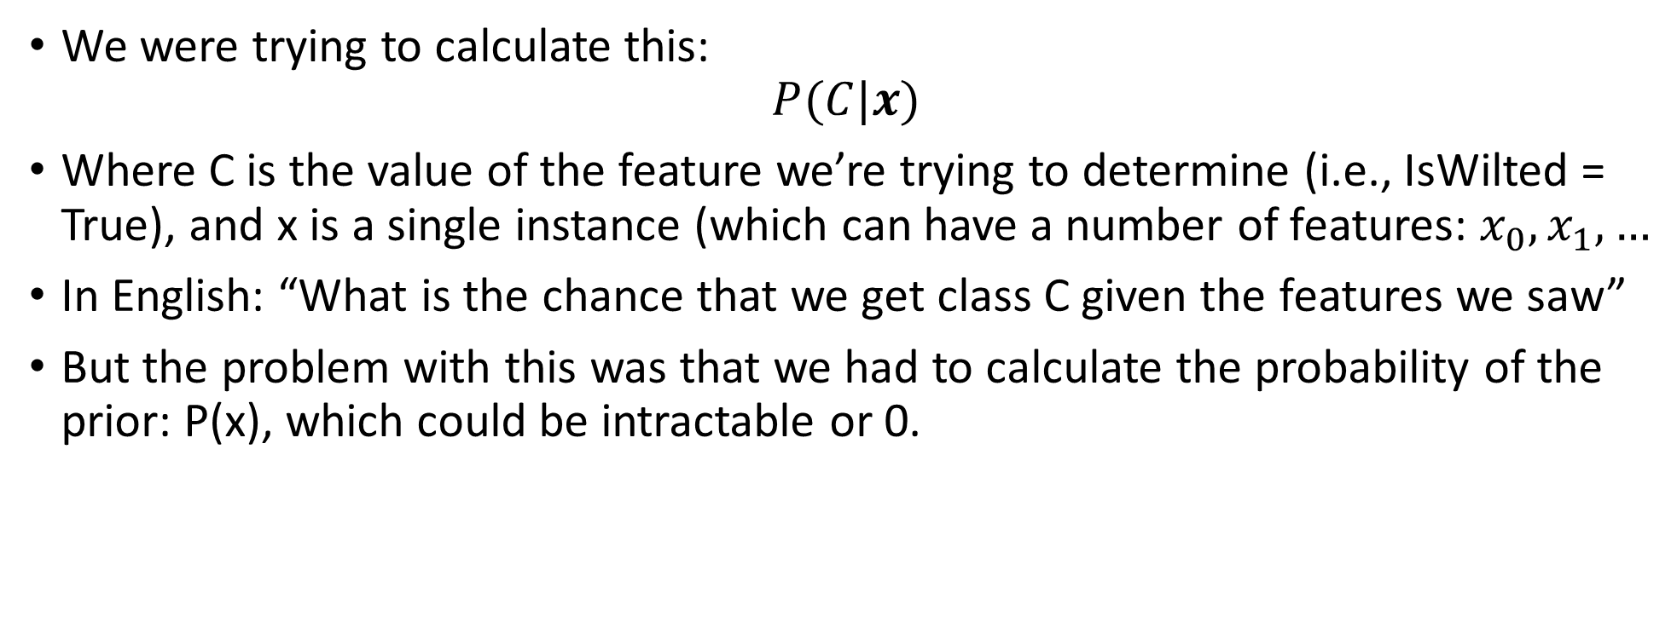
“Fixing” the bayes classifier
We were trying to calculate this: $P(C|x)$
Where C is the value of the feature we’re trying to determine (i.e., IsWilted = True), and x is a single instance (which can have a number of features: $x_{0}, x_{1},…$
In English: “What is the chance that we get class C given the features we saw”
But the problem with this was that we had to calculate the probability of the prior: P(x), which could be intractable or 0.

Slide 44
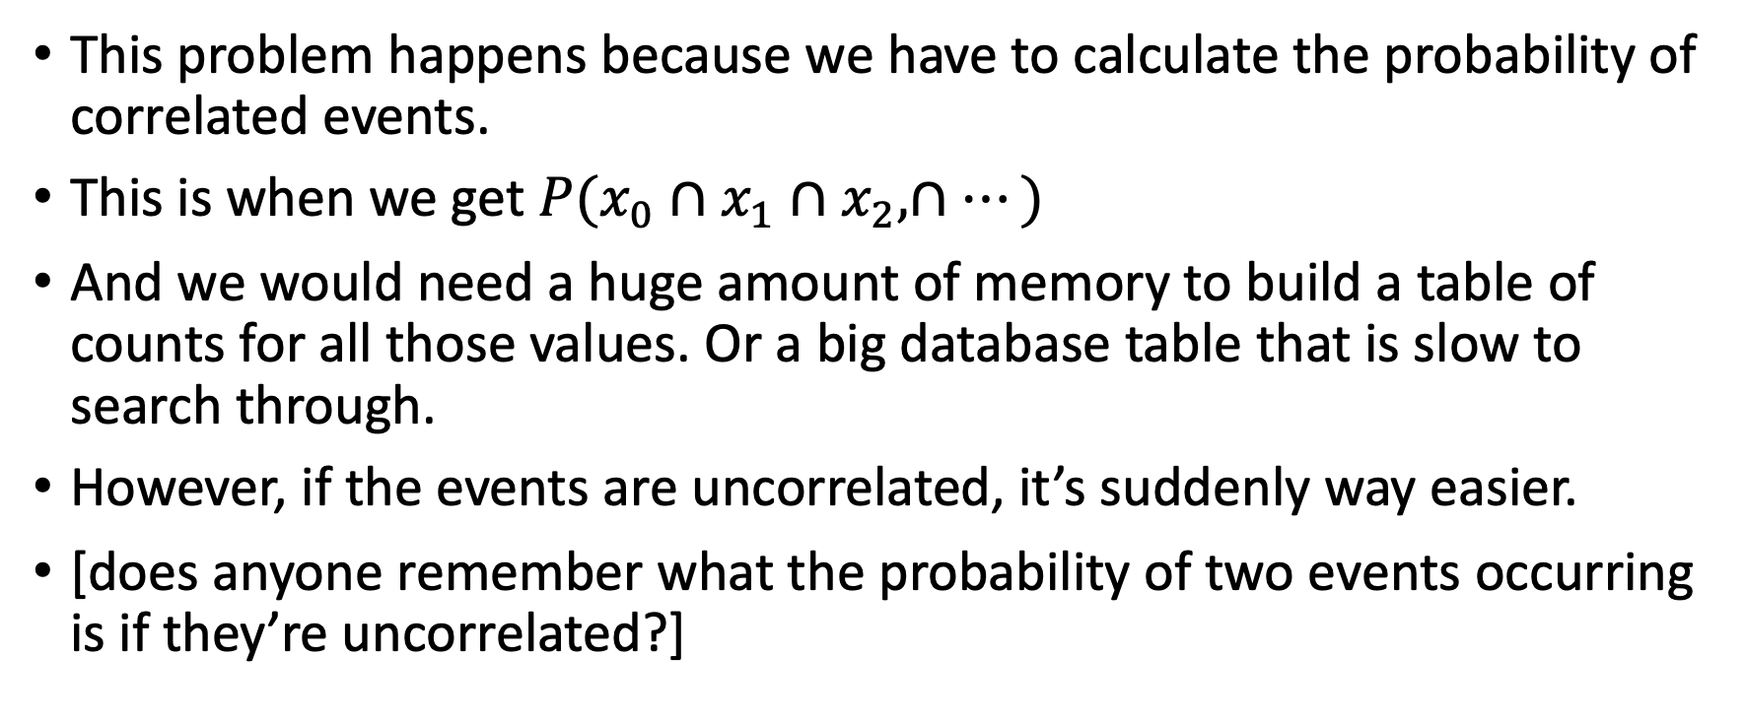
“Fixing” the bayes classifier (2)
This problem happens because we have to calculate the probability of correlated events.
This is when we get $P(x_{0}∩x_{1}∩x_{2},∩…)$
And we would need a huge amount of memory to build a table of counts for all those values. Or a big database table that is slow to search through.
However, if the events are uncorrelated, it’s suddenly way easier.
[does anyone remember what the probability of two events occurring is if they’re uncorrelated?]

Slide 45
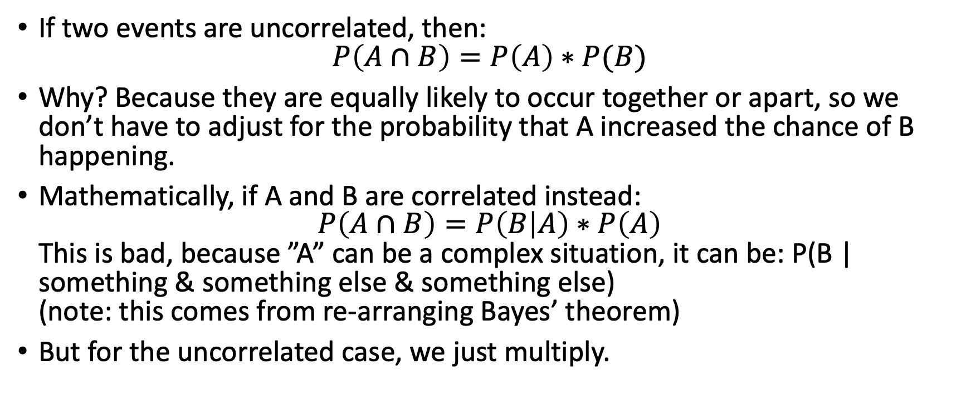
What happens if the events are uncorrelated?
If two events are uncorrelated, then: $P\left(A∩B\right)=P\left(A\right)∗P(B)$
Why? Because they are equally likely to occur together or apart, so we don’t have to adjust for the probability that A increased the chance of B happening.
Mathematically, if A and B are correlated instead: $P\left(A∩B\right)=P\left(B | A\right)∗P\left(A\right)$ This is bad, because ”A” can be a complex situation, it can be: P(B | something & something else & something else) (note: this comes from re-arranging Bayes’ theorem)
But for the uncorrelated case, we just multiply.

Slide 46
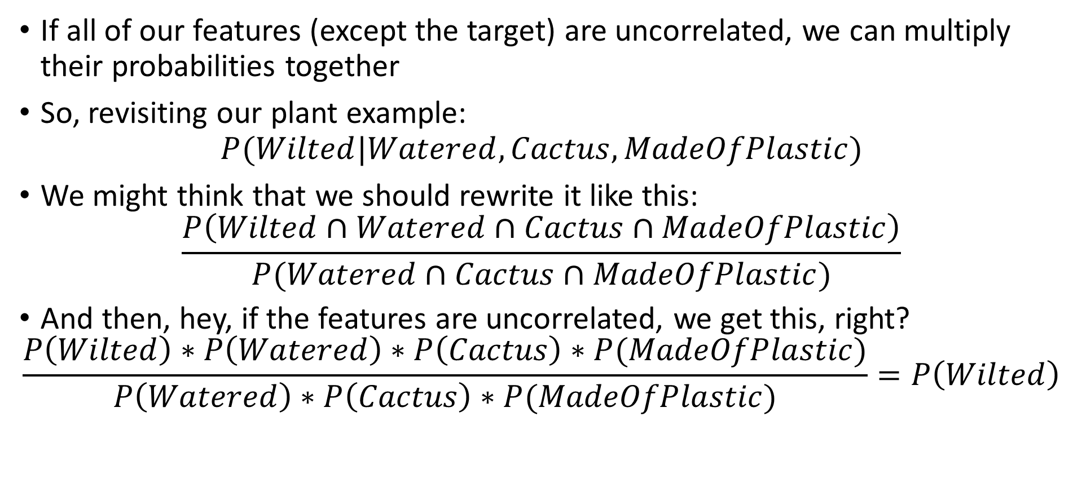
Trying to use this knowledge
If all of our features (except the target) are uncorrelated, we can multiply their probabilities together
So, revisiting our plant example: $P(Wilted|Watered, Cactus, MadeOfPlastic)$
We might think that we should rewrite it like this: $\frac{P\left(Wilted∩Watered∩Cactus∩MadeOfPlastic\right)}{P(Watered∩Cactus∩MadeOfPlastic)}$
And then, hey, if the features are uncorrelated, we get this, right?
$$\frac{P\left(Wilted\right)∗P\left(Watered\right)∗P\left(Cactus\right)∗P(MadeOfPlastic)}{P\left(Watered\right)∗P\left(Cactus\right)∗P(MadeOfPlastic)}=P\left(Wilted\right)$$

Slide 47
Unfortunately, no
The previous result is logical, but not useful
It says “if all your features are uncorrelated, then the chance that a plant is wilted has nothing to do with whether it was a cactus, or watered, or anything else, so just take the base probability that it was wilted and call it a day”
We can’t assume that all the features are uncorrelated without removing all intelligence from the classifier.
Instead, the target feature must be correlated with each of the other features. However, they are all considered to be mutually uncorrelated.

Slide 48
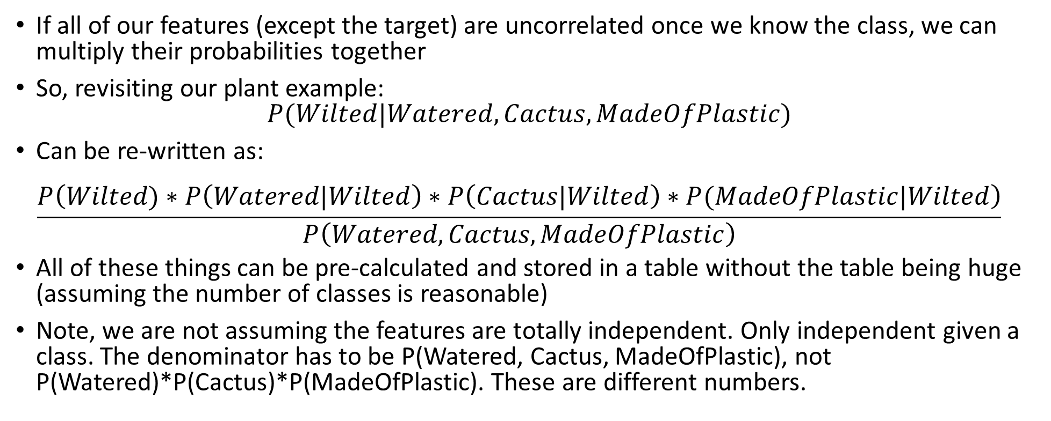
Why this is useful
If all of our features (except the target) are uncorrelated once we know the class, we can multiply their probabilities together
So, revisiting our plant example: $P(Wilted|Watered, Cactus, MadeOfPlastic)$
Can be re-written as: $\frac{P\left(Wilted)∗P\left(Watered|Wilted\right)∗P\left(Cactus|Wilted\right)∗P(MadeOfPlastic|Wilted\right)}{P\left(Watered, Cactus, MadeOfPlastic\right)}$
All of these things can be pre-calculated and stored in a table without the table being huge (assuming the number of classes is reasonable)
Note, we are not assuming the features are totally independent. Only independent given a class. The denominator has to be P(Watered, Cactus, MadeOfPlastic), not P(Watered)*P(Cactus)*P(MadeOfPlastic). These are different numbers.

Slide 49
Reminding ourself of the data
Watered | Cactus | MadeOfPlastic | Wilted (target)
True | False | False | False
True | False | False | False
True | True | False | True
False | False | True | False
False | False | False | True
False | False | False | True
False | False | False | True

Slide 50
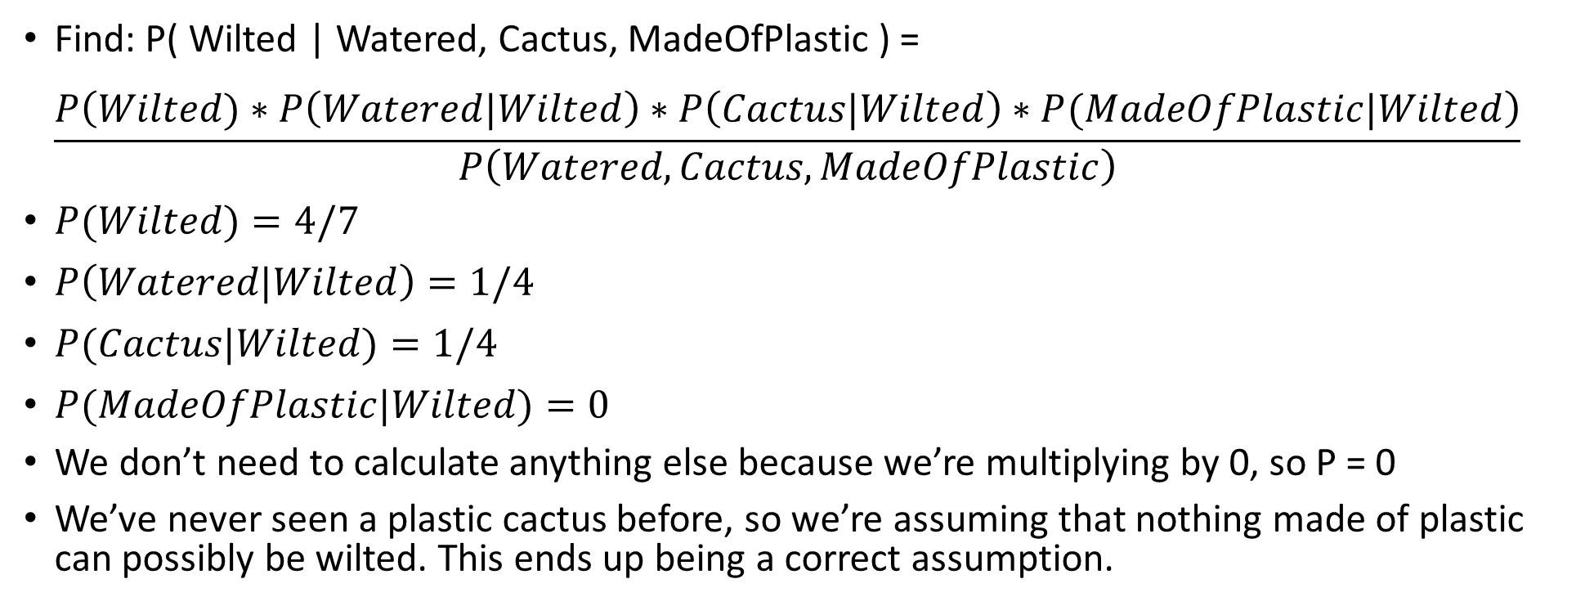
Doing the example
Find: P( Wilted | Watered, Cactus, MadeOfPlastic ) = $\frac{P\left(Wilted)∗P\left(Watered|Wilted\right)∗P\left(Cactus|Wilted\right)∗P(MadeOfPlastic|Wilted\right)}{P\left(Watered,Cactus,MadeOfPlastic\right)}$
$P(Wilted)=4/7$
$P\left(Watered|Wilted\right)=1/4$
$P(Cactus|Wilted)=1/4$
$P(MadeOfPlastic|Wilted)=0$
We don’t need to calculate anything else because we’re multiplying by 0, so P = 0
We’ve never seen a plastic cactus before, so we’re assuming that nothing made of plastic can possibly be wilted. This ends up being a correct assumption.

Slide 51
Questions?

Slide 52
We can just declare things to be independent?
Note that unless our features really are independent, we are actually engaging in self-delusion.
We are pretending that they are independent when they are not.
This is a very naïve assumption, so this classifier is called naïve Bayes.
However, despite being naïve, it actually works pretty well.

Slide 53
Why do we want independence?
Suppose you have two features that are perfectly correlated
For example, suppose we have three non-label features:
Is cloudy
Is raining
Is wet
And suppose we have one label feature to predict: “baseball game on”
Suppose that “Is raining” and “Is wet” are correlated. That is, in our dataset, every time it’s raining it’s wet, and every time it’s wet, it’s raining.

Slide 54
Why do we want independence? (2)
What does that do to the classifier?
When we calculate P( Baseball Game On | Is wet ) we get a very high number. Suppose it’s 90%.
Likewise when we calculate P( Baseball Game On | Is raining ), we get a very high number, too. It would have to be 90% as well.
Remember that these probabilities multiply with each other. If we only included one feature, we’d be multiplying by 90%. However, because we have both, we end up multiplying by 81% (90% * 90%).

Slide 55
Why do we want independence? (3)
If we had 5 correlated probabilities, we’d be multiplying by $90\%^{5}$
Adding more correlated features ends up “pulling us” towards zero.
If we corrected for correlation, this wouldn’t be a problem. But then we wouldn’t have a tractable algorithm anymore.
So, the data scientist who uses Naïve Bayes is responsible for doing feature engineering, and trying to remove cross correlation.

Slide 56
Do we really feel comfortable with P = 0?
Just because something hasn’t happened before doesn’t mean it is impossible.
You may have heard the term “black swan event” to refer to unlikely events.
Really, it doesn’t just mean “unlikely”. It means “thought to be impossible (so none of our statistical/machine learning models even consider it as an option)
[black swan term origin]
Let’s discuss dealing with zero in a second, but first, let’s simplify so we don’t have to.

Slide 57
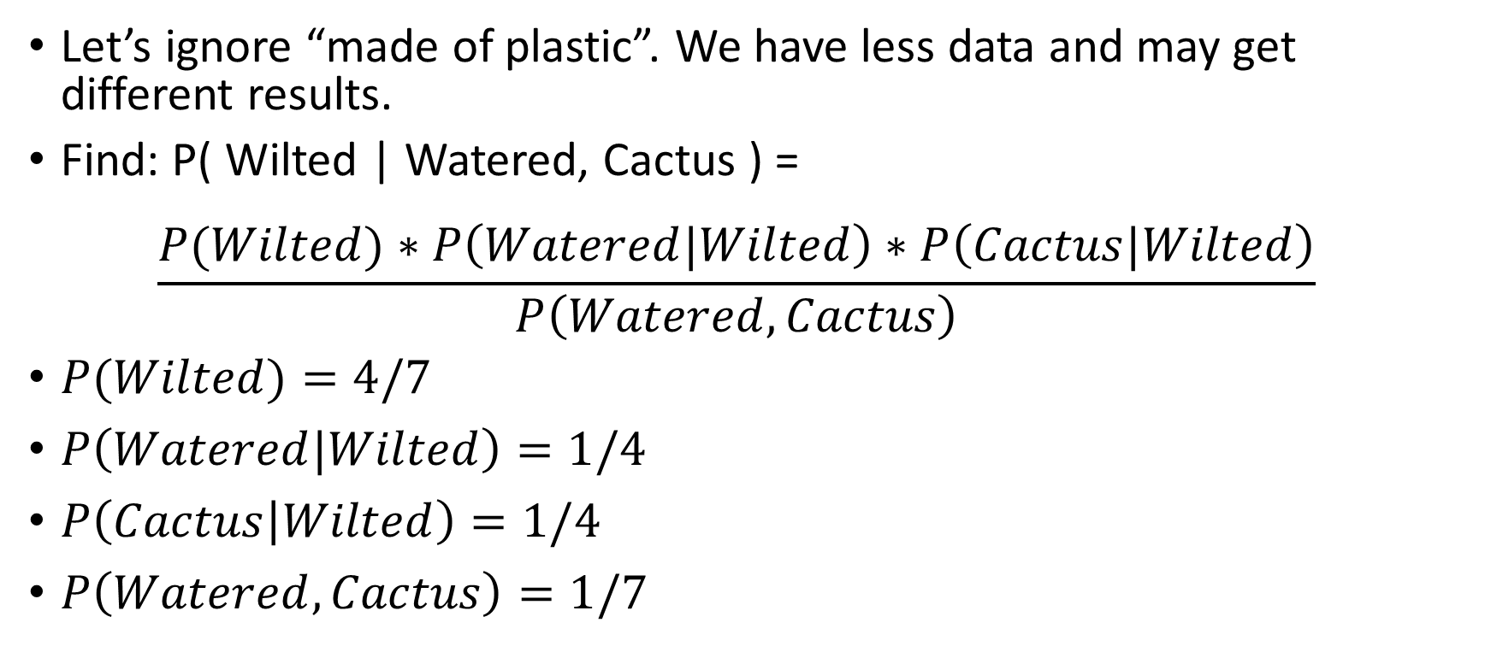
What if we didn’t have “made of plastic?”
Let’s ignore “made of plastic”. We have less data and may get different results.
Find: P( Wilted | Watered, Cactus ) = $\frac{P(Wilted)∗P\left(Watered|Wilted\right)∗P\left(Cactus|Wilted\right)}{P\left(Watered,Cactus\right)}$
$P(Wilted)=4/7$
$P\left(Watered|Wilted\right)=1/4$
$P\left(Cactus | Wilted\right)=1/4$
$P\left(Watered,Cactus\right)=1/7$

Slide 58
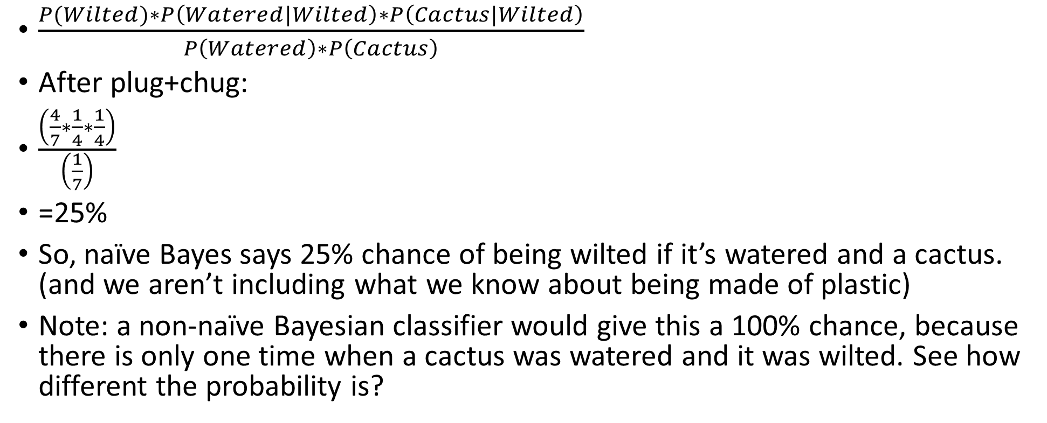
Final formula
$\frac{P(Wilted)∗P\left(Watered|Wilted\right)∗P\left(Cactus|Wilted\right)}{P\left(Watered\right)∗P\left(Cactus\right)}$
After plug+chug:
$\frac{\left(\frac{4}{7}∗\frac{1}{4}∗\frac{1}{4}\right)}{\left(\frac{1}{7}\right)}$
=25%
So, naïve Bayes says 25% chance of being wilted if it’s watered and a cactus. (and we aren’t including what we know about being made of plastic)
Note: a non-naïve Bayesian classifier would give this a 100% chance, because there is only one time when a cactus was watered and it was wilted. See how different the probability is?

Slide 59
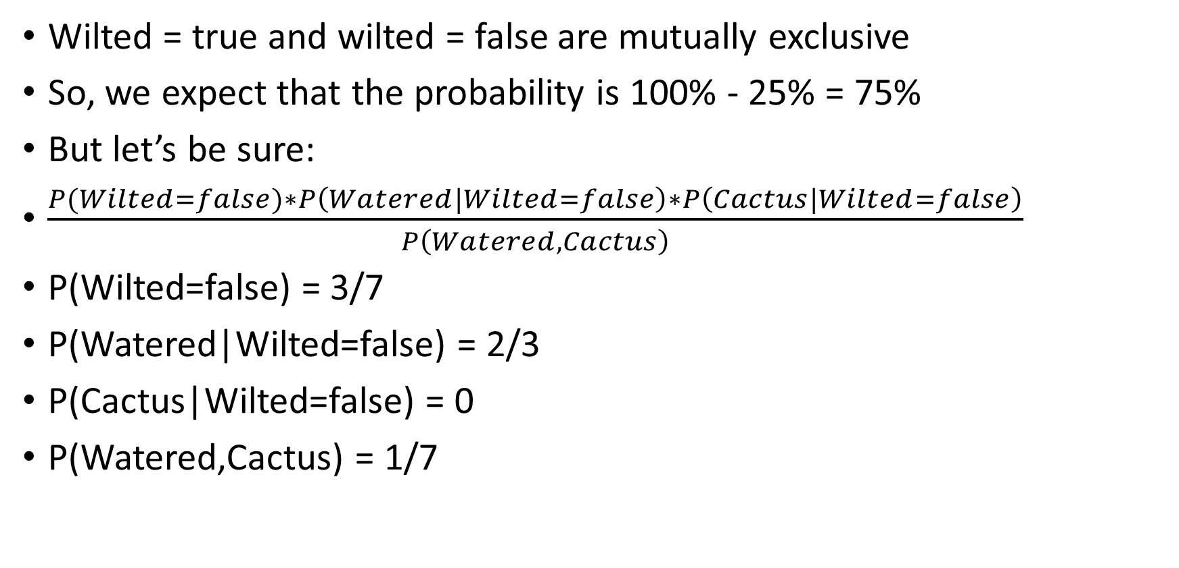
What about wilted = false?
Wilted = true and wilted = false are mutually exclusive
So, we expect that the probability is 100% - 25% = 75%
But let’s be sure:
$\frac{P(Wilted=false)∗P\left(Watered|Wilted=false\right)∗P\left(Cactus|Wilted=false\right)}{P\left(Watered,Cactus\right)}$
P(Wilted=false) = 3/7
P(Watered|Wilted=false) = 2/3
P(Cactus|Wilted=false) = 0
P(Watered,Cactus) = 1/7

Slide 60
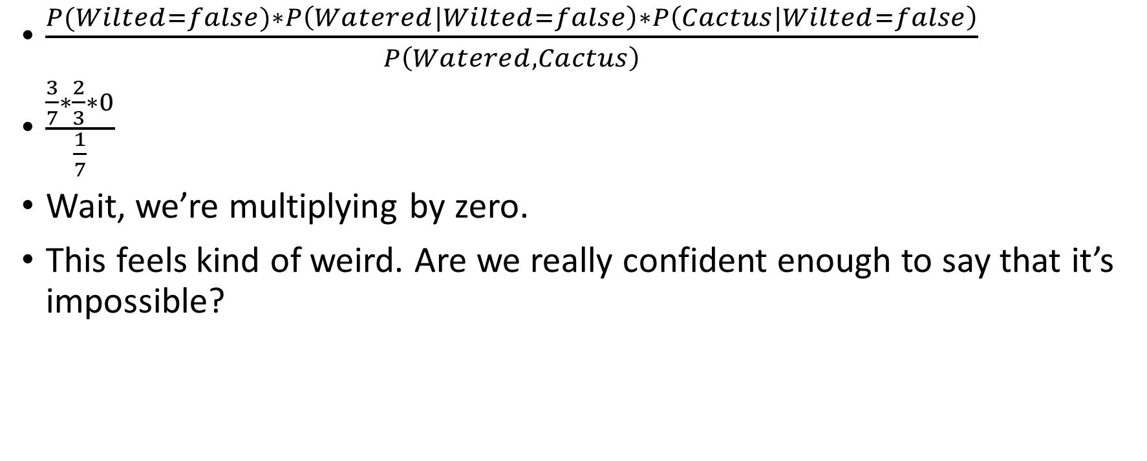
Plug and chug
$\frac{P(Wilted=false)∗P\left(Watered|Wilted=false\right)∗P\left(Cactus|Wilted=false\right)}{P\left(Watered,Cactus\right)}$
$\frac{\frac{3}{7}∗\frac{2}{3}∗0}{\frac{1}{7}}$
Wait, we’re multiplying by zero.
This feels kind of weird. Are we really confident enough to say that it’s impossible?

Slide 61
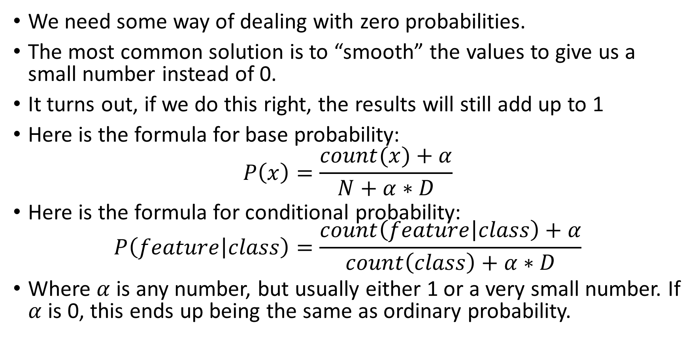
Laplace smoothing
We need some way of dealing with zero probabilities.
The most common solution is to “smooth” the values to give us a small number instead of 0.
It turns out, if we do this right, the results will still add up to 1
Here is the formula for base probability:
$$P\left(x\right)=\frac{count(x)+α}{N+α∗D}$$
Here is the formula for conditional probability: $P\left(feature | class\right)=\frac{count\left(feature | class\right)+α}{count\left(class\right)+α∗D}$
Where $α$ is any number, but usually either 1 or a very small number. If $α$ is 0, this ends up being the same as ordinary probability.

Slide 62
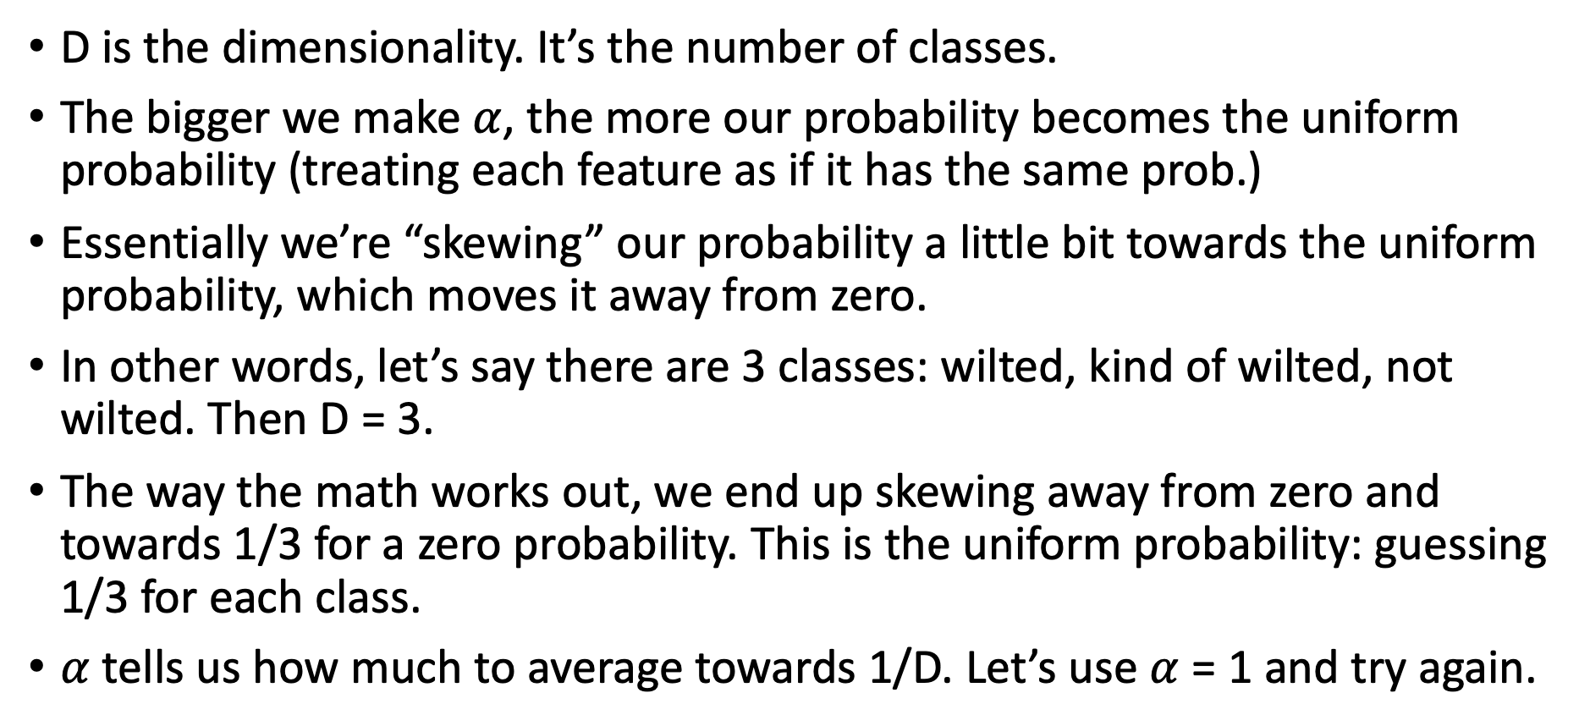
Understanding LaPlace smoothing
D is the dimensionality. It’s the number of classes.
The bigger we make $α$, the more our probability becomes the uniform probability (treating each feature as if it has the same prob.)
Essentially we’re “skewing” our probability a little bit towards the uniform probability, which moves it away from zero.
In other words, let’s say there are 3 classes: wilted, kind of wilted, not wilted. Then D = 3.
The way the math works out, we end up skewing away from zero and towards 1/3 for a zero probability. This is the uniform probability: guessing 1/3 for each class.
$α$ tells us how much to average towards 1/D. Let’s use $α$ = 1 and try again.

Slide 63
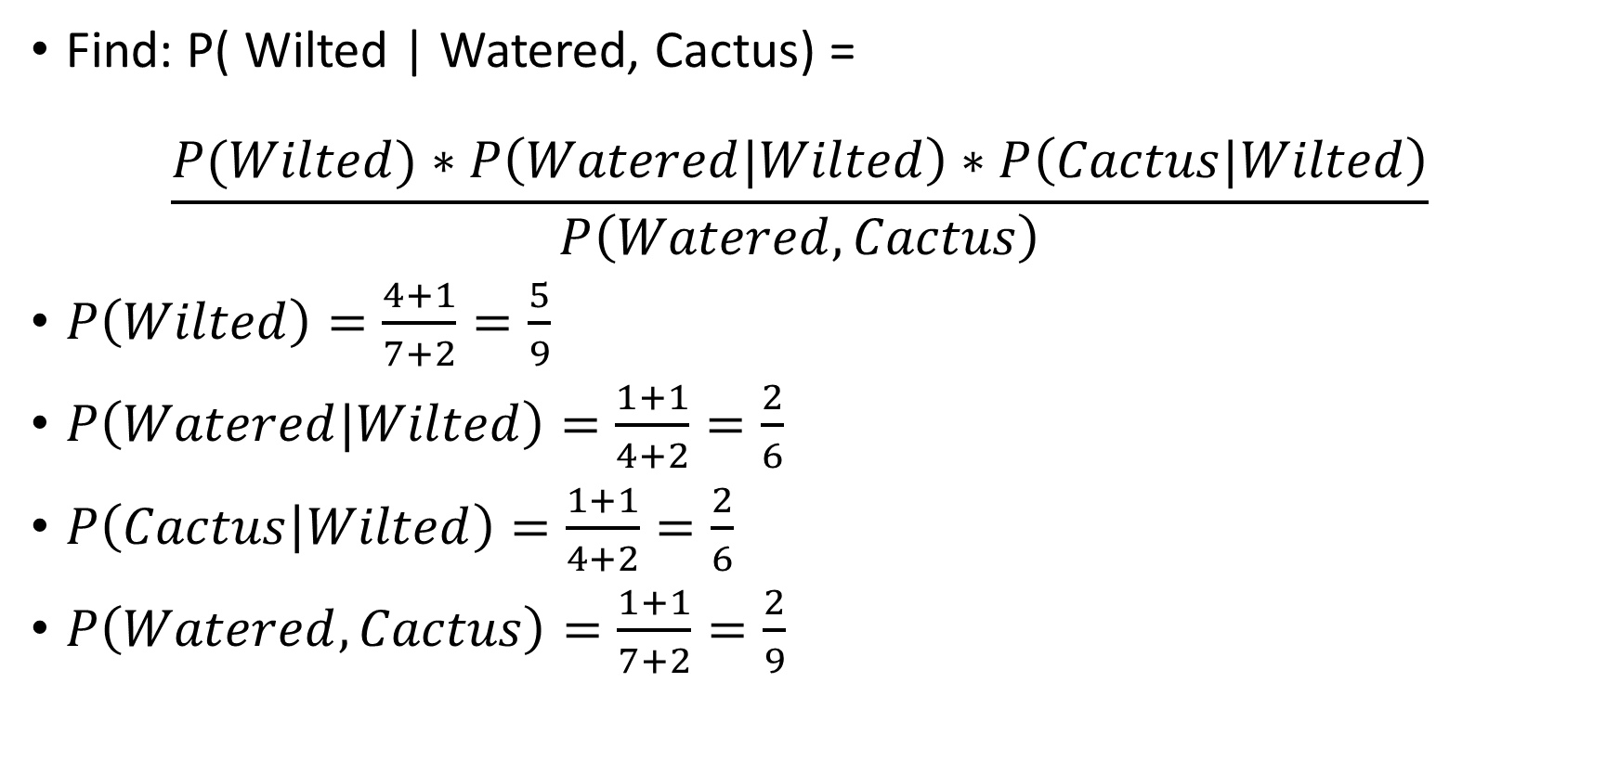
Laplace smoothing (3)
Find: P( Wilted | Watered, Cactus) = $\frac{P(Wilted)∗P\left(Watered|Wilted\right)∗P\left(Cactus|Wilted\right)}{P\left(Watered,Cactus\right)}$
$P\left(Wilted\right)=\frac{4+1}{7+2}=\frac{5}{9}$
$P\left(Watered|Wilted\right)=\frac{1+1}{4+2}=\frac{2}{6}$
$P\left(Cactus | Wilted\right)=\frac{1+1}{4+2}=\frac{2}{6}$
$P\left(Watered,Cactus\right)=\frac{1+1}{7+2}=\frac{2}{9}$

Slide 64
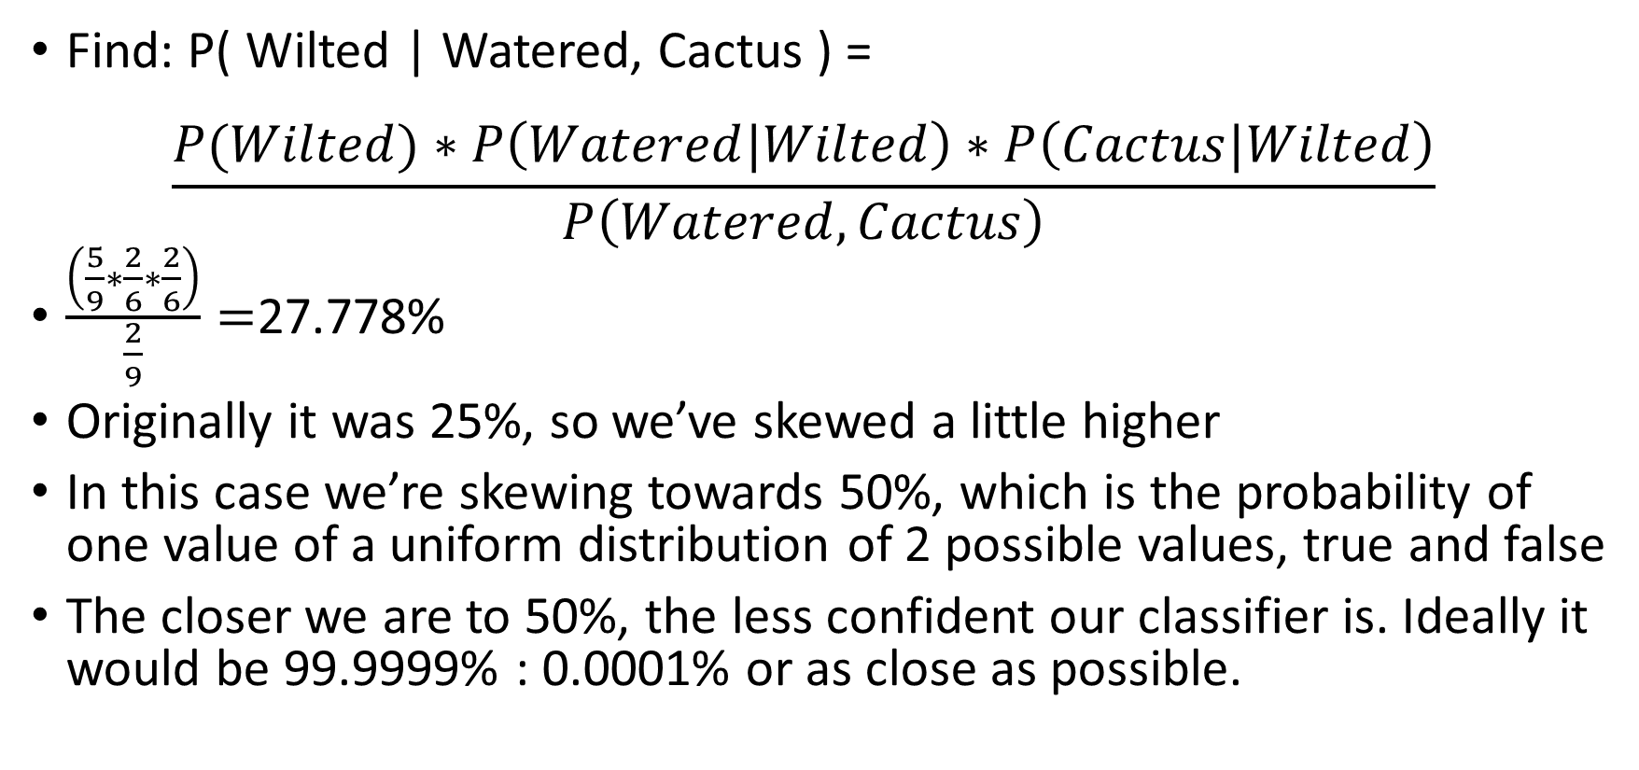
Laplace smoothing (4)
Find: P( Wilted | Watered, Cactus ) = $\frac{P(Wilted)∗P\left(Watered|Wilted\right)∗P\left(Cactus|Wilted\right)}{P\left(Watered,Cactus\right)}$
$\frac{\left(\frac{5}{9}∗\frac{2}{6}∗\frac{2}{6}\right)}{\frac{2}{9}}=$27.778%
Originally it was 25%, so we’ve skewed a little higher
In this case we’re skewing towards 50%, which is the probability of one value of a uniform distribution of 2 possible values, true and false
The closer we are to 50%, the less confident our classifier is. Ideally it would be 99.9999% : 0.0001% or as close as possible.

Slide 65
Another way of seeing LaPlace smoothing
We can think of the probability as a form of “confidence” (note: I’m using informal language—this is not a confidence score like in Stats)
The classifier can say “I’m 99% certain that this plant will be wilted”
It can also say “I’m 1% certain that this plant will be wilted”
Both of these are very confident. An answer of 50% is like shrugging and saying “I have no idea”.
LaPlace smoothing makes it less confident. It moves it away from 0% and also away from 100%, towards a number related to the dimensionality of the features.
Too much smoothing can hurt accuracy, so real classifiers often use a very small number.

Slide 66
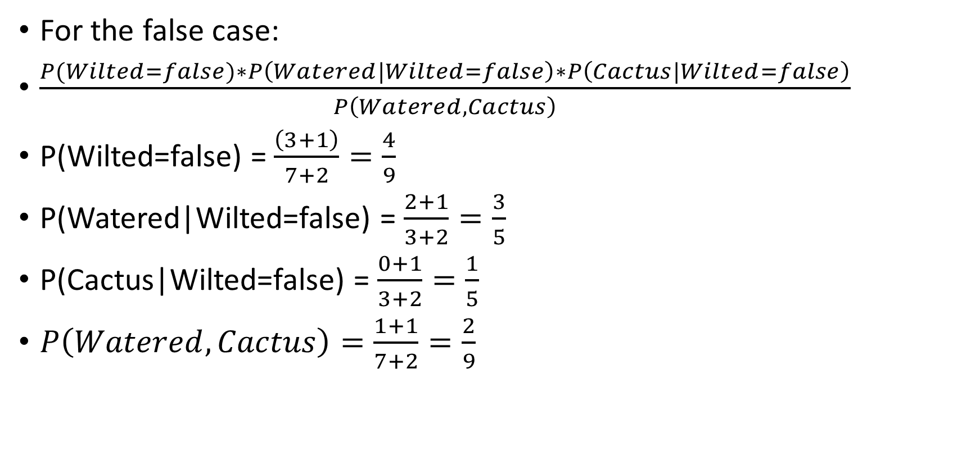
Laplace smoothing (5)
For the false case:
$\frac{P(Wilted=false)∗P\left(Watered|Wilted=false\right)∗P\left(Cactus|Wilted=false\right)}{P\left(Watered,Cactus\right)}$
P(Wilted=false) = $\frac{\left(3+1\right)}{7+2}=\frac{4}{9}$
P(Watered|Wilted=false) = $\frac{2+1}{3+2}=\frac{3}{5}$
P(Cactus|Wilted=false) = $\frac{0+1}{3+2}=\frac{1}{5}$
$P\left(Watered,Cactus\right)=\frac{1+1}{7+2}=\frac{2}{9}$

Slide 67
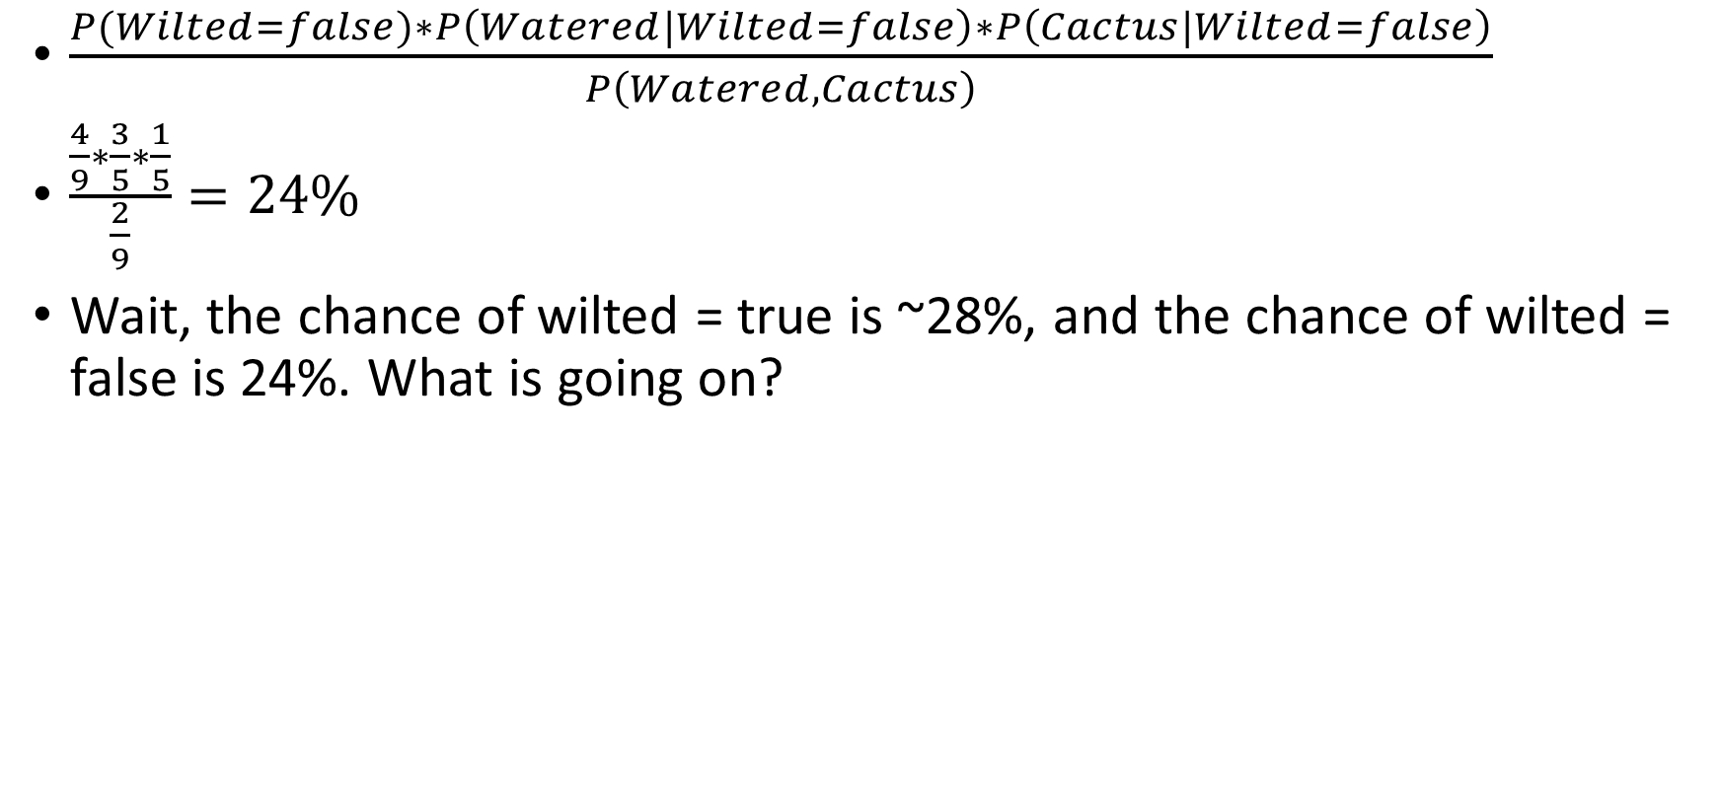
Laplace smoothing (6)
$\frac{P(Wilted=false)∗P\left(Watered|Wilted=false\right)∗P\left(Cactus|Wilted=false\right)}{P\left(Watered,Cactus\right)}$
$\frac{\frac{4}{9}∗\frac{3}{5}∗\frac{1}{5}}{\frac{2}{9}}=24\%$
Wait, the chance of wilted = true is ~28%, and the chance of wilted = false is 24%. What is going on?

Slide 68
Questions?

Slide 69
The law of total probability
We know that if there are mutually exclusive events, the probability that they will happen has to add up to 100%
For example, if the chance of a coin landing on heads is 49%, and 49% for tails, we know that the chance of it landing on its edge must be 2%. (unless a black swan happens: like the coin breaking in two and one side landing heads-up and one side landing tails-up. But that just means our original probabilities were wrong)
But, our probabilities do not.
It’s not LaPlace smoothing’s fault, btw. It happened originally when we had a zero probability.

Slide 70
Naïve bayes
When we use naïve Bayes, we don’t actually use the raw probabilities that the classifier outputs.
Instead, we treat them as odds ratios.
So, instead of 27.778% wilted and 24% not wilted (which doesn’t make sense), we say that the odds of being wilted are 27.778 : 24
What is that as a percentage?
27.778 / ( 27.778 + 24 ) = 53.648267604 %
24 / ( 27.778 + 24 ) = 46.351732396 %
Those do add up to 1.

Slide 71
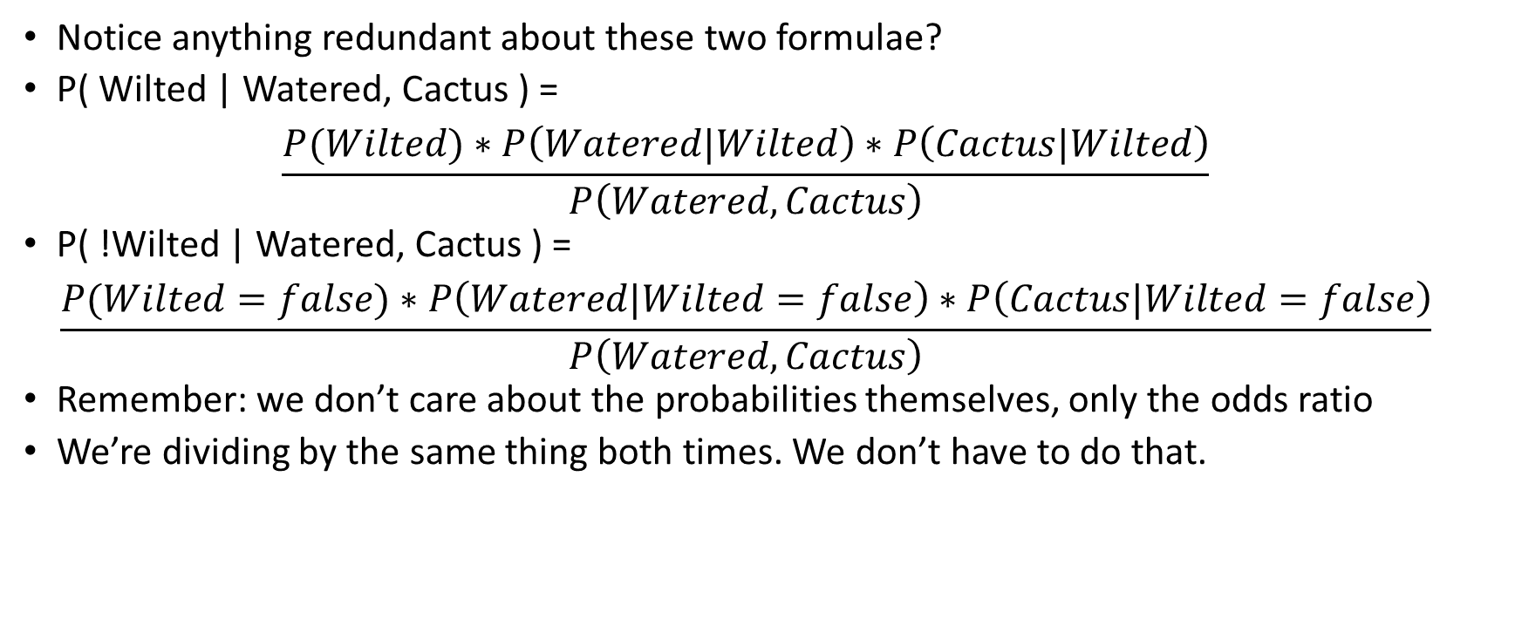
Making it easier
Notice anything redundant about these two formulae?
P( Wilted | Watered, Cactus ) = $\frac{P(Wilted)∗P\left(Watered|Wilted\right)∗P\left(Cactus|Wilted\right)}{P\left(Watered,Cactus\right)}$
P( !Wilted | Watered, Cactus ) = $\frac{P(Wilted=false)∗P\left(Watered|Wilted=false\right)∗P\left(Cactus|Wilted=false\right)}{P\left(Watered,Cactus\right)}$
Remember: we don’t care about the probabilities themselves, only the odds ratio
We’re dividing by the same thing both times. We don’t have to do that.

Slide 72
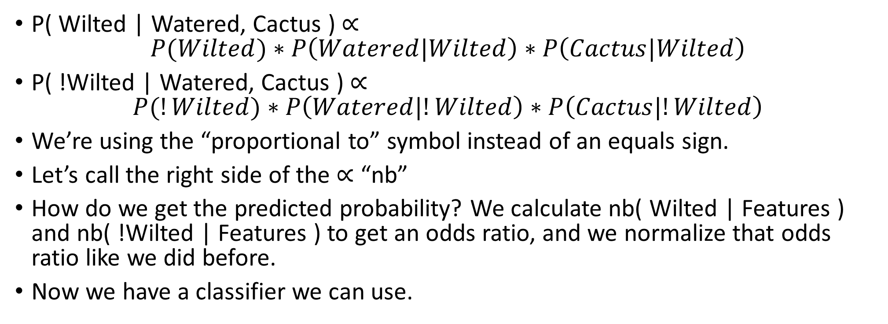
New formulae
P( Wilted | Watered, Cactus ) $∝$ $P(Wilted)∗P\left(Watered|Wilted\right)∗P\left(Cactus|Wilted\right)$
P( !Wilted | Watered, Cactus ) $∝$ $P(!Wilted)∗P\left(Watered|!Wilted\right)∗P\left(Cactus|!Wilted\right)$
We’re using the “proportional to” symbol instead of an equals sign.
Let’s call the right side of the $∝$ “nb”
How do we get the predicted probability? We calculate nb( Wilted | Features ) and nb( !Wilted | Features ) to get an odds ratio, and we normalize that odds ratio like we did before.
Now we have a classifier we can use.

Slide 73
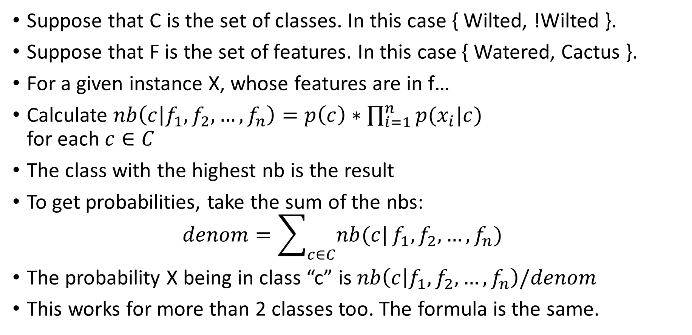
New formulae (2)
Suppose that C is the set of classes. In this case { Wilted, !Wilted }.
Suppose that F is the set of features. In this case { Watered, Cactus }.
For a given instance X, whose features are in f…
Calculate $nb\left(c | f_{1},f_{2},…,f_{n}\right)=p\left(c\right)∗\prod_{i=1}^{n}{p(x_{i}|c)}$ for each $c∈C$
The class with the highest nb is the result
To get probabilities, take the sum of the nbs: $denom=\sum_{c∈C}{nb(c|}f_{1},f_{2},…,f_{n})$
The probability X being in class “c” is $nb\left(c | f_{1},f_{2},…,f_{n}\right)/denom$
This works for more than 2 classes too. The formula is the same.

Slide 74
Questions?

Slide 75
Kinds of Naïve Bayes
There are three different versions of Naïve Bayes
Bernoulli Naïve Bayes: this is the “normal” version. The one we discussed. It only works on Boolean or categorical features.
Multinomial Naïve Bayes: works on “counts” instead of Boolean features. Uses the same formulae we learned, but instead of TRUE/FALSE we can have counts like “10”. Calculating the probability requires summing counts instead of TRUEs.
Gaussian Naïve Bayes: assumes that features are normally distributed variables.
Bernoulli is the one that we just learned. What about multinomial?

Slide 76
Dealing with categorical features
We just saw an example where each feature was true or false
How do we deal with a feature that can have 3 or more values?
Example: Feature FlowerColor, values = { Yellow, Red, Purple } Feature SerratedLeaf, values = { True, False } Class Plant = { Dandelion, Hibiscus, Violet }
Suppose we have the instance: ( Yellow, True ).

Slide 77
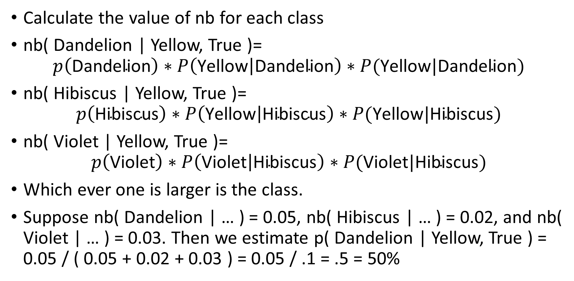
Dealing with categorical features (2)
Calculate the value of nb for each class
nb( Dandelion | Yellow, True )= $p\left(\text{Dandelion}\right)∗P\left(\text{Yellow} | \text{Dandelion}\right)∗P(\text{Yellow}|\text{Dandelion})$
nb( Hibiscus | Yellow, True )= $p\left(\text{Hibiscus}\right)∗P\left(\text{Yellow} | \text{Hibiscus}\right)∗P(\text{Yellow}|\text{Hibiscus})$
nb( Violet | Yellow, True )= $p\left(\text{Violet}\right)∗P\left(\text{Violet} | \text{Hibiscus}\right)∗P(\text{Violet}|\text{Hibiscus})$
Which ever one is larger is the class.
Suppose nb( Dandelion | … ) = 0.05, nb( Hibiscus | … ) = 0.02, and nb( Violet | … ) = 0.03. Then we estimate p( Dandelion | Yellow, True ) = 0.05 / ( 0.05 + 0.02 + 0.03 ) = 0.05 / .1 = .5 = 50%

Slide 78
Creating tables
You can pre-calculate p( Feature = Value ) in a table
You can also pre-calculate p( Feature = Value | Class ) for every class, and store that in a table
Many machine learning frameworks do this, but I won’t require it.
You can also use @lru_cache in python for a similar effect. I tried this in my version of the project and it sped it up a lot.

Slide 79
Underflow
One last thing. For two or three features, multiplying P( feature1 | class ) * P( feature2 | class ) is no big deal.
However, what if we have 10 or 100 features?
Each time we’re multiplying by a number that is in the range [0, 1]
That means it usually gets smaller each time. Sometimes much smaller.
We end up with floating point underflow. Underflow is when the number gets so close to zero that it becomes zero. (Going so low an integer wraps around to a high number is not underflow, that’s negative overflow. Underflow only happens to floats.)
How do you fix this?

Slide 80
Log probs
The key is to take the logarithm of each probability
Then, we add the logarithms together instead of multiplying them.
When we’re done, we can inverse the logarithm: pow( 2, log2( P( class ) ) + log2( P( feature1 | class ) ) + log2( P( feature2 | class ) ) )
This works because log(x) + log(y) is the same as log( x * y ), and when we take exp( log( x * y ) ) we end up with just x * y. But we didn’t need to multiply a bunch of small numbers together.
Be sure to do this in your project.

Slide 81
Questions?

Slide 82
Quiz next class
Make sure you can “solve” a Naïve Bayes problem by hand
I will show you a simple data set. Then I will give you an unlabeled instance and ask you to give me the probabilities that its label is true and false.
The data set will be a table of categorical features, but I might have a #instances column which means that we can repeat a row #instances times. This is to save space. Below: there are 10 instances with the features and target found in the first row.
FeatureA | FeatureB | Target | #Instances
True | True | True | 10
False | True | True | 2
True | False | False | 1

Slide 83
The project
I’ll be asking you to make a Bernoulli Naïve Bayes classifier
Let’s take a look at the project

Slide 84
Questions?

