Slide 1
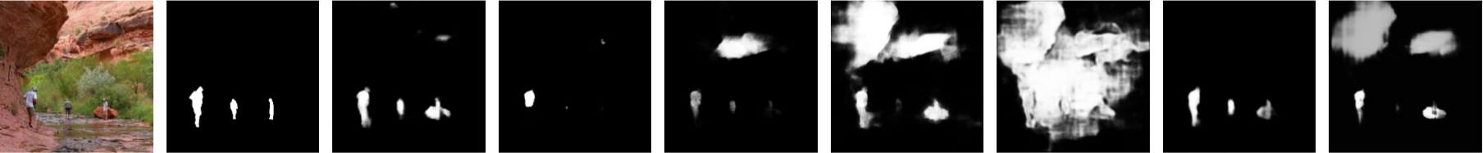

Slide 2

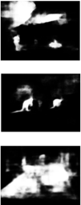
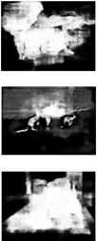

Image
GT
$${\text{DSS}}^{+}$$
Amulet
UCF

Slide 3

Saliency Detection
Output
multi-level features
Shared
Backbone
Network
(ResNet)
Caption
input
Image Caption
(LSTM)
multi-level features

Slide 4
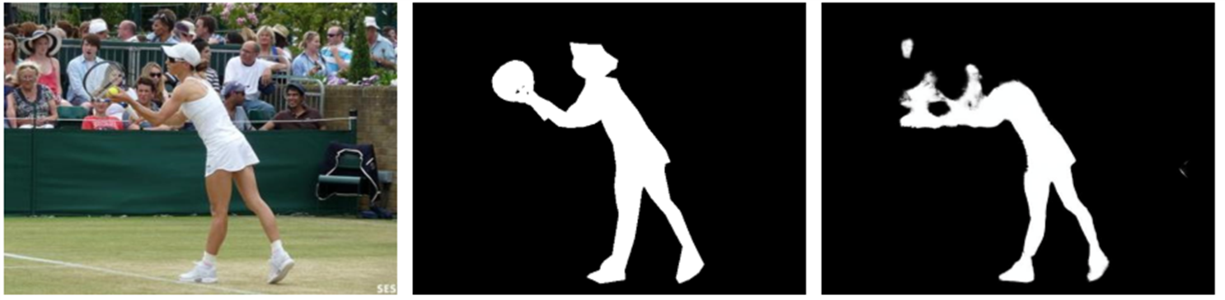






(3 * H * W)
Conv_1
Res2_X
$$h_{1}$$
Res3_X
Attention
Res4_X
Res5_X
$$h_{1}$$
$$h_{2}$$
$$h_{n}$$
AdaPool
PPM
LSTM
LSTM
…
LSTM
<start>
$$w_{1}$$
$$w_{n−1}$$

Slide 5
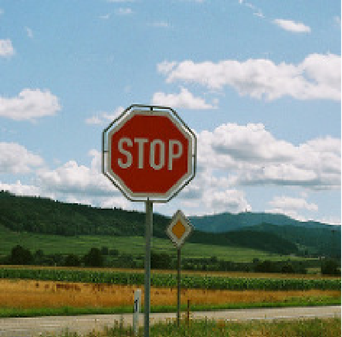
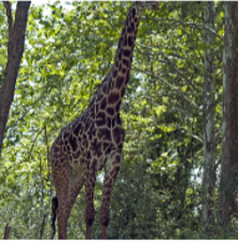
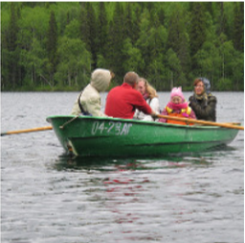
(a) A stop sign is on a road with a mountain in the background.
(b) A giraffe standing in a forest with trees in the background.
(c) A group of people sitting on a boat in the water.

Slide 6
256*256*512
Conv_1
256*256*64
Up5
256*256 *(128+512)
128*128*512
Res2_X
128*128*256
Up4
128*128*(256+512)
64*64*512
Res3_X
64*64*512
Up3
64*64*(512+512)
32*32*512
Res4_X
32*32*1024
Up2
32*32*(1024+512)
16*16*512
Res5_X
16*16*2048
Up1
16*16*(2048+512)
PPM
LSTM
…
attention
Global Supervised Information
Caption Embedded Vector(512)
Hidden State

