Slide 1




BY
<CODINGTON/>

Slide 2

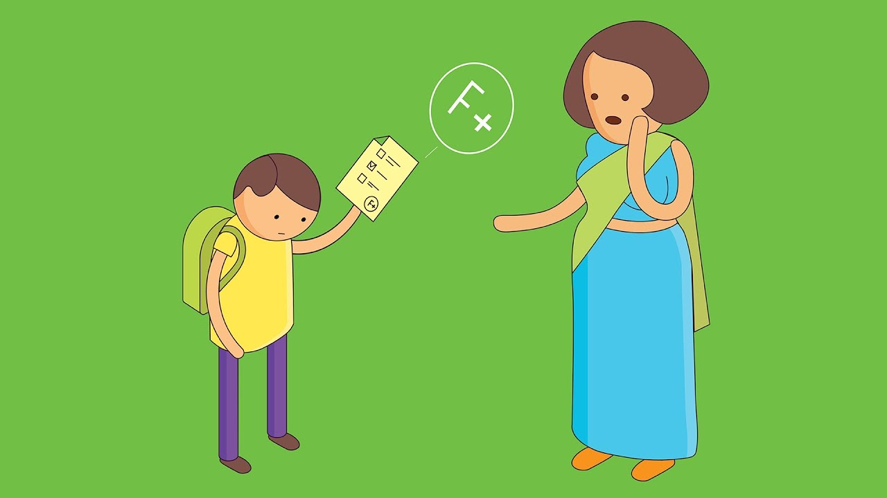
Problems
Problem: Students are dropping out due to Academic struggles.
Problem: Students are dropping out due to Lack of resources.
Problem: Low Pass rate.
Problem: Students are being taught in one learning style.
Problem: Students cant go to school due to corona.
Problem: Students studying Education cannot do their Practicals.

Slide 3
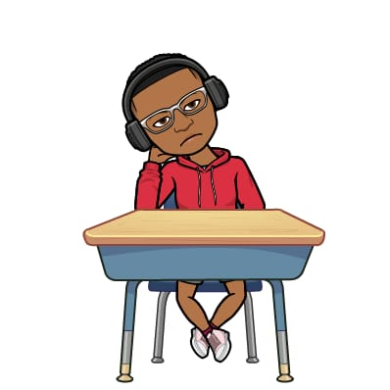
Interesting Information
While girls are less likely to be in school, boys are more likely to repeat grades or drop out altogether
Worldwide, 12% or 775 million adults are considered illiterate
In most developing countries public school is not free. The cost of books, uniform, and teachers’ salaries are depended on the sudents’ famalies
An Estimated 2/3 students who are unable to read with proficiency by the end of grade 4 are more likely to end up in welfare or in jail.
About 2/3 of the world’s lowest literate adults are women

Slide 4




Slide 5

Solution
StuCo Academy
“Where Students Collaborate, Study & Connect”

Slide 6
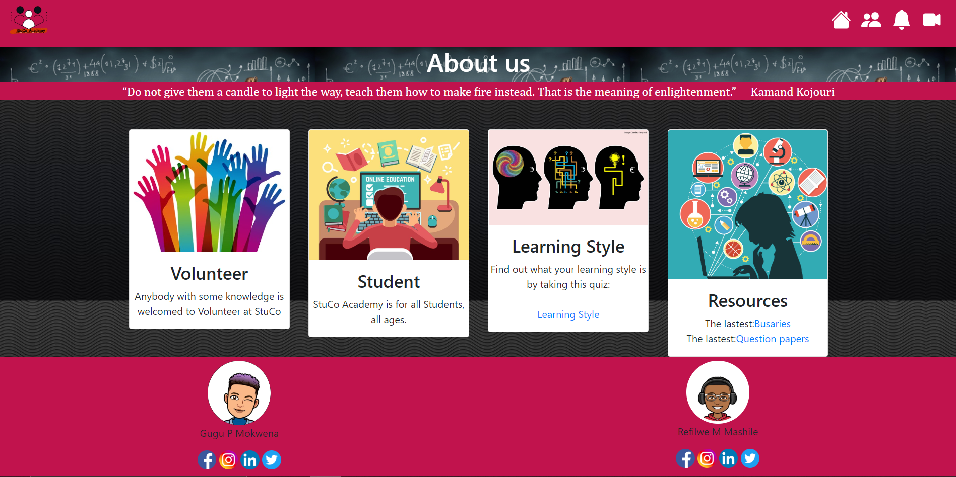




Volunteer
Student
Learning style
Resources

