Slide 1

Big Mountain Budget Recommendations
Machine Learning model results

Slide 2
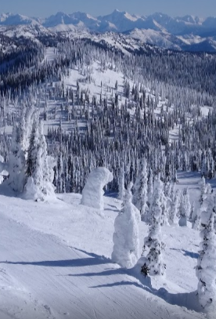
Goals
Big Mountain Resort has installed a new chairlift
Operating costs are projected to reach $1.5 million over the season
How can we increase profit to offset this cost?
Ticket prices at Big Mountain are at a premium, but are they still lower than they could be?
We compared Big Mountain’s amenities and prices to those of other resorts across the country

Slide 3
Recommendation: Raise prices
Current ticket price: $81
Price suggested by model: $96
Most conservative recommended price: $89

Slide 4
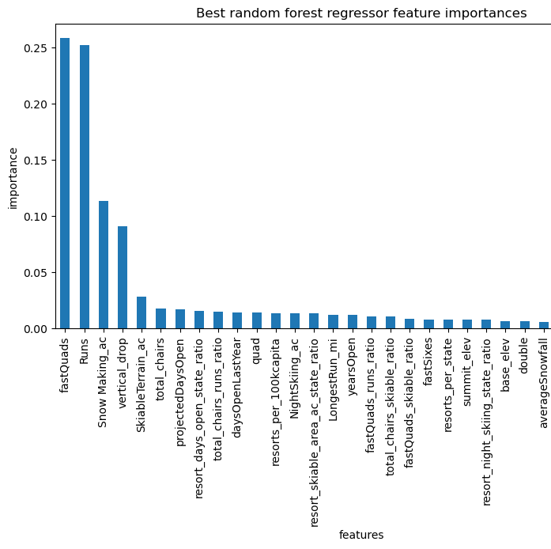
Important features
Best mode found to relate amenities to ticket prices:
Random Forest
Top features relevant to ticket price:
Number of Fast Quads
Number of runs
Amount of snow-making land
Vertical drop

Slide 5
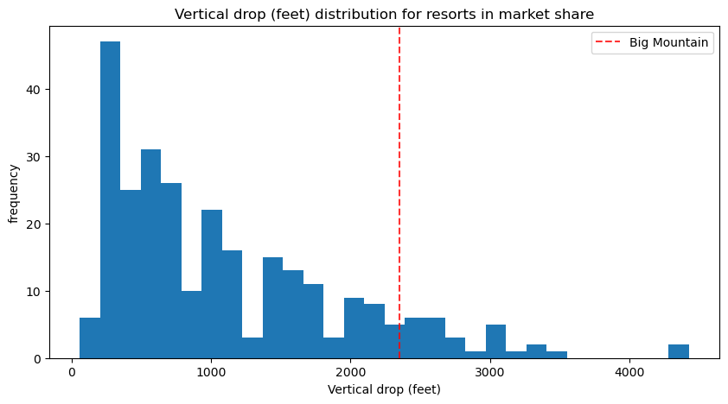
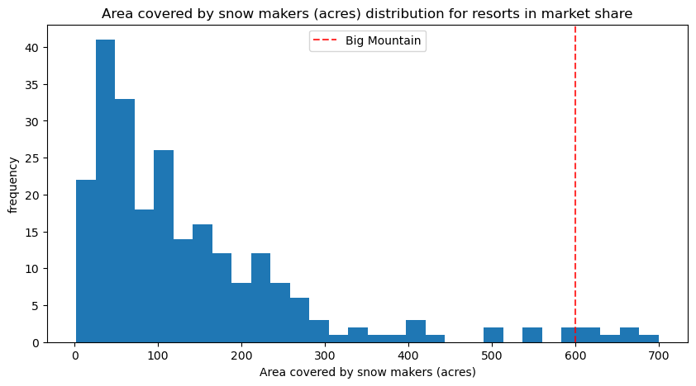
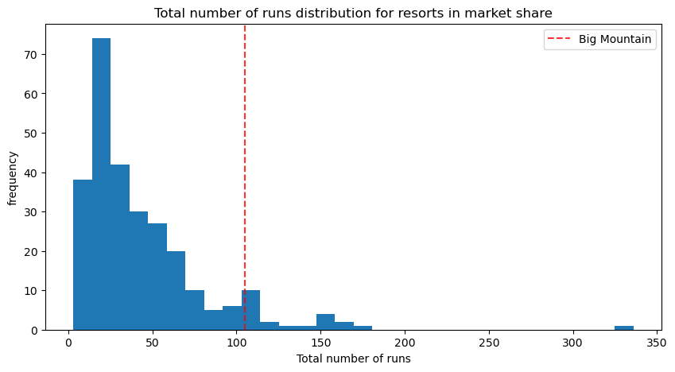
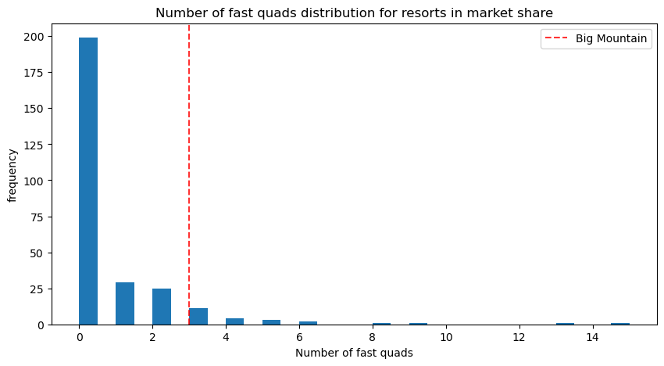
Big Mountain is well above average on all these features

Slide 6
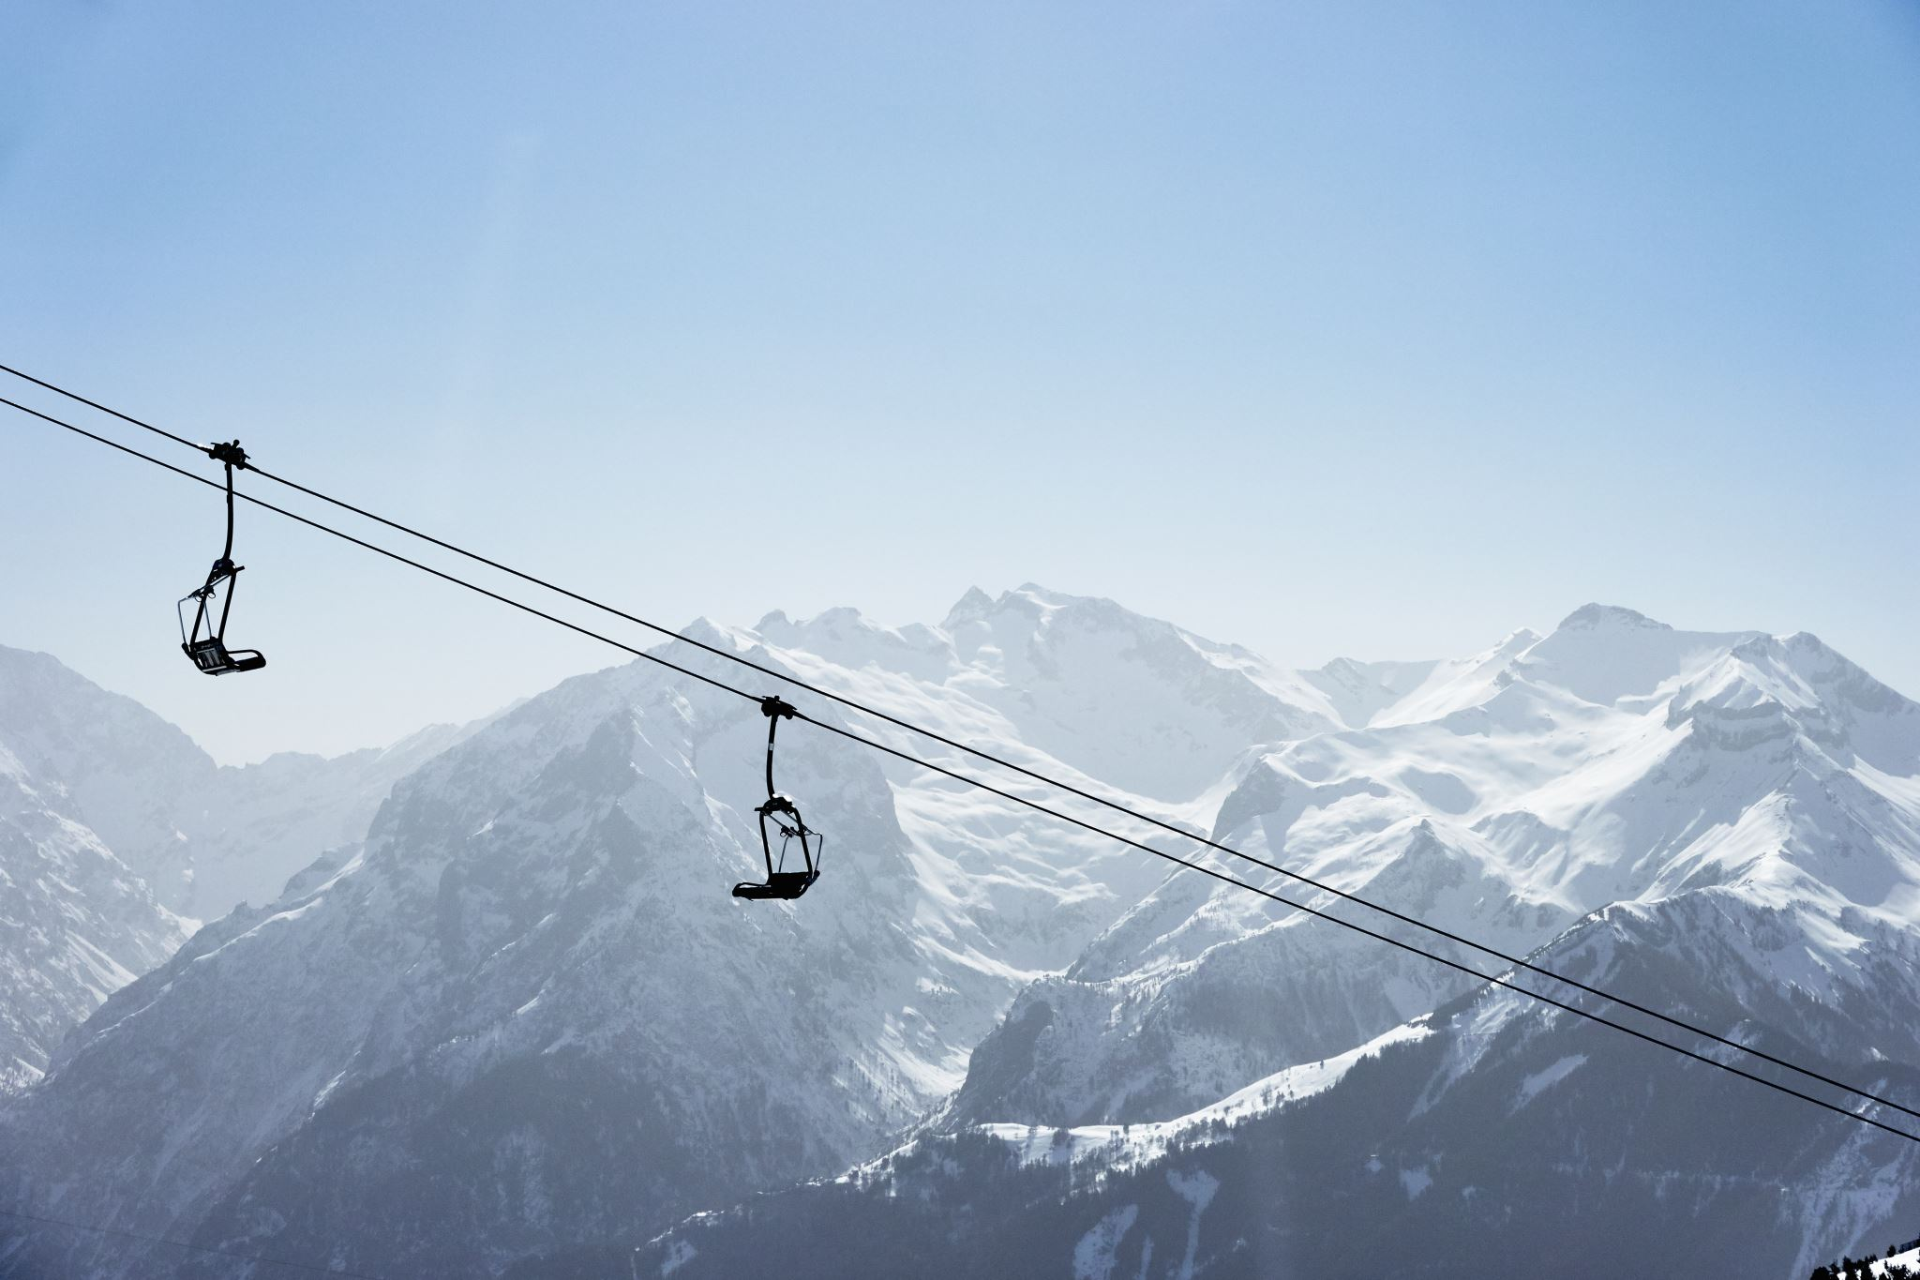
Conclusion
Without making any changes to the resort itself, Big Mountain could justify a price increase of around $15.
This would create a projected revenue increase of $26.2 million over the course of the season
This would recoup the cost of the new chairlift 17.5 times over

