Slide 1

INSE6610 Project Presentation
Tools in cybercrime investigations
Group 05 Project Presentation

Slide 2
INSE6610 Project Presentation
Content
Student Name | Student ID
Shiva Bahador | 40154795
Feiyu Duan | 40160978
Yifeng Shu | 40170236
Harpreet Kaur | 40190384
Parva Rohit Kumar Raval | 40172735
Ranjan Haranahalli Ramesh | 40167577
Aishwarya Shankar | 40170602

Slide 3
INSE6640 Project Presentation
Content
Overview
Methods exist
Memory Forensics
Computer Forensics/Hard drive Forensics
Network Intrusion Detection
Mobile forensics
Contribution
Index

Slide 4
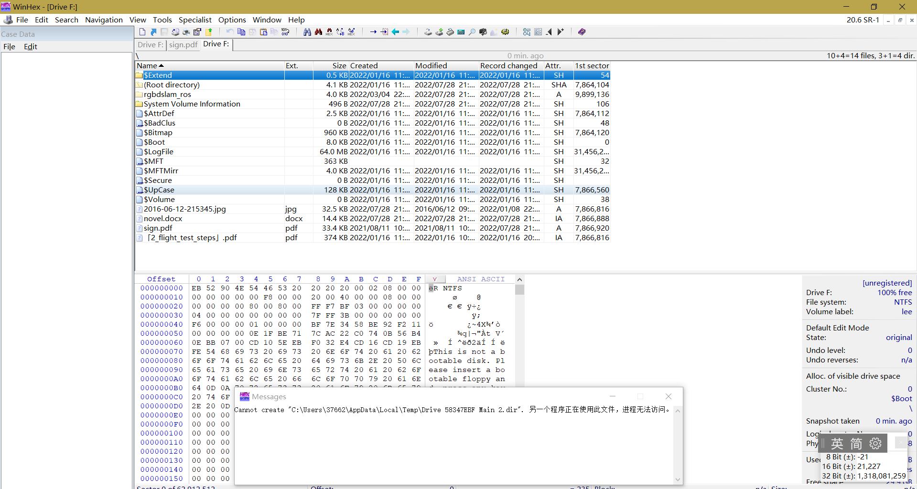
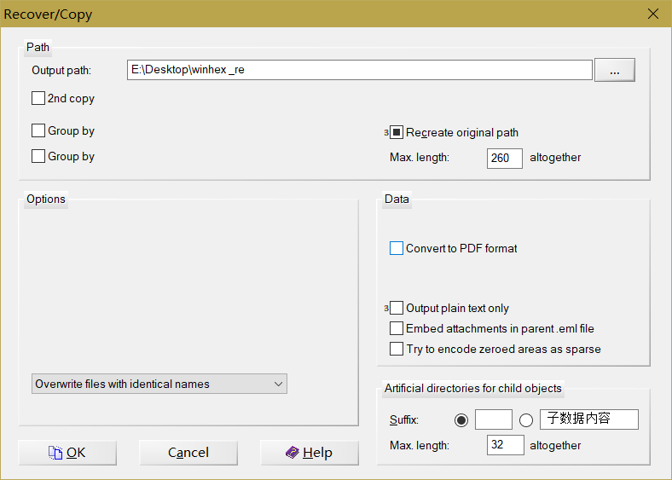
INSE6610 Project Presentation
Computer Forensics
1.Winhex
WinHex is a commercial disk editor and universal hexadecimal editor (hex editor) used for data recovery and digital forensics. It is made by X-Ways Software Technology AG of Germany.

Slide 5
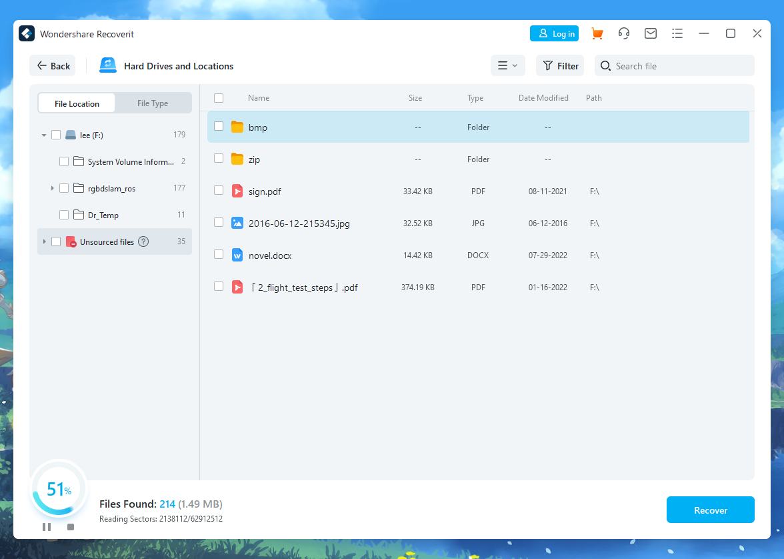
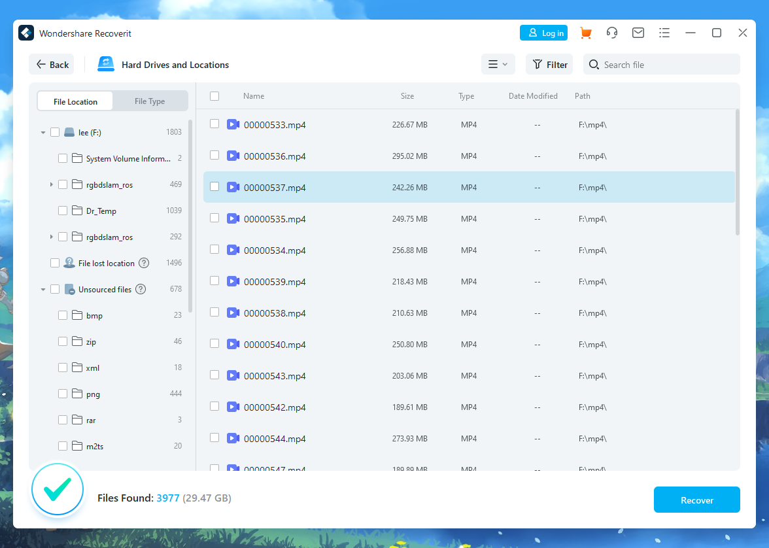
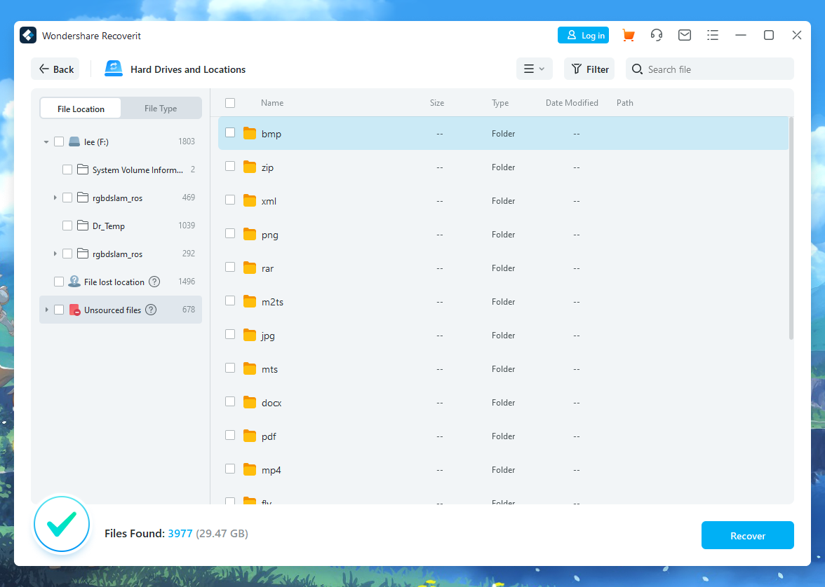
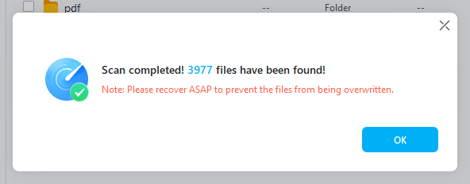
INSE6610 Project Presentation
Computer Forensics
2.Wondershare Recoverit
Wondershare has been active since 2003. Since its creation, it has come a long way, releasing a range of drive recovery and repair tools, in addition to others.

Slide 6
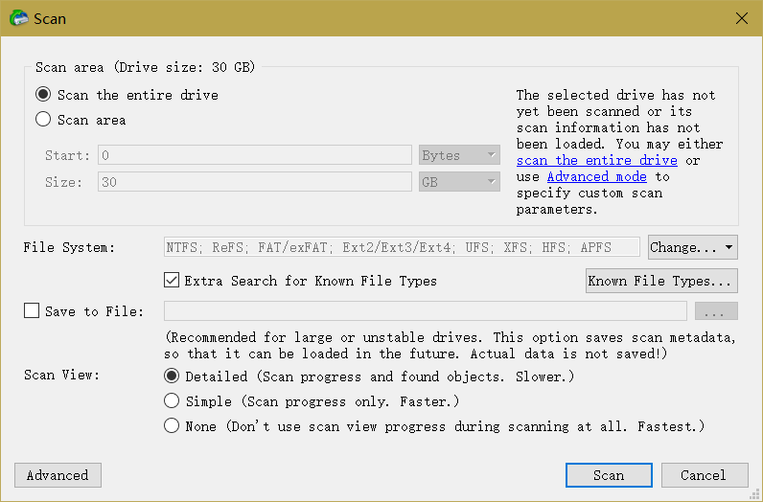
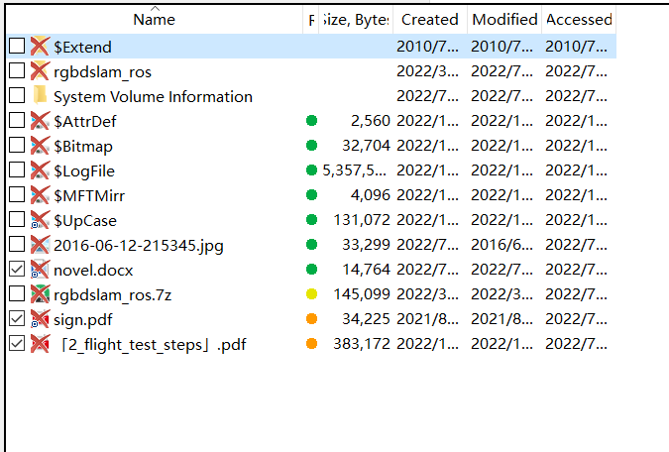
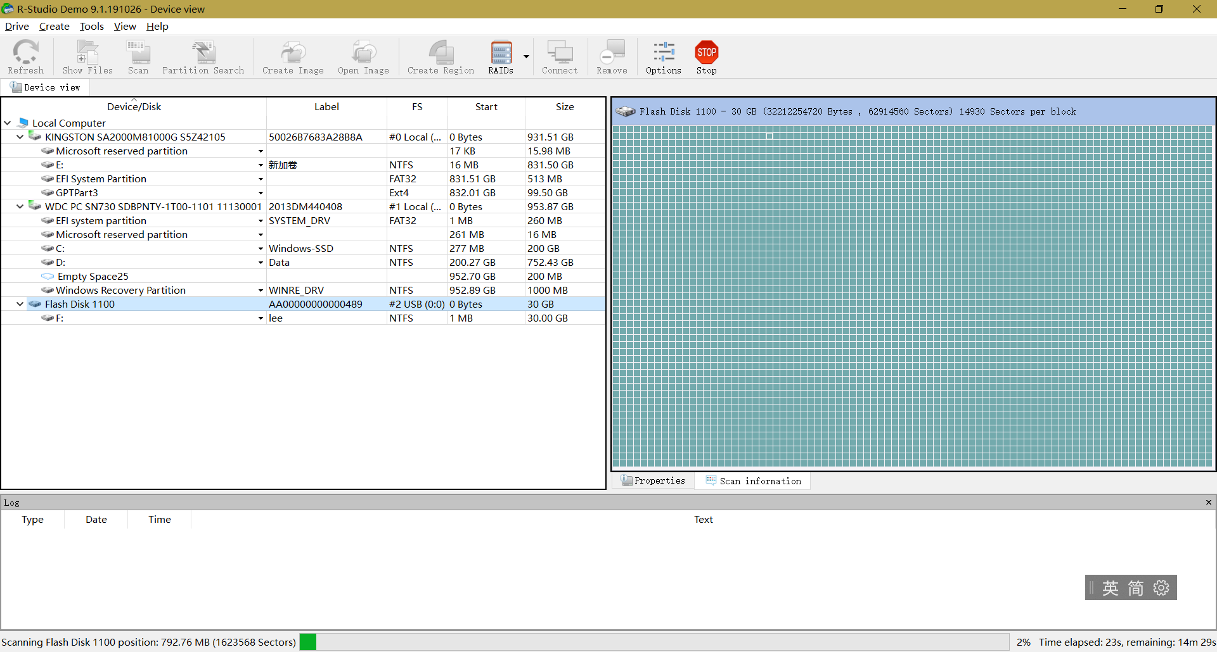
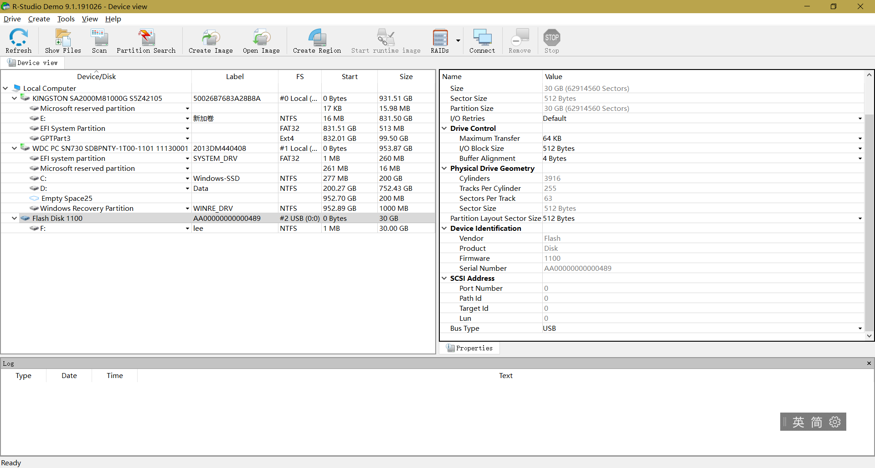
INSE6610 Project Presentation
Computer Forensics
3. R-studio
R-STUDIO functions on local and network disks, even if such partitions are formatted, damaged or deleted

Slide 7
INSE6610 Project Presentation
Computer Forensics
tool name | Time | result | price
winhex | seconds/immediately | good | Free/open source
Wondershare recoverit | 15min | very good | $79.99/Year
r-stdio | 14m52s | very good | $49.99 with a free demo

