Slide 1
USED CAR PRICE PREDICTION
RNS INSTITUTE OF TECHNOLOGY
BENGALURU – 98
DEPARTMENT OF INFORMATION SCIENCE & ENGINEERING
Presentation on Internship
MANIT S HEGDE
USN: 1RN20IS084
Internal Guide
Ms. Chaitra s
Asst. Prof, Dept of ISE, RNSIT

Slide 2
AGENDA
Abstract
About the Company
Introduction
Terminologies
Linear Regression
Random Forest
Implementation
Results
Conclusion
Limitation
Future Enhancements
References

Slide 3
ABSTRACT
This project aims to predict used car prices using Linear Regression and Random Forest models. Pre-processing includes data collection, cleaning, feature engineering, scaling, and encoding. Training and testing datasets are split, and models are evaluated using metrics like MAE and RMSE. Random Forest outperforms Linear Regression due to its ability to handle nonlinearity and complexity. Overall, the project demonstrates machine learning's application in predicting car prices, emphasizing robust pre-processing and model selection to enhance accuracy and inform decision-making in the used car market. Industries can offers valuable insights for stakeholders in the automotive industry, enabling informed and data-driven decision-making for buyers, sellers, and dealers navigating the dynamic used car market.

Slide 4
INTRODUCTION
Model Comparison : Linear Regression serves as a baseline model, offering interpretability, while Random Forest captures intricate relationships in the data, providing a comprehensive comparative analysis.
Performance Metrics : Model evaluation includes key metrics like accuracy, precision, recall, and feature importance, ensuring a thorough assessment of predictive capabilities.
Application Scope : The project's findings offer valuable guidance for stakeholders in the automotive industry, enabling informed decision-making and enhancing efficiency in the used car market.
Data Exploration : A robust exploration of the dataset involves critical steps such as data cleaning, handling missing values, and feature engineering to ensure the quality of input for machine learning models.

Slide 5
TERMINOLOGIES
Regression: A supervised machine learning task where the model learns to predict a continuous output variable (e.g., price) based on given input features (e.g., car characteristics).
Feature Selection: Selecting the most relevant features for the model.
Feature Engineering: Creating new features from existing data or modifying existing features to improve model performance.
Data Preprocessing: Cleaning and preparing the data for model training.
Model Training: The process of feeding the data to the machine learning model and allowing it to learn the relationship between features and the target variable.
Model Evaluation: Assessing the performance of the trained model on unseen data.

Slide 6
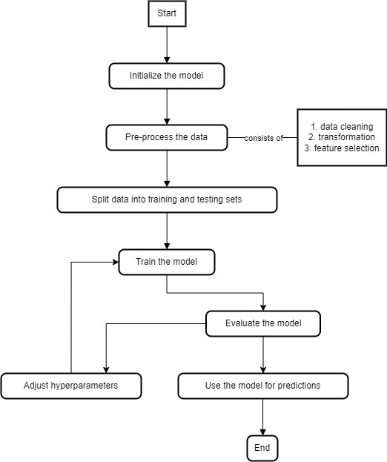
SYSTEM DESIGN

Slide 7
LINEAR REGRESSION
Relationship : It models the linear relationship between one or more independent variables (x) and a dependent variable (y).
Equation : It represents the relationship as a linear equation: y = mx + b, where m is the slope and b is the y-intercept.
Fitting: It finds the "best fit" line by minimizing the sum of squared errors between predicted and actual values of y.
Assumptions : It relies on certain assumptions like linearity, homoscedasticity (constant variance), and independent errors.
Minimizing Error: Learns by finding the line that minimizes the difference between predicted and actual values.
Applications : It is widely used for prediction, analysis, and understanding trends in various fields like economics, finance, science, and engineering.

Slide 8
RANDOM FOREST
Ensemble Learning : Combines multiple decision trees to improve accuracy and reduce overfitting.
Diversity : Each tree is trained on a different random subset of data with features randomly selected at each split, leading to diverse predictions.
Voting : Predictions are made by averaging the predictions of all individual trees, making the model more robust to outliers and noise.
Strengths : Highly accurate for both classification and regression tasks, handles complex relationships, and provides feature importance insights.
Weaknesses : Requires more computational resources than single decision trees, prone to overfitting with high number of trees, and less interpretable compared to linear models.

Slide 9
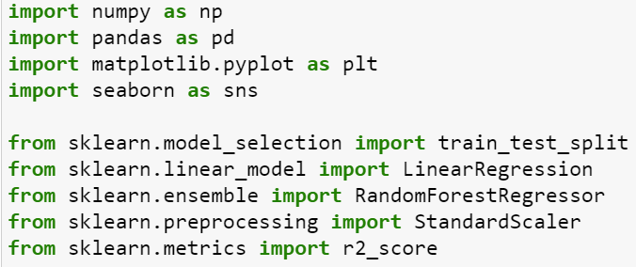
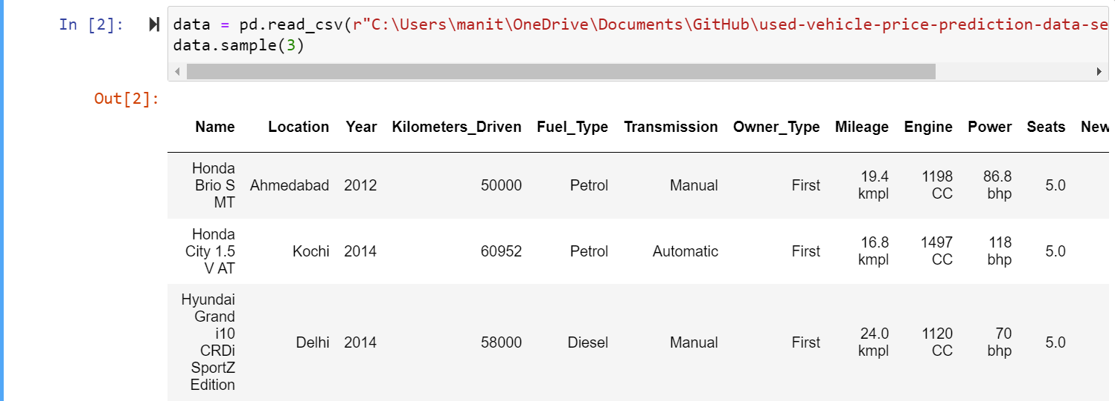
IMPLEMENTATION
IMPORTING THE HEADERS
LOAD THE DATA

Slide 10
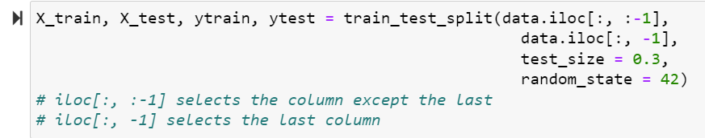
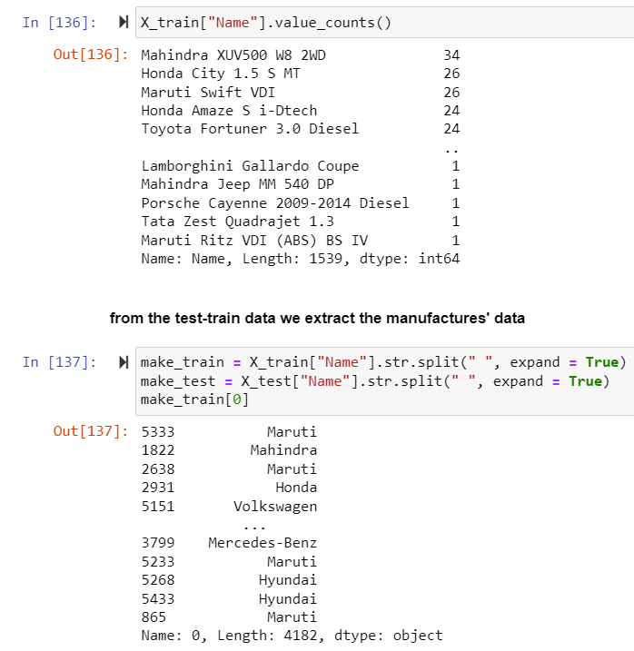
IMPLEMENTATION
SPLITTING THE DATA INTO TRAINING AND TESTING DATASETS
MANUFACTURER’S COLUMN PRE-PROCESSING

Slide 11
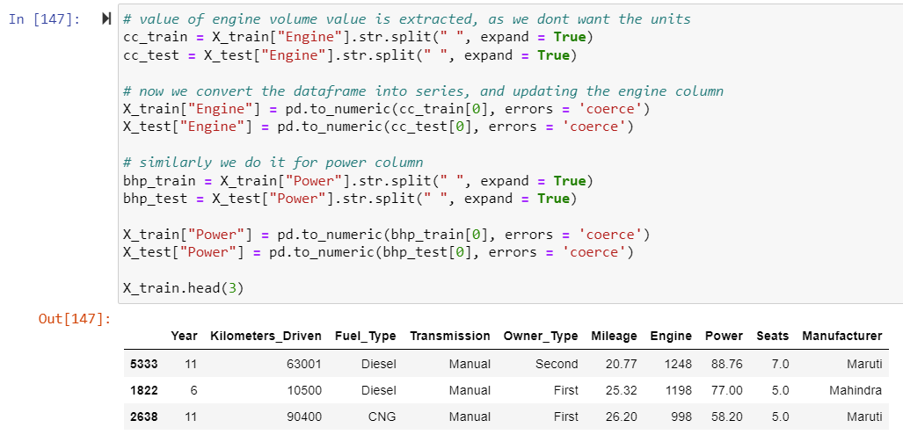
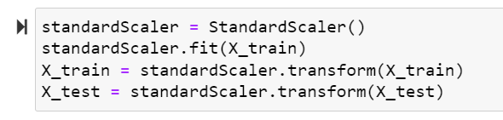
IMPLEMENTATION
ENGINE AND POWER COLUMN PRE-PROCESSING
TRAINING

Slide 12
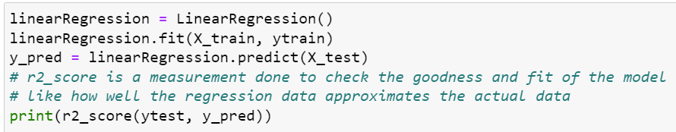
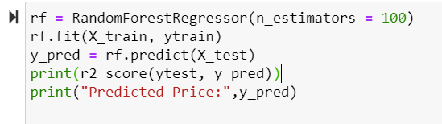
IMPLEMENTATION
TRAINING LINEAR REGRESSION MODEL
TRAINING RANDOM FOREST MODEL

Slide 13
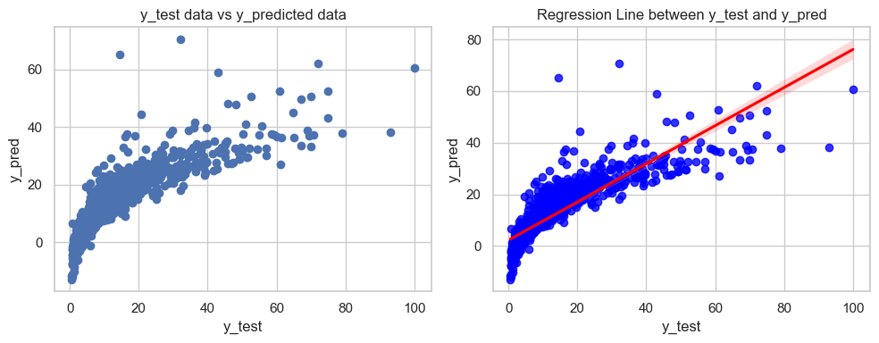
RESULTS
R2 score of linear regression model
R2 Score : The Linear Regression model scored approximately 0.698, explaining 69.8% variance in used car prices.
Goodness of Fit : R2 indicates how well the model approximates actual data, gauging its performance.
Visualization : A scatter plot illustrates the model's predictive relationship between y_pred and y_test.

Slide 14
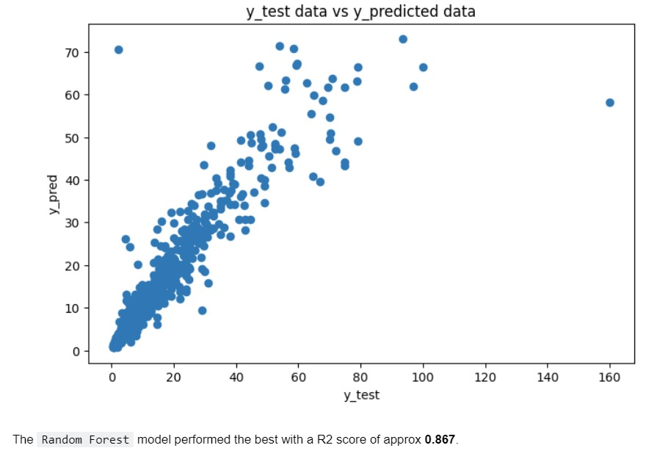
RESULTS
R2 score of random forest model
R2 Score : Random Forest achieved a remarkable 0.868, signifying 86.8% variance explanation.
Outperformance : Surpassing Linear Regression, it excelled in predicting prices.
Visual Insight : A scatter plot illustrates the predictive relationship.

Slide 15
CONCLUSIONS
The project's central goal was to predict used car prices, involving thorough exploration, data preprocessing, and model building.
Two machine learning models, Linear Regression and Random Forest Regression, were trained and evaluated based on the R2 score—a metric measuring the goodness of fit.
Results indicated that the Random Forest Regression model outperformed Linear Regression, achieving a higher R2 score of around 86.7%, while the Linear Regression model achieved approximately 69.7%.
The findings suggest that the Random Forest model is more effective in predicting used car prices, providing a robust foundation for future optimization and insights into critical features influencing prices.

Slide 16
LIMITATIONS
Data Quality Challenges: Inherent inaccuracies or biases in the dataset could impact the models' accuracy, requiring thorough validation and cleaning processes.
Limited Feature Consideration: The models heavily rely on selected features, potentially overlooking crucial factors influencing used car prices and limiting the scope of predictions.
Assumption of Linearity: Linear Regression assumes a linear relationship between variables; if the true relationship is nonlinear, predictions may deviate from actual values.
Generalization Concerns: Models trained on specific data may face challenges when applied to new, unseen data, raising questions about the broader generalizability of predictions.

Slide 17
FUTURE ENHANCEMENTS
Developing a mobile app: Creating a user-friendly mobile app that allows users to input car details and receive an instant price prediction on the go.
Integration with online platforms: Integrating the price prediction model with online car buying and selling platforms can provide sellers with realistic price estimates and buyers with insights into market trends.
Localized Price Trends: Incorporate regional or city-wise price trends to provide more accurate predictions based on the local market conditions.
Historical Price Analysis: Provide users with historical price trends for specific car models. This feature could help users make more informed decisions by understanding how prices have changed over time.

Slide 18
REFERENCES
[1] https://ieeexplore.ieee.org/document/9995772
[2] https://www.academia.edu/77140370/Used_Car_Price_Prediction_using_ Different_Machine_Learning_Algorithms
[3] https://towardsdatascience.com/predicting-used-car-prices-with-machine- learning-techniques-8a9d8313952
[4] https://scikit-learn.org/stable/modules/classes.html

Slide 19
THANK YOU

