Slide 1




// capstone project · 2026
Investment Data Pipeline
Client portfolios in Saudi Riyal, automatically.
Maryam Alotaibi
Fayhaa Alharbi
Rawan Alaklabi
Hanoof Alassiri
SDA Data Engineering Bootcamp · WeCloudData

Slide 2






// problem & solution
Rawan
The problem
Internal ledger
Alpha Vantage
50,000 trades · every 45 min
equities · USD · weekdays only
20 clients
10 portfolios
BUY / SELL
AAPL
MSFT
GOOGL
IBM
SAP
VOD
SPY
GLD
Client portfolio
in SAR = ?
metalprice API
Exchange-rate API
metals · USD / oz · daily
FX rates · daily
XAU
XAG
XPT
XPD
USD
EUR
GBP
CHF
INVASIGHT · 2026
02 / 14

Slide 3

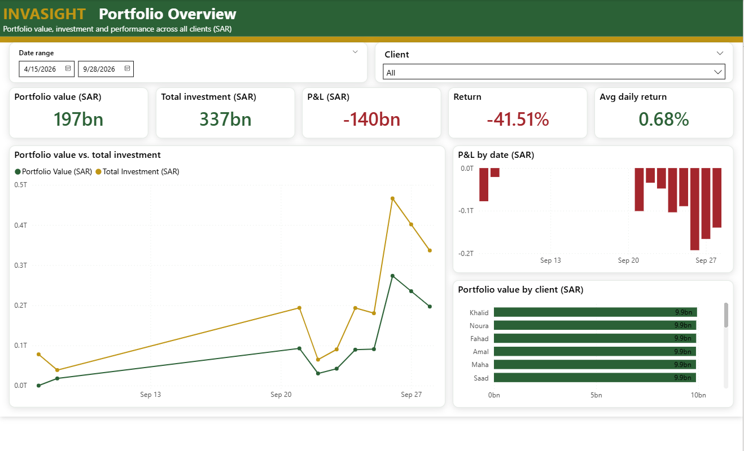







// problem & solution
Rawan
Our solution
Ledger
invasight pipeline
Equities
›
›
›
›
Airflow
ADLS
Snowflake
dbt
Metals
✓ validated
✓ in SAR
✓ tested
One live view per client, in SAR
FX rates
INVASIGHT · 2026
03 / 14

Slide 4


// stakeholders
Rawan
Built for wealth management teams
Risk & compliance
Currency exposure
primary user
Wealth managers
Leadership
Performance at a glance
A daily SAR view of every individual client: value, P&L, allocation.
Data & IT teams
Automated, tested pipeline
INVASIGHT · 2026
04 / 14

Slide 5








// technology stack
Rawan
What InvaSight runs on
orchestration
language
landing zone
warehouse
Apache Airflow
Python · SQL
Azure ADLS
Snowflake
transformation
visualization
containers & ci/cd
cloud
dbt
Power BI
Docker · GitHub Actions
AWS EC2 · Secrets Manager
INVASIGHT · 2026
05 / 14

Slide 6





// how it works
Maryam
Data pipeline architecture
Apache Airflow
orchestration: schedules and triggers every step
1
Generate / fetch & validate
2
Upload
3
COPY INTO
Internal ledger
Equity prices
Snowflake
Power BI
Precious metals
Azure ADLS
data warehouse
landing zone
dashboard
FX rates
Raw
Staging
Analytics
Data sources
4
dbt build
dbt
transformation & tests
INVASIGHT · 2026
06 / 14

Slide 7
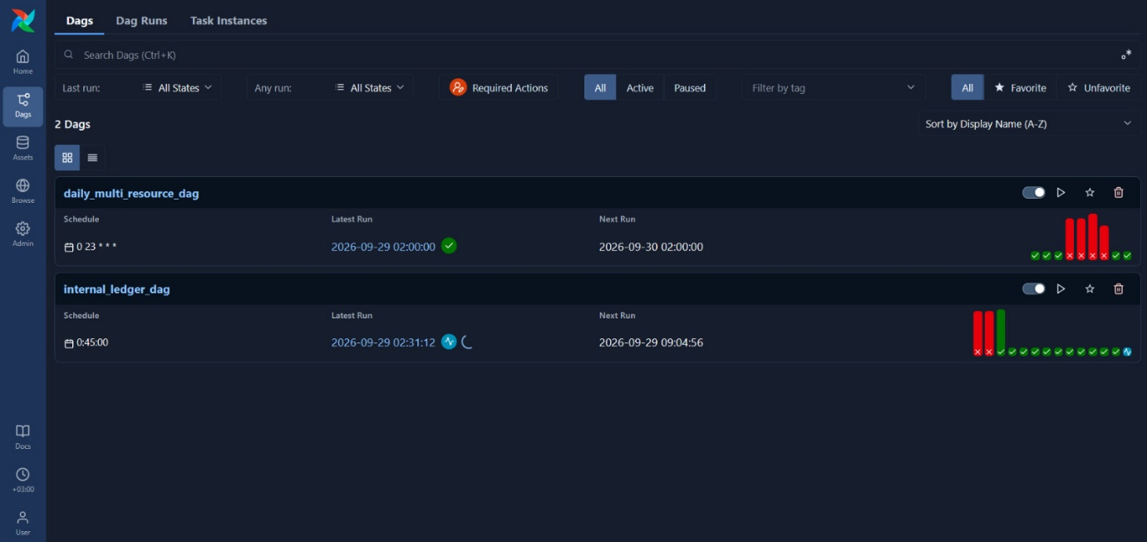
// results
Fayhaa
Pipeline running
airflow · ledger every 45 min · market data daily
INVASIGHT · 2026
07 / 14

Slide 8
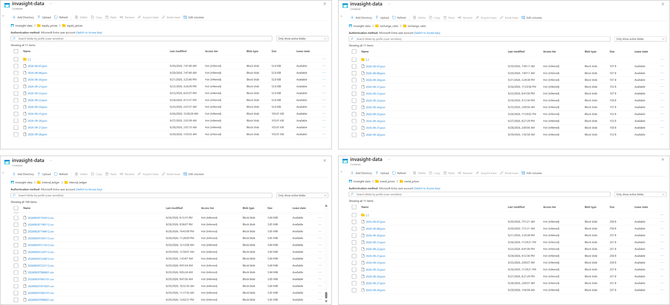
// results
Fayhaa
Azure Blob Storage
adls · one folder per source · a new file every run
INVASIGHT · 2026
08 / 14

Slide 9
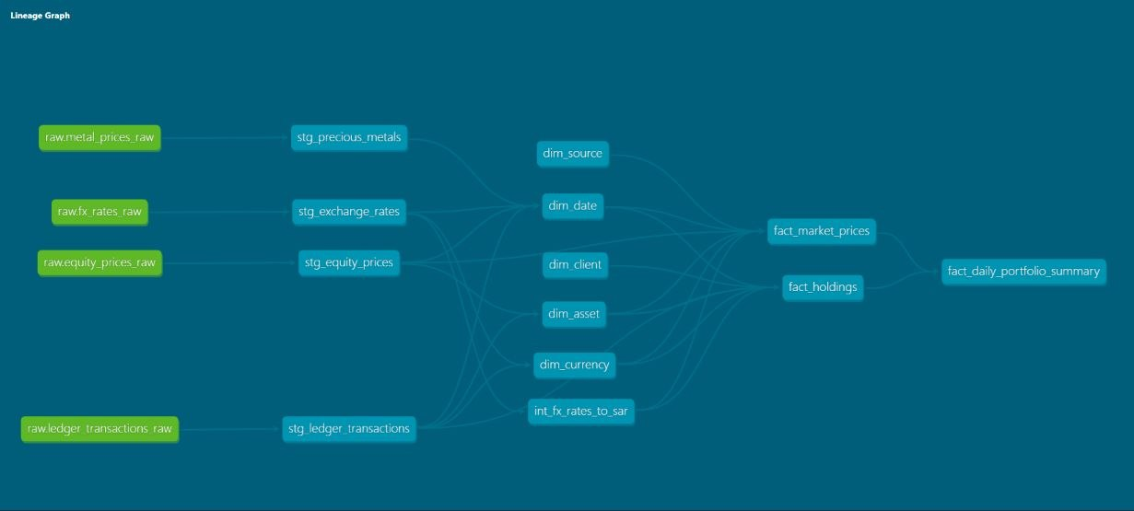
// results
Fayhaa
Lineage graph
dbt · raw → staging → analytics
INVASIGHT · 2026
09 / 14

Slide 10
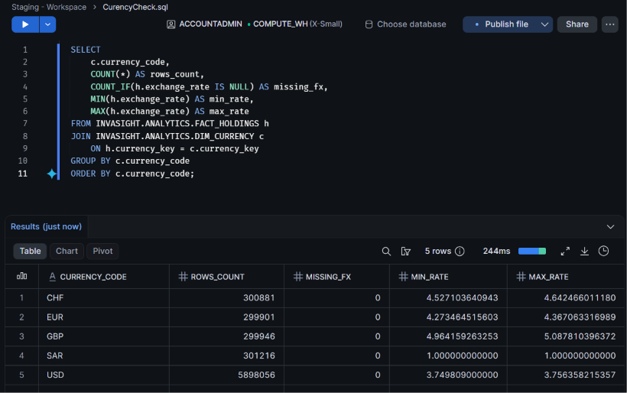
// results
Fayhaa
Dataset: galaxy schema
fact_holdings
dim_date
snowflake · SAR check
dim_asset
fact_market_prices
dim_client
dim_currency
fact_daily_portfolio_summary
dim_source
61/61
0
dbt tests pass
missing FX rates
INVASIGHT · 2026
10 / 14

Slide 11
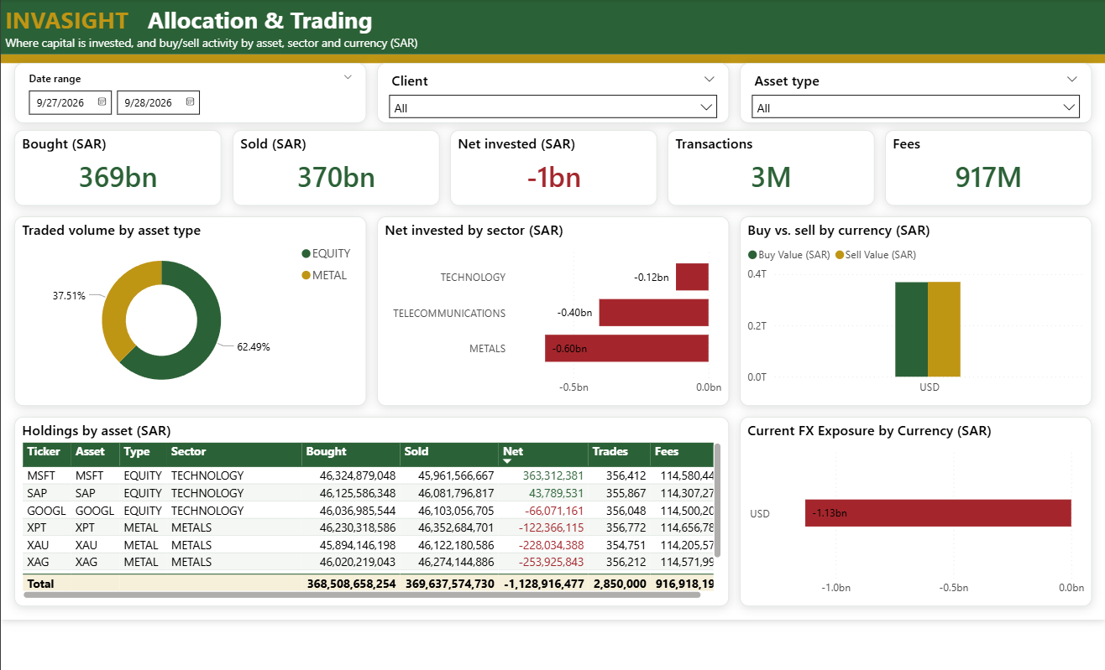
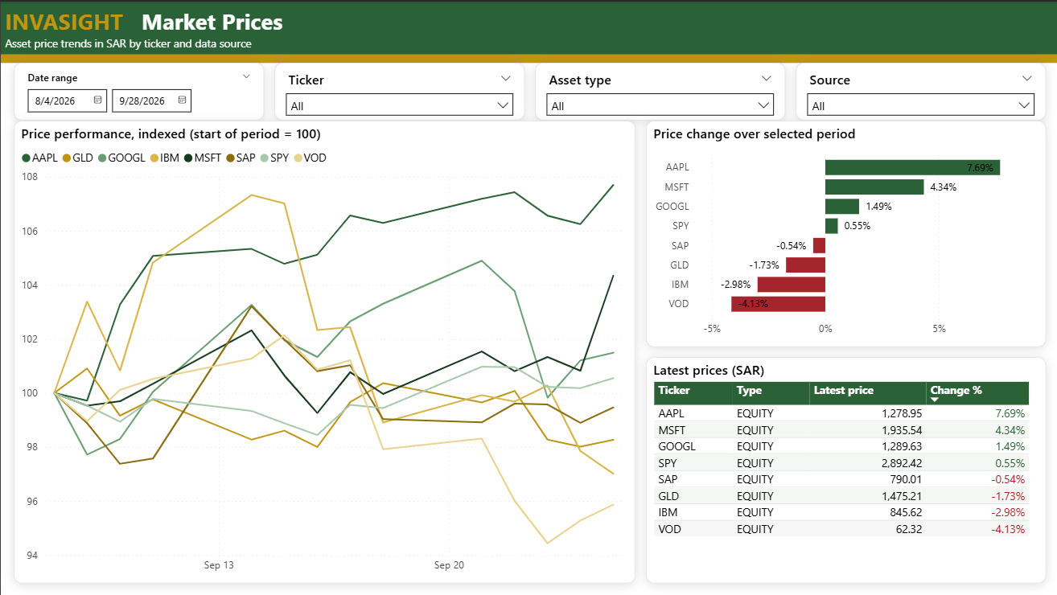
// results
Fayhaa
Dashboard: Power BI on Snowflake
portfolio overview
allocation & trading
market prices
INVASIGHT · 2026
11 / 14

Slide 12


// challenges & limitations
Hanoof
What we ran into
challenges
limitations
Servers brute-forced over open SSH
Renamed columns broke the dashboard
Steps reporting success while doing nothing
Synthetic ledger: returns are illustrative
No stock prices on weekends
API free tier: 25 requests a day
Running locally until redeployed
INVASIGHT · 2026
12 / 14

Slide 13
// future work
Hanoof
Next steps
01
02
03
04
05
Harden & redeploy
Complete CI/CD
Realistic ledger
More market data
Scale
key-only SSH · rotated secrets
images for scripts & dbt
market-based prices
price metals · backfill FX
incremental models · IaC
INVASIGHT · 2026
13 / 14

Slide 14
Thank you
// questions?
Maryam Alotaibi · Fayhaa Alharbi · Rawan Alaklabi · Hanoof Alassiri
INVASIGHT · 2026
14 / 14

