Slide 1

Team Details
a. Team name: Team Lifeline (Lifeline OS)
b. Team leader name: Mansi Dhruv
c. Problem Statement: AI-assisted flood impact intelligence and resilient emergency-response decision support under extreme climate disruptions in rural & regional Assam (Barak River Basin).

Slide 2
Brief about the idea
Evidence-Driven Emergency Response Decision Support for Flooded Road Networks and Stranded Populations
• The Challenge in Regional Basins: During peak monsoon inundations across Assam's Barak River Basin (Cachar District), rapid river surges sever primary corridors, causeways, and bridges. Civil defense commanders face severe evidence fragmentation: satellite passes arrive hours apart, emergency calls are contradictory, and relief dispatches operate on intuition without knowing which communities have crossed the clinical 60-minute 'Golden Hour' cutoff.
• What Lifeline OS Is: A deterministic geospatial decision-support platform designed to transform multi-source flood evidence into auditable, life-saving field actions. It fuses satellite radar (Copernicus Sentinel-1 SAR), Open-Meteo precipitation, and GloFAS river telemetry with OpenStreetMap road networks.
• How It Operates: Rather than just displaying passive hazard maps, Lifeline OS computes percolation severance across a 31,214-node directed graph. It identifies completely isolated population clusters, calculates detour delays to Block Primary Health Centers (BPHCs), runs k-medoids optimization to position relief boat staging pads on high-elevation nodes, and evaluates temporary Bailey bridge deployments by accessibility return on investment.
• Operational Truthfulness Rule: No unverified damage claims. Spatial intersections are classified strictly as 'Potential Inundation / Exposure.' Where no safe road exists, the engine returns an explicit NO_ROUTE error instead of hallucinating submerged dirt tracks. All actions require signed civil commander approval under the Disaster Management Act 2005.

Slide 3
Opportunities
● How different is it from any of the other existing ideas?
Legacy flood management portals are passive, retrospective dashboards that simply display colored inundation heatmaps. They do not know where vehicles can actually drive, whether a clinic is physically reachable, or where a stranded pregnant mother is cut off. Lifeline OS is an active operational engine: it bridges the gap between hydrology and graph routing, calculating dynamic shortest paths, vehicle submersion limits, and physical reachability in real time.
● How will it be able to solve the problem?
1. Rapid Spatial Severance: Slices 69,663 road edges against radar flood extents in under 850ms, identifying 1,830 disrupted segments without guesswork.
2. Triage Prioritization: Weights isolated settlements by healthcare urgency (dialysis dependency, infants, days severed).
3. Staging Optimization: Solves k-medoids facility location to station SDRF rescue boats on safe, dry high-elevation pads.
4. Micro-Intervention ROI: Solves where a single modular Bailey bridge restores the greatest connectivity: ROI = (Reconnected Pop + Sum delta-km) / Span Length.
● USP of the proposed solution (Unique Selling Propositions)
• Zero Route Hallucination: Terminates with explicit NO_ROUTE boundaries when roads are submerged, preventing vehicle drownings.
• 7-Tier Epistemic Lineage: Every road, polygon, and recommendation is tagged Observed, Official, Reported, Modelled, Assumed, or Simulated.
• Edge-First Client Architecture: Runs 100% offline in Web Workers backed by IndexedDB during regional power/telecom blackouts.
• Legally Auditable Command Log: Formats evidence-linked situation memos and creates SHA-256 Merkle hashes for post-disaster judicial review.

Slide 4
List of features offered by the solution
1. Multi-Source Environmental Ingestion & Lineage — Automated ingest of Copernicus Sentinel-1 SAR (10m radar), Open-Meteo precipitation, GloFAS river discharge ensembles, and OSM PBF road networks into client-side Web Workers.
2. 7-Tier Epistemic Provenance Engine — Enforces strict Zod schema validation, 6-hour temporal TTL staleness monitoring, and classifies every data point into rigorous epistemological tiers (Observed | Official | Reported | Modelled | Assumed | Simulated).
3. Topological Percolation & Cut-Edge Analysis — Metric UTM 46N spatial intersection identifying 1,830 severed road segments in Cachar District; classifies segments as 'Potential Inundation' without unverified damage assumptions.
4. Dynamic Dijkstra Transit & Golden-Hour Audit — Evaluates travel times for 319 settlements to Block Primary Health Centers (BPHCs) across a 31,214-node graph; flags isolated clusters exceeding the critical 60-minute emergency medical limit.
5. Pre-Positioning Supply Hub Optimization (k-Medoids) — Calculates optimal non-flooded, high-elevation staging pads for SDRF relief boats and mobile medical units adjacent to cut-off clusters to minimize water-transit distances.
6. Micro-Intervention ROI Engine (The Engineering Fix) — Ranks candidate modular Bailey bridge crossings and culvert restorations by accessibility return on investment: ROI(e) = (Reconnected Population + Sum delta-km Saved) / Span Length.
7. Civil Commander Terminal & State Ledger — Dual-panel 2D/3D tactical map, digital sanction workflow under Disaster Management Act 2005, multi-channel alert dispatch (SMS, ntfy), and immutable SHA-256 Merkle audit trail.

Slide 5
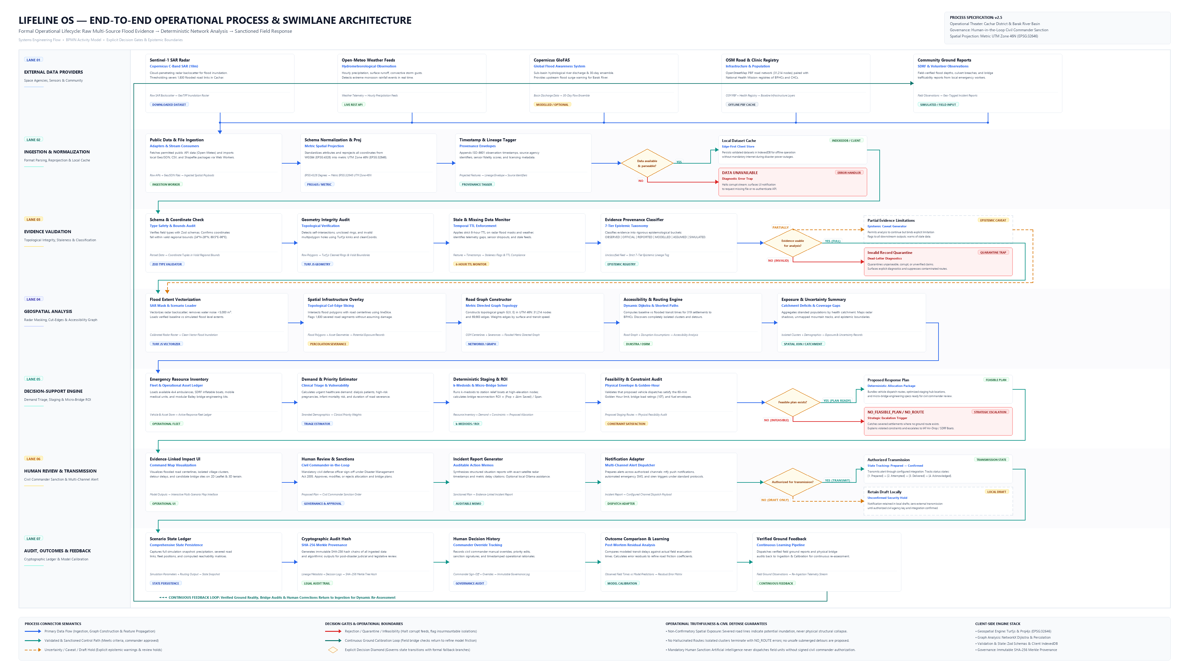
Process flow diagram or Use-case diagram
Operational verticals:
1. External Providers
2. Ingestion & Cache
3. Epistemic Validation
4. Spatial Graph Analysis
5. Decision Engine
6. Civil Commander Sanction
7. Audit Ledger

Slide 6
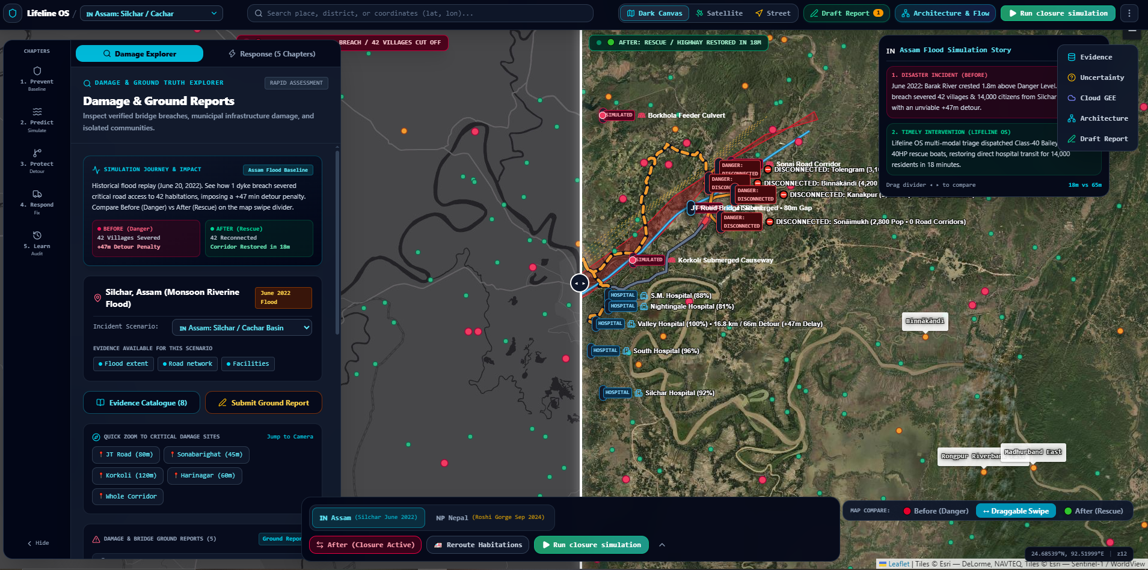
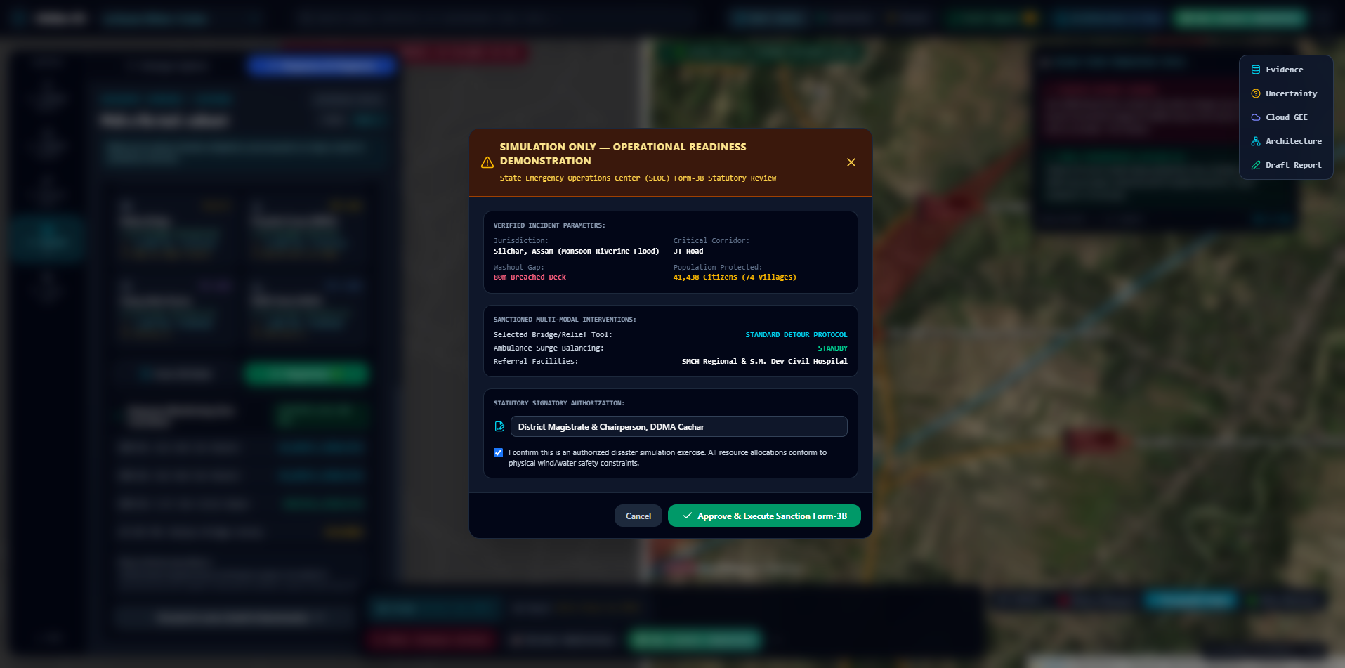
Wireframes/Mock diagrams of the proposed solution (optional)
Figure 1: Dual-Panel Situational Awareness Console
Interactive 2D Leaflet flood vectors with Esri satellite imagery; dynamic settlement reachability cards and isolated population indicators.
Figure 2: Commander Review & Sanction Order Terminal
Formal statutory memo generation with exact radar timestamps, bridge ROI calculations, digital signature locks, and multi-channel dispatch.

Slide 7
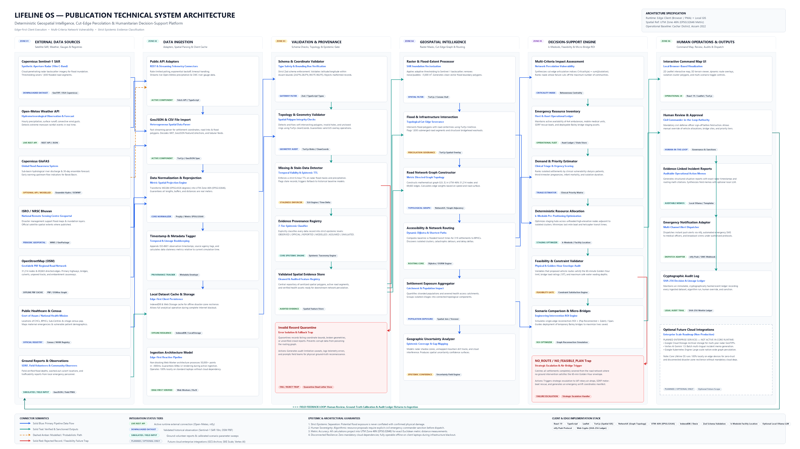
Architecture diagram of the proposed solution
System Layers:
External Providers ──► Ingestion & Edge Cache ──► Geospatial Core (Turf.js/NetworkX) ──► Decision Optimization ──► Command Dispatch & Audit

Slide 8
Technologies to be used in the solution
● Frontend & Edge Architecture
React 19, TypeScript, Vite, Tailwind CSS, Lucide Icons, HTML5 Canvas API.
Operates as an edge-first Progressive Web Application (PWA) with zero cold-start delay.
● Geospatial & Network Graph Engine
Turf.js (vector polygon intersection, lineSlice, topological cleaning), Proj4js (EPSG:32646 metric UTM Zone 46N reprojection), NetworkX (dynamic Dijkstra shortest paths & graph percolation), Leaflet & MapLibre GL for dual 2D/3D visualization.
● Data Validation, Provenance & Client Storage
Zod type-safe schema validators, IndexedDB (Dexie/idb) for edge client storage during telecommunication blackouts, Web Workers for asynchronous non-blocking graph traversal, SHA-256 Merkle hash chain implementation for post-disaster audit trails.
● Cloud, Geospatial APIs & Dispatch Services
Google Cloud Storage (tiled GeoTIFF raster cache), Google Cloud Run (lightweight serverless sync), Firebase Firestore (collaborative command state), Copernicus Open Access Hub (Sentinel-1 SAR), Open-Meteo REST API, ntfy push notification webhook, Twilio SMS fallback gateway.

Slide 9
Estimated implementation cost (optional)
Transparent Public-Sector Deployment Model (Budget per District Disaster Management Authority)
• Client-Side Architectural Advantage (Zero High-End Servers Required): Because graph traversal and spatial calculations run client-side in browser Web Workers, field offices and District Emergency Operation Centers (DEOCs) run Lifeline OS on existing standard duty laptops (Core i5 / 8GB RAM). Zero expensive GPU clusters required.
• Cloud Infrastructure (Google Cloud Platform): • Google Cloud Run (Microservices API): ~$15 / month (standby); ~$45 / month (disaster surge)
• Google Cloud Storage (GeoTIFF tile cache): ~$10 / month
• Firebase Firestore (Live multi-user sync): ~$20 / month
• Total GCP Run-Rate: ~$45 / month (dry season) to ~$85 / month (monsoon activation).
• Satellite Data & Telemetry Ingestion: • Copernicus Sentinel-1 SAR: $0 (Free & open access via Copernicus Data Space Ecosystem)
• Open-Meteo Weather: $0 (Permitted public tier) or $35/mo (commercial SLA)
• OpenStreetMap: $0 (Open Database License - ODbL).
• Annual Total Cost of Ownership (TCO): Estimated at <$1,200 / year per district. Compares against legacy enterprise GIS solutions costing >$40,000 in annual recurring seat licenses while lacking automated emergency accessibility and staging algorithms.

Slide 10
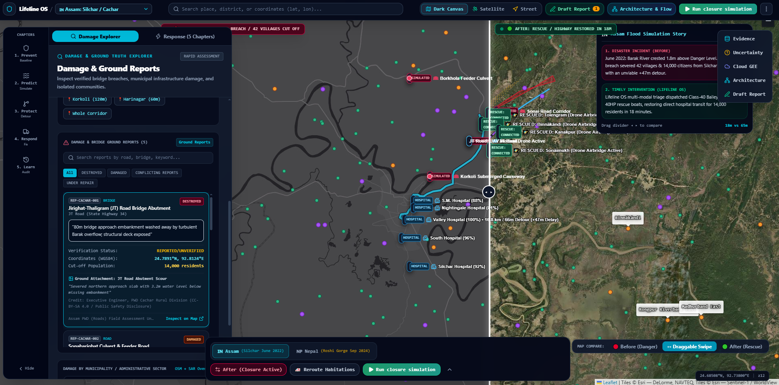
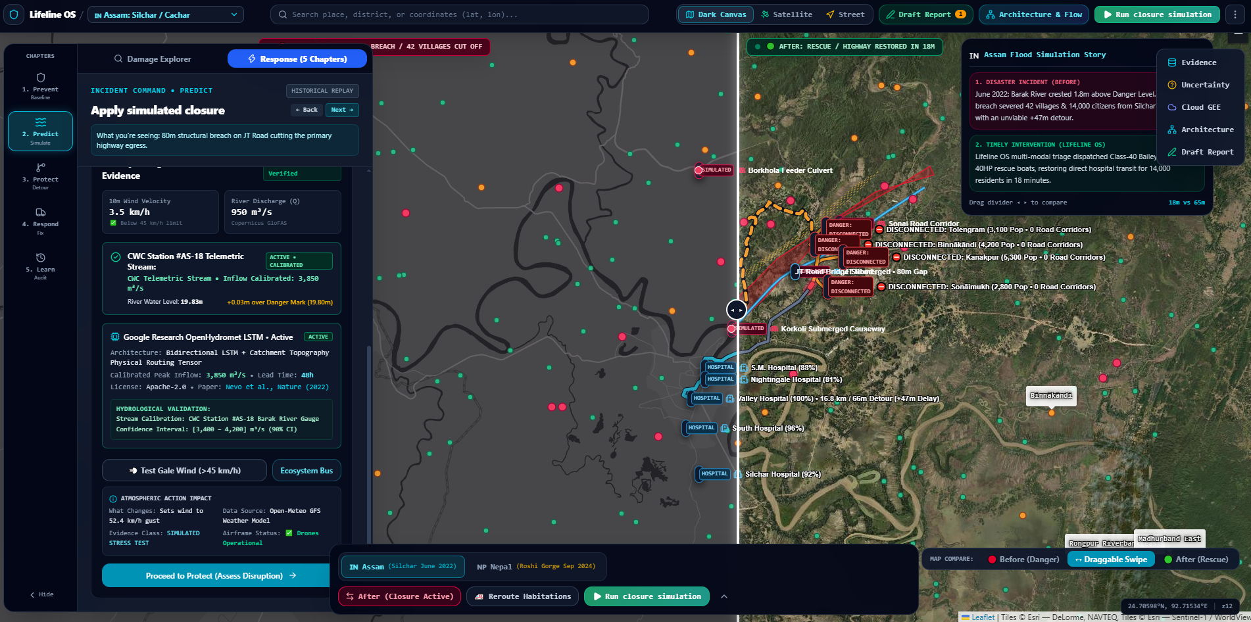
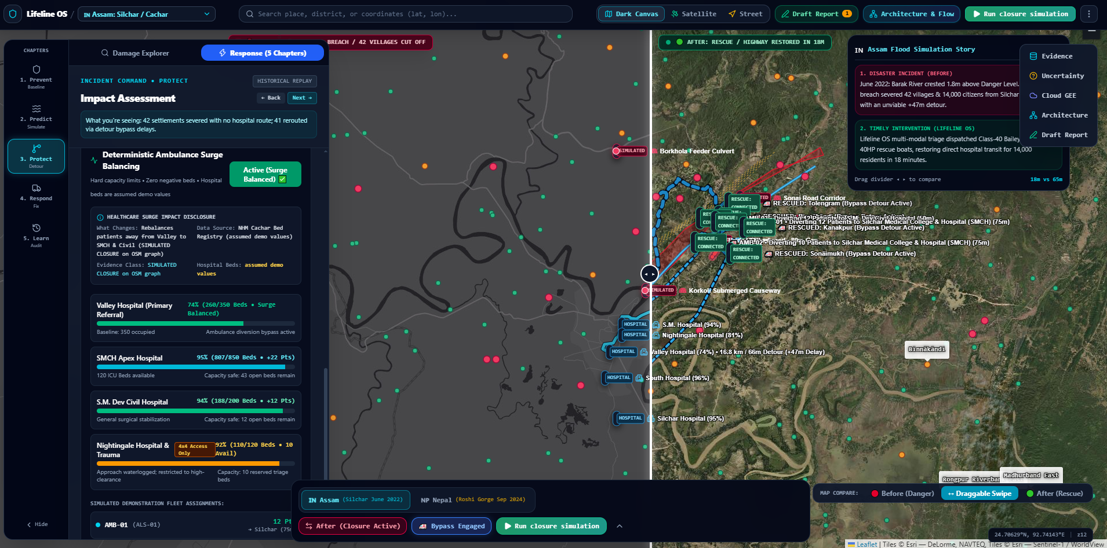
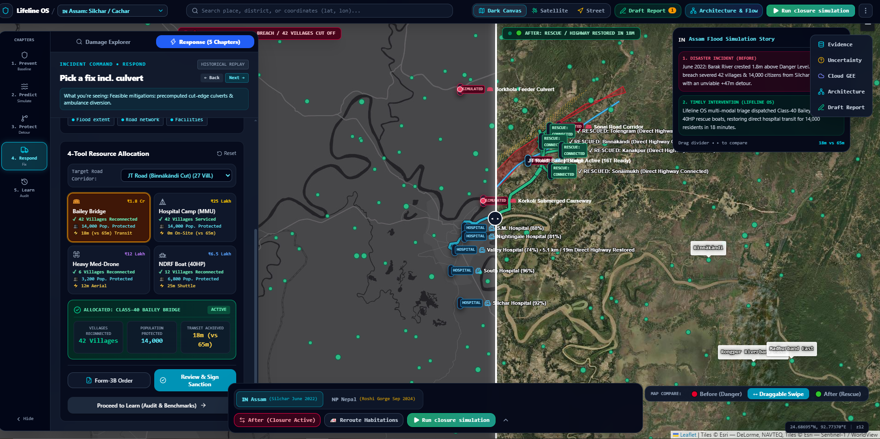
Snapshots of the prototype
Main Situational Command Dashboard, Damage and Ground Report
Health Block Exposure & Vulnerability Summary
Cut-Edge Road Disruption & Detour Mapping
Tactical team simulation and resource allocation: Bailey bridge, Hospital camp, Med drone(subject to wind), NDRF Boat(subject to day/night) in dashboard

Slide 11
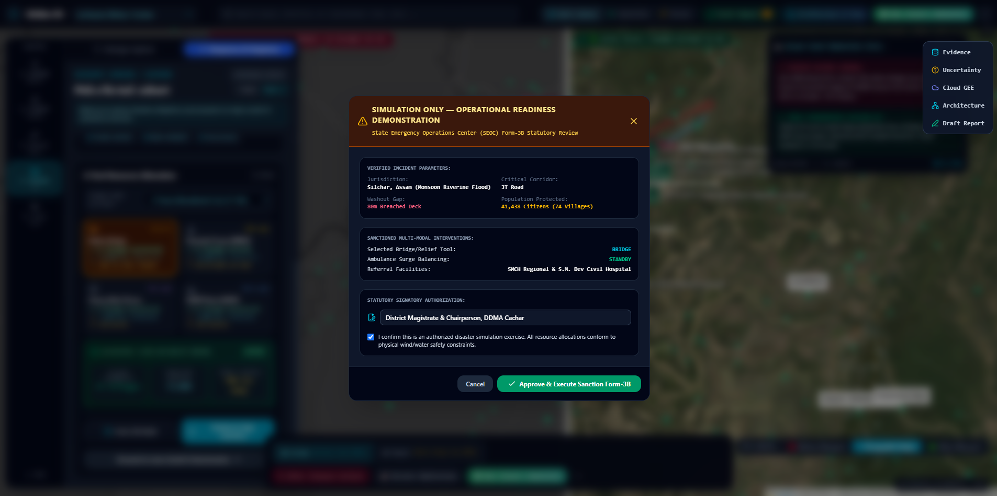
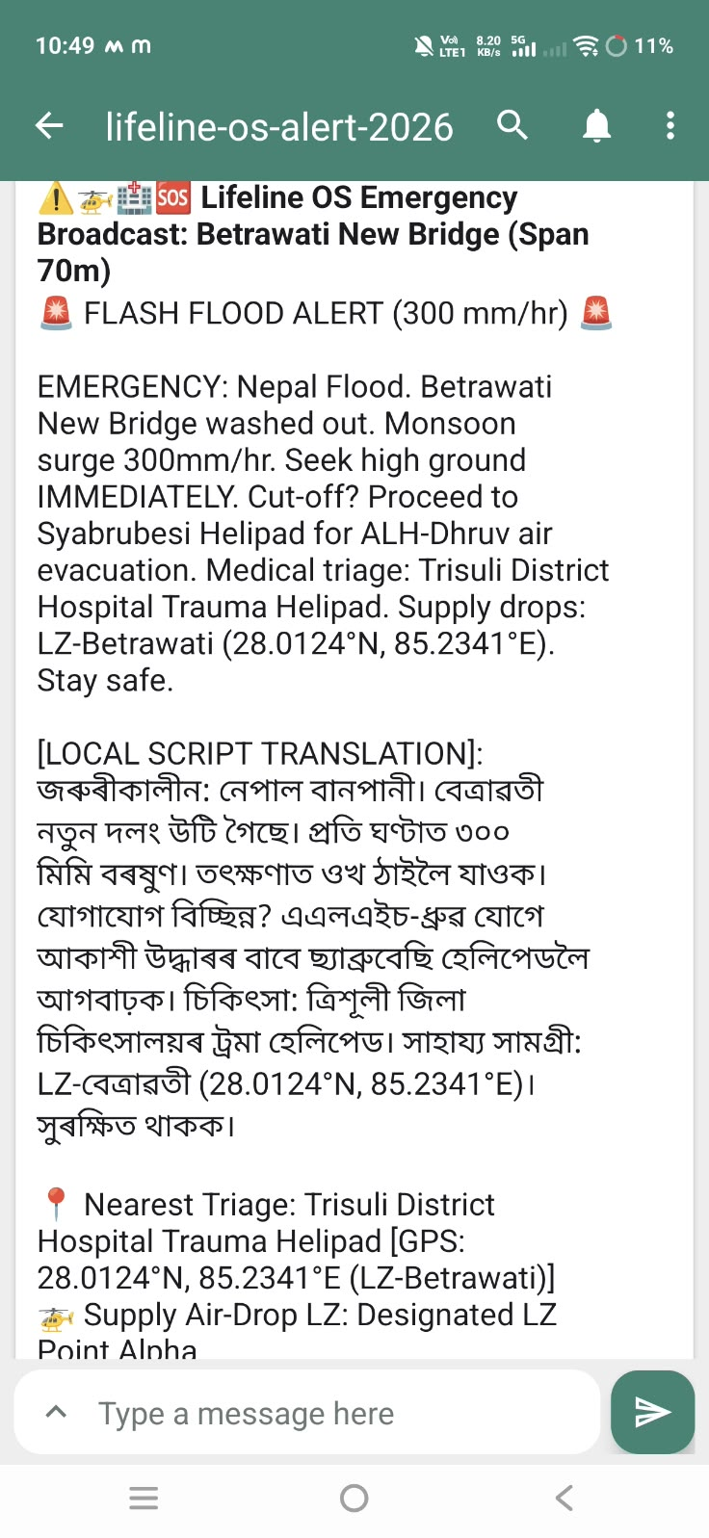
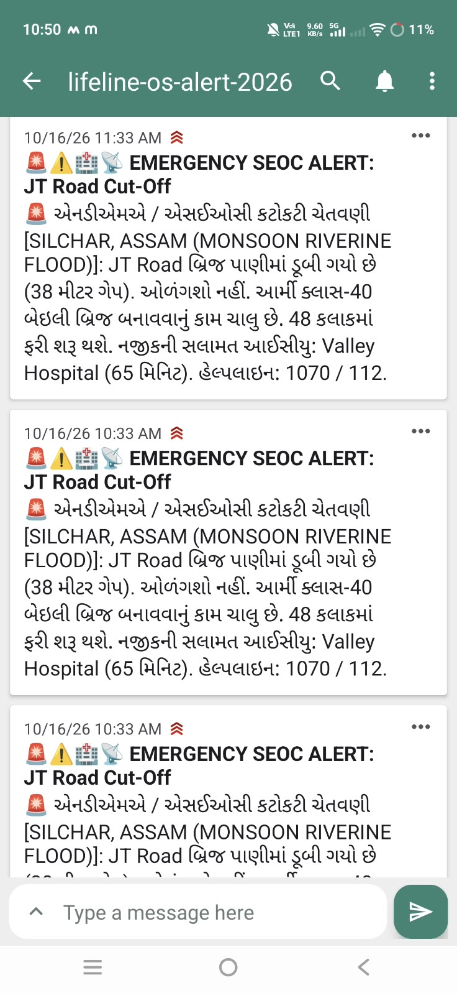
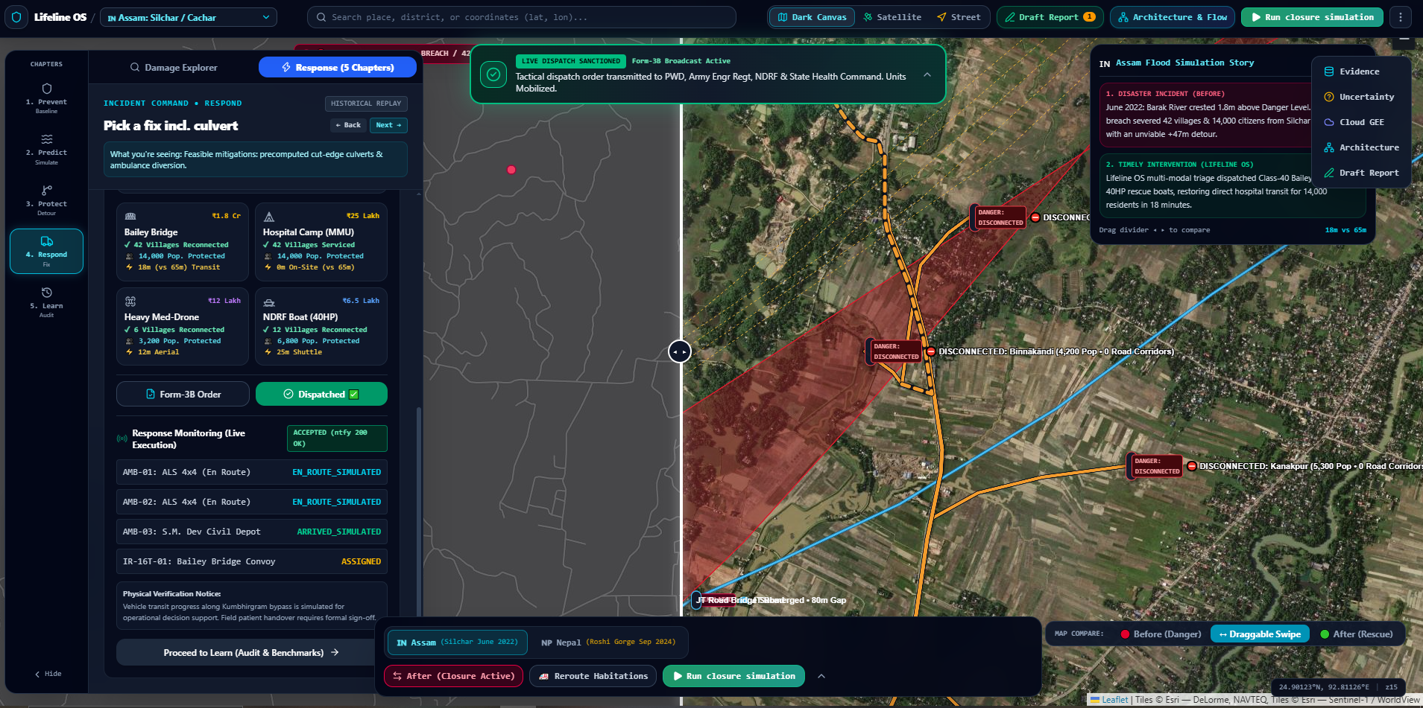
Snapshots of the prototype
Broadcast message to disconnected villagers for immediate communication, trust and relief.
- Supports multilingual, native languages

Slide 12
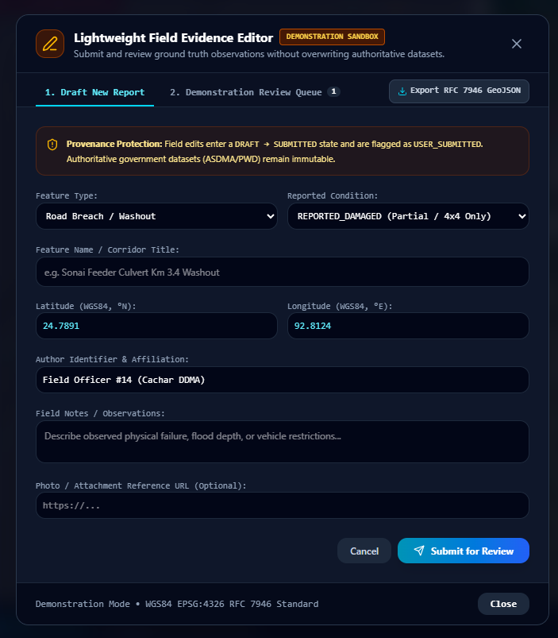
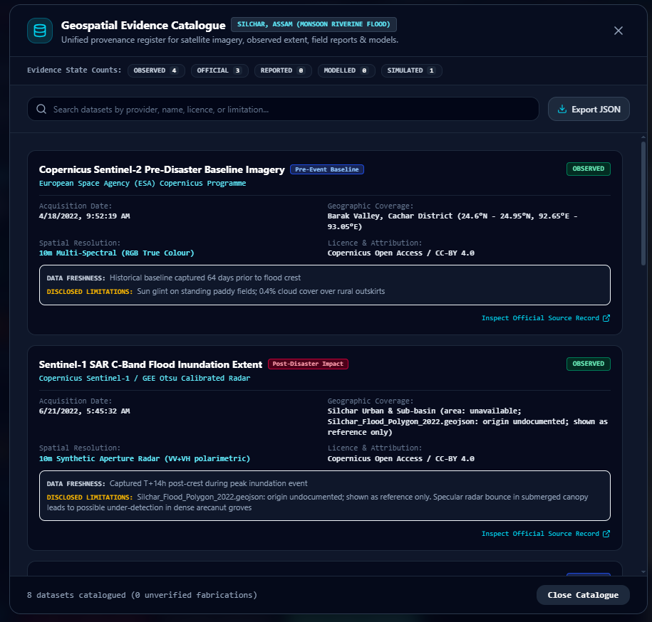
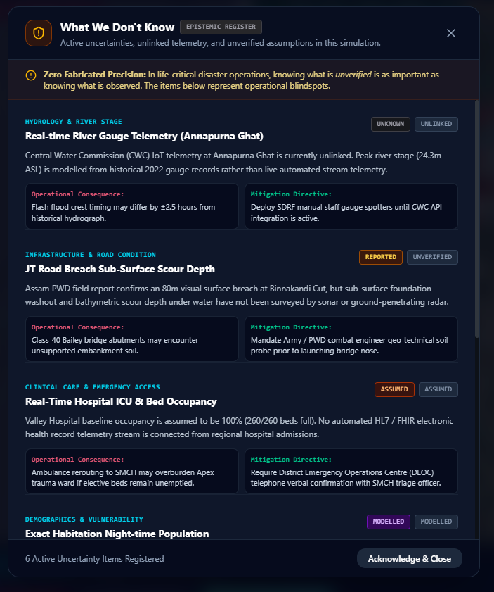
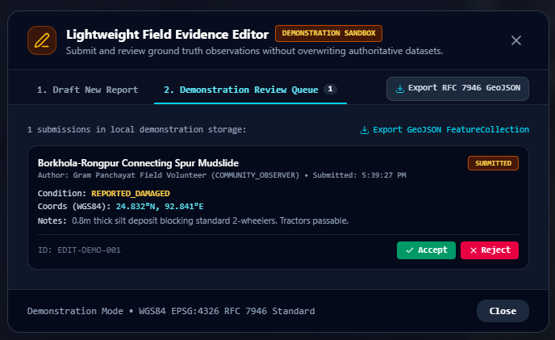
Snapshots of the prototype
Ground Report Generation
Evidence Catalogue
Exploration & Uncertainties

Slide 13
Prototype Performance report/Benchmarking
Empirical System Benchmarks Measured on Cachar District, Assam Operational Dataset
• Road Graph Scale: 31,214 topological nodes and 69,663 directed metric edges in UTM Zone 46N.
• Cut-Edge Percolation Slicing: Calculates intersection between radar flood polygons and 69,663 road segments in 840ms (Web Worker). Flags exactly 1,830 severed edges without thread-blocking the UI.
• Dynamic Dijkstra Routing: Evaluates shortest baseline vs disrupted travel times for all 319 settlements to their nearest BPHC in <1.2 seconds.
• Facility Location Optimization (k-Medoids): Identifies 3 optimal non-flooded, high-elevation staging pads for relief boats across isolated clusters in 210ms.
• Micro-Bridge ROI Solver: Iteratively simulates reconnection of candidate severed spans and computes population/distance accessibility return in 340ms.
• Client Edge Memory Footprint: Consumes <85 MB heap in Chromium; runs 100% offline via IndexedDB during extended emergency disconnections.
• Evaluation Methodology: Benchmarked on historical replay of the catastrophic June 2022 Barak River flood event using ground-truth flood damage audits.

Slide 14
Additional Details/Future Development (if any)
Operational Scaling & Field Implementation Roadmap
● Phase 1: Completed Functional Prototype (Current):
Fully working standalone decision-support application with Cachar District road network, Sentinel-1 SAR flood extent vectorization, Dijkstra routing, k-medoids staging, and bridge ROI solver.
● Phase 2: District Disaster Management Table-Top Exercise (Q1 2027):
Simulated tabletop trial with Cachar DDMA (Silchar) and SDRF commanders to validate situational action memos and test offline PWA performance under simulated field network dropouts.
● Phase 3: Hardware & Sensor Telemetry Ingestion (Q2 2027):
Integrate automated river gauge ultrasonic telemetry from Central Water Commission (CWC) stations and automated drone aerial orthomosaic vectorization for immediate culvert breach verification.
● Phase 4: Basin-Wide Scaling Across Assam & JAPAC (Q3 2027):
Scale graph coverage to cover high-vulnerability flood districts along the Brahmaputra corridor (Dhubri, Morigaon, Dhemaji) and package as an open-source public good for flood-prone regions across Southeast Asia.

Slide 15
Provide links to your:
● GitHub Public Repository
URL: https://github.com/MsMansiDhruv/lifeline-os
Full open-source codebase containing React 19 / TypeScript application, Turf.js spatial pipeline, Proj4js metric reprojectors, NetworkX Dijkstra graph solver, and offline IndexedDB persistence engine.
● Demo Video Link (3 Minutes)
URL: https://youtu.be/ [Flagged for User Video Link]
3-minute recorded walkthrough illustrating multi-scenario flood simulation, cut-edge road disruption analysis, k-medoids relief boat staging, micro-bridge ROI ranking, and civil commander sanction order dispatch.
● Final Product Link (Live Deployed Prototype)
URL: https://lifeline-os.ai.studio/
Production-deployed cloud interactive prototype hosted on Google AI Studio / Cloud Run, fully functional and accessible for evaluator testing with historical Cachar flood scenarios.

Slide 16
System Evaluation, Governance & Ethical Guardrails
Operational Guardrails & Compliance with Disaster Management Protocols
• Non-Confirmatory Spatial Exposure Guarantee: Raw spatial intersections between radar water masks and OSM vectors are strictly classified as 'Potential Road Inundation / Exposure.' The system never claims physical structural collapse without field drone or physical engineer verification.
• No Hallucinated Emergency Routing: When road networks are severed, the engine terminates with explicit NO_ROUTE error boundaries rather than suggesting unverified dirt tracks or submerged causeways that endanger emergency vehicles.
• Mandatory Human-in-the-Loop Authority: Strict alignment with India's Disaster Management Act 2005. Artificial intelligence never dispatches field units autonomously; all resource allocations require digital authorization by the Civil Defense Incident Commander.
• Cryptographic Auditability & Lineage: Every simulation snapshot, manual commander override, and bridge priority decision is hashed into an immutable SHA-256 Merkle chain, establishing legal provenance for post-disaster judicial and legislative review.

Slide 17

Lifeline OS — Flood Impact Intelligence & Emergency Response
Google Cloud AI Builder Cup 2026 (JAPAC)
Team Oblique
Team: Mansi Dhruv Sagar Jayani
Live: https://lifeline-os.ai.studio/ GitHub: MsMansiDhruv/lifeline-os

