Slide 1
DATA ANALYSIS REPORT • APRIL 2026
Transaction Behavior Patterns
in Nigeria's Digital Payment
Ecosystem
15,500×
growth in POS transactions
Jan 2009 → Jun 2025
Agent Banking, Merchant Adoption, and the Next Wave
of Digital Financial Inclusion in Nigeria
Obakoya Iyanujesu
Data Scientist
Data: CBN Payment System Statistics (2009–2025) • EFInA Access to Finance Survey 2023 • World Bank Findex 2021

Slide 2
THE QUESTION
One country. Two realities.
1.38 BILLION
97% of payments
POS transactions processed
every single month in June 2025
involved cash at point of purchase
(EFInA 2023 — pre-full normalisation)
Up from 89,349 in January 2009.
A 15,500-fold increase in 16 years.
Likely lower by 2026 — sustained POS growth through 2025 signals continued cash-to-digital conversion, particularly in urban markets.
Research question: What does Nigeria's payment data tell us about where the next wave of digital adoption will come from, what will trigger it, and what is blocking it?
Obakoya Iyanujesu | Transaction Behavior Patterns in Nigeria's Digital Payment Ecosystem | April 2026

Slide 3
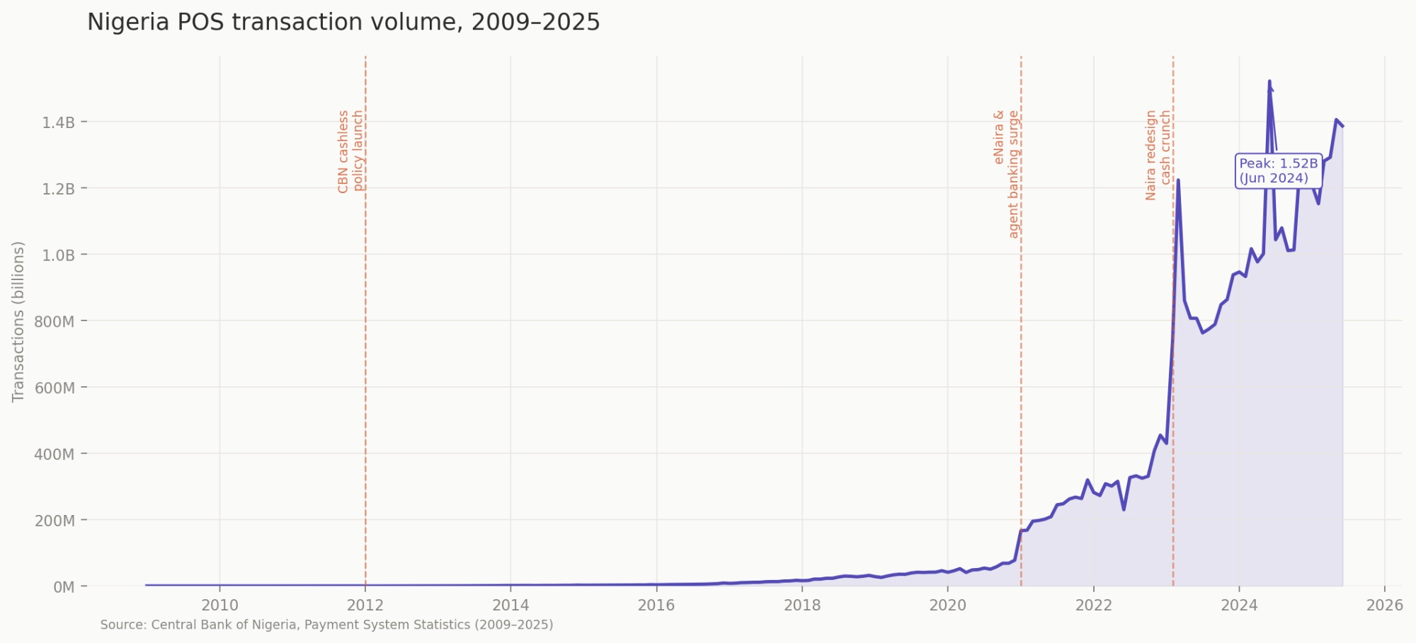
SECTION 1 — THE TRANSACTION LANDSCAPE
16 years. Three phases. One structural shift.
Obakoya Iyanujesu | Transaction Behavior Patterns in Nigeria's Digital Payment Ecosystem | April 2026

Slide 4
SECTION 1 — THE TRANSACTION LANDSCAPE
Each surge had a different driver
01
02
03
2012–2020
2021
2023
Policy-driven
Infrastructure-driven
Crisis-driven
CBN Cashless Policy mandated POS acceptance. Slow, steady, urban-concentrated. Monthly volumes grew from 89K to 78M.
Agent banking reached critical density. Monthly volumes doubled in one month: 78M → 167M. The network effect kicked in.
Naira redesign removed cash from circulation. POS volumes hit 1.22B in March 2023 — and never retreated. Crisis became habit.
Obakoya Iyanujesu | Transaction Behavior Patterns in Nigeria's Digital Payment Ecosystem | April 2026

Slide 5
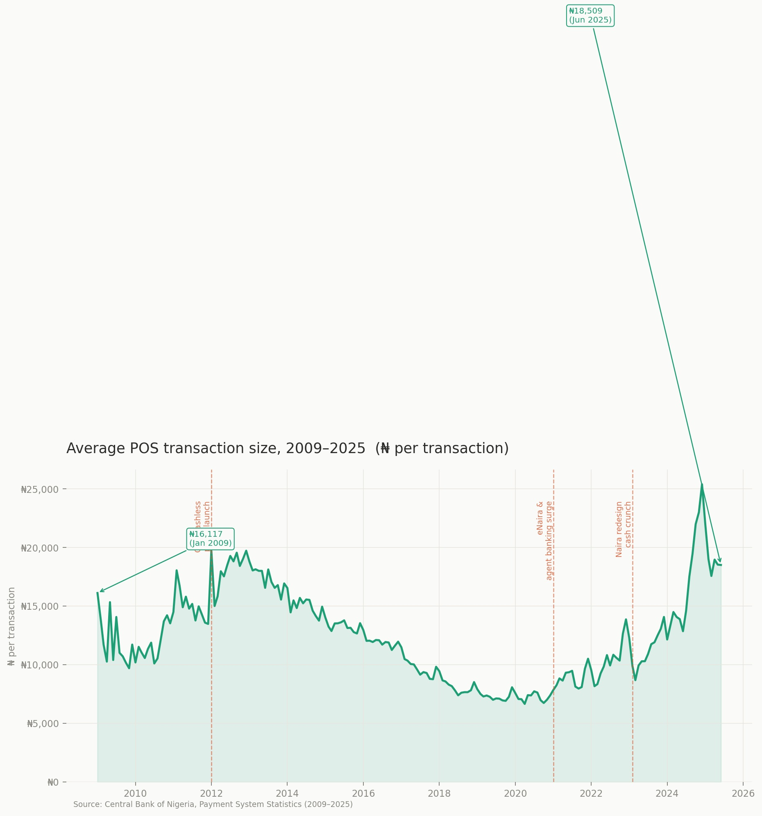
SECTION 1 — THE TRANSACTION LANDSCAPE
Growth was wide, not deep — a signal of new user adoption
The key
insight
Average transaction size barely moved over 16 years — from ₦16,117 to ₦18,509.
This means growth came from millions of new users, not from existing users spending more.
The ecosystem reached
micro-merchants.
Obakoya Iyanujesu | Transaction Behavior Patterns in Nigeria's Digital Payment Ecosystem | April 2026

Slide 6
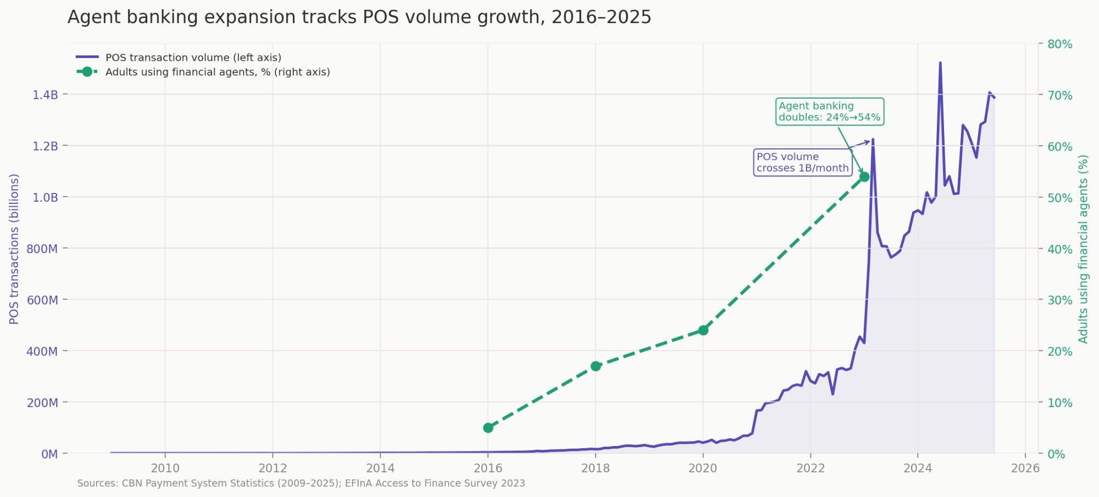
SECTION 2 — THE MERCHANT BEHAVIOR STORY
Agent banking built the infrastructure that made adoption permanent
Obakoya Iyanujesu | Transaction Behavior Patterns in Nigeria's Digital Payment Ecosystem | April 2026

Slide 7
SECTION 2 — THE MERCHANT BEHAVIOR STORY
Nigeria is three digital payment markets operating simultaneously
Stage 1 — Cash-dominant
Stage 2 — Transition
Stage 3 — Digital-first
33–38%
60–80%
90–98%
inclusion rate
inclusion rate
inclusion rate
North-West, North-East
North-Central, parts of South-East
South-West, South-South
47% of NW adults excluded. 18.7M people across 2 zones are the most under-served. Sporadic POS use, low agent density.
Agent networks expanding. Rural-urban gap narrowed from 30pts to 20pts 2020–2023. Infrastructure arriving faster than behavior.
Lagos at 98% formal inclusion. POS is expected, not novel. Competition shifts from access to product depth and credit.
Largest untapped opportunity
Active frontier — invest now
Deepen, don't expand
Obakoya Iyanujesu | Transaction Behavior Patterns in Nigeria's Digital Payment Ecosystem | April 2026

Slide 8
The 2023 crisis answered the most important question in Nigerian fintech:
What makes people switch
to digital payments permanently?
FORCED USAGE
INFRASTRUCTURE
PERMANENT SHIFT
Cash disappeared overnight. 2.8x POS surge in 8 weeks.
Where agent networks existed, the behavior stuck. Where they didn't, users reverted.
Monthly volumes stabilized above 1 billion. 2024 saw 13B annual transactions vs 660M in 2020.
Conclusion: Infrastructure density is the prerequisite for durable adoption. Build the network first. The behavior follows.

Slide 9
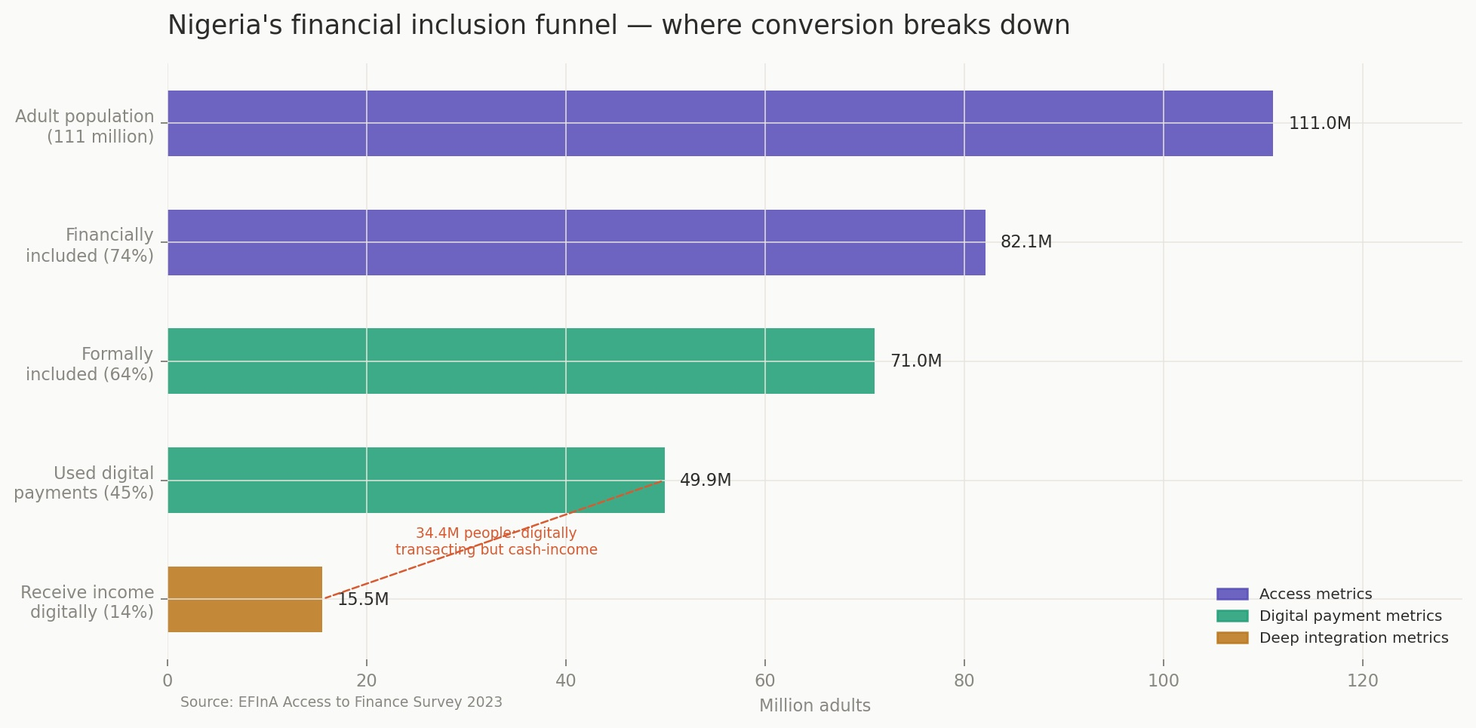
SECTION 3 — THE INCLUSION CONTEXT
Access has been solved. Depth has not.
Obakoya Iyanujesu | Transaction Behavior Patterns in Nigeria's Digital Payment Ecosystem | April 2026

Slide 10
SECTION 3 — THE INCLUSION CONTEXT
Three barriers stand between access and genuine financial participation
47%
No transactional account
52 million adults cannot independently send or receive digital payments. Agent access is not the same as account ownership.
85%
Still receive income in cash
If income arrives in cash, digital payments remain supplementary not primary. Income formalization is the missing bridge.
62%
Earn under ₦100,000/month
Low, irregular income makes formal account ownership feel impractical. Products must work for ₦5,000 float sizes, not ₦50,000.
Obakoya Iyanujesu | Transaction Behavior Patterns in Nigeria's Digital Payment Ecosystem | April 2026

Slide 11
STRATEGIC IMPLICATIONS
What these findings mean for Nigeria's
agent-led financial services operators
Where is the growth?
Stage 2 markets now. North-Central and peri-urban South-East have growing infrastructure but under-served merchant populations. Invest in agent density there before Stage 2 becomes Stage 3.
What triggers adoption?
Infrastructure + forcing event. The 2023 data proved that where agent networks are present, crisis converts to habit. Create the infrastructure. Let triggers — income, payments, credit — do the conversion.
What removes the barrier?
Transactional account for the 47%. The depth problem is not distribution — agents have reached 60M people. It is product design for irregular income: flexible onboarding, zero-balance accounts, micro-credit from Day 1.

Slide 12
The volume problem is solved.
Depth is the frontier.
Nigeria's POS ecosystem grew 15,500× in 16 years by solving the access problem. The next 10 years belong to whoever solves the depth problem — designing products that convert 52 million agent-reached Nigerians from the edge of the financial system into its functioning core.
13.1B
60M
52M
POS transactions
in 2024
Adults reached by
agent banking
Adults with no
transactional account
Sources: CBN Payment System Statistics (2009–2025) • EFInA Access to Finance Survey 2023 • World Bank Findex 2021

