Slide 1
Milestone Two
KVM-Based eBPF Malware Detection Engine

Slide 2
Project Team & Overview
Luis Abraham • Dylin Irons • Dominick Morales • Braiden Ames
Faculty Advisor: Dr. Ribeiro
Client: Amy Alvarez, NASA Scientist
Advisor meetings: monthly, TR 2:00–3:15pm (office hours) • Client meetings: monthly, when available
10/26/2026
Milestone 2
(Slide No.) ‹#›

Slide 3
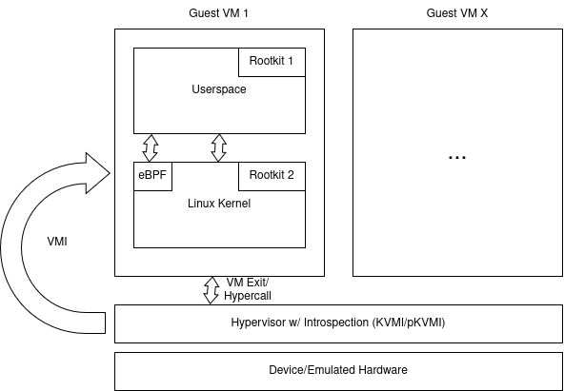
Milestone 2 Overview
Expand capabilities via pKVM tooling
OS and eBPF Analysis
Web UI integration with M1 work
“what is going on here?”
10/26/2026
Milestone 2
(Slide No.) ‹#›

Slide 4
Milestone 2 Responsibilities
Task | Completion | Luis | Braiden | Dominick | Dylin
pKVM module VMI | 100% | 100% | 0% | 0% | 0%
Linux Kernel Introspection | 100% | 10% | 90% | 0% | 0%
Initial eBPF Introspection | 100% | 10% | 0% | 90% | 0%
Initial Python Bindings | 100% | 0% | 0% | 0% | 100%
Bindings Integrations w/ web UI | 100% | 0% | 0% | 0% | 100%
10/26/2026
Milestone 2
(Slide No.) ‹#›

Slide 5
UI Python Bindings
Guest VM
rvtest
Machine being monitored
C Engine
librootview.so
Reads guest kernel memory from hypervisor
Bindings
rvprim / rvtools
ctypes turns C calls to Python objects
Web Server
FastAPI
Scans every 5 seconds and runs detection
Dashboard
Findings appear live in browser
10/26/2026
Milestone 2
(Slide No.) ‹#›

Slide 6
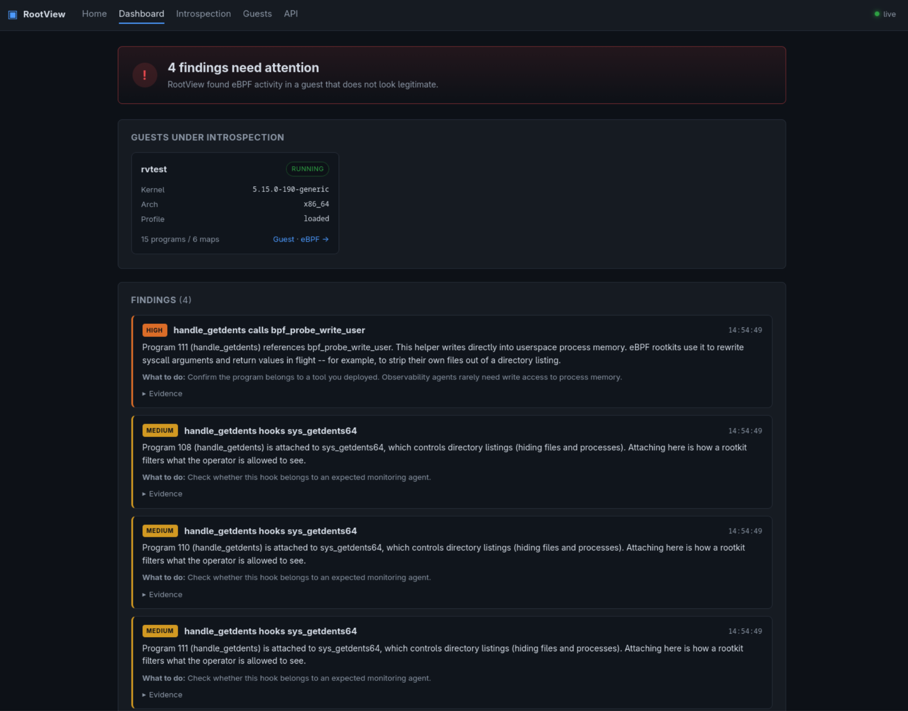
Dashboard Test
PID Hider Test
Flagged handle_getdents (rootkits program)
hooking sys_getdents64
  how linux lists directories
calling bpf_probe_write_user
  lets eBPF overwrite program memory
Each piece harmless alone but together they hide a process from ps
10/26/2026
Milestone 2
(Slide No.) ‹#›

Slide 7
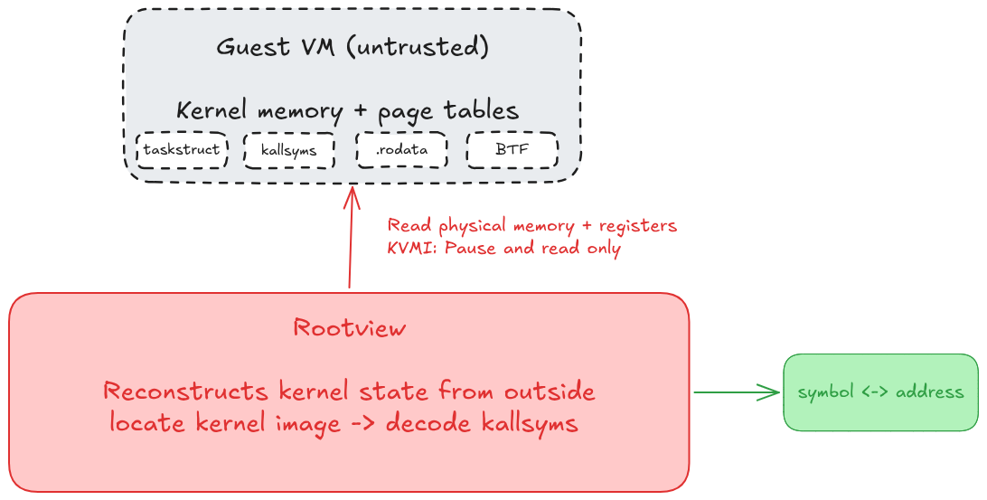
Overview
M2: Finding and decoding kallsyms in guest memory
The guest is untrusted — only raw memory + registers, no ELF header, no symbol file
Goal: resolve any kernel symbol address from .rodata alone
10/26/2026
Milestone 2
(Slide No.) ‹#›

Slide 8
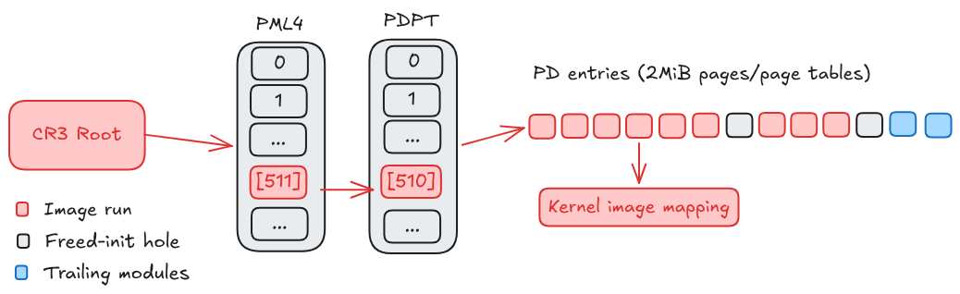
Locate kernel image
pt_image finds the image extent: contiguous present PD entries under PML4[511]→PDPT[510], from 0xffffffff80000000 up
Handles 2 MiB pages vs page tables, freed-init holes, trailing modules
Loads the non-executable runs — where the kallsyms tables live
10/26/2026
Milestone 2
(Slide No.) ‹#›

Slide 9
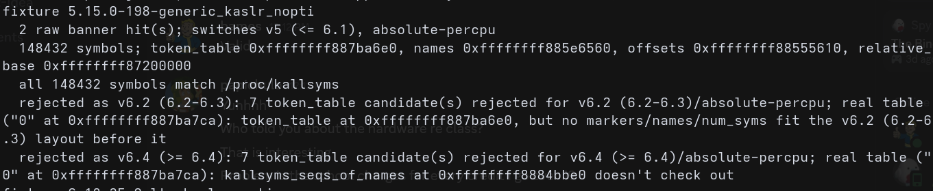
Decode kallsyms
Anchor by raw-scanning for "Linux version ", parse the release to pick the decode config
The hard part: both the table layout (≤6.1 / 6.2–6.3 / ≥6.4) and the address encoding (relative-base vs absolute-percpu) shift across kernels — detect both, validate structurally so a wrong guess is rejected
Decode compressed names → sorted table + hash → ksym_by_name / ksym_by_addr
10/26/2026
Milestone 2
(Slide No.) ‹#›

Slide 10
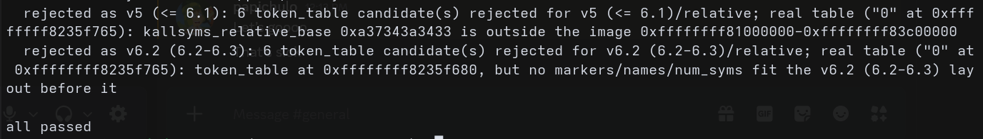
Verify across kernels
Cross-check: resolve linux_banner through the decoded table, read it back, confirm it matches the raw scan
Tested offline on RAM-dump fixtures — 5.15 and 6.18, KASLR/KPTI variants — against the guest’s own /proc/kallsyms
10/26/2026
Milestone 2
(Slide No.) ‹#›

Slide 11
Initial eBPF Introspection
What can we do now that we can read memory?
  Learn about everything that is going on in the kernel
    eBPF is the part we care about the most
  See a picture of what has been done to memory that hasn’t been tampered with
10/26/2026
Milestone 2
(Slide No.) ‹#›

Slide 12
What Are eBPF Programs and Maps?
eBPF Programs
  Custom sandboxed programs that run in kernel space without having to recompile your kernel or install kernel modules
  Bytecode that gets JIT translated into native machine code
    Write once, run on any kernel version (ideally)
eBPF Maps
  Kernel space data structures that make data transfer between user space and kernel space fast
    Come in the following forms: key/value pairs, hash maps, ring buffers
    Accessed via syscall
10/26/2026
Milestone 2
(Slide No.) ‹#›

Slide 13
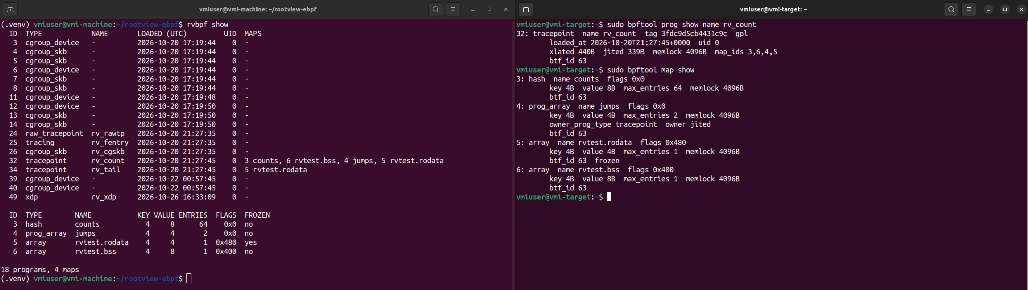
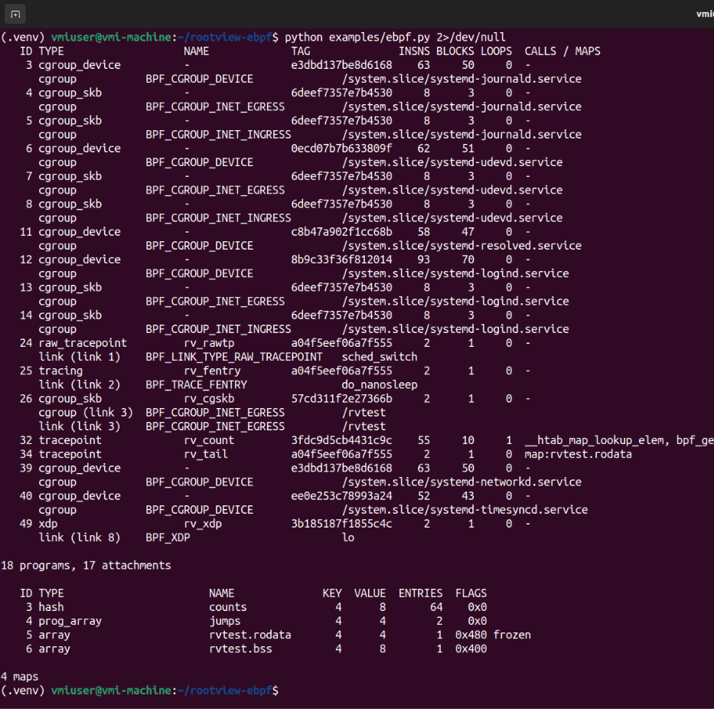

Slide 14
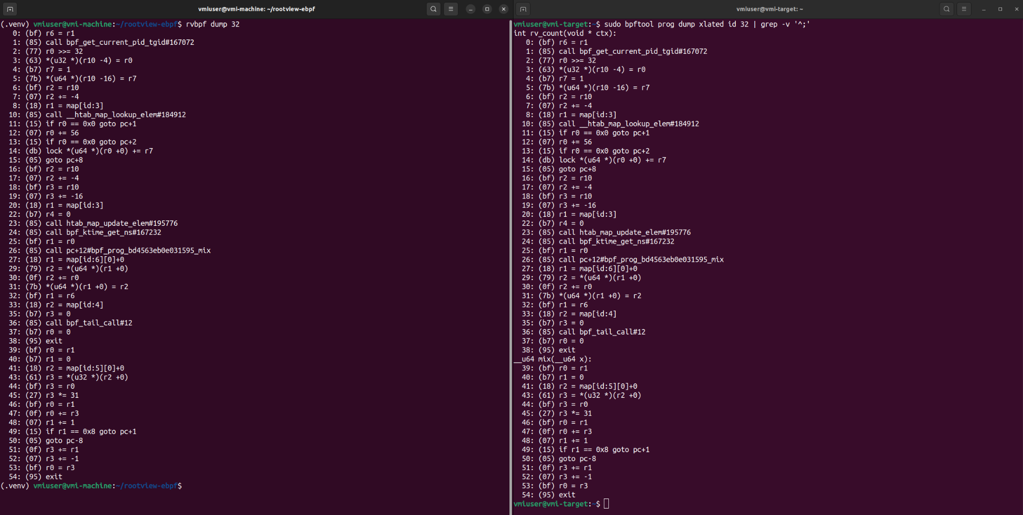
Reading eBPF Program Code
We can see the programs now, but there’s something even cooler we can do
Rip eBPF program bytecode out of memory, post verifier modifications
Create a disassembly of that bytecode
10/26/2026
Milestone 2
(Slide No.) ‹#›

Slide 15
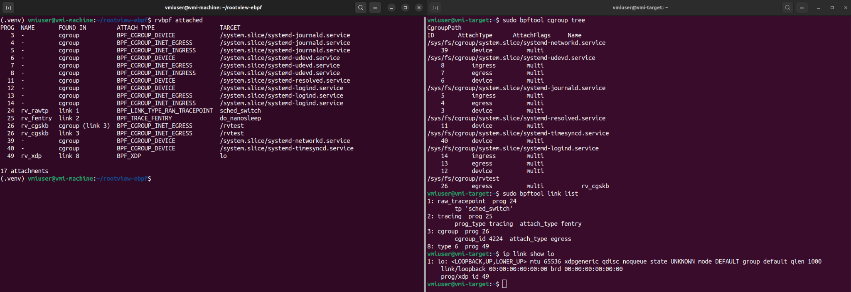
eBPF Attachments
eBPF attachments are what actually allow it to do what it was made for
eBPF programs can carry out tasks by hooking to different parts of the kernel (an attachment)
  One of the main reasons eBPF even exists is to carry out networking functionality in a fast manner
We can find attachments in two places:
  cgroup tree
  bpf_link objects through the link_idr table
10/26/2026
Milestone 2
(Slide No.) ‹#›

Slide 16
eBPF Introspection Results
What the user can now do:
  Use the created python modules to inspect the eBPF structures and data in memory
  Currently, this means programs, cgroup attachments, maps, and links
Future work
  There are still some missing eBPF structures and information that isn’t analyzed yet. This is to be done in M3
10/26/2026
Milestone 2
(Slide No.) ‹#›

Slide 17
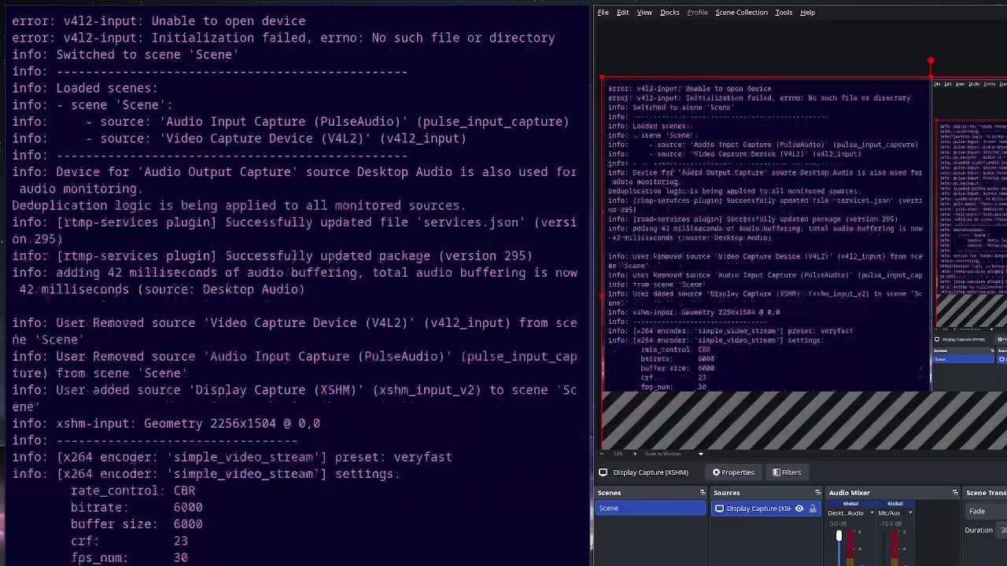
GUI, Kernel, & eBPF Demo
10/26/2026
Milestone 2
(Slide No.) ‹#›

Slide 18
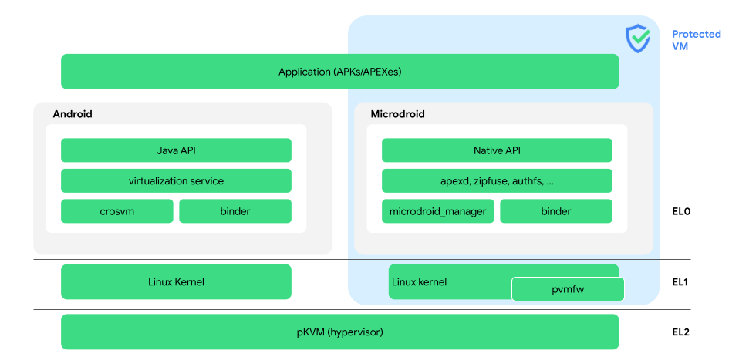
pKVM introspection module
Recap: we are using KVM-VMI for “outside looking in” introspection
  No tools like this exist for pKVM
  pKVM is used on modern pixel phones (past 2022)
Develop a tool that achieves the same goal, as well as introspecting on pKVM itself
This milestone I just wanted to get the base primitives and understand pKVM internals
10/26/2026
Milestone 2
(Slide No.) ‹#›

Slide 19
Proof of concept
For the time being we are just going to “ping pong” from the host OS
  this is temporary (wait a few slides)
Data is transferred through
  registers for cmd’s and err codes
  shared pages for large chunks of data
Similarly to the primitives from KVM-VMI, we want at least
  physical memory read
  system registers read
With these, we can build to have virtual memory read like in M1
hypercall
shared pages
10/26/2026
Milestone 2
(Slide No.) ‹#›

Slide 20
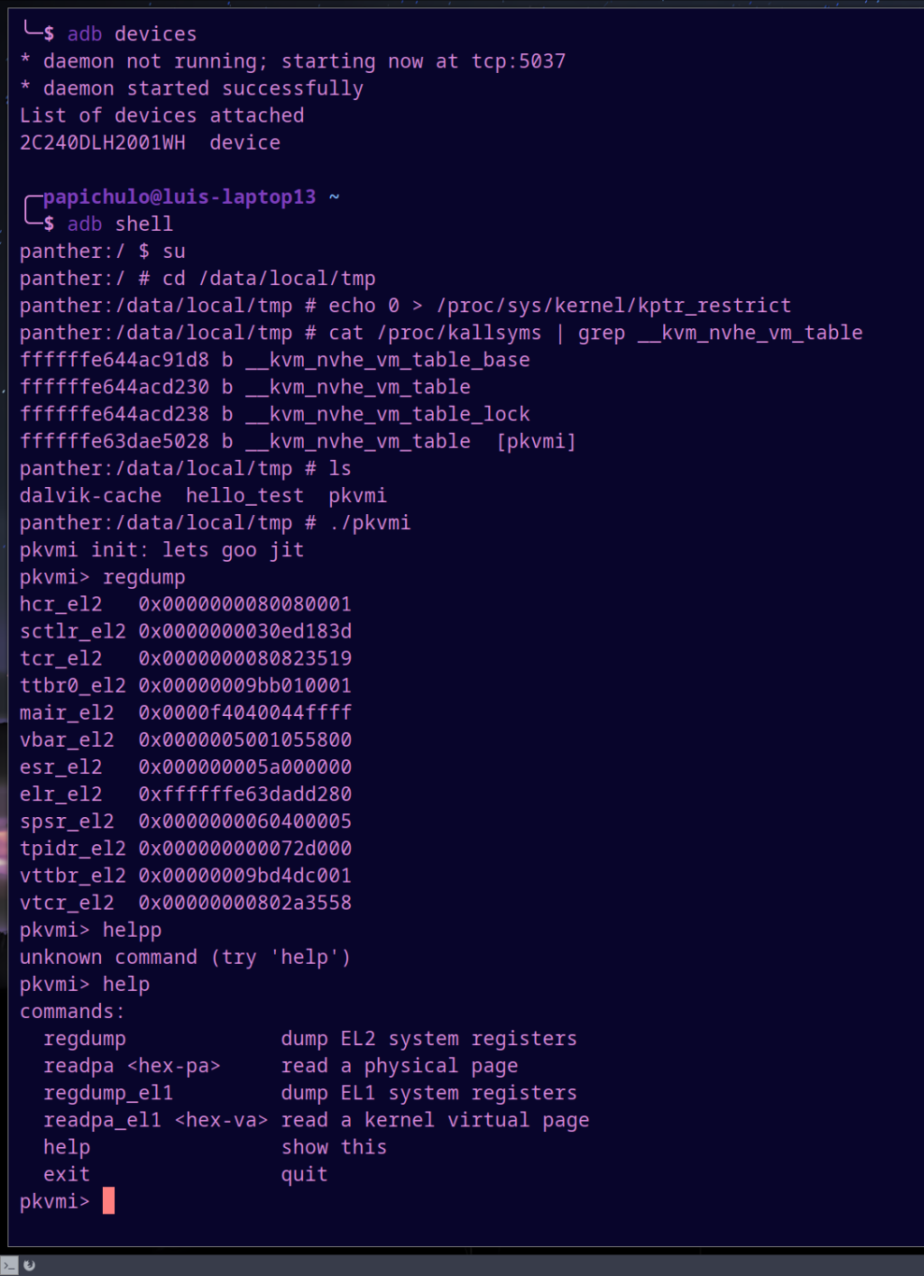
Proof on the Pixel 7
Here you can see we can
  read EL2 (hypervisor) regs
  read EL2 (hypervisor) pmem
  read EL1 (host OS) regs
  read EL1 (host OS) pmem
10/26/2026
Milestone 2
(Slide No.) ‹#›

Slide 21
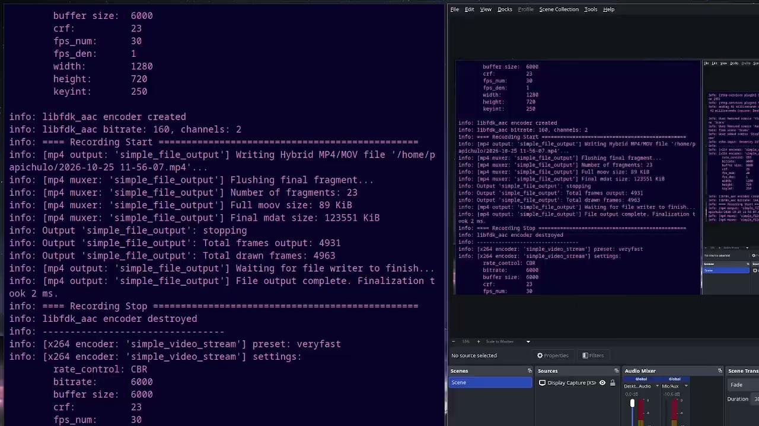
Proof on the Pixel 7
Here you can see we can
  read EL2 (hypervisor) regs
  read EL2 (hypervisor) pmem
  read EL1 (host OS) regs
  read EL1 (host OS) pmem
10/26/2026
Milestone 2
(Slide No.) ‹#›

Slide 22
Milestone 3 - pKVM-VMI
Migrate functionality to an isolated pVM
  This is to ensure the “outside looking in” requirement, as the host OS can’t know it’s being watched
Add pKVM-VMI support for the greater toolkit
Test and verify support for the Pixel phone
hypercall
shared pages
10/26/2026
Milestone 2
(Slide No.) ‹#›

Slide 23

Milestone 3 - RootView
KVM-VMI is an old KVM fork, we would like to port it to modern kernels
eBPF research and better toolkit development
Developing test cases for testing future rootkit detection
Improving web UI functionality
10/26/2026
Milestone 2
(Slide No.) ‹#›

Slide 24
Milestone 3 Matrix
Task | Luis | Dominick | Braiden | Dylin
pKVMI integration to rootview | 100% | 0% | 0% | 0%
Isolated pVM for introspection instead kernel module | 100% | 0% | 0% | 0%
Porting KVMI to the latest Linux Kernel | 0% | 100% | 0% | 0%
Add more eBPF analysis features that the WebUI needs | 0% | 100% | 0% | 0%
Research into eBPF rootkits | 0% | 0% | 100% | 0%
Start design of specific test cases for eBPF manipulation | 0% | 0% | 100% | 0%
Dashboard hidden object detection, flag mismatches and improve information displayed | 0% | 0% | 0% | 100%
10/26/2026
Milestone 2
(Slide No.) ‹#›

Slide 25
Questions?
10/26/2026
Milestone 2
(Slide No.) ‹#›

Slide 26
What Are eBPF Programs and Maps?
The kernel has ID tables prog_idr and map_idr which contain eBPF program and map info
Through the hypervisor, you can walk these tables
  We can find out about programs: name, type, load time, loader UID, and the maps it uses
  We can find out about maps: type, key/value sizes, entry count, and whether it is frozen
This also happens to be what bpftool does
10/26/2026
Milestone 2
(Slide No.) ‹#›

