Slide 1
EXPLORATORY DATA ANALYSIS:
Onchocerciasis in Sierra Leone

Slide 2
Data : onchocerciasis (‘river blindness’) data from Sierra Leone
classification :
lived in villages in savannah (grassland) or rainforest areas.
infected - microfilariae (mf) of river blindness were found in skin snips taken from the iliac crest. (microfilariae - larvel stage of filarial worm)
Participants age : 5 years and above

Slide 3

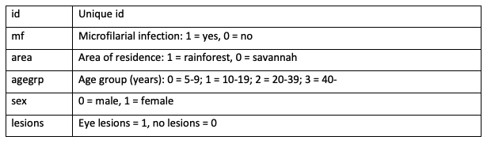

Slide 4
Population: 1302
Comparison: savannah and rainforest
Primary Outcome: microfilarial infection
Secondary Outcome: eye lesions
Intervention: sex, age
Sample size >=90

Slide 5
Packages used :
readxl
tibble
Hmisc
gtsummary

Slide 6


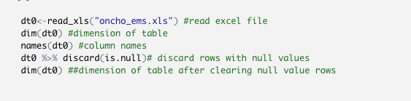


Slide 7

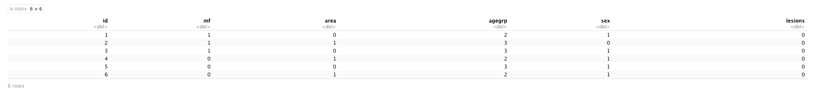

Slide 8
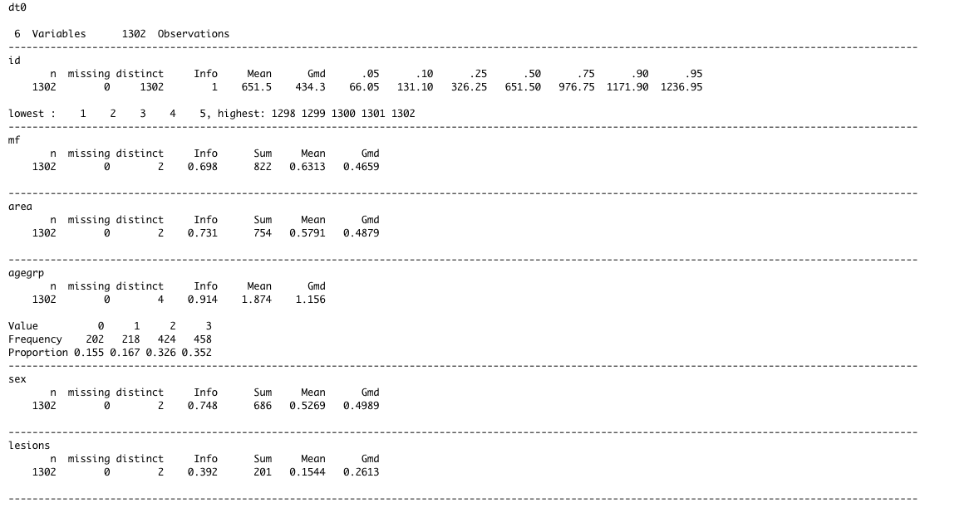

Slide 9

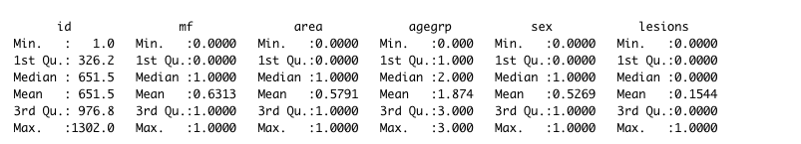

Slide 10
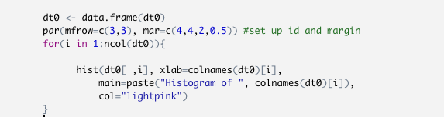
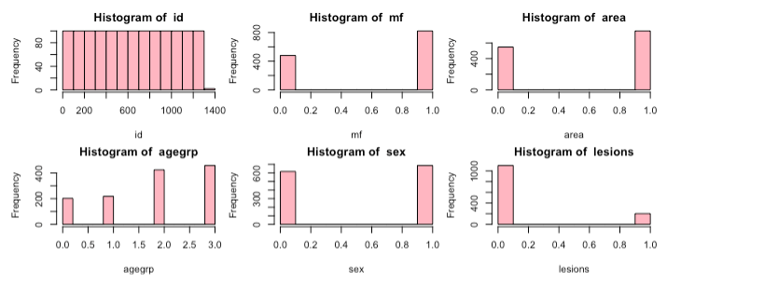
Distribution of Onchocerciasis Variables

Slide 11
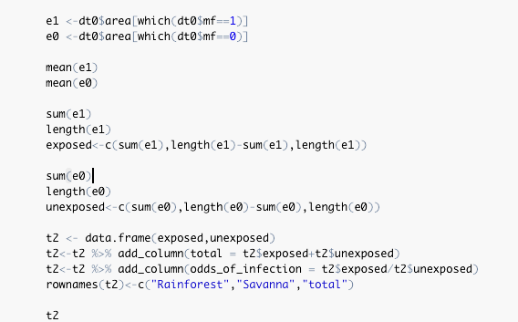
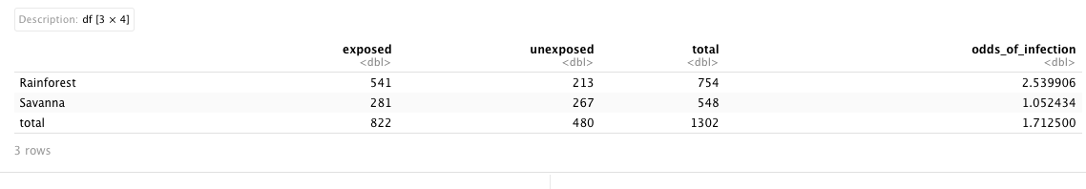
The prevalence of microfilarial infection appears to be greater for individuals living in rainforest areas compared to those living in the savannah; the associated odds ratio is 2.540/1.052 = 2.413

Slide 12
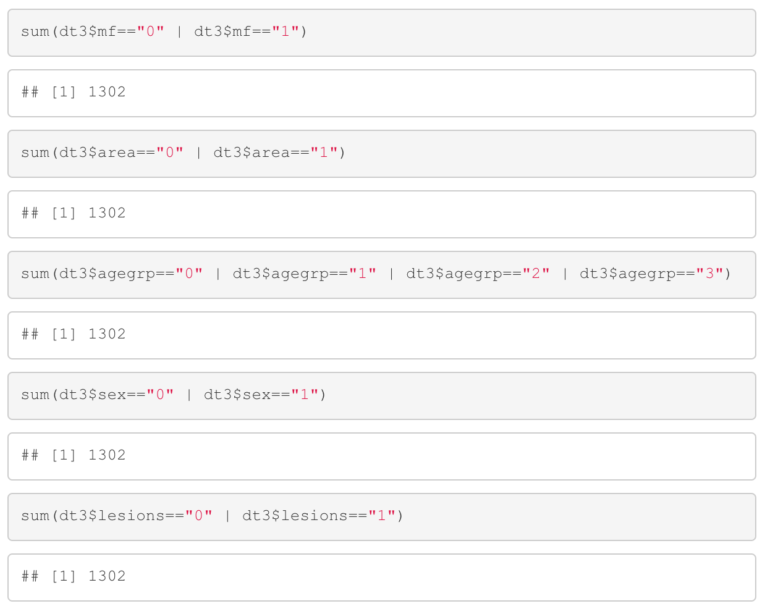
Data checking
Our data only contains binary and ordinal variables, so we do not need to worry about things like outliers. We need to check whether there are missing data or factors that are out of range.
There is no missing data or unexpected factors in our dataset.

Slide 13
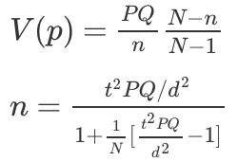
Sample size
P is the population's probability of the infection
p is the estimation
Where t indicates the confidence interval of our estimation
d is what we expect our error would be less than

Slide 14
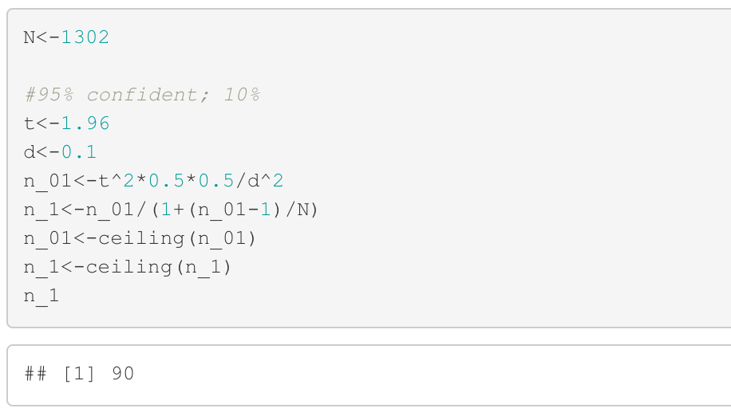

In this case, we hope that there is 95% of probability to get an estimation error within 10%.
According to the formula, we have:
Since we don't know the actual probability, we assume that it is 0.5, so we can get the biggest standard deviation, making sure that the sample size is always big enough.

Slide 15
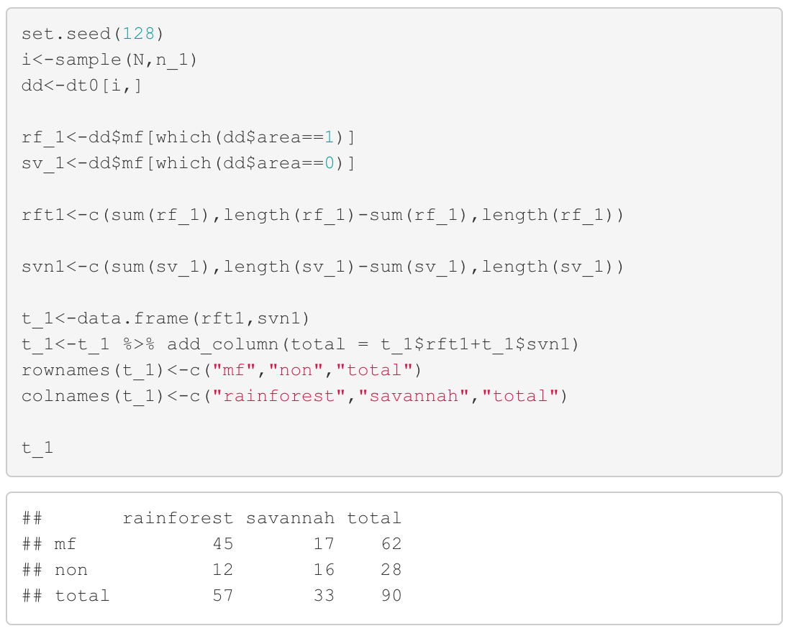
Null hypothesis: living in the rainforest or savannah does not affect the risk of microfilarial infection.
Get a sample of 90 and check the microfilarial infection of these people.
We notice that people living in forest are more likely to get infected.

Slide 16
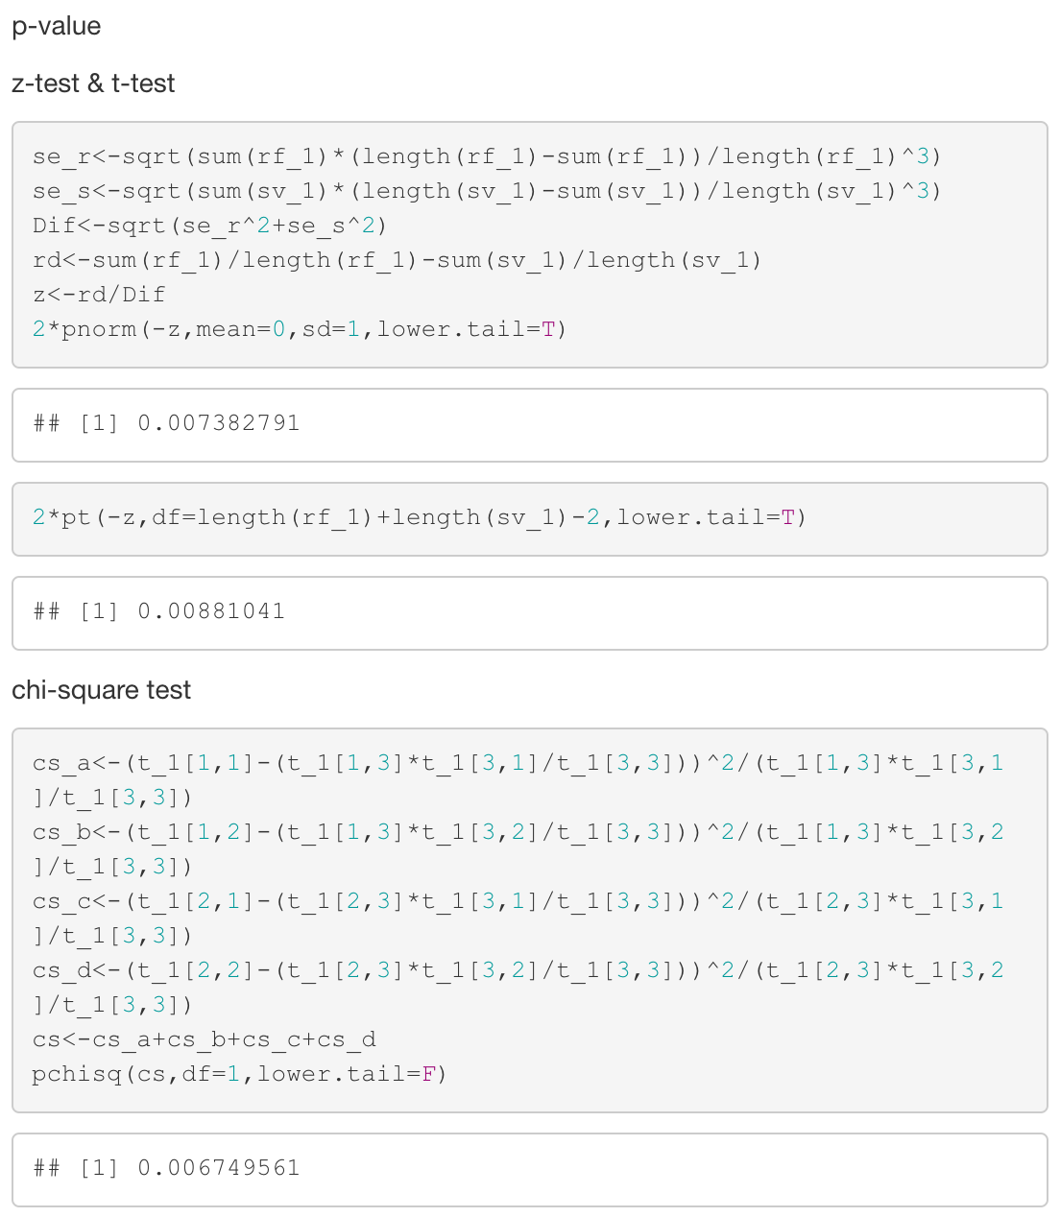
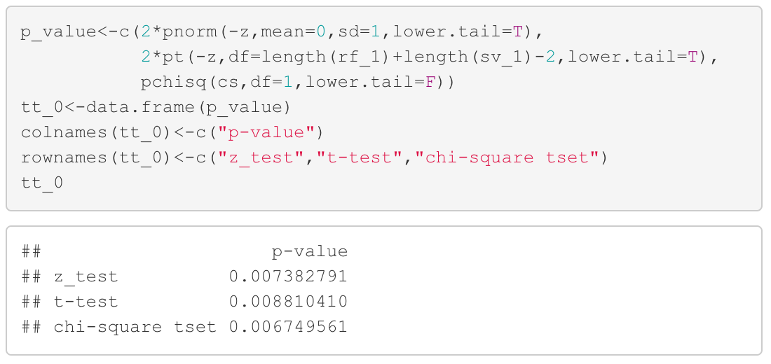
P-value of all three tests are very small, which is strongly against the null hypothesis. So, we think that the area people are living in has effect on the microfilarial infection.

Slide 17
​ | estimate​ | 95% confidence interval​ | p-value​
Microfilarial infection​ | 0.6888889​ | 0.592707 to 0.7850708​ | <0.01​
 | Rainforest | Savannah | Total
Microfilarial infection | 45 | 17 | 62
Non | 12 | 16 | 28
Total | 57 | 33 | 90
 | p-value
z-test | 0.00738279
t-test | 0.008810410
chi-square test | 0.006749561

Slide 18
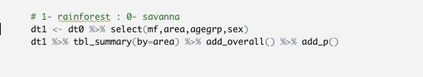
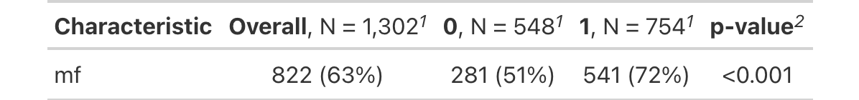
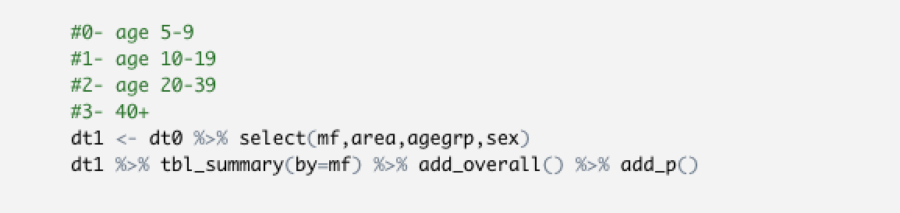
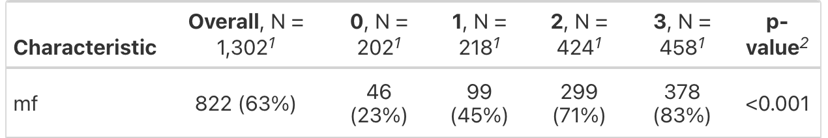
Area
OVERALL
Alpha value = 0.05
Sample size >= 90
Reject Ho
Age group

Slide 19
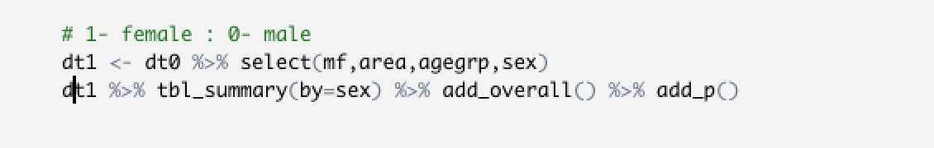
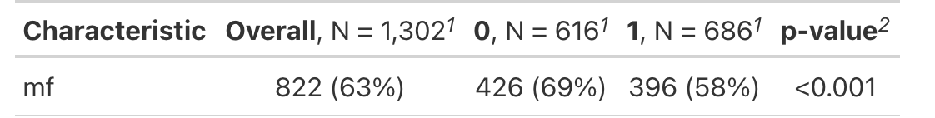
Sex
OVERALL
Alpha value = 0.05
Sample size >= 90
Reject Ho

Slide 20
CONCLUSION
The risk of microfilarial infection is 0.689 .
In rainforest area, the risk is 0.789, while in savannah area it is 0.515.
The area that people are living in has biggest influence on the risk of microfilarial infection.
Also, age group and sex have effect on the risk of infection.
Elder people are more likely to get infected.
Male have higher risk of infection.

Slide 21
END

