Slide 1
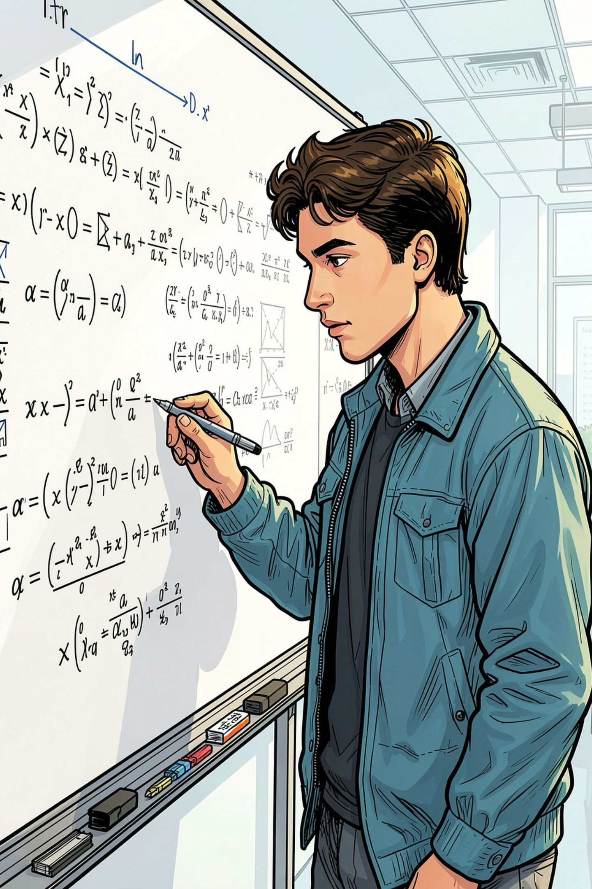
The Maths Behind MEB
Foundation Mathematics for Material & Energy Balance
Today is a consolidation lesson — not a new MEB topic. We will revisit the six key mathematical skills used throughout your MEB module, so you can apply them with confidence.

Slide 2
Six Foundation Mathematics Skills
These skills appear in every MEB calculation — density, moles, composition, material flow, and energy.
Algebra & Formulae
Measurement & Unit Conversion
Rearrange and solve equations
Keep units consistent
Ratio, Proportion & Percentage
Fractions
Stream composition
Mass fractions
Basic Arithmetic Calculations
Decimal Places
Add, subtract, multiply, divide
Report answers correctly.

Slide 3
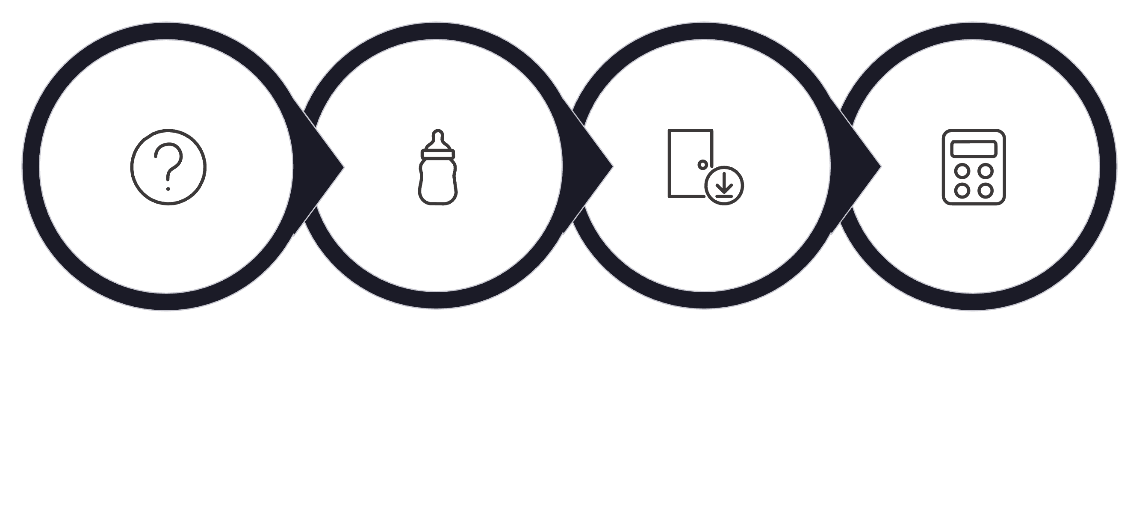










SKILL 1
Algebra & Formulae
Identify
Rearrange
Substitute
Calculate
Apply these steps to every MEB formula. For : rearrange to or . The same approach works for and .
Quick Check: To find volume from , which rearrangement is correct?
A) B) C)

Slide 4




SKILL 2
Measurement & Unit Conversion
Key Conversions
⚠️ Spot the Problem
1 kg = 1,000 g
1 kmol = 1,000 mol
1 kJ = 1,000 J
1 L = 1,000 mL
Use where and mass = 500 g.
What is wrong?
Always convert before substituting into a formula.
Mass is in grams but is per kg. Convert first: 500 g = 0.5 kg.

Slide 5

SKILL 3
Ratio, Proportion & Percentage
MEB Example
Concept | Simple idea | MEB example
Ratio | Compare two quantities | A:B = 1:3 means 1 part A for every 3 parts B
Proportion | Scale quantities while keeping the same relationship | If 100 kg contains 20 kg A, then 500 kg contains 100 kg A
Percentage | Part out of 100 | 20% of 500 kg = 100 kg
A 500 kg stream contains 20% component A.
Interpret: What does 30% component A mean in a 200 kg stream?
Summary :Ratio compares. Proportion scales. Percentage shows a part of the total.

Slide 6
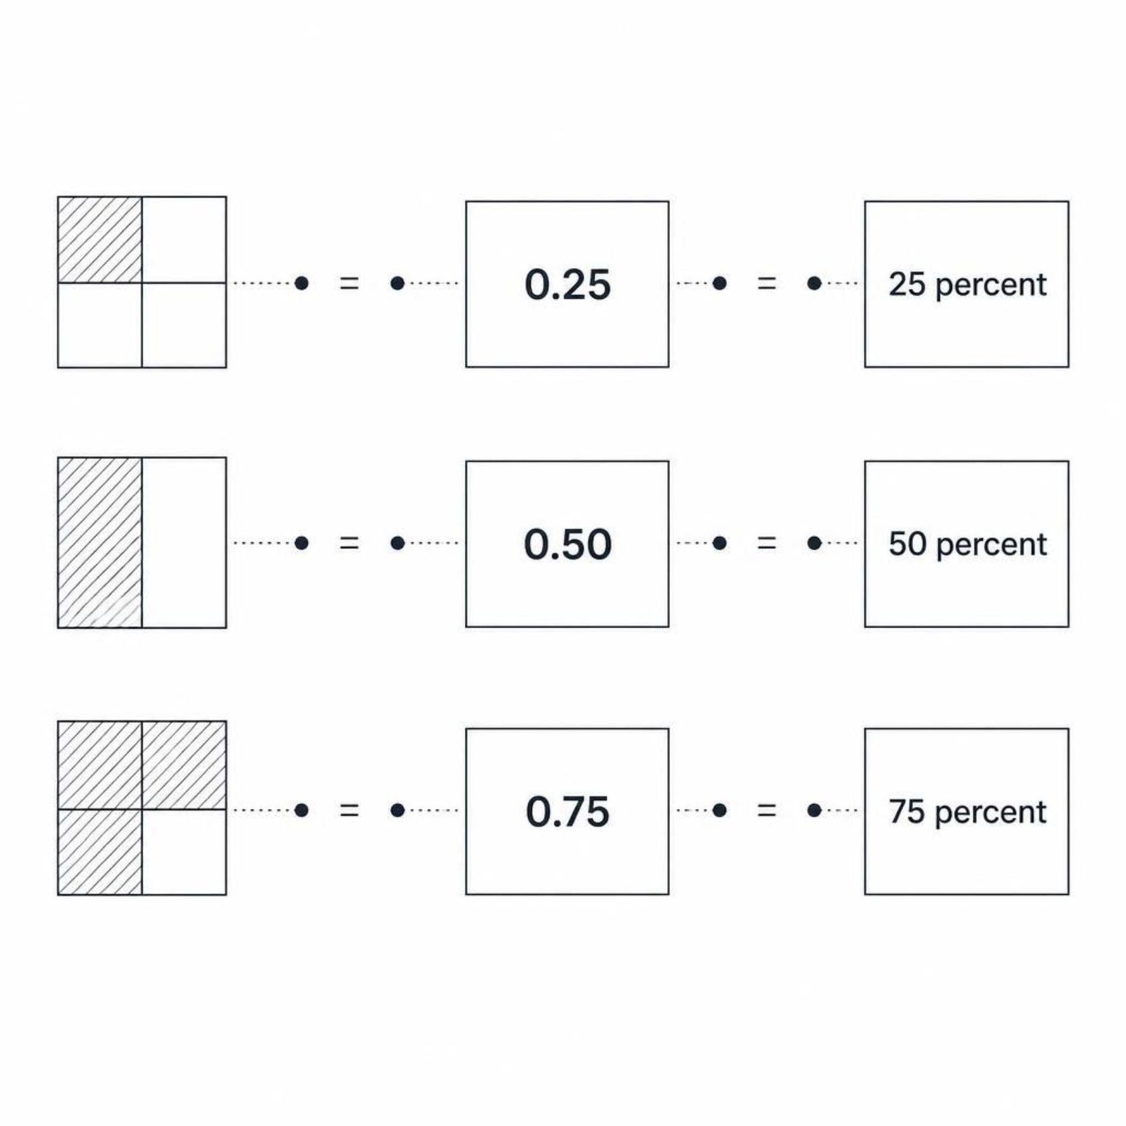

SKILL 4
Fractions
Connection to MEB
Fractions, decimals, and percentages all describe the same proportion — used in mass fraction and stream composition.
Example: ¼ of a 240 kg stream:
Mass fraction of 0.25 means 25% of the total stream mass.

Slide 7
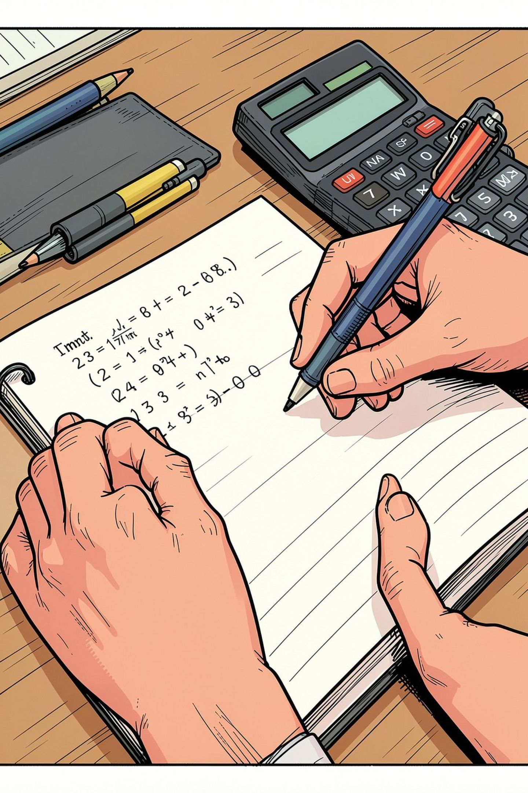




SKILL 5
Basic Arithmetic Calculations
+ Addition
Combine stream masses
− Subtraction
Find an unknown component
× Multiplication
Apply formulae
÷ Division
Rearrange formulae
Example: Total stream = 600 kg, Component A = 150 kg.
Component B =
Always calculate brackets first: , not .

Slide 8

SKILL 6
Decimal Places
Rounding and Decimal Places
Worked Example - Decimal Place
4.26 → 4.3 to 1 d.p.
7.842 → 7.84 to 2 d.p.
12.195 → 12.20 to 2 d.p.
If the answer is required to 1 decimal place:
3.78→3.8
Rule:
Look at the digit immediately after the required decimal place.
0–4 → keep the previous digit unchanged
5–9 → increase the previous digit by 1
Calculate first, then round the final answer to the required decimal place.

Slide 9



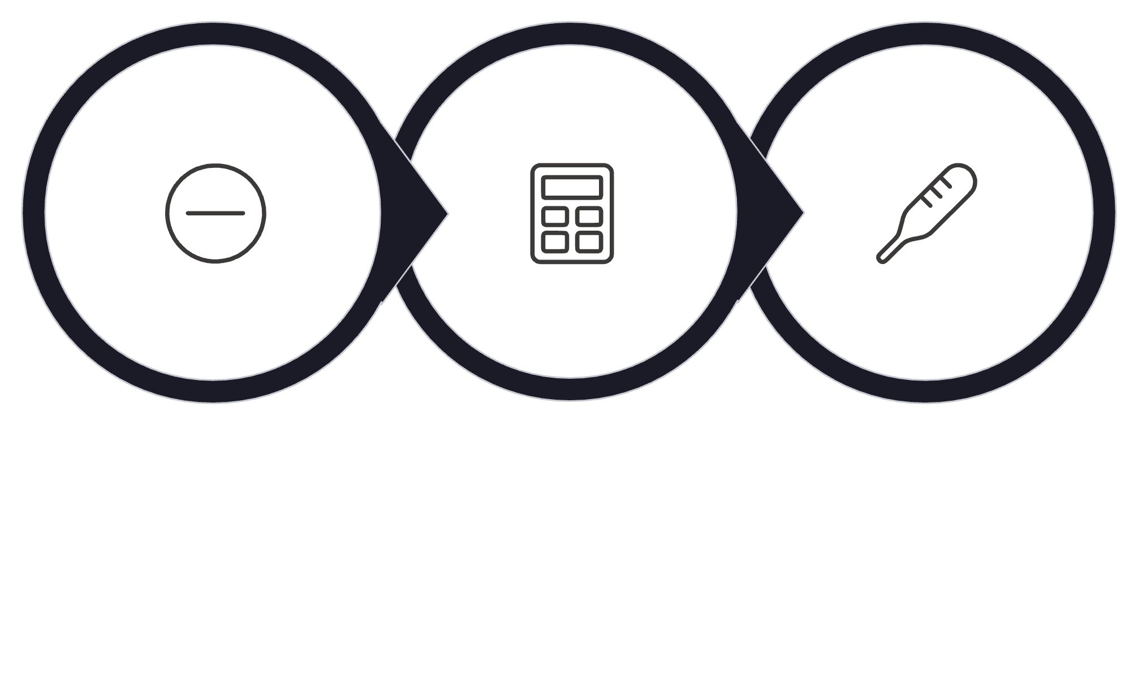

PUT IT ALL TOGETHER
One Problem, Six Skills
Given: , , temperature rises from 20°C to 50°C.
Use .
Find ΔT
Substitute
Calculate Q
Which Foundation Mathematics skills did we use? Discuss with a partner.

Slide 10
Key Takeaway
01
02
Algebra & Formulae
Unit Conversion
03
04
Ratio & Percentage
Fractions
05
06
Basic Arithmetic Operations
Decimal Place
Different MEB topics, same Foundation Mathematics skills.
Next: Let's go through the mission chapter together for more practice.

