Slide 1


Slide 2



Vision Statement
“To make entertainment the base of life”

Slide 3

Mission Statement
Customers
“We are on a mission every day to serve customers young and old with family entertainment. By offering popular parks and Disney TV shows. We use many Disney characters such as Mickey Mouse and Donald Duck to excite customers globally. We produce apps for smartphones in the Interactive Media division. We offer many internships for college students. Everything we do at Disney is possible because of our great employees and fans worldwide.”
young and old
products
popular parks and Disney TV shows
Self-concept
Disney characters
Markets
Technology
globally
apps for smartphones
Concern for public image
Philosophy
college students
possible
Concern for employees
employees

Slide 4
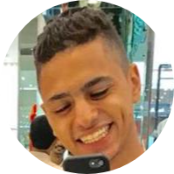
Team Members
Mohamed Safi Ahmed
20170237
Under Supervision of
TA. Nessma Mohamed El-Kelany

Slide 5
Thank You For Listening!
Any Questions?

