Slide 1

Fingerprint Scanners
By :Mohammad Sameer
ECE B
087

Slide 2
How Does
Fingerprint Scanners
work?

Slide 3
Types of Fingerprint Scanners
1.Optical Scanners
2.Capacitive Scanners

Slide 4
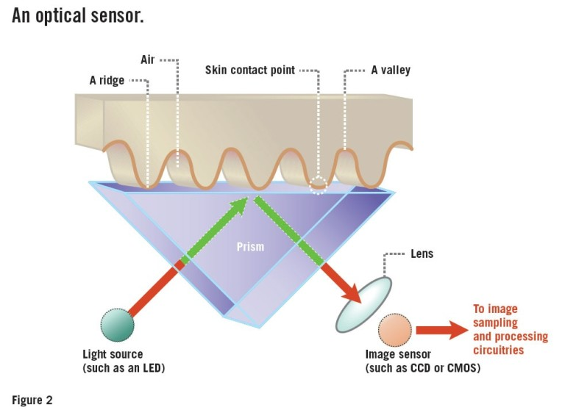

Slide 5
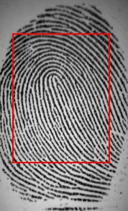
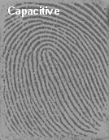
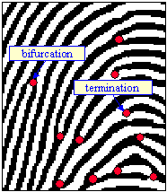
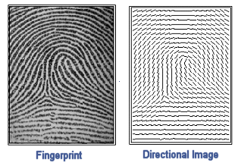

Slide 6
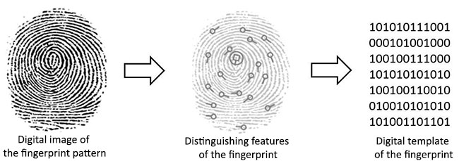

Slide 7
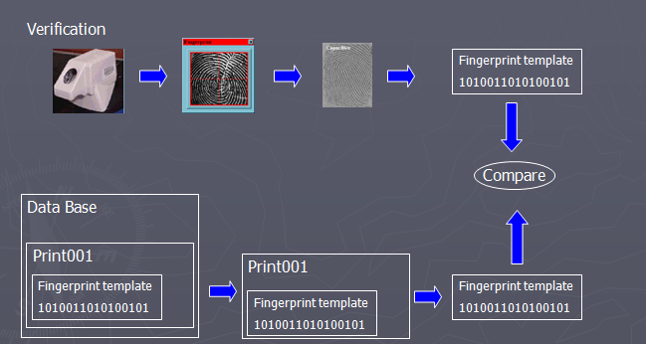

Slide 8
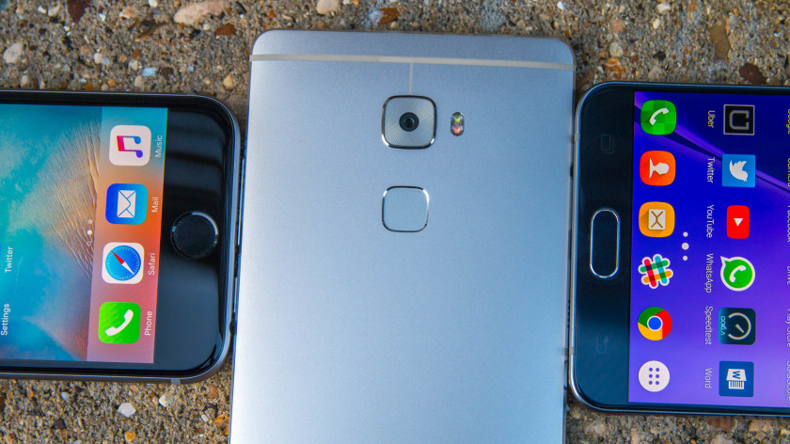
CAPACITIVE SCANNERS

Slide 9
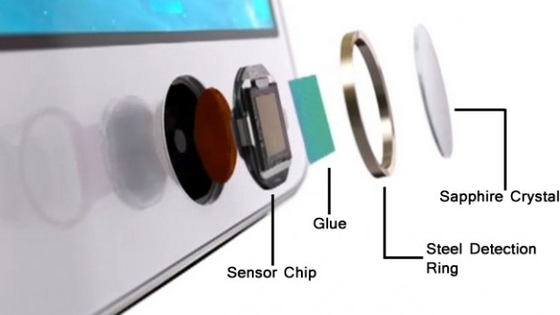

Slide 10
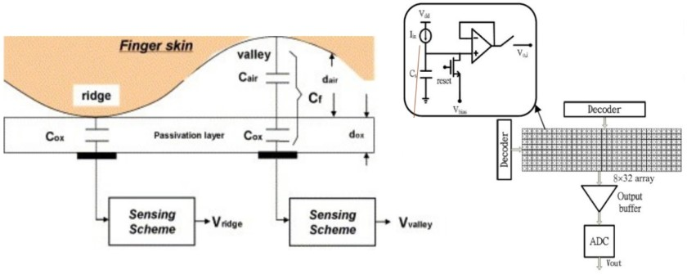
Capacitive Scanners

Slide 11
Ultrasonic scanners

Slide 12


Slide 13
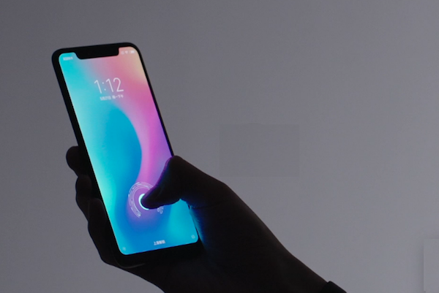
In-Display
Finger Print Sensor

Slide 14
Thank You!

