Slide 1
Employee Data Analysis using Excel
STUDENT NAME: M.SANDHIYA
REGISTER NO. :312204248
DEPARTMENT :B.COM (Accounting and Finance)
COLLEGE : Annai Violet Arts And Science College

Slide 2
PROJECT TITLE
Employee Performance Analysis using Excel
Visualizing Employee Attendance Trends With
Excel Charts

Slide 3


AGENDA
Problem Statement
Project Overview
End Users
Our Solution and Proposition
Dataset Description
Modelling Approach
Results and Discussion
Conclusion
3/21/2024 Annual Review

Slide 4

PROBLEM STATEMENT
In this project, an analysis was conducted to showcase the employee attendance trends, work preference patterns, such as working from home, and the frequency of sick leaves taken. The objective was to provide insights for managers to facilitate meeting planning and allocation of office space in accordance with the majority of employee presence in a given week etc.

Slide 5

PROJECT OVERVIEW
The dataset contains of attendance data, the day an employee worked from home, took sick leave, half leave etc. Here are the metics of the attendance
.

Slide 6

WHO ARE THE END USERS?
HR managers
Supervisor
Senior Management Data Analysts
Empoyees
Training and Development Teams

Slide 7

OUR SOLUTION AND ITS VALUE PROPOSITION
Overall, this attendance insights dashboard provides us with a powerful tool to monitor and optimize our workforce attendance, enabling us to make data-driven decisions that ultimately benefit our organization.

Slide 8
Dataset Description
if the data shows that employees tend to take more sick leave on Mondays, organizations may want to consider offering flexible work arrangements or mental health resources to help employees manage the transition from the weekend to the workweek more effectively.

Slide 9

THE "WOW" IN OUR SOLUTION
This dashboard offers a comprehensive overview of our employee attendance and trends over time, allowing us to make data-driven decisions to optimize our workforce management.
3/21/2024 Annual Review
9

Slide 10
MODELLING
Excel's charting and data visualization capabilities can help you create visually appealing reports and dashboards to visualize employee attendance trends. Here are some tips for using Excel to visualize employee attendance:
10

Slide 11
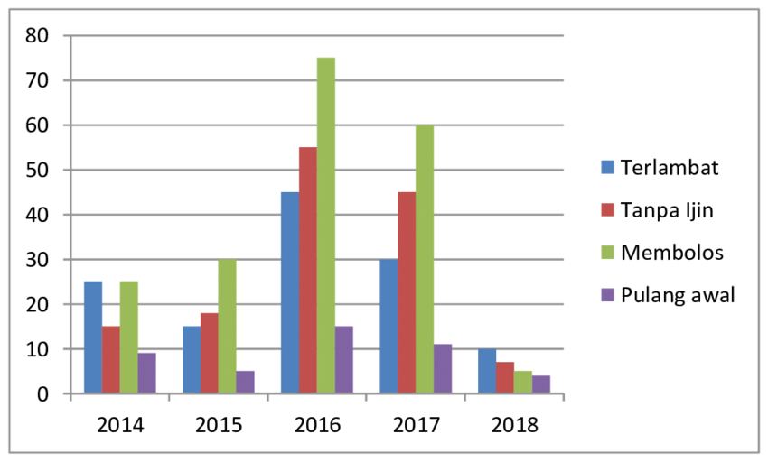
RESULTS
11

Slide 12
conclusion
One of the key features of this dashboard is the 'Present Percentage by Date' area chart, which provides a clear visual representation of employee attendance on a daily basis.

