Slide 1
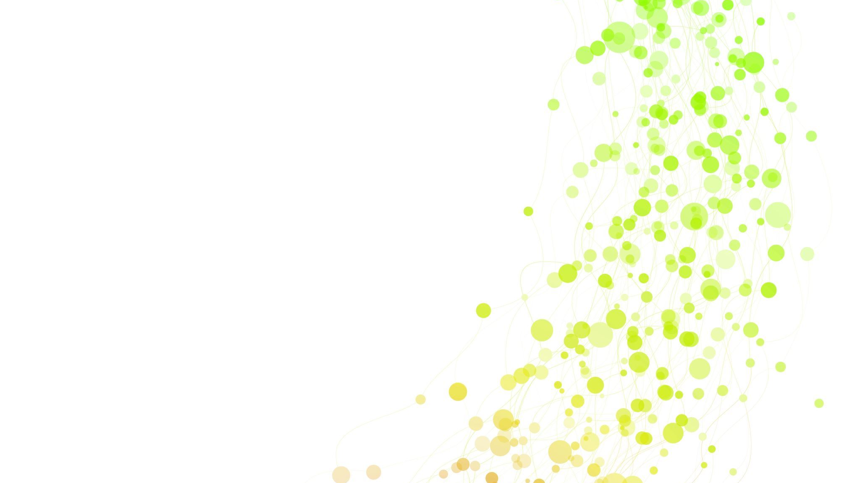
ML Projekt (wstęp)
Miłosz Witkowski i Alan Pietrasz

Slide 2
Problem to solve:
We want to build a wine recommendation system that uses your past ratings to predict the next wines you might enjoy.
We also want an aggregation model so you can choose wine by price, taste, texture, aroma, etc., and get the best wine for you (using your ratings and/or only tasters’ ratings).
We want to find out if price really matters when it comes to wine, and we would also like to know which affordable (student-friendly) good wines we can get. 😊
We may also check relationship between description of wine (smell, taste, character) and type of wine (Pinot Noir, Cabernet Sav., etc.).

Slide 3
Dataset
We are using zynicide/wine-reviews dataset from kaggle author scraped around 150k wine reviews from WineEnthusiast. Also author posted code for said scrapping.
The data consists of 12 fields:
Points: the number of points WineEnthusiast rated the wine on a scale of 1-100 (though they say they only post reviews for wines that score >=80)
Title: the title of the wine review, which often contains the vintage if you're interested in extracting that feature
Variety: the type of grapes used to make the wine (ie Pinot Noir)
Description: a few sentences from a sommelier describing the wine's taste, smell, look, feel, etc.

Slide 4
What does the data include?
Country: the country that the wine is from
Province: the province or state that the wine is from
Region 1: the wine growing area in a province or state (ie Napa)
Region 2: sometimes there are more specific regions specified within a wine growing area (ie Rutherford inside the Napa Valley), but this value can sometimes be blank
Winery: the winery that made the wine
Designation: the vineyard within the winery where the grapes that made the wine are from
Price: the cost for a bottle of the wine
Taster Name: name of the person who tasted and reviewed the wine

Slide 5
Problems, Methods and excepted results
Problem: Extracting meaningful information from text descriptions (for example: “This is ripe and fruity, a wine that is smooth while still structured. Firm tannins are filled out w…”).
Method: Tokenize the words and remove non-informative tokens. Build a one-hot encoding representation from the resulting tokens.
Expected result: A usable dataset for subsequent distance (similarity) calculations.

Slide 6
Problems, Methods and excepted results
Problem: Calculating distances between wine reviews from tasters and your own.
Method: Using FAISS (Facebook AI Similarity Search) — an open-source library for efficient similarity search and clustering of high-dimensional vectors, ideal for finding nearest neighbors in large datasets. FAISS allows us to compare encoded vectors representing wine reviews to identify the most similar ones based on distance metrics (e.g., Euclidean).
Expected result: Recommendations of wines that match your taste.

Slide 7
Problems, Methods and excepted results
Problem: Aggregating data to fit your personal needs (e.g., budget), so that you can identify specific wine taste preferences or find affordable options.
Methods: Build user interfaces that allow users to select the data and aggregation criteria they care about, using search and aggregated datasets to filter and refine results.
Expected result: The best wine recommendations tailored to you.

Slide 8
Problems, Methods and excepted results
Problem: Finding out whether price is closely related to wine ratings, and identifying which wines are good and affordable.
Method: Calculating the relationship and analyzing the distribution of price over rating points.
Expected results: Getting an answer to whether price and rating are correlated, and finding some affordable high-quality wines (outliers) that represent good value.

Slide 9
Problems, Methods and excepted results
Problem: Investigating whether there is a relationship between wine descriptions (e.g., aroma, taste, character) and wine variety (such as Pinot Noir, Cabernet Sauvignon, etc.).
Method: Analyze the tasting notes to find the most frequently used words associated with each wine variety and check whether these words differ significantly between varieties. This is similar to how we used text analysis to identify distinguishing vocabulary in forum posts or topic modeling in one of previous tasks.
Expected result: Identify sets of words that are characteristic of each wine variety; some wine types may have descriptions that are more similar to each other, while others will be more distinct.

Slide 10
More problems
- Null values, especially null values in prices (we can try scraping them from the internet if possible)
Problem with scraping, we may have a problem in finding the name of wine because we only have the winery
Different words in descriptions (synonyms), different inflected forms or parts of speech
And more yet to come...

