Slide 1
Ex7.s6: Repeated subsequences
🔍 Find all repeated substrings of length ≥ m in a string s by identifying positions i and j where s[i..i+m] == s[j..j+m]

Slide 2

Ex7.s6: Repeated subsequences
🔍 Find all repeated substrings of length ≥ m in a string s by identifying positions i and j where s[i..i+m] == s[j..j+m]
💡For simplicity, let’s say s= "banana banana”; m=3
Generate all suffixes of string s:
i | suffix
0 | banana banana
1 | anana banana
2 | nana banana
3 | ana banana
4 | na banana
5 | a banana
6 | banana
7 | banana
8 | anana
9 | nana
10 | ana
11 | na
12 | a

Slide 3
Ex7.s6: Repeated subsequences
🔍 Find all repeated substrings of length ≥ m in a string s by identifying positions i and j where s[i..i+m] == s[j..j+m]
💡For simplicity, let’s say s= "banana banana”; m=3
Sort all suffixes alphabetically:
i | suffix
6 | banana
12 | a
5 | a banana
10 | ana
3 | ana banana
1 | anana banana
8 | anana
0 | banana banana
7 | banana
2 | nana banana
9 | nana
11 | na
4 | na banana

Slide 4
Ex7.s6: Repeated subsequences
🔍 Find all repeated substrings of length ≥ m in a string s by identifying positions i and j where s[i..i+m] == s[j..j+m]
💡For simplicity, let’s say s= "banana banana”; m=3
Sort all suffixes alphabetically:
i | suffix
6 | banana
12 | a
5 | a banana
10 | ana
3 | ana banana
1 | anana banana
8 | anana
0 | banana banana
7 | banana
2 | nana banana
9 | nana
11 | na
4 | na banana
💡 now, any repeated substring of length ≥ 3 must appear as a common prefix between neighbouring suffixes in this sorted list

Slide 5
Ex7.s6: Repeated subsequences
🔍 Find all repeated substrings of length ≥ m in a string s by identifying positions i and j where s[i..i+m] == s[j..j+m]
💡For simplicity, let’s say s= "banana banana”; m=3
Sort all suffixes alphabetically:
i | suffix
6 | banana
12 | a
5 | a banana
10 | ana
3 | ana banana
1 | anana banana
8 | anana
0 | banana banana
7 | banana
2 | nana banana
9 | nana
11 | na
4 | na banana
💡 now, any repeated substring of length ≥ 3 must appear as a common prefix between neighbouring suffixes in this sorted list
➞ For each pair of neighbours, check whether they share more than 3 characters at the beginning

Slide 6
Ex7.s6: Repeated subsequences
🔍 Find all repeated substrings of length ≥ m in a string s by identifying positions i and j where s[i..i+m] == s[j..j+m]
💡For simplicity, let’s say s= "banana banana”; m=3
Sort all suffixes alphabetically:
i | suffix
6 | banana
12 | a
5 | a banana
10 | ana
3 | ana banana
1 | anana banana
8 | anana
0 | banana banana
7 | banana
2 | nana banana
9 | nana
11 | na
4 | na banana
0
1
1
3
3
5
0
6
0
💡 now, any repeated substring of length ≥ 3 must appear as a common prefix between neighbouring suffixes in this sorted list
➞ For each pair of neighbours, check whether they share more than 3 characters at the beginning
4
2
2

Slide 7
Ex7.s6: Repeated subsequences
🔍 Find all repeated substrings of length ≥ m in a string s by identifying positions i and j where s[i..i+m] == s[j..j+m]
💡For simplicity, let’s say s= "banana banana”; m=3
Sort all suffixes alphabetically:
i | suffix
6 | banana
12 | a
5 | a banana
10 | ana
3 | ana banana
1 | anana banana
8 | anana
0 | banana banana
7 | banana
2 | nana banana
9 | nana
11 | na
4 | na banana
0
1
1
3
✅
✅
3
5
✅
0
6
✅
0
💡 now, any repeated substring of length ≥ 3 must appear as a common prefix between neighbouring suffixes in this sorted list
➞ For each pair of neighbours, check whether they share more than 3 characters at the beginning
4
✅
2
2

Slide 8
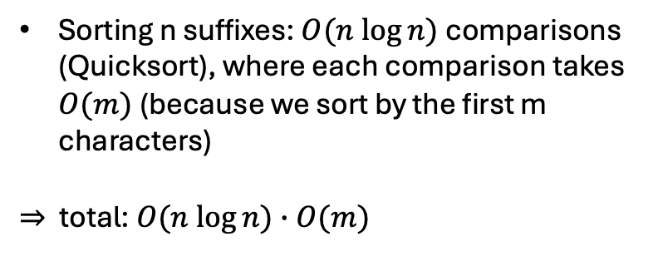
Ex7.s6: Repeated subsequences
🔍 Find all repeated substrings of length ≥ m in a string s by identifying positions i and j where s[i..i+m] == s[j..j+m]
Running time
Sorting n suffixes: $O(n log⁡n)$comparisons (Quicksort), where each comparison takes $O(m)$(because we sort by the first m characters)
⇒ total: $O(n log⁡n)∙O(m)$

