Slide 1

E-Commerce 2018: Business. Technology. Society
Fourteenth Edition
Chapter 2
E-Commerce Business Models and Concepts
Copyright © 2019, 2018, 2017 Pearson Education, Inc. All Rights Reserved
Notes:
If this PowerPoint presentation contains mathematical equations, you may need to check that your computer has the following installed:
1) MathType Plugin
2) Math Player (free versions available)
3) NVDA Reader (free versions available)

Slide 2
Learning Objectives
2.1 Identify the key components of e-commerce business models.
2.2 Describe the major B2C business models.
2.3 Describe the major B2B business models.
2.4 Understand key business concepts and strategies applicable to e-commerce.
Notes:
Slide 2 is list of textbook LO numbers and statements

Slide 3
Tweet Tweet: Will Twitter Ever Find a Business Model That Works?
Class Discussion
What characteristics or benchmarks can be used to assess the business value of a company such as Twitter?
Have you used Twitter to communicate with friends or family? What are your thoughts on this service?
What are Twitter’s most important assets?
Which of the various methods described for monetizing Twitter’s assets do you feel might be most successful?

Slide 4
E-Commerce Business Models
Business model
Set of planned activities designed to result in a profit in a marketplace
Business plan
Describes a firm’s business model
E-commerce business model
Uses/leverages unique qualities of the Internet, the Web, and the mobile platform.

Slide 5
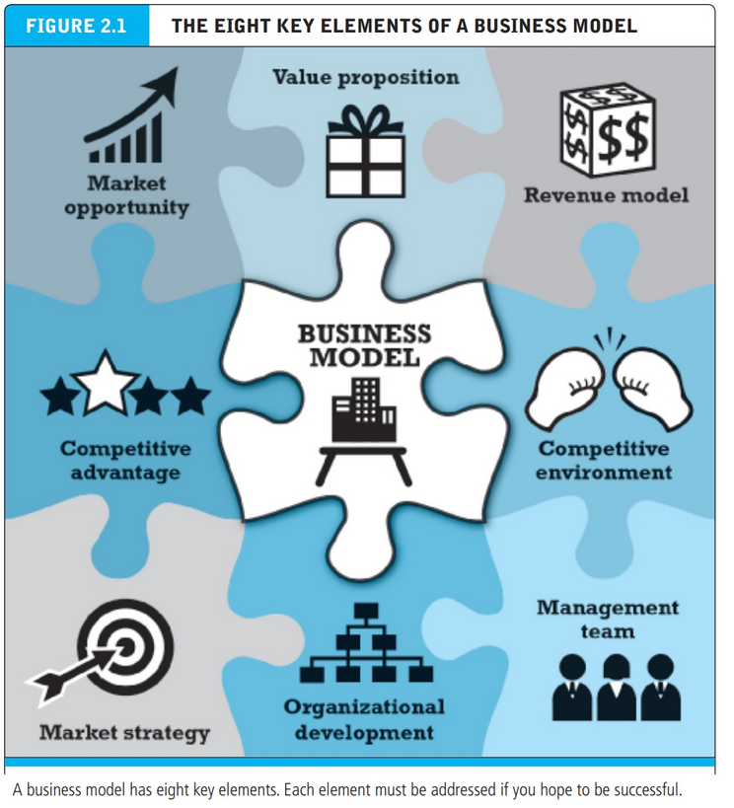
Eight Key Elements of a Business Model
Value proposition
Revenue model
Market opportunity
Competitive environment
Competitive advantage
Market strategy
Organizational development
Management team

Slide 6
1. Value Proposition
“Why should the customer buy from you?”
Successful e-commerce value propositions:
Personalization/customization
Reduction of product search, price discovery costs
Facilitation of transactions by managing product delivery

Slide 7
2. Revenue Model
“How will you earn money?”
Major types of revenue models:
Advertising revenue model
Subscription revenue model
Freemium strategy
Transaction fee revenue model
Sales revenue model
Affiliate revenue model

Slide 8
Insight on Society: Foursquare: Check Your Privacy at the Door
Class discussion:
What revenue model does Foursquare use? What other revenue models might be appropriate?
Are privacy concerns the only shortcoming of location-based mobile services?
Should business firms be allowed to text or call mobile devices with advertising messages based on location?
Notes:
Privacy and safety

Slide 9
3. Market Opportunity
“What marketspace do you intend to serve and what is its size?”
Marketspace: Area of actual or potential commercial value in which company intends to operate
Realistic market opportunity: Defined by revenue potential in each market niche in which company hopes to compete
Market opportunity typically divided into smaller niches

Slide 10
4. Competitive Environment
“Who else occupies your intended marketspace?”
Other companies selling similar products in the same marketspace
Includes both direct and indirect competitors
Influenced by:
Number and size of active competitors
Each competitor’s market share
Competitors’ profitability
Competitors’ pricing

Slide 11
5. Competitive Advantage
“What special advantages does your firm bring to the marketspace?”
Is your product superior to or cheaper to produce than your competitors’?
Important concepts:
Asymmetries
First-mover advantage, complementary resources
Unfair competitive advantage
Leverage
Perfect markets

Slide 12
6. Market Strategy
“How do you plan to promote your products or services to attract your target audience?”
Details how a company intends to enter market and attract customers
Best business concepts will fail if not properly marketed to potential customers

Slide 13
7. Organizational Development
“What types of organizational structures within the firm are necessary to carry out the business plan?”
Describes how firm will organize work
Typically, divided into functional departments
As company grows, hiring moves from generalists to specialists

Slide 14
8. Management Team
“What kind of backgrounds should the company’s leaders have?”
A strong management team:
Can make the business model work
Can give credibility to outside investors
Has market-specific knowledge
Has experience in implementing business plans

Slide 15
Raising Capital
Seed capital
Elevator pitch
Traditional sources
Incubators, angel investors
Commercial banks, venture capital firms
Strategic partners
Crowdfunding
J O B S Act

Slide 16
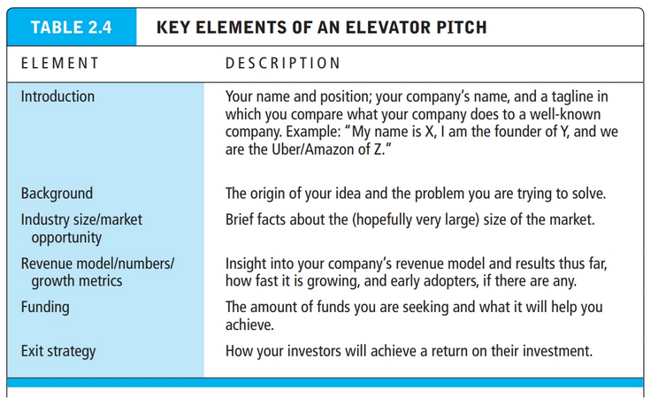

Slide 17
Insight on Business: Crowdfunding Takes off
Class Discussion
What types of projects and companies might be able to most successfully use crowdfunding?
Are there any negative aspects to crowdfunding?
What obstacles are presented in the use of crowdfunding as a method to fund startups?

Slide 18
Categorizing E-Commerce Business Models
No one correct way
Text categorizes according to:
E-commerce sector (e.g., B2B)
E-commerce technology (e.g., m-commerce)
Similar models appear in different sectors
Companies may use multiple business models (e.g., eBay)
E-commerce enablers

Slide 19
B2C Business Models
E-tailer
Community provider (social network)
Content provider
Portal
Transaction broker
Market creator
Service provider

Slide 20
B2C Models: E-Tailer
Online version of traditional retailer
Revenue model: Sales
Variations:
Virtual merchant
Bricks-and-clicks
Catalog merchant
Manufacturer-direct
Low barriers to entry

Slide 21
B2C Models: Community Provider
Provide online environment (social network) where people with similar interests can transact, share content, and communicate
Examples: Facebook, LinkedIn, Twitter, Pinterest
Revenue models:
Typically hybrid, combining advertising, subscriptions, sales, transaction fees, and so on

Slide 22
B2C Models: Content Provider
Digital content on the Web:
News, music, video, text, artwork
Revenue models:
Use variety of models, including advertising, subscription; sales of digital goods
Key to success is typically owning the content
Variations:
Syndication
Aggregators

Slide 23
Insight on Technology: Will the Connected Car Become the next Hot Entertainment Vehicle?
Class Discussion
What value does the Internet of Things (I o T) have for businesses?
What impact does the I o T have on the content industry?
What impact does the I o T have on vehicles?
Are there any disadvantages to “connected” cars?

Slide 24
B2C Business Models: Portal
Search plus an integrated package of content and services
Revenue models:
Advertising, referral fees, transaction fees, subscriptions for premium services
Variations:
Horizontal/general
Vertical/specialized (vortal)
Search

Slide 25
B2C Models: Transaction Broker
Process online transactions for consumers
Primary value proposition—saving time and money
Revenue model:
Transaction fees
Industries using this model:
Financial services
Travel services
Job placement services

Slide 26
B2C Models: Market Creator
Create digital environment where buyers and sellers can meet and transact
Examples: Priceline, eBay
Revenue model: Transaction fees, fees to merchants for access
On-demand service companies (sharing economy): platforms that allow people to sell services
Examples: Uber, Airbnb

Slide 27
B2C Models: Service Provider
Online services
Example: Google—Google Maps, Gmail, and so on
Value proposition
Valuable, convenient, time-saving, low-cost alternatives to traditional service providers
Revenue models:
Sales of services, subscription fees, advertising, sales of marketing data

Slide 28
B2B Business Models
Net marketplaces
E-distributor
E-procurement
Exchange
Industry consortium
Private industrial network

Slide 29
B2B Models: E-Distributor
Version of retail and wholesale store, M R O goods, and indirect goods
Owned by one company seeking to serve many customers
Revenue model: Sales of goods
Example: Grainger

Slide 30
B2B Models: E-Procurement
Creates digital markets where participants transact for indirect goods
B2B service providers, S a a S and P a a S providers
Scale economies
Revenue model:
Service fees, supply-chain management, fulfillment services
Example: Ariba

Slide 31
B2B Models: Exchanges
Independently owned vertical digital marketplace for direct inputs
Revenue model: Transaction, commission fees
Create powerful competition between suppliers
Tend to force suppliers into powerful price competition; number of exchanges has dropped dramatically

Slide 32
B2B Models: Industry Consortia
Industry-owned vertical digital marketplace open to select suppliers
More successful than exchanges
Sponsored by powerful industry players
Strengthen traditional purchasing behavior
Revenue model: Transaction, commission fees
Example: SupplyOn

Slide 33
Private Industrial Networks
Digital network used to coordinate among firms engaged in business together
Typically evolve out of large company’s internal enterprise system
Key, trusted, long-term suppliers invited to network
Example: Walmart’s network for suppliers

Slide 34
How E-Commerce Changes Business
E-commerce changes industry structure by changing:
Rivalry among existing competitors
Barriers to entry
Threat of new substitute products
Strength of suppliers
Bargaining power of buyers
Industry structural analysis

Slide 35
Industry Value Chains
Set of activities performed by suppliers, manufacturers, transporters, distributors, and retailers that transform raw inputs into final products and services
Internet reduces cost of information and other transactional costs
Leads to greater operational efficiencies, lowering cost, prices, adding value for customers

Slide 36
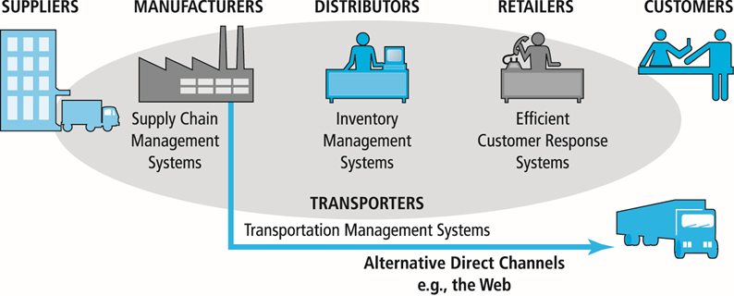
Figure 2.4 E-Commerce and Industry Value Chains
Notes:
Figure 2.4, Page 90.
Every industry can be characterized by a set of value-adding activities performed by a variety of actors. E-commerce potentially affects the capabilities of each player as well as the overall operational efficiency of the industry.

Slide 37
Firm Value Chains
Activities that a firm engages in to create final products from raw inputs
Each step adds value
Effect of Internet:
Increases operational efficiency
Enables product differentiation
Enables precise coordination of steps in chain

Slide 38
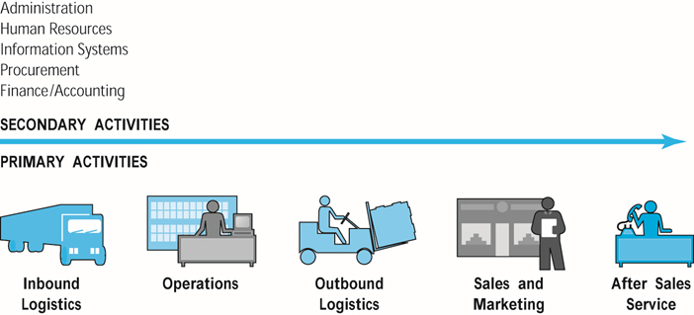
Figure 2.5 E-Commerce and Firm Value Chains
Notes:
Figure 2.5, page 91.
Every firm can be characterized by a set of value-adding primary and secondary activities performed by a variety of actors in the firm. A simple firm value chain performs five primary value-adding steps: inbound logistics, operations, outbound logistics, sales and marketing, and after sales service.

Slide 39
Firm Value Webs
Networked business ecosystem
Uses Internet technology to coordinate the value chains of business partners
Coordinates a firm’s suppliers with its own production needs using an Internet-based supply chain management system

Slide 40
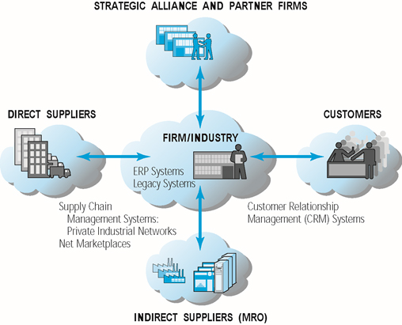
Figure 2.6 Internet-Enabled Value Web
Notes:
Figure 2.6, page 92.
Internet technology enables firms to create an enhanced value web in cooperation with their strategic alliance and partner firms, customers, and direct and indirect suppliers.

Slide 41
Business Strategy
Plan for achieving superior long-term returns on capital invested: that is, profit
Five generic strategies
Product/service differentiation
Cost competition
Scope
Focus/market niche
Customer intimacy

Slide 42
E-Commerce Technology and Business Model Disruption
Disruptive technologies
Digital disruption
Sustaining technology
Stages
Disruptors introduce new products of lower quality
Disruptors improve products
New products become superior to existing products
Incumbent companies lose market share

Slide 43
Careers in E-Commerce
Position: Assistant Manager of E-business
Qualification/Skills
Preparing for the Interview
Possible Interview Questions

Slide 44

Copyright

