Slide 1
WS-standard
Xiaofan Xu
Ziqi Tang
John Bonino
Ruochen Liu

Slide 2
Introduction
A web service is a type of component that is available on the web and can be incorporated in applications or used as a standalone service
The goal of web services is to achieve universal interoperability between applications by using Web standards.

Slide 3



Introduction
three organizations that are key to the evolution of Web services standards：

Slide 4
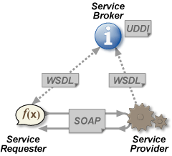
Highlights
eXtensible Markup Language (XML)
Simple Object Access Protocol (SOAP)
Web Services Description Language (WSDL)
Universal Description, Discovery, and Integration (UDDI)
Notes:
Service-Oriented Computing: Semantics, Processes, Agents
August 2004
© Singh & Huhns

Slide 5
SOAP (Simple Object Access Protocol)
a messaging protocol specification for exchanging structured information in the implementation of web services in computer networks. Its purpose is to provide extensibility, neutrality and independence.
It uses XML Information Set for its message format, and relies on application layer protocols (HTTP or SMTP), for message negotiation and transmission.

Slide 6
WSDL (Web Services Description Language )
It is an XML-based language for describing Web Services and how to access them.
It specifies the location of the service and the operations the services exposes.

Slide 7
UDDI (Universal Description, Discovery, and Integration)
The Universal Description, Discovery, and Integration specs define a way to publish and discover information about Web services.
The UDDI business registration is an XML file that describes a business entity and its Web services

Slide 8
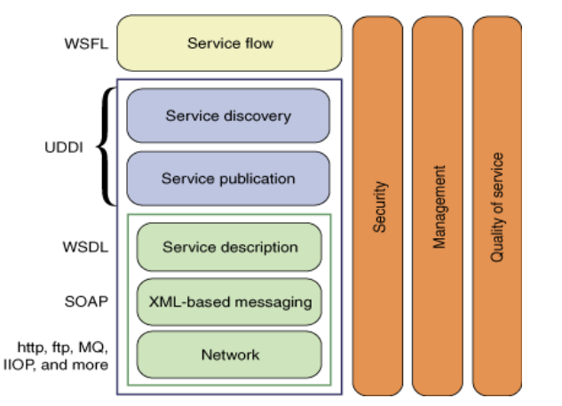
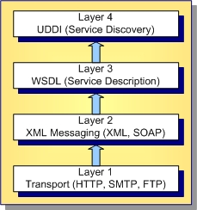
Standards for Web Services

Slide 9
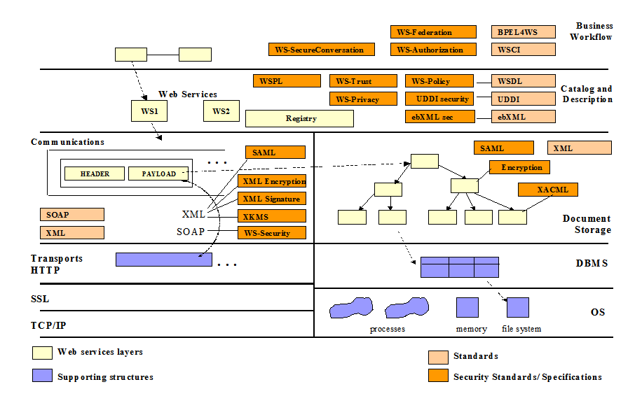
Layers

Slide 10
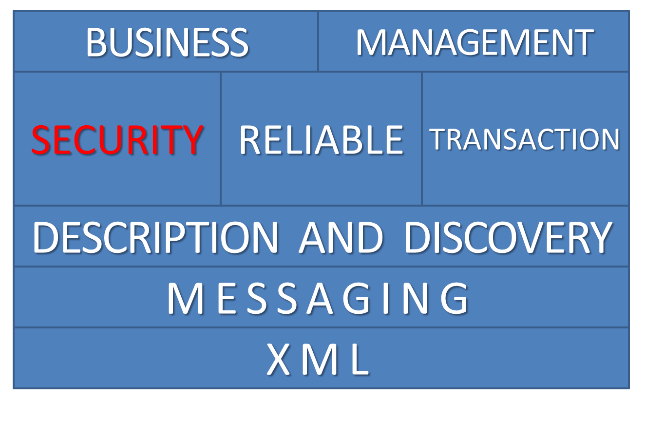
WS specification stack

Slide 11
Specifications(1)
Messaging
  SOAP
  WS-Addressing
    message routing data within SOAP headers. Instead of relying on network-level transport to convey routing information

Slide 12
Specifications(2)
Description and Discovery
  UDDI
  JSON-WSP
    a web-service protocol that uses JSON for service description, requests and responses.
  WS-Discovery
    allows computers and other devices to find services in a local area network without prior configuration

Slide 13
Specifications(3)
Transaction
  WS-Transaction
    indicates how transactions will be handled and controlled in Web Services.
Reliable
  WS-ReliableMessaging.
    a protocol that allows SOAP messages to be reliably delivered

Slide 14
Specifications(4)
Security
  WS-Security
    Its goal is to let applications secure SOAP message exchanges by providing encryption, integrity, and authentication support. Reliable
  WS-Trust
    allow web services to share user identities by incorporating standard security tokens into SOAP headers

Slide 15
THANK YOU!

