Slide 1
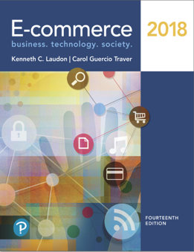
E-Commerce 2018: Business. Technology. Society
Fourteenth Edition
Chapter 1
The Revolution Is Just Beginning
Copyright © 2019, 2018, 2017 Pearson Education, Inc. All Rights Reserved
Notes:
If this PowerPoint presentation contains mathematical equations, you may need to check that your computer has the following installed:
1) MathType Plugin
2) Math Player (free versions available)
3) NVDA Reader (free versions available)

Slide 2
Learning Objectives
1.1 Understand why it is important to study e-commerce.
1.2 Define e-commerce, understand how e-commerce differs from e-business, identify the primary technological building blocks underlying e-commerce, and recognize major current themes in e-commerce.
1.3 Identify and describe the unique features of e-commerce technology and discuss their business significance.
1.4 Describe the major types of e-commerce.
1.5 Understand the evolution of e-commerce from its early years to today.
1.6 Describe the major themes underlying the study of e-commerce.
1.7 Identify the major academic disciplines contributing to e-commerce.
Notes:
Slide 2 is list of textbook LO numbers and statements

Slide 3
Uber: The New Face of E-Commerce?
Class Discussion
Have you used Uber or any other on-demand service companies?
What is the appeal of these companies for users and providers?
Are there any negative consequences to the increased use of on-demand services like Uber and Airbnb?

Slide 4
Uber:
Uber and other firms with similar business models, such as Lyft (a ride service similar to Uber’s), Airbnb (rooms for rent), Heal (doctor home visits), Handy (part-time household helpers), Instacart (grocery shopping), Washio (laundry service), and BloomThat (flower delivery), are the pio-neers of a new on-demand service e-commerce business model that is sweeping up billions of investment dollars and disrupting major industries, from transportation to hotels, real estate, house cleaning, maintenance, and grocery shopping.

Slide 5
Uber:
Drivers are signing up at an exponential rate: as of the beginning of 2016, there were over 450,000 drivers in the United States and over 1 million worldwide.

Slide 6
Uber:
Uber is the current poster child for “digital disruption.” It is easy to see why Uber has ignited a firestorm of opposition from existing taxi services both in the United States and around the world.

Slide 7
Uber:
Uber’s business model differs from traditional retail e-commerce. Uber doesn’t sell goods.
Instead it has created a smartphone-based platform that enables people who want a service—like a taxi—to find a provider with the resources, such as a personal automobile and a driver with available time, to fill the demand.
It’s important to understand that although Uber and similar firms are often called “sharing economy” companies, this is a misnomer.
Uber drivers are selling their services as drivers and the temporary use of their car. Uber itself is not in the sharing business either: it charges a hefty fee for every transaction on its platform.

Slide 8
Uber:
Uber is not an example of true “peer-to-peer” e-commerce because Uber transactions involve an online intermediary: a third party that takes a cut of all transactions and arranges for the marketplace to exist in the first place.
Uber has disrupted the traditional taxi business model because it offers a superior, fast, convenient taxi-hailing service when compared to traditional taxi companies.
How?

Slide 9
The First Thirty Seconds
First 20 years of e-commerce
Just the beginning
Rapid growth and change
Technologies evolve at exponential rates
Disruptive business change
New opportunities
Why study e-commerce
Understand opportunities and risks
Analyze e-commerce ideas, models, issues

Slide 10
Introduction to E - c o m m e r c e
Use of Internet to transact business
Includes Web, mobile browsers and apps
More formally:
Digitally enabled commercial transactions between and among organizations and individuals

Slide 11
The Difference between E-Commerce and E-Business
E-business:
Digital enabling of transactions and processes within a firm, involving information systems under firm’s control
Does not include commercial transactions involving an exchange of value across organizational boundaries

Slide 12
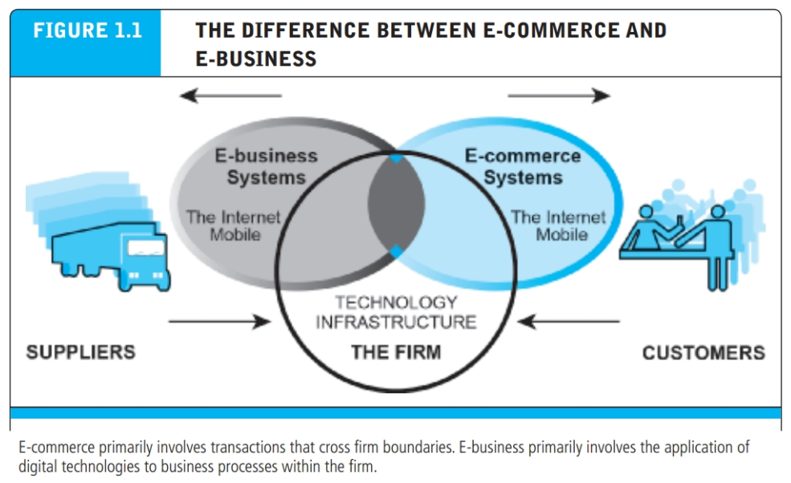

Slide 13
Technological Building Blocks Underlying E -Commerce
Internet: A worldwide network of computer networks,
World Wide Web: One of the Internet’s most popular services, providing access to billions of web pages.
H T M L
Deep Web versus. “surface” Web
Mobile platform
Mobile apps

Slide 14
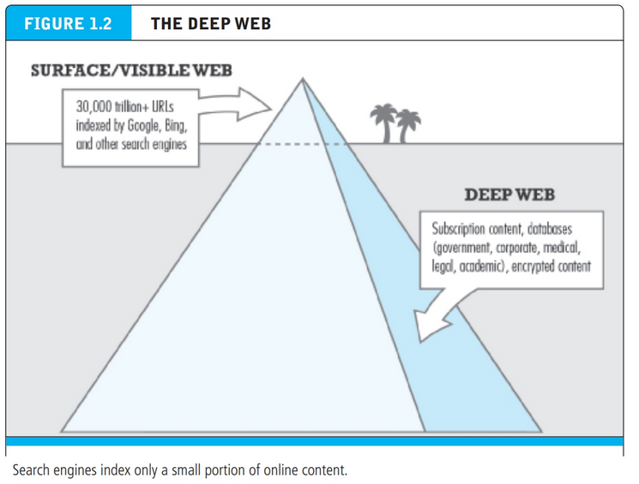

Slide 15
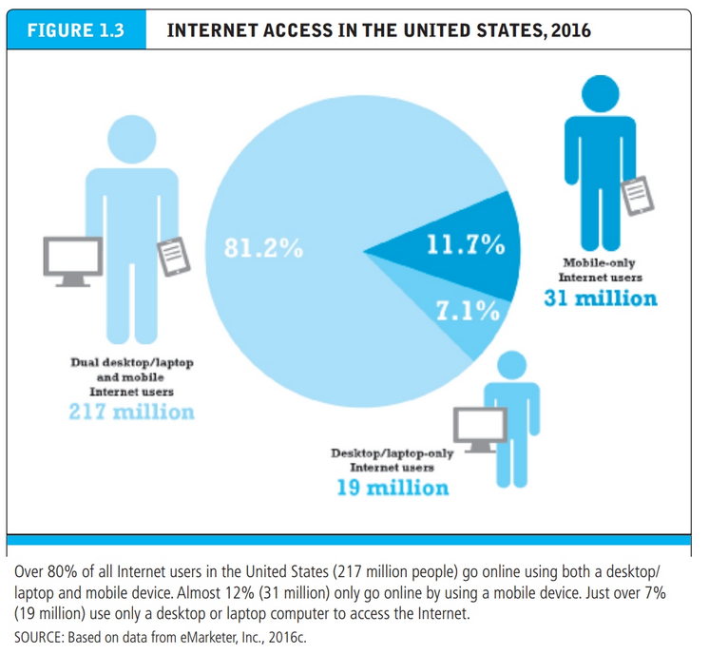

Slide 16
Insight on Technology: Will Apps Make the Web Irrelevant?
Class Discussion
What are the advantages and disadvantages of apps, compared with websites, for mobile users?
What are the benefits of apps for content owners and creators?
Will apps eventually make the Web irrelevant? Why or why not?

Slide 17
Major Trends in E-Commerce
Business trends include:
All forms of e-commerce show very strong growth
Technology trends include:
Mobile platform has made mobile e-commerce reality
Societal trends include:
Increased online social interaction and sharing
p16

Slide 18
Unique Features of E-Commerce Technology
Prior, companies sold their products via well-insulated channels. Consumers were trapped by geographical and social boundaries, unable to search widely for the best price and quality.
Information about prices, costs, and fees could be hidden from the consumer, creating profitable information asymmetries for the selling firm.
Information asymmetry refers to any disparity in relevant market information among parties in a transaction.

Slide 19
Unique Features of E-Commerce Technology (1 of 2)
Ubiquity
Global reach
Universal standards
Information richness
Notes:
Additional concepts and terminology include: Information asymmetry, menu costs, marketplaces and marketspaces, transaction costs, cognitive energy, market entry costs, search costs, price discovery, network externalities.

Slide 20
Unique Features of E-Commerce Technology (2 of 2)
Interactivity
Information density
Personalization/customization
Social technology
Notes:
Additional concepts and terminology include price transparency, cost transparency, and price discrimination.

Slide 21
ubiquity
In traditional commerce, a marketplace is a physical place you visit in order to transact.
E-commerce, in contrast, is characterized by its ubiquity: it is available just about everywhere, at all times. It liberates the market from being restricted to a physical space and makes it possible to shop from your desktop, at home, at work, or even from your car, using mobile e-commerce.
The result is called a marketspace—a marketplace extended beyond traditional boundaries and removed from a temporal and geographic location.
Benefits:
reduces transaction costs
lowers the cognitive energy required to transact in a marketspace.

Slide 22
GLOBAL REACH
E-commerce technology permits commercial transactions to cross cultural, regional, and national boundaries far more conveniently and cost-effectively than is true in traditional commerce.
As a result, the potential market size for e-commerce merchants is roughly equal to the size of the world’s online population

Slide 23
universal standards
The technical standards of the Internet, and therefore the technical standards for conducting e-commerce, are universal standards—they are shared by all nations around the world.
lower market entry costs
price discovery becomes simpler, faster, and more accurate
experience network externalities—benefits that arise because everyone uses the same technology.

Slide 24
richness
The richness enabled by e-commerce technologies allows retail and service merchants to market and sell “complex” goods and services that heretofore required a face-to-face presentation by a sales force to a much larger audience.

Slide 25
interactivity
They enable two-way communication between merchant and consumer and among consumers.
Traditional television or radio, for instance, cannot ask viewers questions or enter into conversations with them, or request that customer information be entered into a form.
Interactivity allows an online merchant to engage a consumer in ways similar to a face-to-face experience.

Slide 26
information density
The total amount and quality of information available to all market participants, consumers and merchants alike.
Price transparency refers to the ease with which consumers can find out the variety of prices in a market.
Cost transparency refers to the ability of consumers to discover the actual costs merchants pay for products.
Price discrimination—selling the same goods, or nearly the same goods, to different targeted groups at different prices.

Slide 27
PERSONALIZATION AND CUSTOMIZATION
Personalization: merchants can target their market-ing messages to specific individuals by adjusting the message to a person’s name, interests, and past purchases.
Customization—changing the delivered product or service based on a user’s preferences or prior behavior.
Personalization and customization allow firms to precisely identify market segments and adjust their messages accordingly.

Slide 28
Social technology
User-generated content and social networks.
p22

Slide 29
Types of E-Commerce
Business-to-Consumer (B2C)
Business-to-Business (B2B)
Consumer-to-Consumer (C2C)
Mobile e-commerce (M-commerce)
Social e-commerce
Local e-commerce

Slide 30
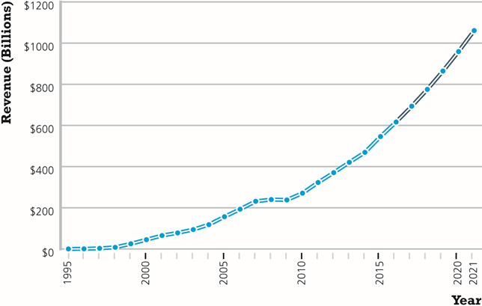
Figure 1.5 The Growth of B2C E-Commerce in the United States
Notes:
Figure 1.5, Page 22.
In the early years, B2C e-commerce was doubling or tripling each year. Although B2C e-commerce growth in the United States slowed in 2008–2009 due to the economic recession, it resumed growing at about 13% in 2010 and since then, has continued to grow at double-digit rates.
SOURCES: Based on data from eMarketer, Inc., 2017d, 2017e; authors’ estimates.

Slide 31
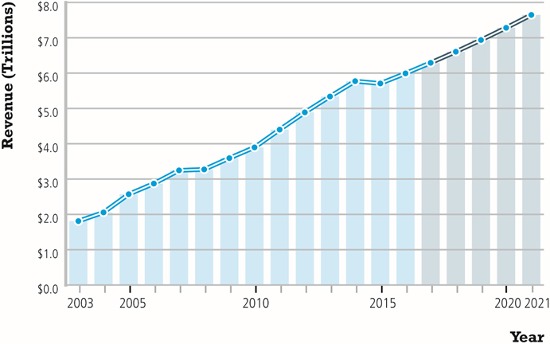
Figure 1.7 The Growth of B2B E-Commerce in the United States
Notes:
Figure 1.7, Page 24.
B2B e-commerce in the United States is about 10 times the size of B2C e-commerce. In 2021, B2B e-commerce is projected to reach about $7.6 trillion. (Note: Does not include EDI transactions.)
SOURCES: Based on data from U.S. Census Bureau, 2017; authors’ estimates.

Slide 32
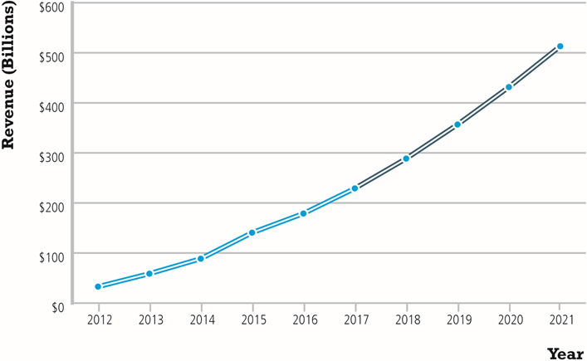
Figure 1.8 The Growth of M-Commerce in the United States
Notes:
Figure 1.8, page 25.
In the last five years, m-commerce has increased astronomically, from just $32.8 billion in 2012 to almost $230 billion in 2017, and it is anticipated that it will continue to grow by over 20% over the next five years as consumers become more and more accustomed to using mobile devices to purchase products and services.
SOURCE: Based on data from eMarketer, Inc., 2017f, 2017g, 2015a, 2015b, 2014.

Slide 33
E-Commerce: A Brief History (1 of 4)
Precursors
Baxter Healthcare modem-based system
Order entry systems
Electronic Data Interchange (E D I) standards
French Minitel

Slide 34
E-Commerce: A Brief History (2 of 4)
1995–2000: Invention
Sale of simple retail goods
Limited bandwidth and media
Euphoric visions of
Friction-free commerce
First-mover advantages
Dot-com crash of 2000
Notes:
Additional concepts include disintermediation, monopoly profits, switching costs, network effects, disrupting traditional channels.

Slide 35
E-Commerce: A Brief History (3 of 4)
2001–2006: Consolidation
Emphasis on business-driven approach
Traditional large firms expand presence
Start-up financing shrinks
More complex products and services sold
Growth of search engine advertising
Business web presences expand

Slide 36
E-Commerce: A Brief History (4 of 4)
2007–Present: Reinvention
Rapid growth of:
Web 2.0, including online social networks
Mobile platform
Local commerce
On-demand service economy
Entertainment content develops as source of revenues
Transformation of marketing

Slide 37
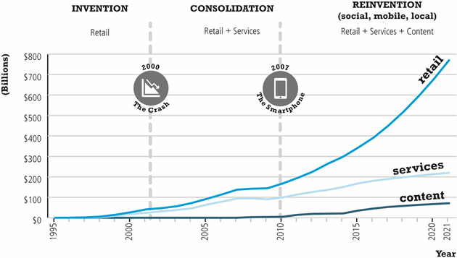
Figure 1.10 Periods in the Development of E-Commerce
Notes:
Figure 1.10, page 28.

Slide 38
Insight on Business: Startup Boot Camp
Class Discussion
Why do you think investors today are still interested in investing in startups?
What are the benefits of investing in a company that is a graduate of a Y Combinator boot camp?
Is an incubator the best solution for startups to find funding? Why or why not?

Slide 39
Disintermediation: displacement of market middlemen who tradition-ally are intermediaries between producers and consumers by a new direct relationship between producers and consumers.
Friction-free commerce: a vision of commerce in which information is equally distributed, trans-action costs are low, prices can be dynamically adjusted to reflect actual demand, intermediaries decline, and unfair compet-itive advantages are eliminated
First mover: a firm that is first to market in a particular area and that moves quickly to gather market share

Slide 40
Assessing E-Commerce (1 of 2)
Stunning technological success
Early years a mixed business success
Few early dot-coms have survived
Online sales growing rapidly
Many early visions not fulfilled
Price dispersion
Information asymmetry
New intermediaries

Slide 41
Assessing E-Commerce (2 of 2)
Other surprises
Fast-follower advantages
Start-up costs
Impact of mobile platform
Emergence of on-demand e-commerce

Slide 42
Understanding E-Commerce: Organizing Themes
Technology:
Development and mastery of digital computing and communications technology
Business:
New technologies present businesses with new ways of organizing production and transacting business
Society:
Intellectual property, individual privacy, public welfare policy

Slide 43
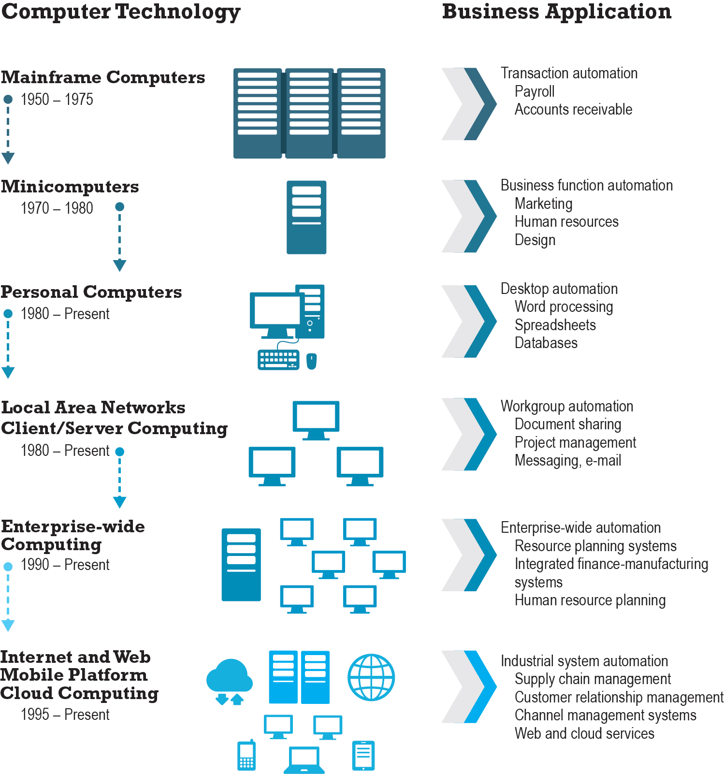
Figure 1.11 The Internet and the Evolution of Corporate Computing
Notes:
Figure 1.11, page 38.
The Internet and Web, and the emergence of a mobile platform held together by the Internet cloud, are the latest in a chain of evolving technologies and related business applications, each of which builds on its predecessors.

Slide 44
Insight on Society: Facebook and the Age of Privacy
Class discussion:
Why are social networks interested in collecting user information?
What types of privacy invasion are described in the case? Which is the most privacy-invading, and why?
Is e-commerce any different than traditional markets with respect to privacy? Don’t merchants always want to know their customer?
How do you protect your privacy on the Web?

Slide 45
Academic Disciplines Concerned with Technology
Technical
Computer science, management science, information systems
Behavioral
Information systems research, economics, marketing, management, finance/accounting, sociology

Slide 46
Careers in E-Commerce
Position: Category specialist in E-commerce Retail Program
Qualification/Skills
Preparing for the Interview
Possible Interview Questions

Slide 47

Copyright

