Slide 1

Trouvaille.IO
Horizons School of technology demo day fall 2017
Alex glaze
Tyrone scafe, jr.
Matt schwartz

Slide 2
overview
Medium/Long-Distance Social Rideshare mobile application for use in the USA

Slide 3
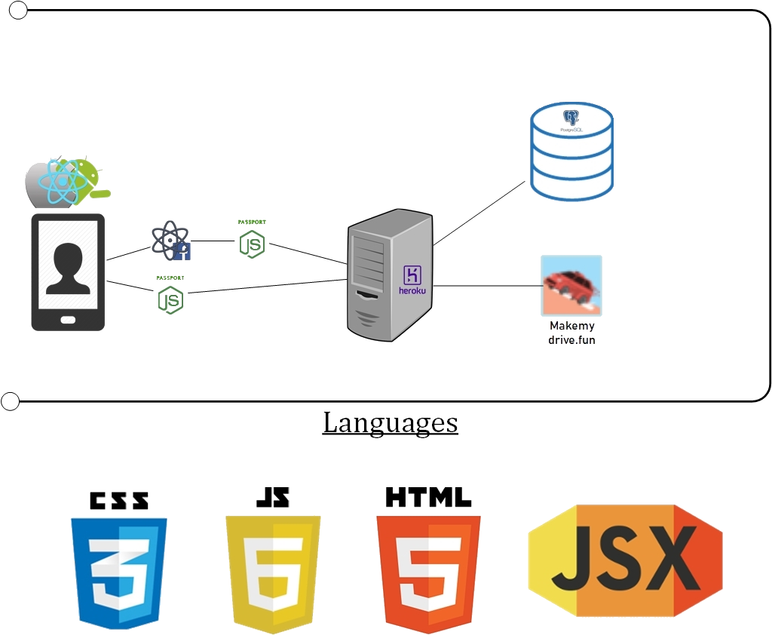
Our restful architecture

Slide 4
Trouvaille.io demonstration

Slide 5
Moving forward
Revisit Compromises
Spotify Connection/Playlists
Having a Website Companion Application
User Feed Constraints
Great framework to build from here
React Redux Website
Algorithmic Explore Page
Search Bar
Notifications
Figure Out Payment Model
Expand on Payment Options

