Slide 1
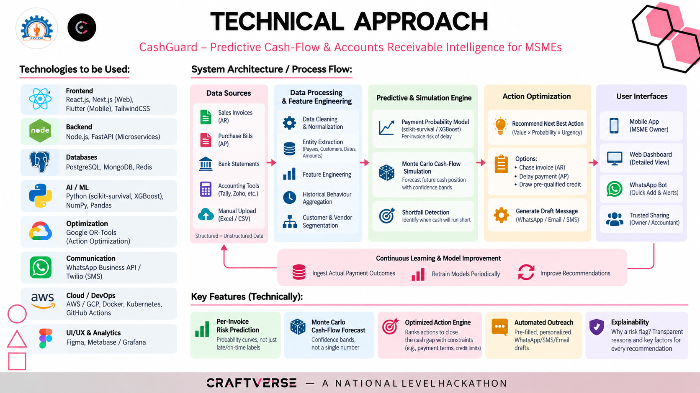
TECHNICAL APPROACH
CashGuard – Predictive Cash-Flow & Accounts Receivable Intelligence for MSMEs
Technologies to be Used:
System Architecture / Process Flow:
Frontend
Data Sources
Data Processing
& Feature Engineering
Predictive & Simulation Engine
Action Optimization
User Interfaces
React.js, Next.js (Web),
Flutter (Mobile), TailwindCSS
Sales Invoices
(AR)
Data Cleaning
& Normalization
Payment Probability Model
Recommend Next Best Action
Mobile App
Backend
(scikit-survival / XGBoost)
Per-invoice risk of delay
(Value × Probability × Urgency)
(MSME Owner)
Node.js, FastAPI (Microservices)
Purchase Bills
(AP)
Entity Extraction
(Payees, Customers, Dates,
Amounts)
Monte Carlo Cash-Flow
Simulation
Options:
Web Dashboard
Bank Statements
Feature Engineering
Forecast future cash position
with confidence bands
• Chase invoice (AR)
• Delay payment (AP)
• Draw pre-qualified credit
(Detailed View)
Databases
PostgreSQL, MongoDB, Redis
WhatsApp Bot
Accounting Tools
(Tally, Zoho, etc.)
Historical Behaviour
Aggregation
Shortfall Detection
(Quick Add & Alerts)
AI / ML
Generate Draft Message
Python (scikit-survival, XGBoost),
NumPy, Pandas
Manual Upload
(Excel / CSV)
Customer & Vendor
Segmentation
Identify when cash will run short
(WhatsApp / Email / SMS)
Trusted Sharing
(Owner / Accountant)
Optimization
Structured + Unstructured Data
Google OR-Tools
(Action Optimization)
Continuous Learning & Model Improvement
Ingest Actual Payment Outcomes
Retrain Models Periodically
Improve Recommendations
Communication
WhatsApp Business API /
Twilio (SMS)
Key Features (Technically):
Cloud / DevOps
Per-Invoice
Risk Prediction
Monte Carlo
Cash-Flow Forecast
Optimized Action Engine
Automated Outreach
Explainability
AWS / GCP, Docker, Kubernetes,
GitHub Actions
Probability curves, not just
late/on-time labels
Confidence bands,
not a single number
Ranks actions to close
the cash gap with constraints
(e.g., payment terms, credit limits)
Pre-filled, personalized
WhatsApp/SMS/Email
drafts
Why a risk flag? Transparent
reasons and key factors for
every recommendation
UI/UX & Analytics
Figma, Metabase / Grafana
CRAFTVERSE
— A NATIONAL LEVEL HACKATHON

