Slide 1
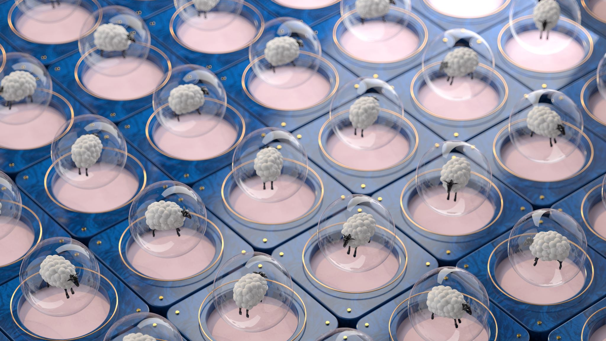
Mole Classification Using Deep Convolutional Neural Network
Moshood Owolabi
Junior Data Analyst
@Becode
25th May, 2022

Slide 2
Overview
Introduction
Pipeline
Result
App Demo

Slide 3
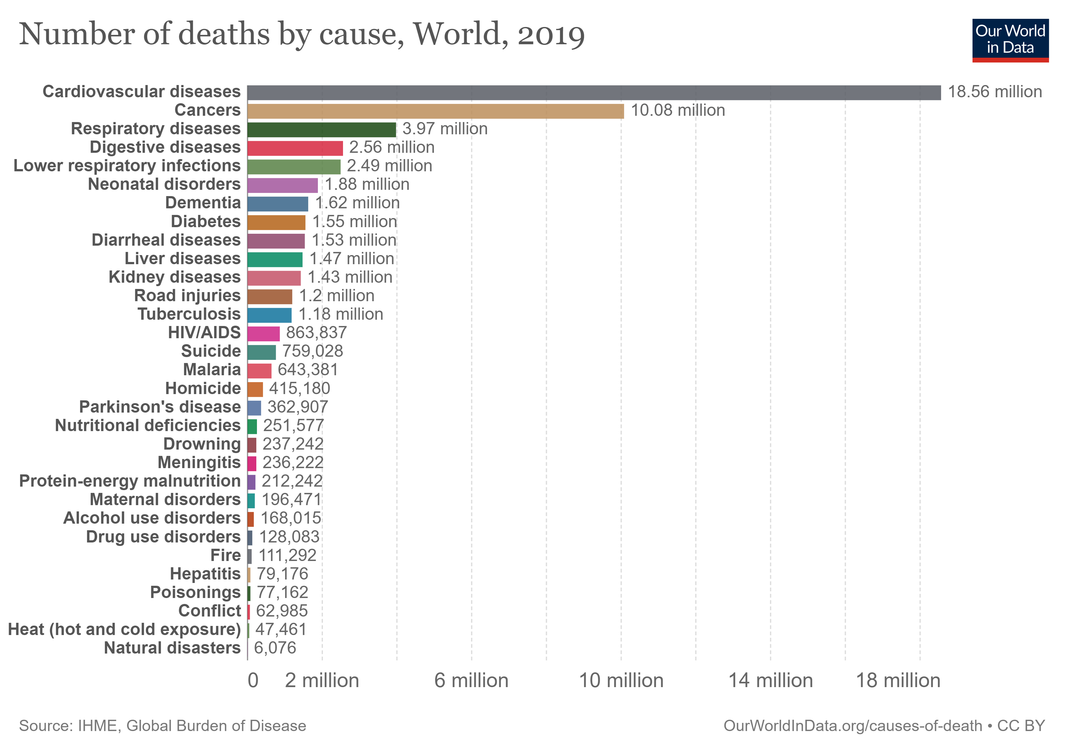
Introduction
Cancer is one of the world’s largest health problems.
As at 2020, skin cancer is the fifth most common new cases of cancer (1.20 million) while beast, lung, colon and return and prostate are top four.
World Health Organization (2022)

Slide 4
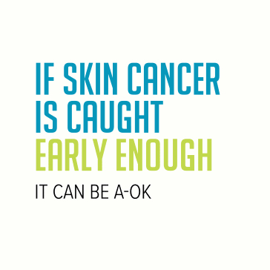
Introduction
For early discovery, 99% estimated five-year survival rate.
68 % when the disease reaches the lymph nodes.
30 % when the disease metastasizes to distant organs.
Cancer Facts and Figures (2022)

Slide 5
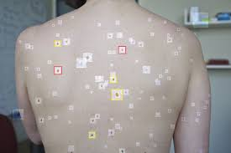
Mole Detention Bot
Using a deep convolutional neural networks to make accuracy prediction.

Slide 6
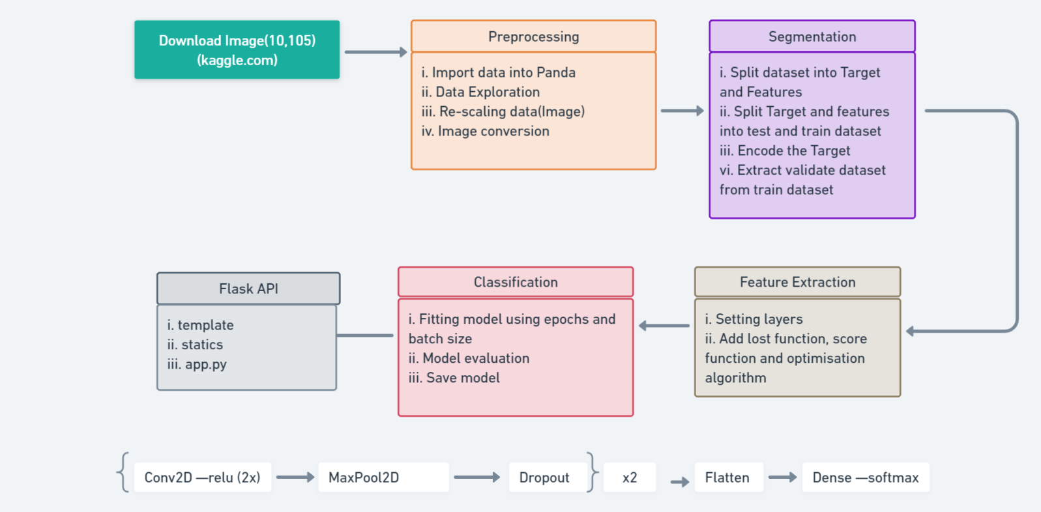
Pipeline
epochs = 25 batch size = 10

Slide 7
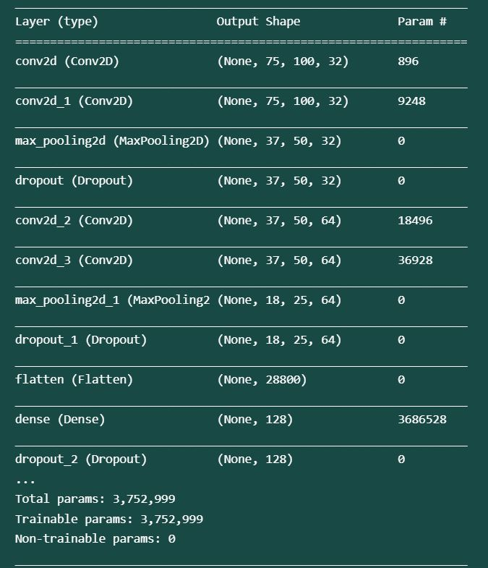
Result

Slide 8
App Demo
Skin Analyzer Bot
http://127.0.0.1:5000/

Slide 9
Improvement
Different layers
Epochs and batch size
Web application
Heroku Deployment

Slide 10






Moshood Owolabi
Junior Data Analyst and AI Operator
masudowolabi@gmail.com
https://www.linkedin.com/in/owolabi-moshood/
https://github.com/Msdot001
Discord:Msdot#1658

