Slide 1







Technology Trends & Their Future
Monifah Sergeant
February 2021

Slide 2



OUTLINE
Executive Summary
Introduction
Methodology
Results
Visualization – Charts
Dashboard
Discussion
Findings & Implications
Conclusion
Appendix

Slide 3

EXECUTIVE SUMMARY
Programming Languages & Databases
Trends in technology over the year
Future expectations
Demographic Findings
Technology affects on Countries
Gender in relation to jobs

Slide 4

INTRODUCTION
Purpose of this presentation is to analyze the trends in software development, and identify future skill requirements
Key objectives to address:
What are the top programming languages in demand?
What are the top database skills in demand?
What are the popular IDEs?

Slide 5

METHODOLOGY
Data Collection Sources
GitHub Job Postings
Programming Languages Annual Salary
Data Exploration
Data Cleaning
Data Visualizations
Dashboards

Slide 6
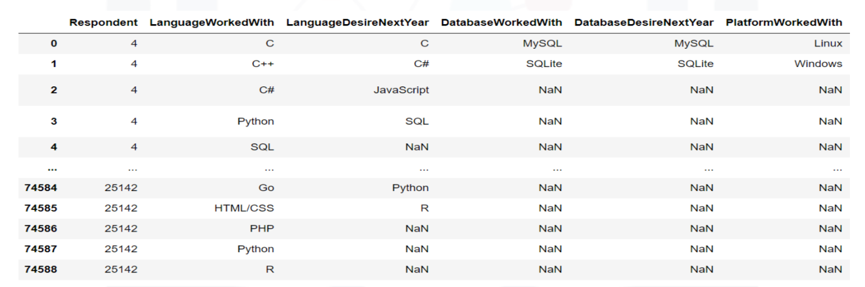
Results are based on the following table:

Slide 7
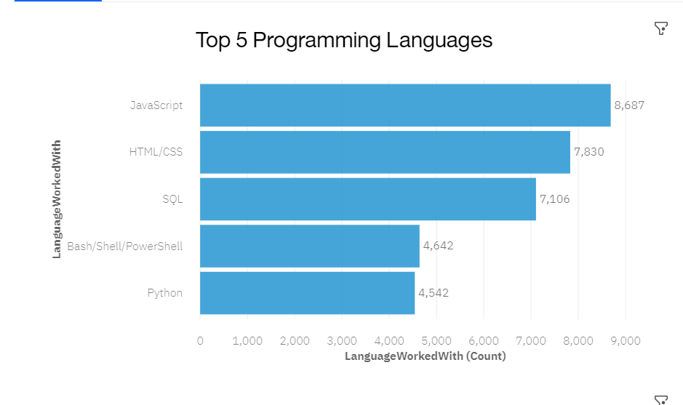
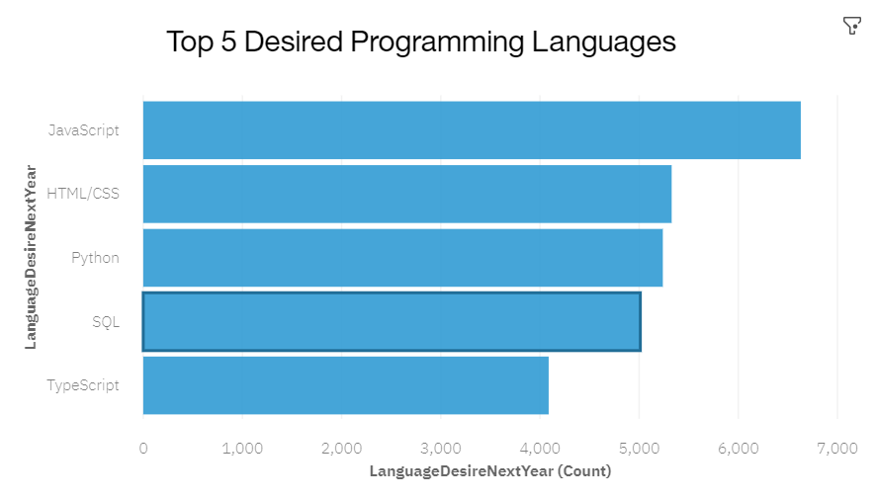
PROGRAMMING LANGUAGE TRENDS
Current Year
Next Year

Slide 8
PROGRAMMING LANGUAGE TRENDS - FINDINGS & IMPLICATIONS
Findings
JavaScript, HTML/CSS & SQL are the top 3 languages this year
Python & TypeScript became popular the following year
PowerShell fazed out slightly the next year
Implications
Web development is still in high demand
Major Data Companies are still requiring the use of SQL
Python is the better choice when it comes to the demand of ML

Slide 9
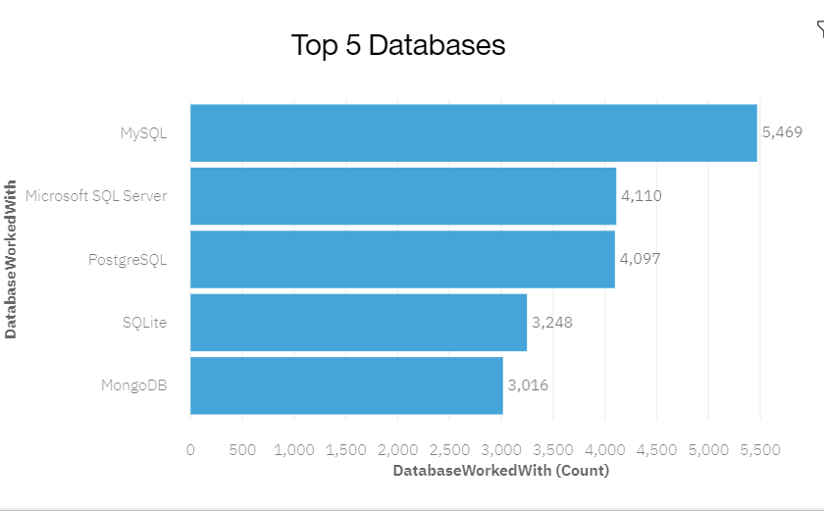
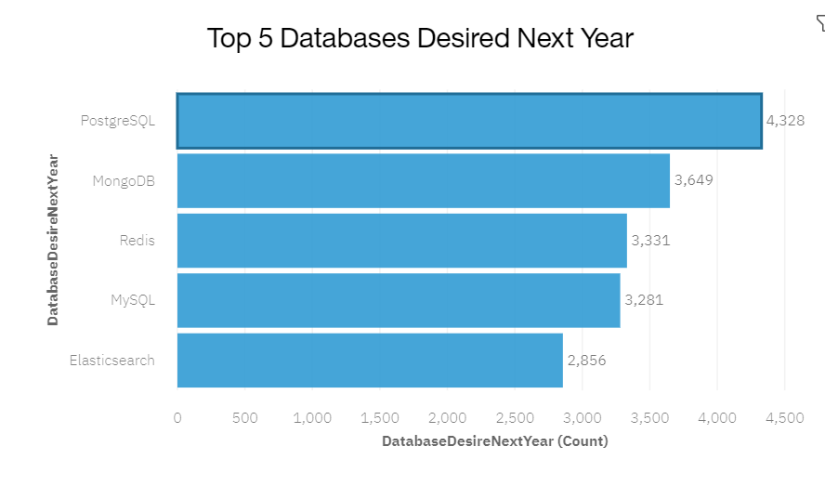
DATABASE TRENDS
Current Year
Next Year

Slide 10
DATABASE TRENDS - FINDINGS & IMPLICATIONS
Findings
MySQL is the most popular
Microsoft SQL & Postgre SQL are among the top three popular databases in the current year
Elasticsearch is a new desired database in next year
By next, Postgre SQL & MongoDB are among the top 3
Implications
Open-source databases are still preferred among companies
NoSQL databases will have an impact towards storing non-relational data

Slide 11

DASHBOARD
https://dataplatform.cloud.ibm.com/dashboards/02efba77-a4c8-4e5d-8431-d797f8523a2b/view/0017dc3f1a8a31ce12ddcce407ca7e022965215ab2bb8502d3d77b490a607297a83d15c7c82a1d0cd3420c60f2ba1b5cc0

Slide 12
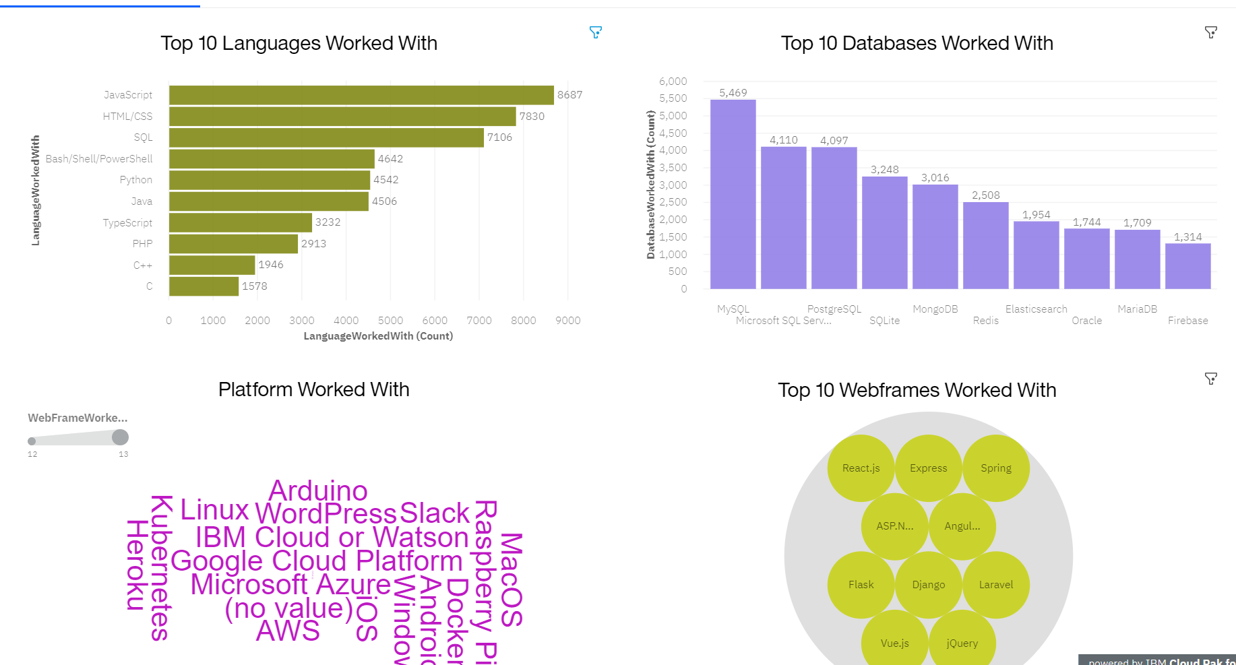
Current Technology Usage

Slide 13
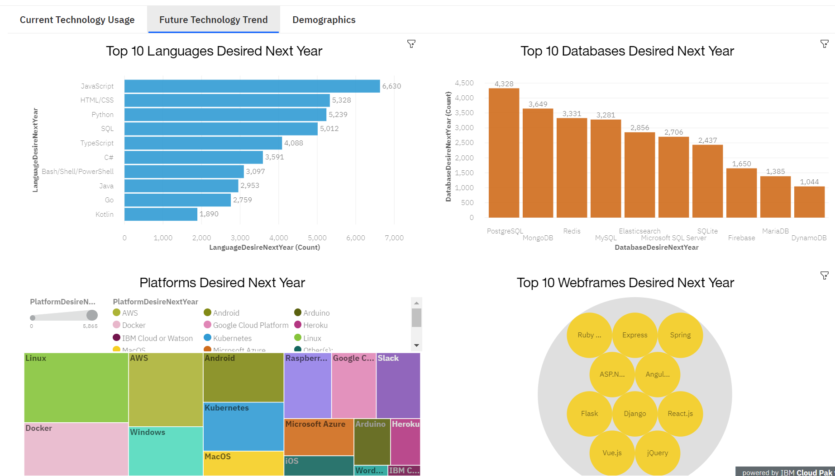
Future Technology Trend

Slide 14
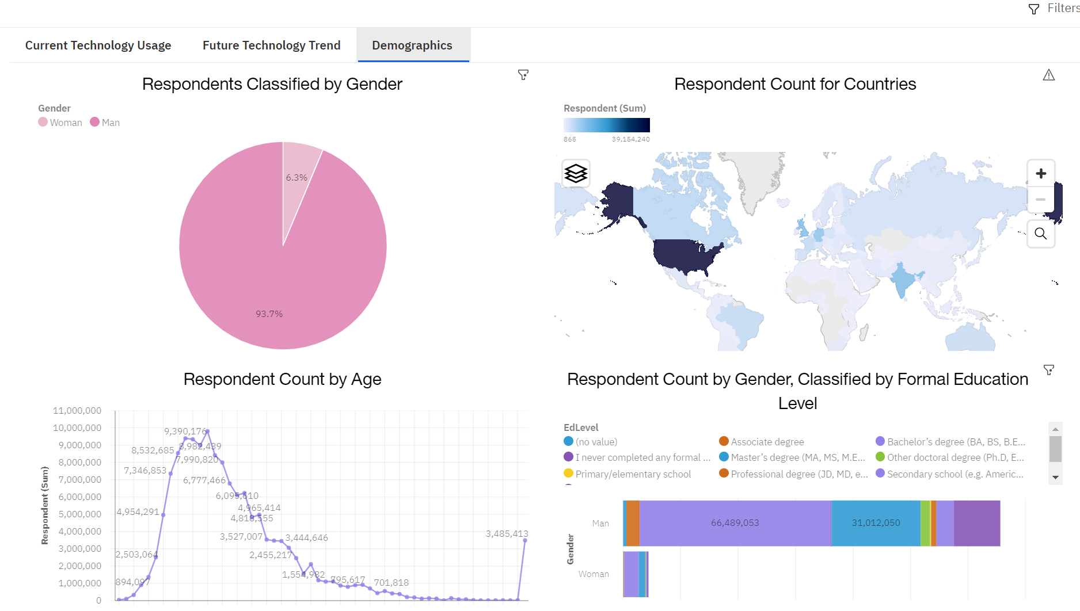
Demographics

Slide 15
DISCUSSION
Technology Trends & the future
Female status in Technology
Training and Reskilling workers with Technology
Concerns about the technology gap among developing countries
Age and Education discrimination among employment

Slide 16
OVERALL FINDINGS & IMPLICATIONS
Findings
Technology is changing faster and faster
The gender gap in technology jobs is an issue
Concentration is indeed in several countries and their links to technology
Implications
Companies need to be more open-minded and adaptable to the changings occurring in technology
Technology needs to be introduced and focused more towards lagging countries who are behind in advancements
The impact of job hiring among genders and/or by age and education is a huge divider in the technology world.

Slide 17

CONCLUSION
Technology Trends for current and next year
Programming Languages & Databases
Demographics overview in Technology
Future Actions needed to bridge the gap between genders in technology.

Slide 18

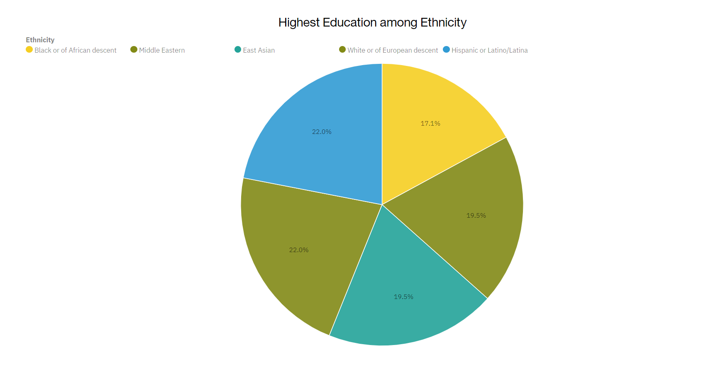
APPENDIX

Slide 19
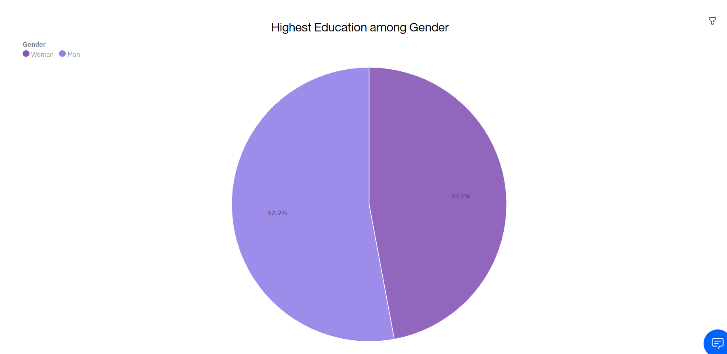
Appendix cont.

Slide 20
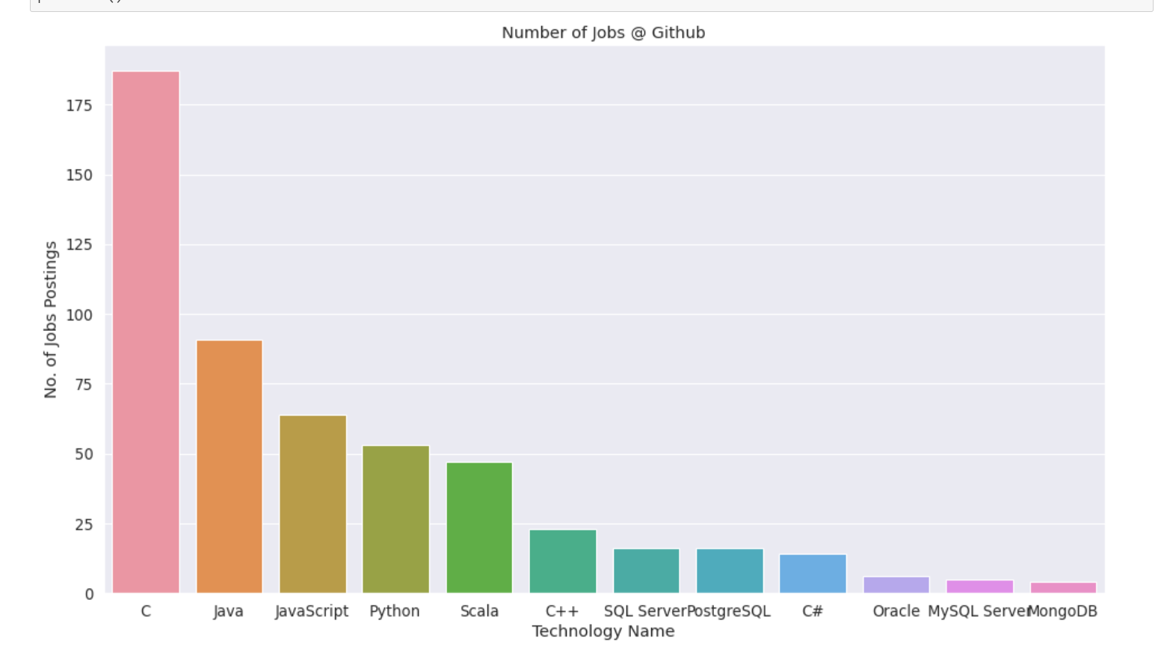
GITHUB JOB POSTINGS

Slide 21
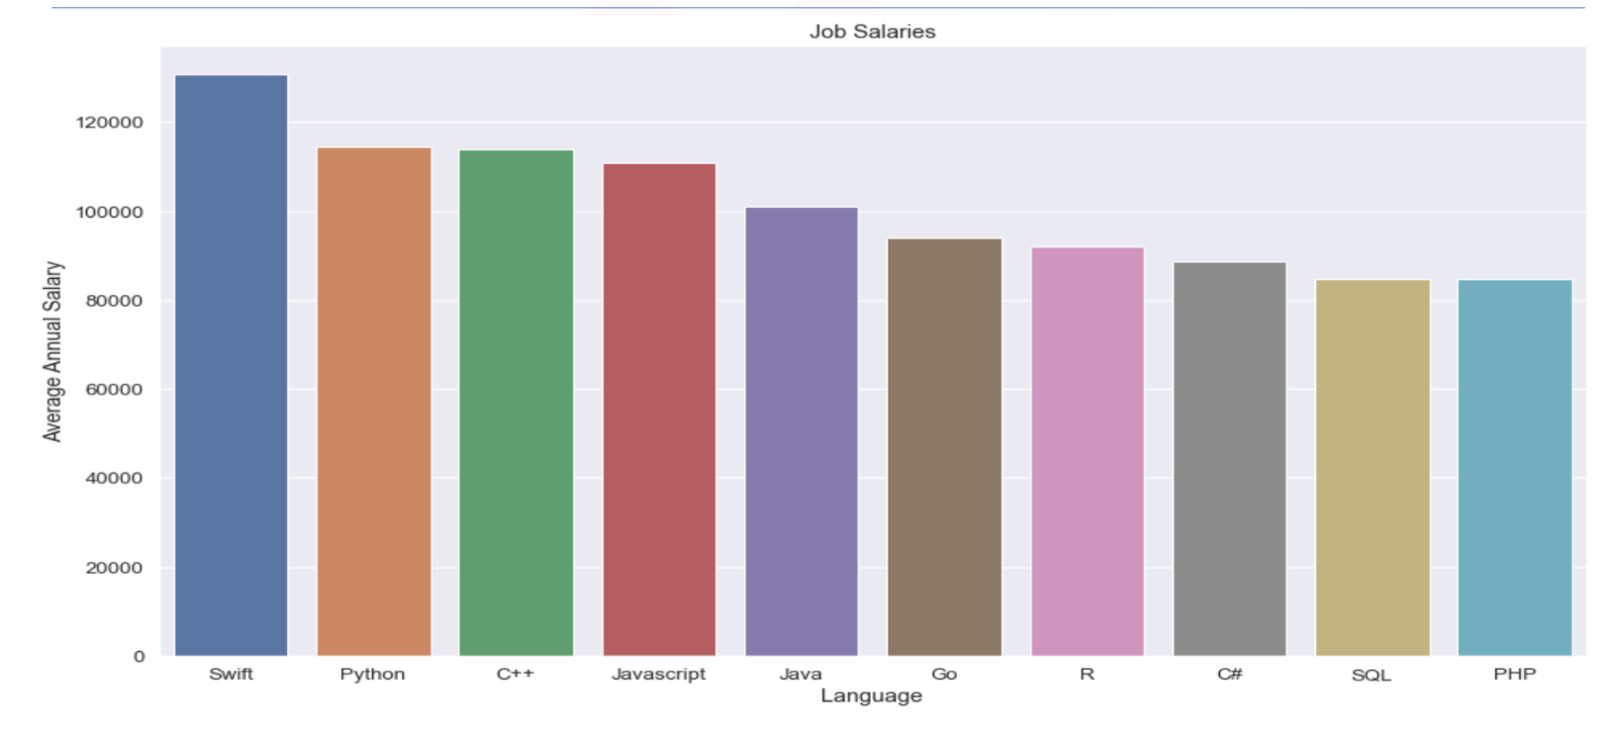
POPULAR LANGUAGES

