Slide 1

Career Awareness Session
On
Software Testing
Notes:
11/28/16

Slide 2
Regression and Retesting
Regression Testing - Execution of a corrected test and/or execution of tests in order to ensure that defects have not been introduced in unchanged areas of the software or that defect fixing did not introduce other defects.
Retesting: Re-testing is the testing for a specific bug after it has been fixed.
Notes:
11/28/16

Slide 3


Manual and Automation Difference
Manual Testing
Time Consuming
Low Reliability
Required Human Resources
Inconsistent
                Save Time
                Speed
                Repeatability
                Reliability and Consistent
Notes:
11/28/16

Slide 4
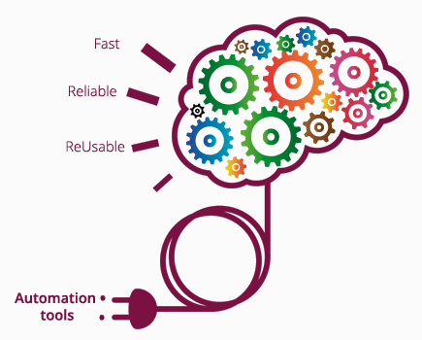
Automation Testing
Automation testing means using an automate tool to perform the testing or to execute the test case suite by writing scripts.
Automation Software can also enter the test data in to system under test,
compare expected result and actual results and generate detailed test reports.
Notes:
11/28/16

Slide 5
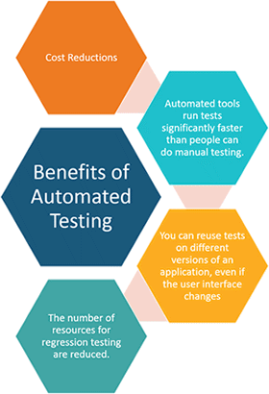
Advantages of Automation
Faster than the manual testing
Reliable in results
Ensure Consistency
Saves Time and Cost
Improves accuracy
No Human Intervention required while execution
Increases Efficiency
Re-usable test scripts
Notes:
11/28/16

Slide 6
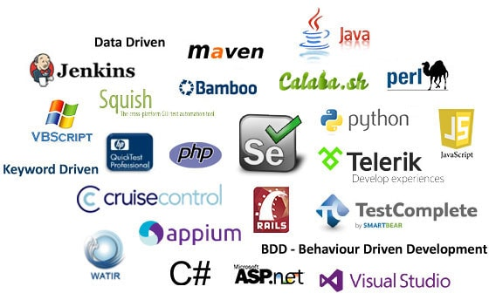
Automation Tools
Notes:
11/28/16

Slide 7
Selection of Automation Tool
Ease of Use
Support platforms and technology.
Supports multiple testing frameworks.
Minimize training cost of selected tools
It should have good debugging facilities.
Feature rich but also easy to create automated tests.
Create automated tests that are reusable and maintainable .
Supports various types of test including Functional, Test Management, Mobile etc.
Notes:
11/28/16

Slide 8
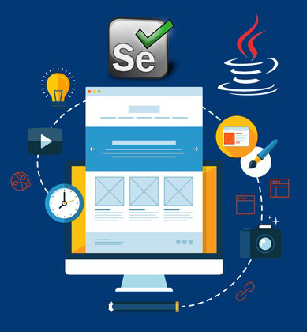
Introduction to Selenium
Selenium is an open source automation testing tool for web based applications.
It can't use for Desktop based application automation.
Can test Mobile Application by using third party tools.
Notes:
11/28/16
11/28/16

Slide 9
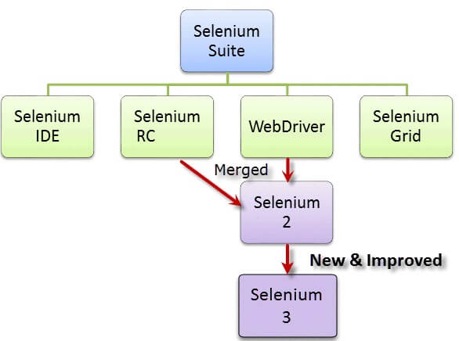
Selenium Overview
Notes:
11/28/16
11/28/16

Slide 10
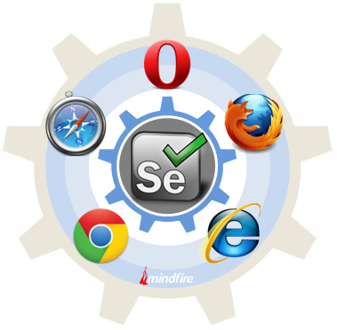
Supported Browsers
Selenium works on multiple browsers:
  Mozilla
  IE 6,7,8
  Google Chrome
  Opera
  Safari
Selenium can make it on multiple platforms
  Windows
  Mac
  Linux/Unix
Notes:
11/28/16
11/28/16

Slide 11
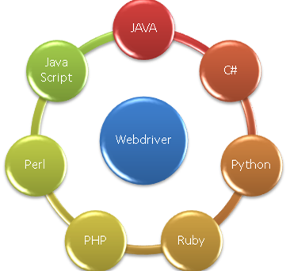
Selenium Languages
  Selenium scripts can be write in different languages:
Selenium is made up of four components:
Notes:
11/28/16
11/28/16

Slide 12
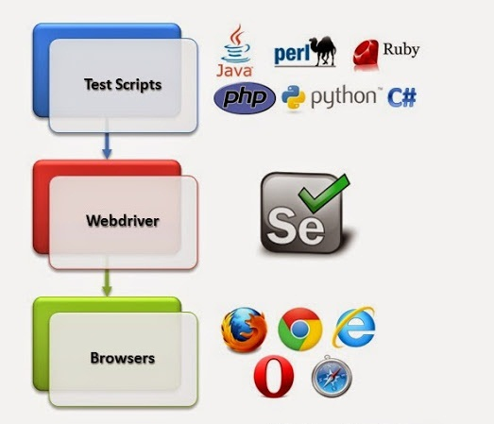
Selenium Webdriver
Notes:
11/28/16
11/28/16

Slide 13
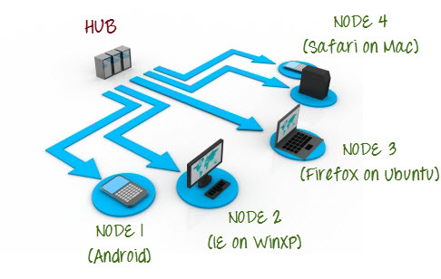
Selenium Grid
Notes:
11/28/16
11/28/16

Slide 14
Benefits of Selenium
  Selenium is an open-source tool.
  Has capabilities to execute scripts across different browsers.
  Can execute scripts on various operating systems.
  Supports mobile devices. Supports mobile devices with the help of third-party tools.
  Executes tests within the browser, so focus is NOT required while script execution is in progress.
  Can execute tests in parallel with the use of Selenium Grids.
  Selenium is Flexible and Extendible.
Notes:
11/28/16
11/28/16

