Slide 1



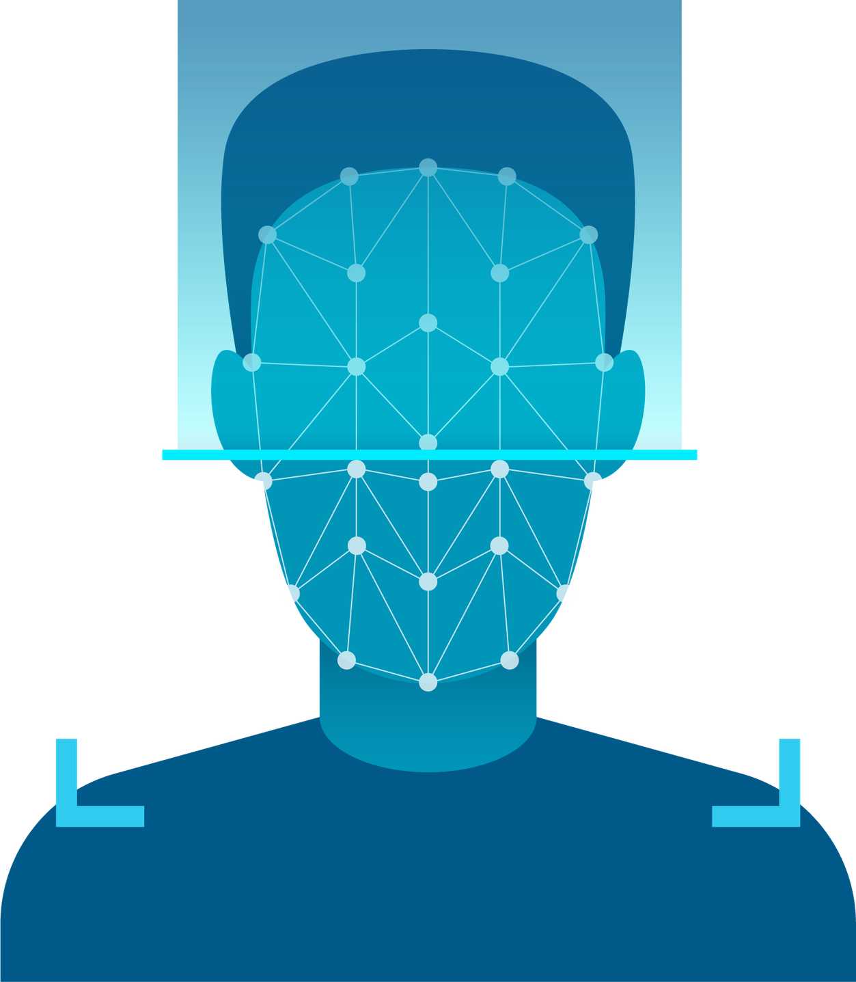


Smart Door lock using Facial Recognition

Slide 2



Traditional security measures such as physical keys, PIN codes, and RFID cards possess inherent vulnerabilities: they can be lost, stolen, forgotten, or duplicated

Slide 3







Facial Recognition
SEAMLESS | FRICTIONLESS | SECURE
DENY ACCESS
DETECT
IDENTIFY
GRANT ACCESS

Slide 4



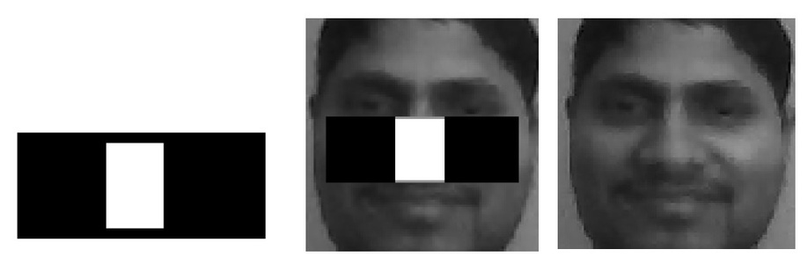
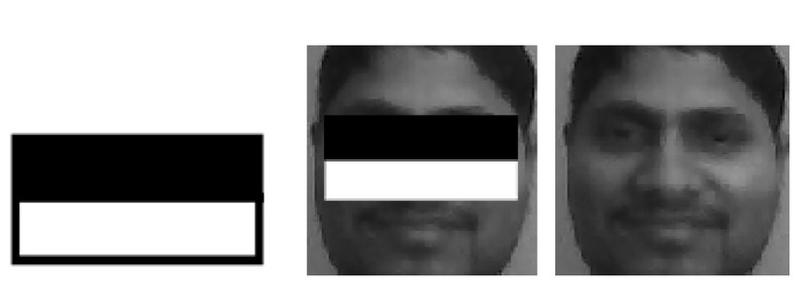
DETECT
THE SYSTEM CAPTURES LIVE VIDEO FEEDS VIA A STANDARD WEBCAM. TO MINIMIZE COMPUTATIONAL OVERHEAD, THE SYSTEM USES OPENCV’S HAAR CASCADE CLASSIFIER
THE CLASSIFIER USES SIMPLE BLACK AND WHITE RECTANGULAR FILTERS (SHOWN RIGHT) TO ANALYZE CONTRAST. FOR EXAMPLE, IT DETECTS THAT THE EYE REGION IS GENERALLY DARKER THAN THE NOSE BRIDGE AND UPPER CHEEKS.

Slide 5




Facial Recognition
SEAMLESS | FRICTIONLESS | SECURE
DENY ACCESS
DETECT
IDENTIFY
GRANT ACCESS

Slide 6


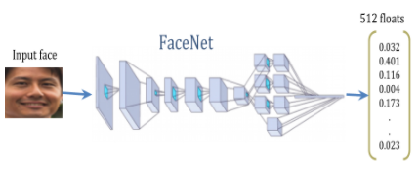
IDENTIFY
THE CROPPED FACE IS PASSED INTO THE FACENET CNN. FACENET PROCESSES THE IMAGE AND OUTPUTS A 512-DIMENSIONAL EMBEDDING VECTOR. THIS VECTOR MAPS THE FACIAL FEATURES INTO A EUCLIDEAN SPACE WHERE THE GEOMETRIC DISTANCE BETWEEN TWO VECTORS DIRECTLY CORRESPONDS TO FACIAL SIMILARITY.

Slide 7
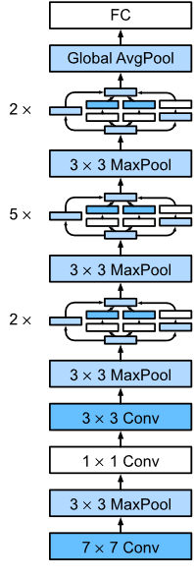
4
FACENET
2
3
DEEP CNN ARCHITECTURE OVERVIEW
STEM: INITIAL CONVOLUTIONS AND POOLING RAPIDLY REDUCE THE IMAGE SIZE.
INCEPTION MODULES: PARALLEL PROCESSING CAPTURES FINE DETAILS AND BROAD STRUCTURES SIMULTANEOUSLY.
DOWNSAMPLING: MAXPOOL LAYERS BETWEEN BLOCKS PROGRESSIVELY LOWER RESOLUTION.
OUTPUT: FEATURES ARE CONSOLIDATED VIA GLOBAL AVERAGE POOLING INTO A FULLY CONNECTED LAYER.
2
3
2
1

Slide 8

Operational Modes
MODE A: REGISTRATION MODE
1) WEBCAM ONBOARDING
2) BULK FILE IMPORT
3) GROUP PHOTO PARSER
MODE B: RECOGNITION MODE
1) LIVE RECOGNITION (CONTINUOUS)
2) SINGLE UNLOCK ATTEMPT (WITH LIVENESS CHECKS)

Slide 9


Key Features
INGESTION & RECOGNITION FEATURES
1) INGESTION SUBFEATURES
Automatic Directory Labeling
CRASH PREVENTION
LIVE CACHE SYNC
2) FACE MATCHING FEATURES
CONFIDENCE SCORES
ADAPTIVE AUTO-LEARNING
GRANT ACCESS

Slide 10
Key Features
SECURITY & ANTI-SPOOFING FRAMEWORK
1) MULTI-MODAL ANTI-SPOOFING
Blink Detection (EAR)
3D HEAD ROTATION TRACKING
2) THREAT MONITORING
STRANGER PERSISTENCE DETECTION
AUDIT LOGGING
3) NIGHT GUARD & ALERT SYSTEM
RESTRICTED-TIME MONITORING
EMAIL ALERTS
BACKGROUND THREAD OPTIMIZATION
GRANT ACCESS

Slide 11

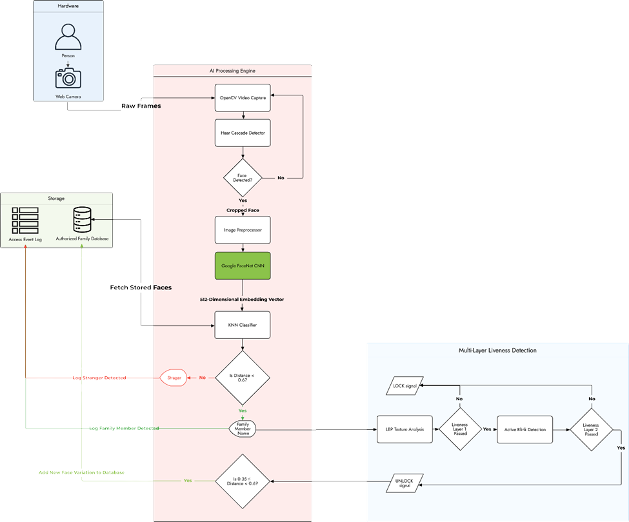
Architecture

Slide 12

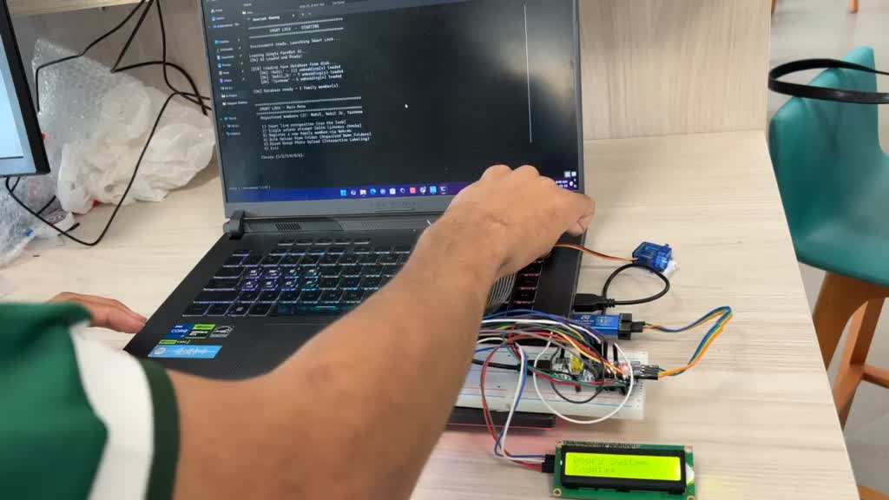

Results & Outcomes
A BALANCED THRESHOLD OF 0.60
ACHIEVED 100% PROTECTION AGAINST 2D SPOOFING ATTACKS
TRIGGERS ALARMS, SNAPSHOTS, & AUDIT LOGS IN NIGHT MODE

Slide 13



Challenges
1) Group Photo Face Detection
Small/distant faces & complex backgrounds caused “ghost” face detections
Solution: Tune detector settings
scaleFactor = 1.02 → finer 2% scanning ⟶ accuracy
minNeighbors = 12 → stronger voting threshold
minSize = (100,100) → ignores tiny detections
Aspect ratio filtering (0.75≤R≤1.3) to reject stretched background objects

Slide 14
Challenges
2) Cross-Domain Image Bias
Webcam frames had low resolution & blur, while smartphone images had high quality and distortion
FaceNet sometimes misidentified known users across different image sources
Solution: Use separate thresholds
0.60 for live webcam tracking
0.72 for uploaded/static images

Slide 15
Challenges
3) 3D Spoofing vs User Convenience
Added liveness checks (blink + head movement detection) to stop photo attacks
Dim lighting sometimes caused landmark detection failures and slower access
Solution:
Lazy-loading dlib models
Adding visual guidance (eye contours + tracking bar)

Slide 16
Challenges
4) Network Latency & Camera Freezing
Sending email alerts froze the OpenCV feed for 2–3 seconds
Caused by blocking internet requests inside the main loop
Solution:
moving send_alert into a background thread/subprocess
Enabled smooth real-time tracking while alerts are sent asynchronously

Slide 17
Conclusion
DEVELOPED A HANDS-FREE SMART LOCK USING LOCAL FACIAL RECOGNITION AND FACENET EMBEDDINGS
ACHIEVED 97.4% ACCURACY WITH LOW FALSE REJECTION (1.9%) AND FALSE ACCEPTANCE (0.7%) RATES
IMPLEMENTED MULTI-LAYER ANTI-SPOOFING USING:
BLINK DETECTION
3D HEAD TRACKING
ACHIEVED 100% DETECTION AGAINST PHOTO/SCREEN SPOOFING ATTACKS
ADDED ADAPTIVE AUTO-LEARNING, REAL-TIME ALERTS, AND NIGHT GUARD SECURITY MODE

Slide 18

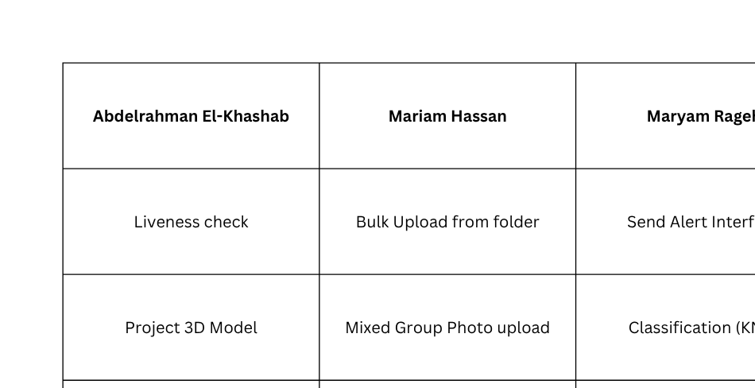
Contribution :)

Slide 19

Thank You!

