Slide 1




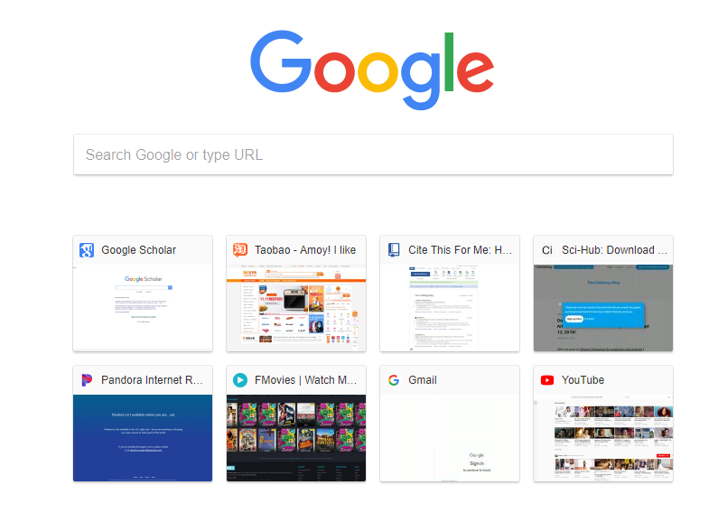
SecAdapt
Google
Bing
Baidu
http://www.google.com
Notes:
Home

Slide 2


SecAdapt
Google
Bing
Baidu
http://www.google.com
Tabs and Windows
User Dashboard
Settings
100%
Exit
Notes:
Home

Slide 3
SecAdapt
Google
Bing
Baidu
http://www.google.com
Tabs and Windows
New Window
Private Window
Full Screen
User Dashboard
Settings
100%
Exit
Notes:
Home

Slide 4
SecAdapt
Google
Bing
Baidu
http://www.google.com
SecAdapt Registration
Have you registered for personalized adaptive cybersecurity?
No
Yes
Notes:
Home

Slide 5
SecAdapt
Google
Bing
Baidu
http://www.google.com
User Registration for Personalized Security and Privacy Policy
Username
Password
Confirm
Password
Email
Please indicate your gender
  Male
  Female
Please indicate your age range
  18 - 24 years
  25 - 34 years
  35 - 44 years
  45 - 64 years
  65 + years
Please indicate your ethnic group
  White
  Hispanic or Latino
  Black or African American
  Native American / American Indian
  Asian / Pacific Islander
  Other
What level of Education have you completed?
12th grade or less (no diploma)
High school diploma
Some college, no degree
Associate or technical degree
Bachelor's degree
Graduate degree/professional
Cancel
Register
Notes:
Home

Slide 6
SecAdapt
Google
Bing
Baidu
http://www.google.com
User Registration for Personalized Security and Privacy Policy
Username
Password
Confirm
Password
Email
Please indicate your gender
  Male
  Female
Please indicate your age range
  18 - 24 years
  25 - 34 years
  35 - 44 years
  45 - 64 years
  65 + years
Please indicate your ethnic group
  White
  Hispanic or Latino
  Black or African American
  Native American / American Indian
  Asian / Pacific Islander
  Other
What level of Education have you completed?
12th grade or less (no diploma)
High school diploma
Some college, no degree
Associate or technical degree
Bachelor's degree
Graduate degree/professional
Are you sure you want to cancel?
Yes
No
Cancel
Register
Notes:
Home

Slide 7
SecAdapt
Google
Bing
Baidu
http://www.google.com
You need to set your security and privacy levels for your dashboard to be personalized.
Click OK to go to the settings page
OK
Later
Notes:
Home

Slide 8
SecAdapt
Google
Bing
Baidu
http://www.google.com
It is very important to match security and privacy levels in your browser with the sensitivity of your online activities
I would remind you again when you are less busy with your browsing activites...
October
29
2018
11
25
PM
OK
Cancel
Notes:
Home

Slide 9







SecAdapt
Google
Bing
Baidu
http://www.google.com
Personal Privacy
Personal Privacy Settings
Cyber Security
Tracking
History
Location
Third-party software
This Browser will:
Tracking Protection
ON
Delete browsing history daily
Deny location requests
Parental Control
Browser Controls
Select a level from which cookies would be blocked
Low
High
Restore Defaults
Apply
Cancel
Notes:
Home

Slide 10
SecAdapt
Google
Bing
Baidu
http://www.google.com
Personal Privacy
Personal Privacy
Cyber Security
Tracking
History
Location
Third-party software
This Browser will:
Tracking Protection
ON
Delete browsing history daily
Deny location requests
Parental Control
Browser Controls
Your contact details can be saved without your consent
Select a level from which cookies would be blocked
Low
High
Restore Defaults
Apply
Cancel
Notes:
Home

Slide 11
SecAdapt
Google
Bing
Baidu
http://www.google.com
Personal Privacy
Personal Privacy
Cyber Security
Tracking
History
Location
Third-party software
This Browser will:
Tracking Protection
ON
Delete browsing history daily
Deny location requests
Parental Control
Don’t allow data that can reveal my identity
Browser Controls
Select a level from which cookies would be blocked
Low
High
Keep Defaults
Apply
Cancel
Notes:
Home

Slide 12
SecAdapt
Google
Bing
Baidu
http://www.google.com
Personal Privacy
Personal Privacy
Cyber Security
Tracking
History
Location
Third-party software
This Browser will:
Tracking Protection
ON
Delete browsing history daily
Deny location requests
Parental Control
Never remember history
Only remember search history
Only remember browsing history
Only remember download history
Always use private browsing
Block Pop-ups
OFF
Browser Controls
Select a level from which cookies would be blocked
Low
High
Restore Defaults
Apply
Cancel
Notes:
Home

Slide 13



SecAdapt
Google
Bing
Baidu
http://www.google.com
Personal Privacy
Cyber Security Settings
Cyber Security
Anti-Malware
Content
Third-party software
Scan and block dangerous downloads and prevent virus infections.
Enable safe-search to exclude adult and deceptive contents from your search results.
Parental Control
Protected Mode
ON
Safe-search Mode
OFF
Browser Controls
Manage Logins
Adaptive Cyber Protection (ACP)
Enable ACP for personalized automated security assistance
Enable password manager
ACP
OFF
Manage Saved Logins
Restore Defaults
Apply
Cancel
Notes:
Home

Slide 14
SecAdapt
Google
Bing
Baidu
http://www.google.com
Personal Privacy
Cyber Security Settings
Cyber Security
Anti-Malware
Content
Third-party software
Scan and block dangerous downloads and prevent virus infections.
Enable safe-search to exclude adult and deceptive contents from your search results.
Parental Control
Protected Mode
ON
Safe-search Mode
OFF
Browser Controls
Manage Logins
Adaptive Cyber Protection (ACP)
Enable ACP for personalized automated security assistance
Enable password manager
Safe-search Mode
ON
Manage Saved Logins
Select a risk level from which your security settings would be optimized to automatically block online threats
Low
High
Keep Defaults
Apply
Cancel
Notes:
Home

Slide 15




SecAdapt
Google
Bing
Baidu
http://www.google.com
Browser Controls
Toggle View
Startup
Tabs
Themes
Search
Set as Default Browser
Ctrl+Tab cycles through tab in recently used order
Default
Share
Open new windows in a new tab instead
Microsoft
Show my home page
Download
Show a blank page
Show my windows and tabs from last time
Use Current Page
Use Bookmark
Restore to Default
When I open a link in a new tab, switch to it immediately
Apple
Devices
Show tab previews in the Windows taskbar
Solid Color
Settings
Alerts
Restore Defaults
Apply
Cancel
5
Keep Defaults
Apply
Cancel
Notes:
Home

Slide 16
SecAdapt
Google
Bing
Baidu
http://www.google.com
Getting things ready!
You can now view your dashboard
Initializing your personal dashboard…
80%
Initializing your personal dashboard… 40%
Initializing your personal dashboard…
100%
Initializing your personal dashboard…
20%
OK
Cancel
Notes:
Home

Slide 17
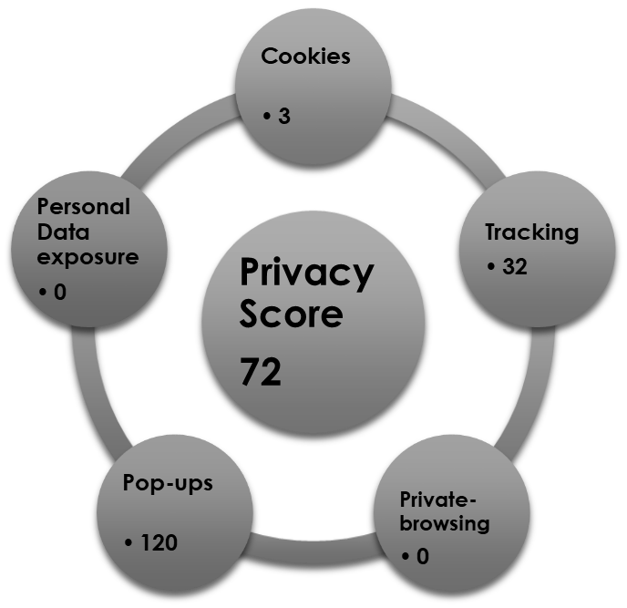
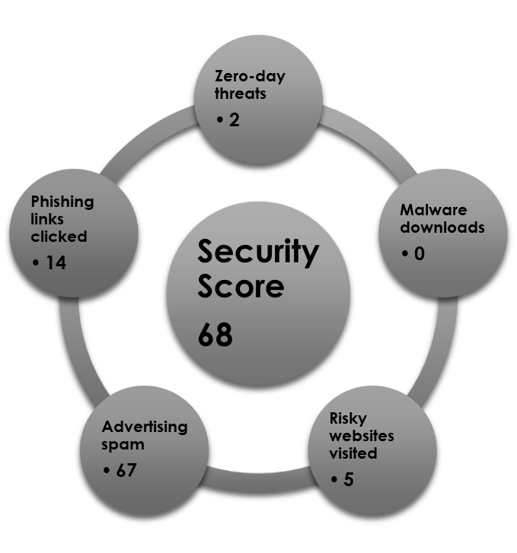
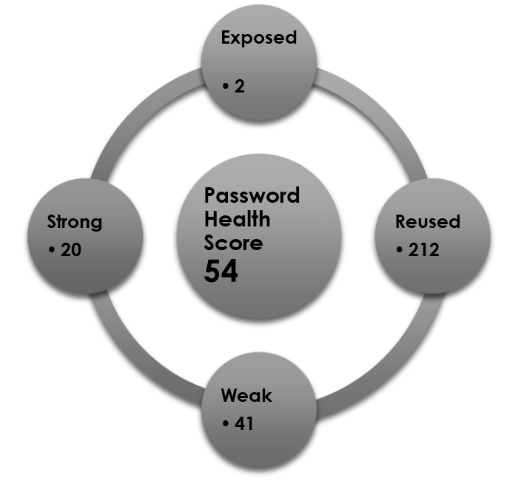

SecAdapt
Google
Bing
Baidu
http://www.google.com
Adaptive Cyber Protection Dashboard
Change all exposed passwords now!
Toggle View
Search
Share
Download
Devices
Settings
Hover mouse over on the diagrams for specific details
5
Alerts
Notes:
Home

Slide 18
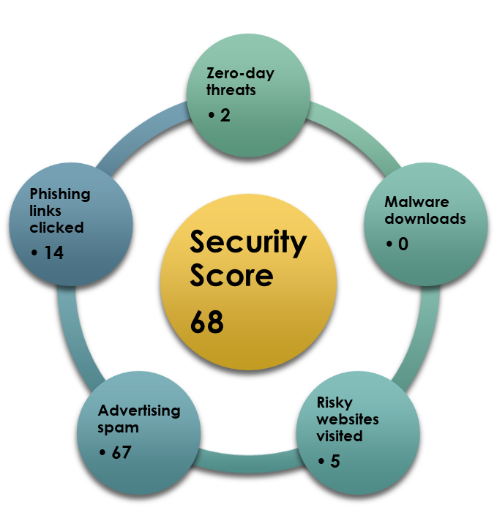

SecAdapt
Google
Bing
Baidu
http://www.google.com
Adaptive Cyber Protection Dashboard
Hover mouse on an item to view details
Change all exposed passwords now!
Toggle View
Search
Share
Download
Devices
5
Settings
You have five security alerts!
5
Alerts
Notes:
Home

Slide 19
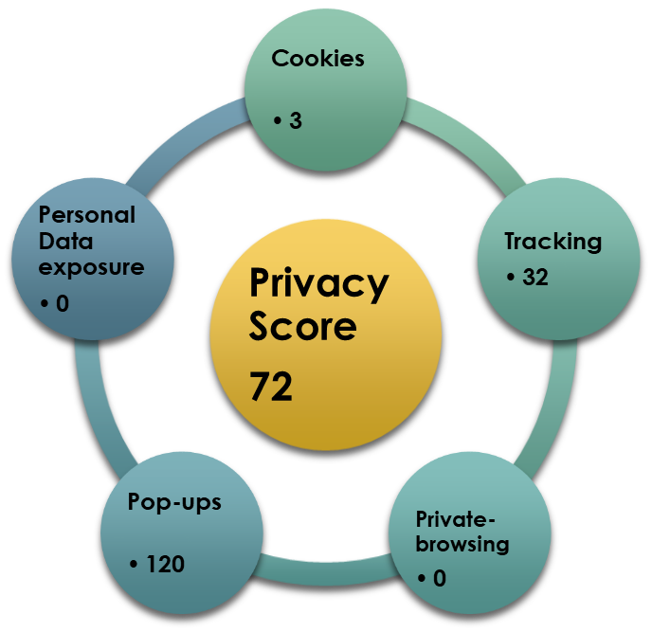

SecAdapt
Google
Bing
Baidu
http://www.google.com
Adaptive Cyber Protection Dashboard
Click on an item to view details
Change all exposed passwords now!
Toggle View
Search
Share
Download
Hover mouse on an item to view details
Devices
Awesome, your privacy score is looking good!
None of your personal data have been exposed
Settings
5
Alerts
Notes:
Home

Slide 20
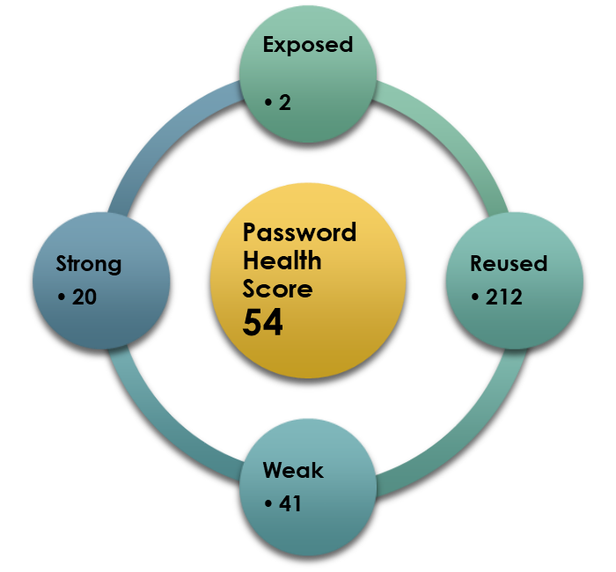

SecAdapt
Google
Bing
Baidu
http://www.google.com
Adaptive Cyber Protection Dashboard
Hover mouse on an item to view details
Toggle View
Search
Share
Download
Devices
Settings
Some of your passwords are exposed on breached websites. Change now to protect your safety.
5
Manage Passwords
Alerts
Notes:
Home

Slide 21
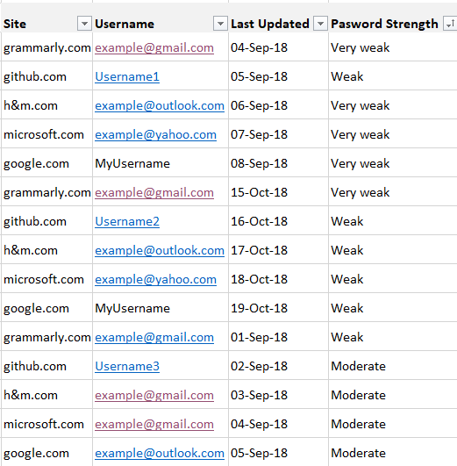
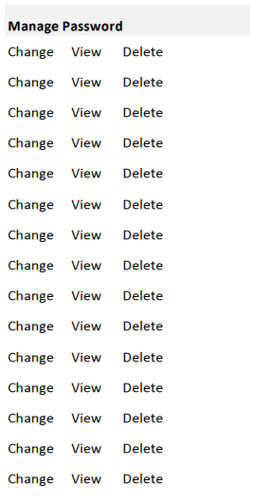
SecAdapt
Google
Bing
Baidu
http://www.google.com
Password Management Panel
Toggle View
Search
Share
Download
Devices
Settings
5
Alerts
Restore Defaults
Save
Cancel
Notes:
Home

