Slide 1



Playing with opencv
Presenter : Mohammad Siavashi
Fall 2016

Slide 2
Agenda
Introduction to OpenCV
Explaining Some Basics of Image processing
Coding a simple object tracking in OpenCV

Slide 3

What is opencv ?!

Slide 4


OpenCV is an Image Processing library created by Intel and maintained by Willow Garage.
Available for C, C++, Python, java and MATLAB.
Newset Stable update is version v2.4.13.
Over 500 functions
Open Source and free
Easy to use and install
OpenCV – Image Processing – Mohammad Siavashi

Slide 5
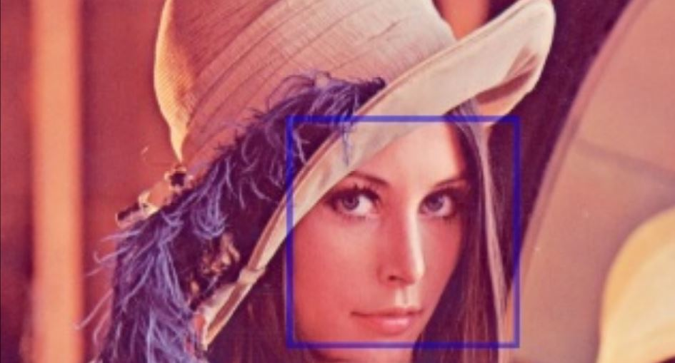
Face/Object Recognition

Slide 6
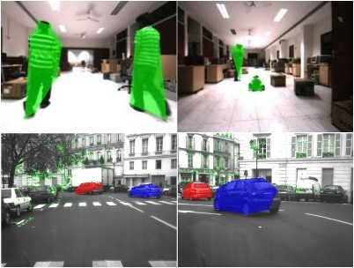
object tracking

Slide 7
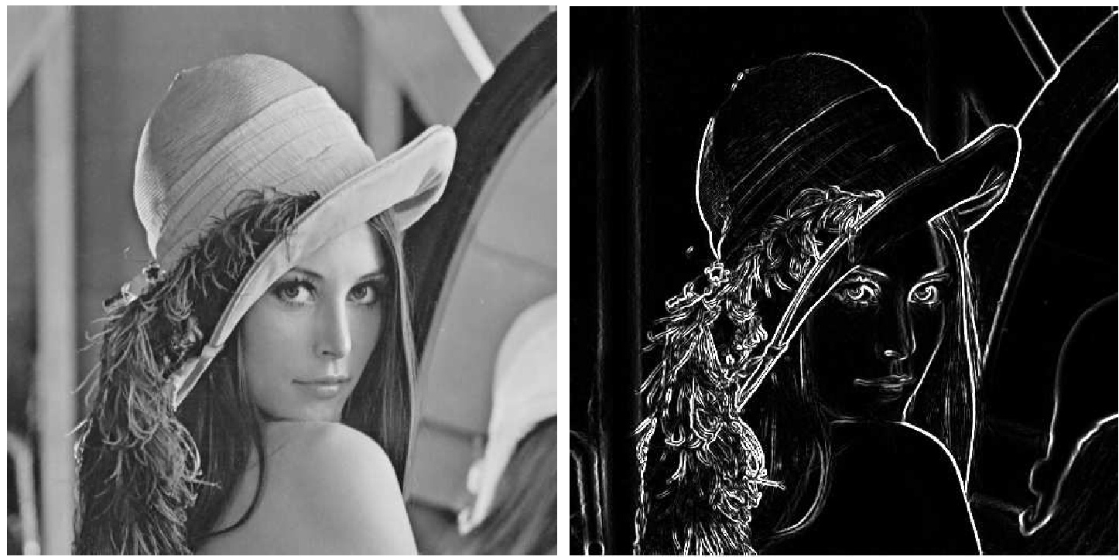
Filtering images (laplace, sobel , ….)

Slide 8

let’s define some basics

Slide 9
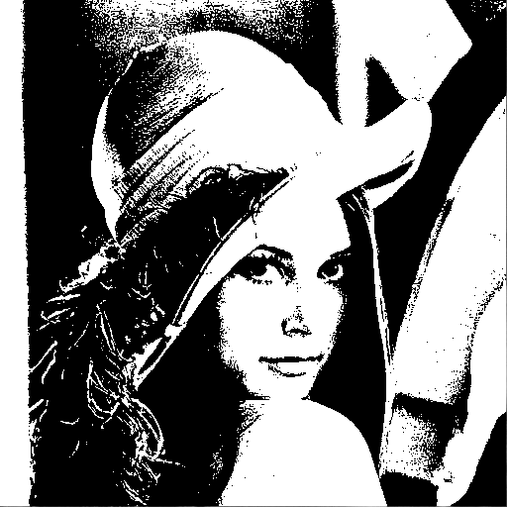
monochrome / threshold

Slide 10
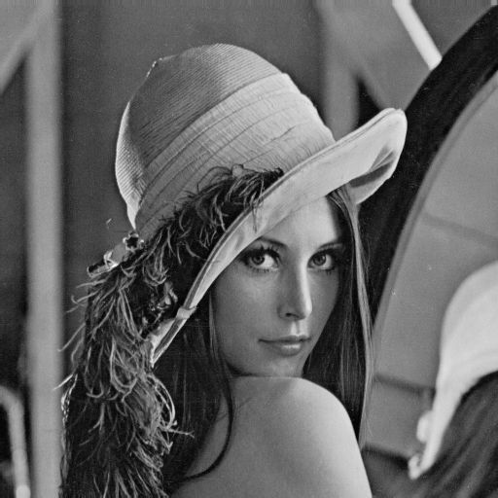
grayscale

Slide 11
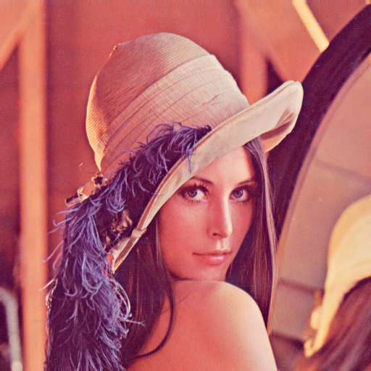
BGR / RBG (red, blue, green)

Slide 12
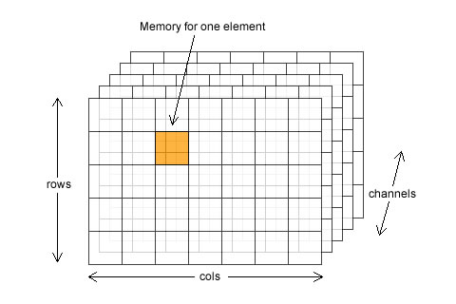
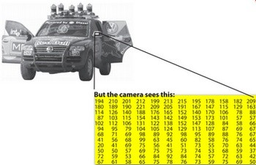
Image container(Matrix)

Slide 13
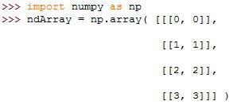


Numpy Nd arrays

Slide 14
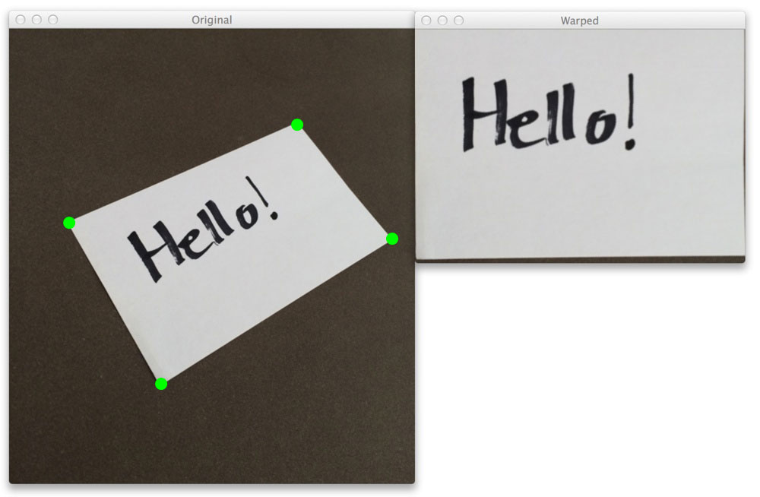
Perspective transform

Slide 15

Questions And answers
You Are Asking
‘Mohammad
Siavashi’
About
“Image Processing with
OpenCV”

