Slide 1
Embedded System Laboratory
2020 Summer Training
Lecture 2: UART
Made by 許家偉 2020/7

Slide 2
Outline
Introduction
Implementation
Homework

Slide 3
Introduction
Universal Asynchronous Receiver Transmitter
All sequence interface transform from Parallel to Serial on transmitter (Tx)
All sequence interface transform from Serial to Parallel on receiver(Rx)
UART provide some status information
Receiver full or not
Transmitter empty or not

Slide 4
Introduction
Microcontroller
UART
Rx
Tx
Device
Serial input
Parallel output
CPU
Match baud rate
Rx full
Serial output
Parallel input
Match baud rate
Tx empty

Slide 5
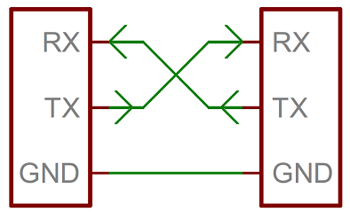
Introduction

Slide 6
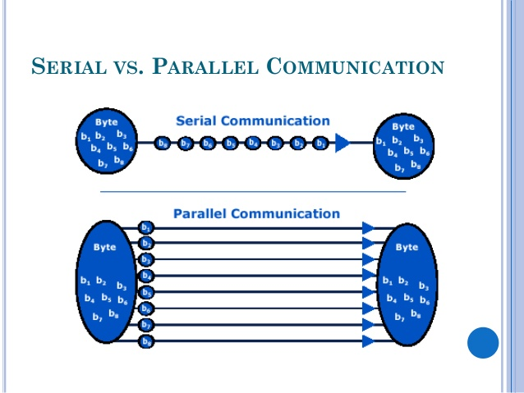
Introduction
Serial vs Parallel

Slide 7
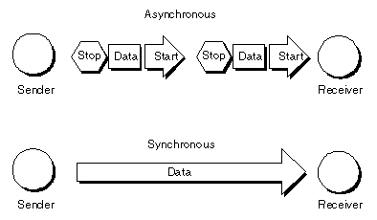
Introduction
Asynchronous vs Synchronous

Slide 8
Introduction
Baud rate(Speed)
the unit for symbol rate or modulation rate in symbols per second or pulses per second
Data frame
Between start bit & stop bit for content
High for no data/stop bit
Low for data/start bit
Parity
detecting errors in transmission
extra data bit

Slide 9
Introduction
What is baud-rate
baud rate gives the frequency at which bits are transmitted on the line
Why we need baud-rate
no clock is transmitted in asynchronous communication
the transmitter and receiver must run independently at nearly the same baud rates
A
B
C
D
E
F
G
H
I
J
Transmitter :
A B C D E F G I J
Receiver :
A C E G I

Slide 10
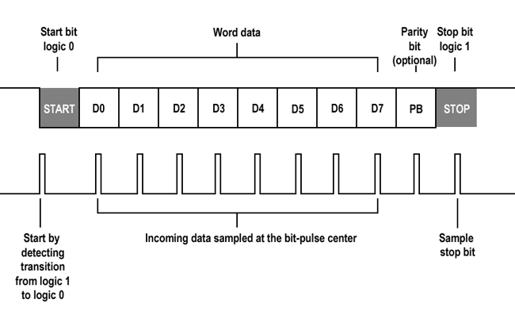
Introduction
Data frame
Img src: https://developer.electricimp.com/resources/uart

Slide 11
Introduction
What is odd/even/non parity bit
the number of bit 1 in an word either even or odd
even parity : we add a parity bit that number of bit 1 are even
odd parity : we add a parity bit that number of bit 1 are odd
What is parity bit function
UART of transmitter will calculate parity bit and send it
UART of receiver will calculate parity bit from the data it receive
compare two parity bit are same or not

Slide 12
Introduction
Example : parity bit
假設傳送 word : 0100 0000
odd parity bit : 0
even parity bit : 1
假設傳送word : 1111 1111
odd parity bit : 1
even parity bit : 0
Example : how to work (odd parity)
Tx
Rx
1110 0110 0

Slide 13
Implementation
UART in Raspberry 3
UART0: PL011
UART1: mini UART
The features of mini UART
7 or 8 bit operation
1 start and 1 stop bit
No parities
Break generation
8 symbols deep FIFOs for receive and transmit
SW controlled RTS, SW readable CTS
Auto flow control with programmable FIFO level
16550 like registers
Baudrate derived from system clock
Notes:
一個是完整功能 PL011 (UART0). 即 Pi 目前內建Linux driver /dev/ttyAMA0

Slide 14
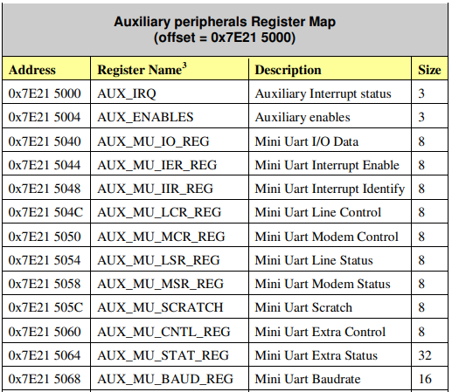
Implementation
Mini uart Reg.
BCM2837-ARM-Peripherals page 8.

Slide 15
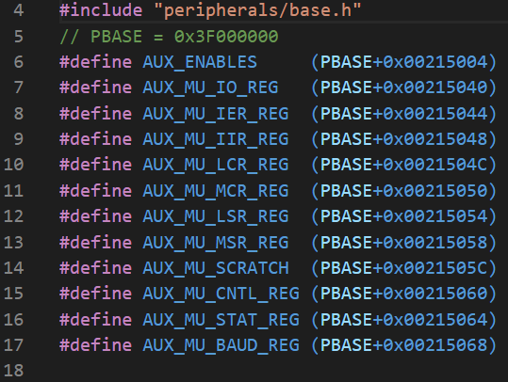
Implementation
The address of Reg.

Slide 16
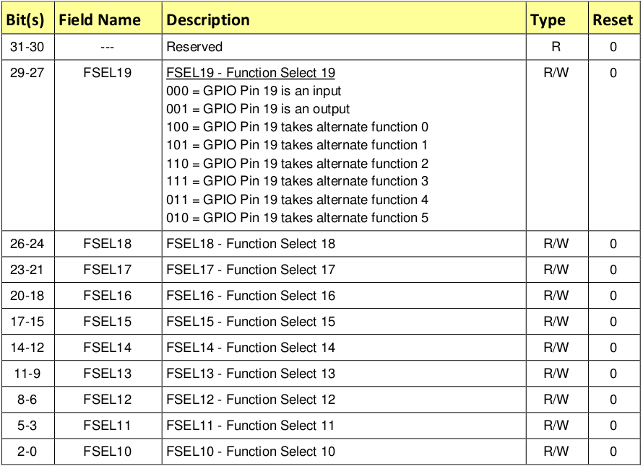
Implementation
Mini uart GPIO

Slide 17
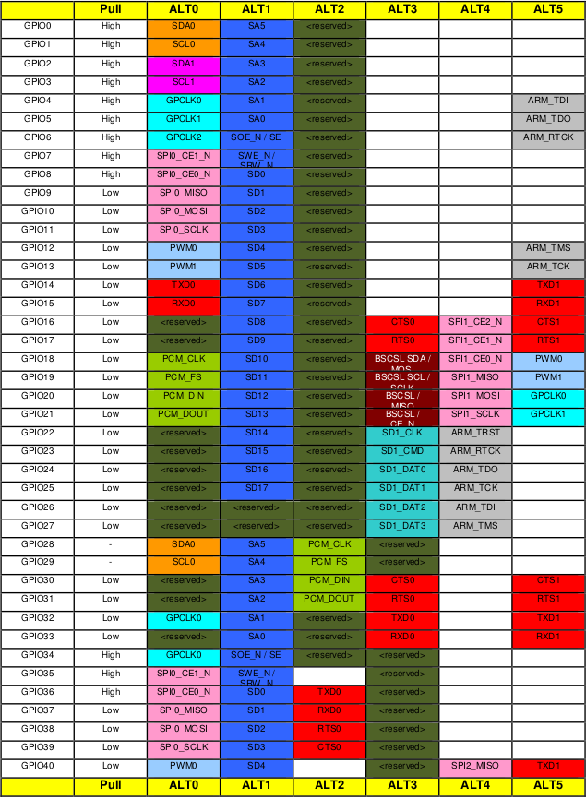
Implementation
Mini uart GPIO functions
BCM2837-ARM-Peripherals page 102.

Slide 18
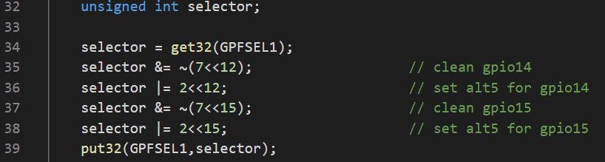
Implementation
Set mini uart GPIO
BCM2837-ARM-Peripherals page 102.

Slide 19
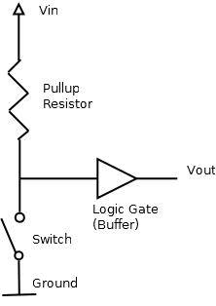
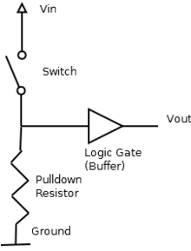
Implementation – Pull-up/down
not pressed (disconnect), the value read is “1”.
pressed (connect), the value read is “0”.
not pressed (disconnect), the value read is “0”.
pressed (connect), the value read is “1”.

Slide 20
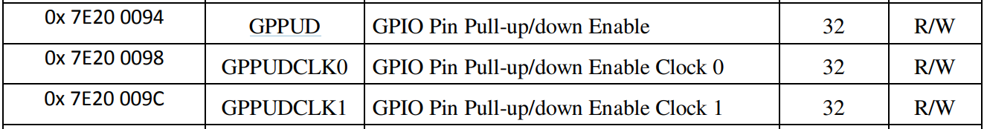
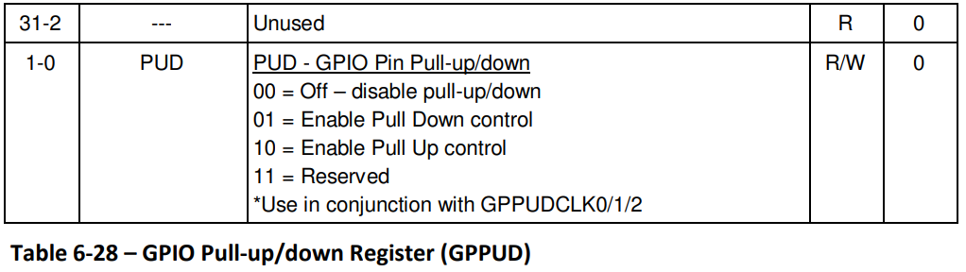
Implementation – Pull-up/down
BCM2837-ARM-Peripherals page 91, 100.

Slide 21
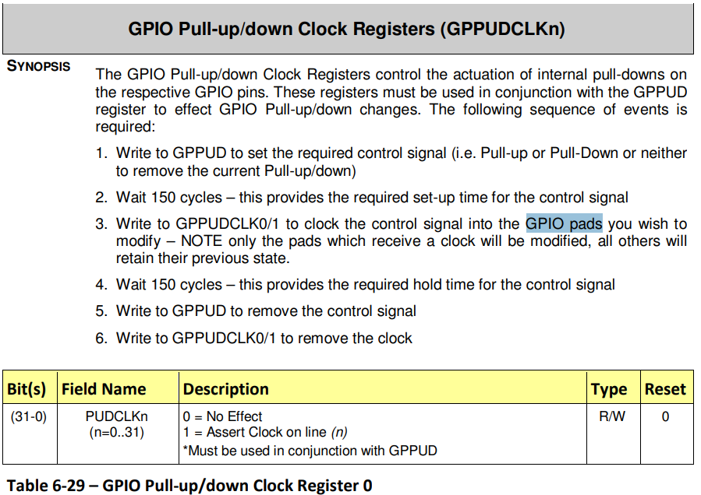
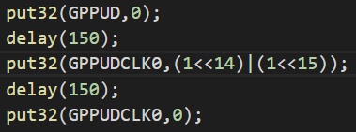
Implementation – Pull-up/down
BCM2837-ARM-Peripherals page 101.

Slide 22
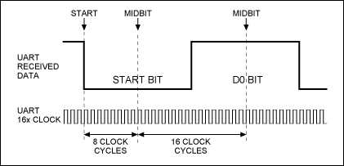
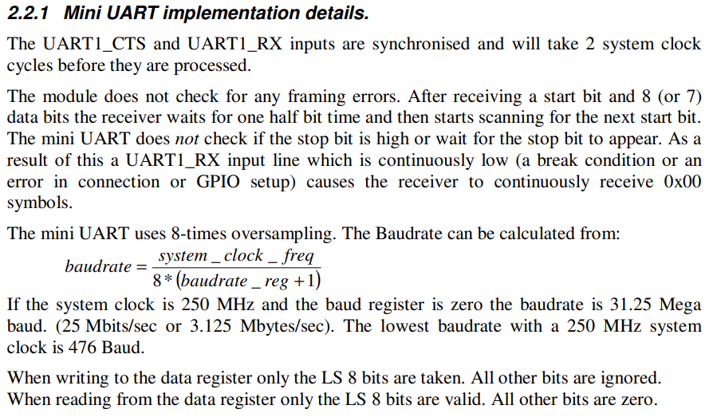
Implementation
Set Baud rate to 115200 bit/s
page 11.

Slide 23
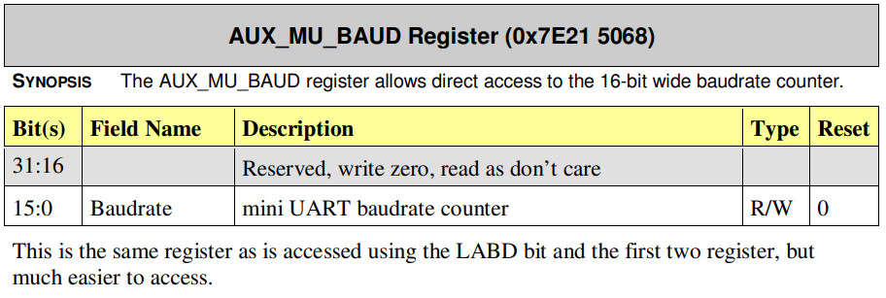
Implementation
Set AUX_MU_BAUD to 270
page 19.

Slide 24
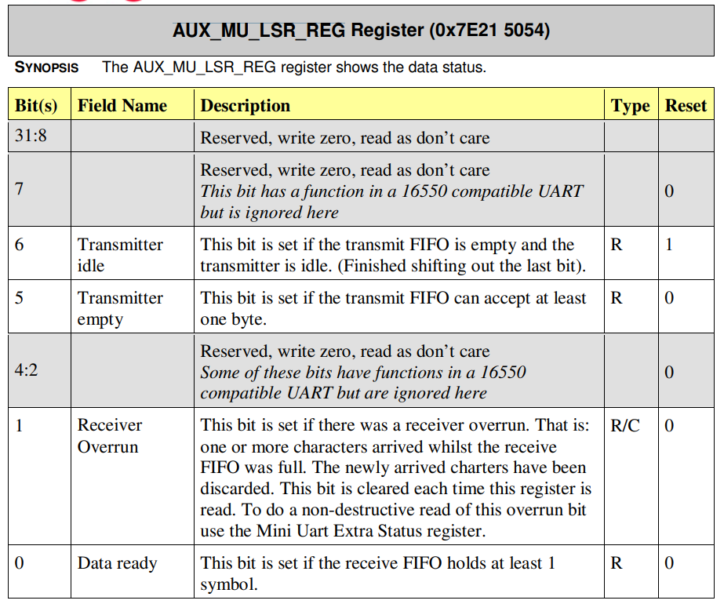
Implementation

Slide 25
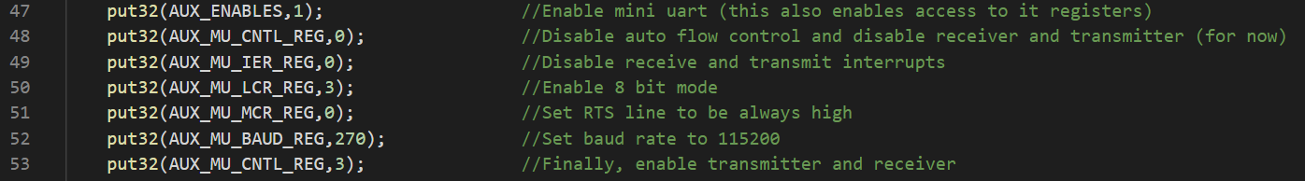
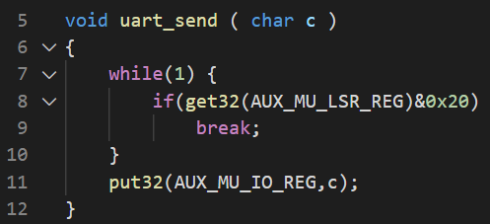
Implementation
Set mini uart control & send messages

Slide 26

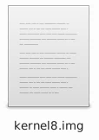
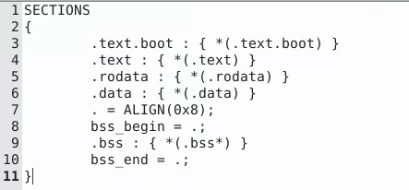
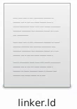
Implementation
config.txt
kernel_old=1 # load kernel from 0x0000
disable_commandline_tags=1
kernel8.img
The object code of old kernel.

Slide 27
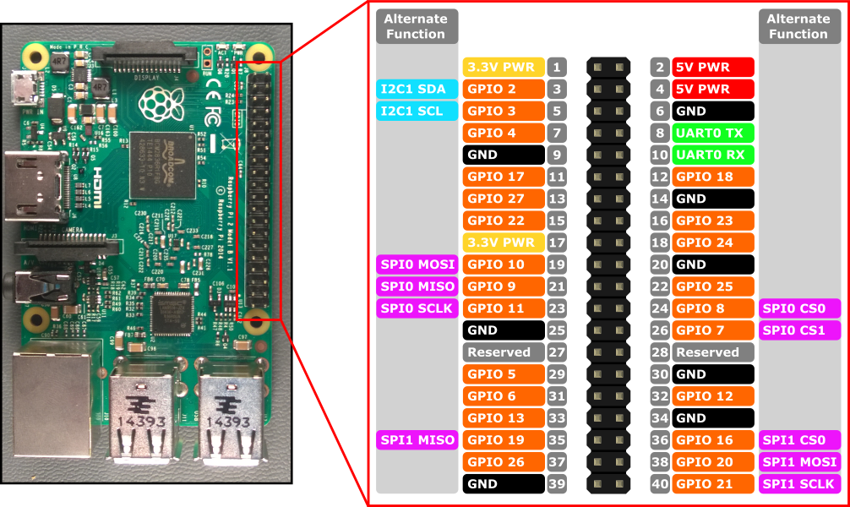
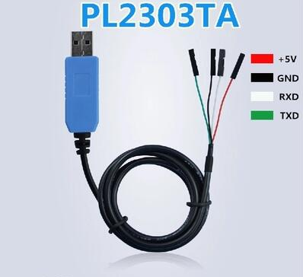
Implementation
Circuit & Pins

Slide 28
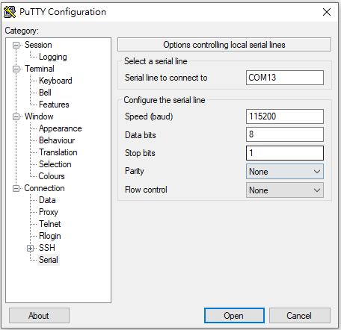
Implementation
Terminal on the computer
Download PuTTY

Slide 29
Implementation
The driver of pl2303HXA
https://www.ez2o.com/Blog/Post/PL2303HX-Win8-Win8.1-Win10

Slide 30
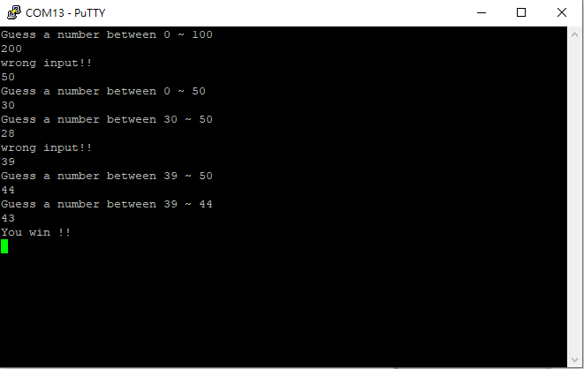
Homework
終極密碼
密碼可以自訂 (不用隨機)
Hint:
utils.S is useful.
Remind:
Do not modify the following files
mm.S, linker.ld, config.txt, boot.S, include/mm.h

