Slide 1
URL Threat Checker
From raw link to explainable verdict
A hybrid system for automatic URL threat analysis and classification
1. Extract numeric URL signals
Local ML
Heuristics
VirusTotal
2. Predict benign / phishing / malware
3. Correct obvious false positives
4. Compare with external reference
5. Show a safe / suspicious / dangerous report
01

Slide 2
URL THREAT CHECKER
The problem is small links carrying large risk
Phishing and malware URLs often look normal at first glance. A useful tool must be fast, explainable, and careful with trusted platforms that attackers can imitate.
Input
Output
URL text
Verdict
The project therefore does not rely on a single black-box answer. It combines local prediction, visible rules, and VirusTotal as an outside reference.
Risk
Risk
False alarm
Missed threat
02

Slide 3
URL THREAT CHECKER
Architecture: one clear path from URL to report
Next.js UI
->
FastAPI
->
Feature extractor
manual scan form + reports
auth, validation, routes
turn URL into numbers
Random Forest
->
Hybrid verdict
->
SQLite report
model-only signal
rules + model + VT
history and dashboard
The backend never crawls submitted pages. It analyzes URL text and optional VirusTotal reputation data.
03

Slide 4
URL THREAT CHECKER
Feature engineering makes the URL measurable
Length & structure
Security hints
URL length, dots, subdomains
HTTPS, IP address, @ symbol
Suspicious text
Trusted context
login, verify, password, wallet
registered-domain whitelist + trusted pages
Complexity
query count, risky extension, entropy
This is the bridge from raw text to math: every URL becomes the same numeric feature row.
04

Slide 5
URL THREAT CHECKER
The local model is strong, but not treated as magic
Rows used
Accuracy
Weighted F1
Classes
640,905
93.47%
93.62%
4
The Random Forest predicts benign, phishing, malware, or defacement from URL features only.
Its confidence is model probability, not guaranteed truth. That is why the final system also uses visible rules and VirusTotal comparison.
05

Slide 6
URL THREAT CHECKER
Hybrid logic protects the demo from obvious model mistakes
Trusted domain
Fake trusted text
External signal
google.com, youtube.com, github.com
google.com.fake-domain.ru is not google.com
VirusTotal detections can escalate risk
The whitelist is applied to the registered domain, not to random text inside the URL.
This is why a real Google search can stay safe, while a fake domain containing “google.com” is still dangerous.
06

Slide 7
URL THREAT CHECKER
VirusTotal is a reference, not the answer key
Eligible scans
Agreement
VT risky
VT clean
8
100%
5
3
The comparison is calculated only when VirusTotal returned usable analysis stats: fetched or cached.
We report agreement and disagreement buckets. We do not claim VirusTotal is absolute ground truth.
07

Slide 8
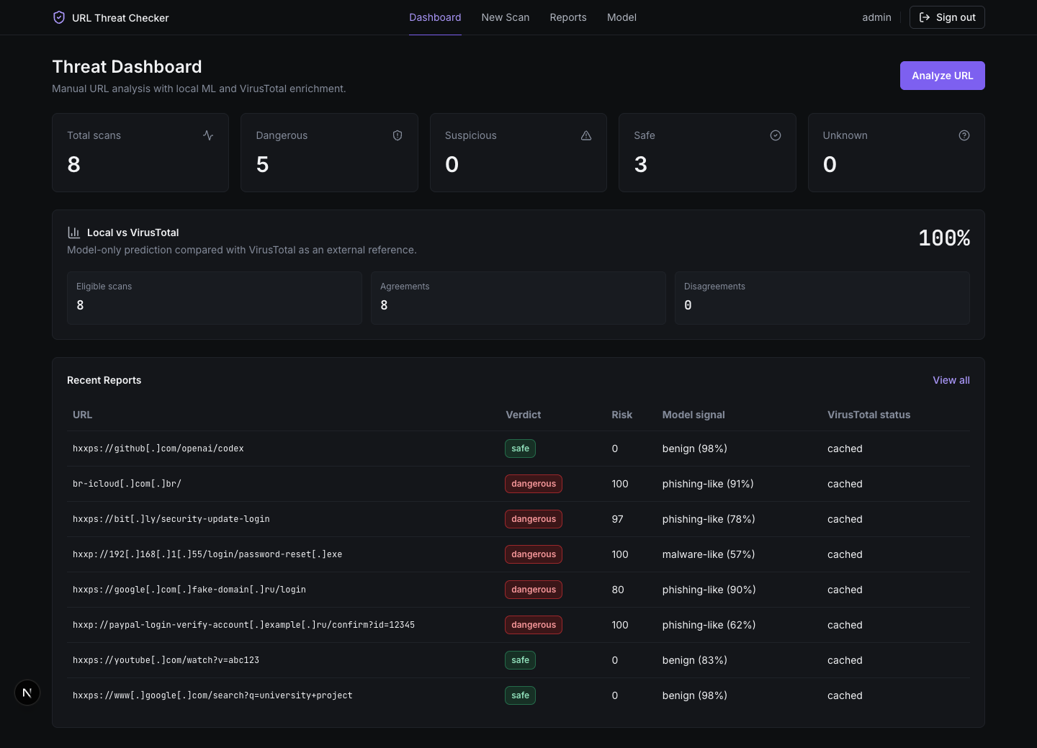
URL THREAT CHECKER
The dashboard makes the system demonstrable
One screen shows volume, verdict mix, comparison rate, and recent reports.
This is what makes the project feel like software, not just a trained model in isolation.
08

Slide 9
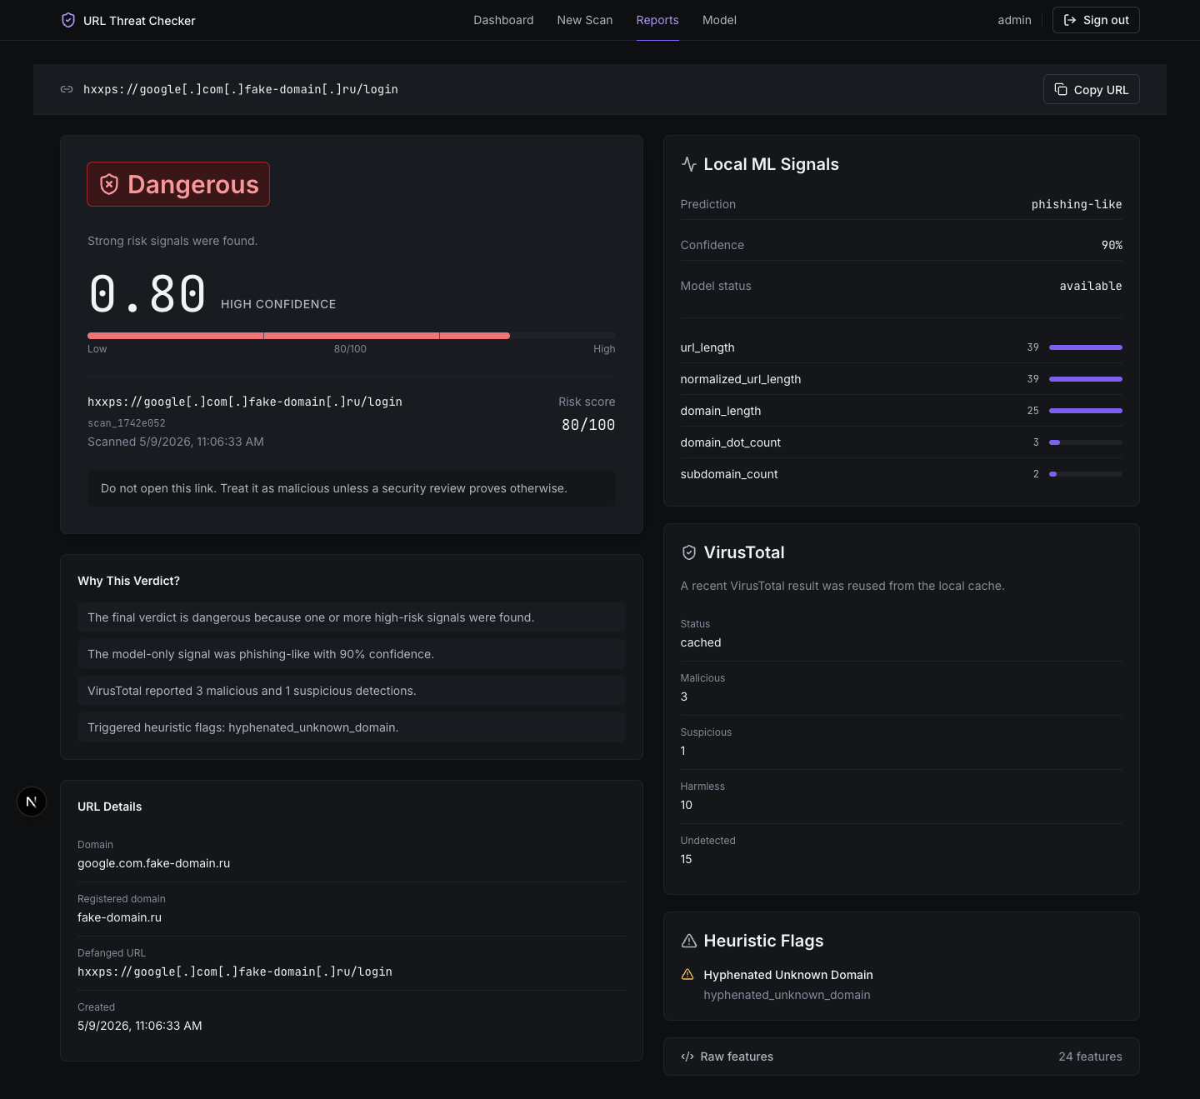
URL THREAT CHECKER
Each report explains the verdict, not just the label
Useful security tools explain “why”.
- defanged URL
- risk score
- model signal
- VirusTotal counts
- heuristic flags
- recommendation
09

Slide 10
URL THREAT CHECKER
Complete for v1, honest about future work
Delivered
Validated
Packaged
UI + API + ML
41 tests
private GitHub
V1 intentionally skips webhook ingestion. The manual scan flow already proves the core idea.
Future work: email, Slack, Telegram or WhatsApp webhooks can reuse the same backend scan function.
Core thesis: local ML + explainable heuristics + external reference gives a practical hybrid URL threat checker.
10

