Slide 1
Women in the Workforce
What are the effects of increased
women in the workforce?

Slide 2

OVERVIEW
Since the 1960s, there has been a noticeable influx of women in the workforce.
There are a number of variables that have been impacted by an increased percentage of women in the workforce and in this presentation we will discover what those variables are.

Slide 3
Questions:
What are the effects of increased women in the workforce?
How has the GDP been impacted (if at all)?
How has the birth rate been impacted (if at all)?
How does this data vary by region?
Are there other unrelated societal changes that could potentially mimic the same trends?

Slide 4
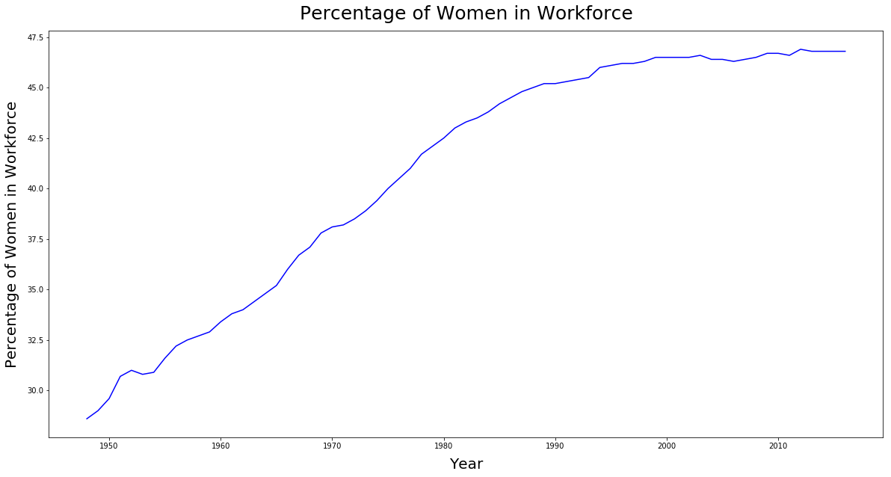

Slide 5
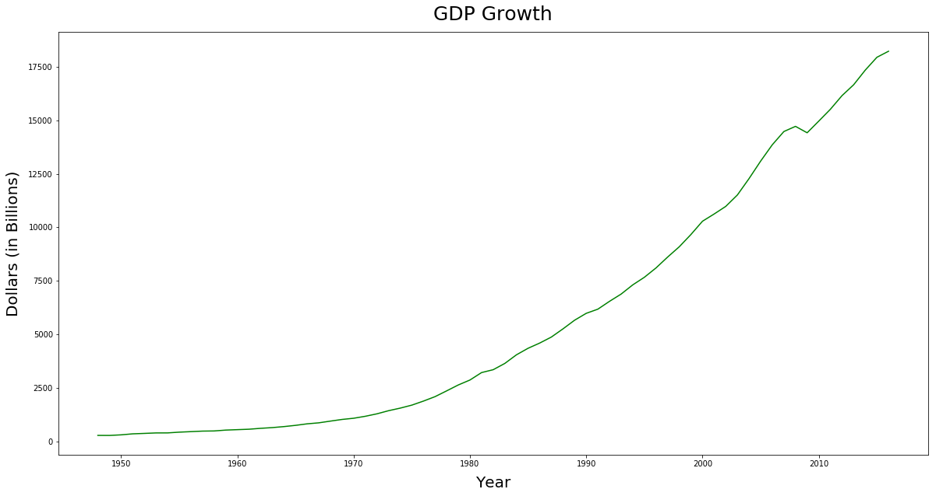
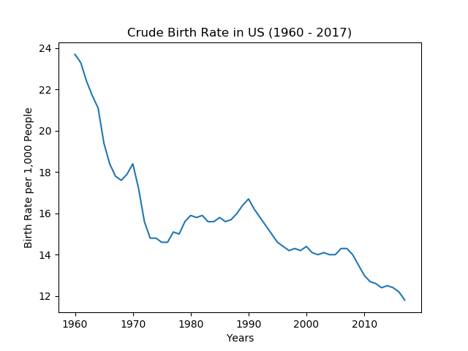
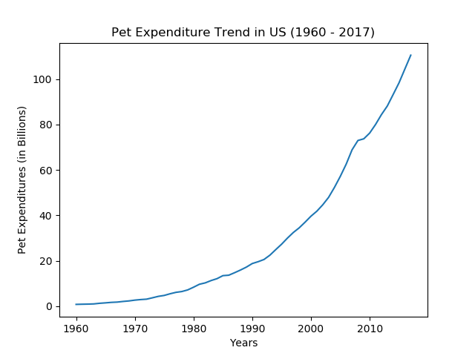
What are the effects of increased women in the workforce?
Growing GDP
Declining Birth Rates
Increase in Pet Expenditures

Slide 6
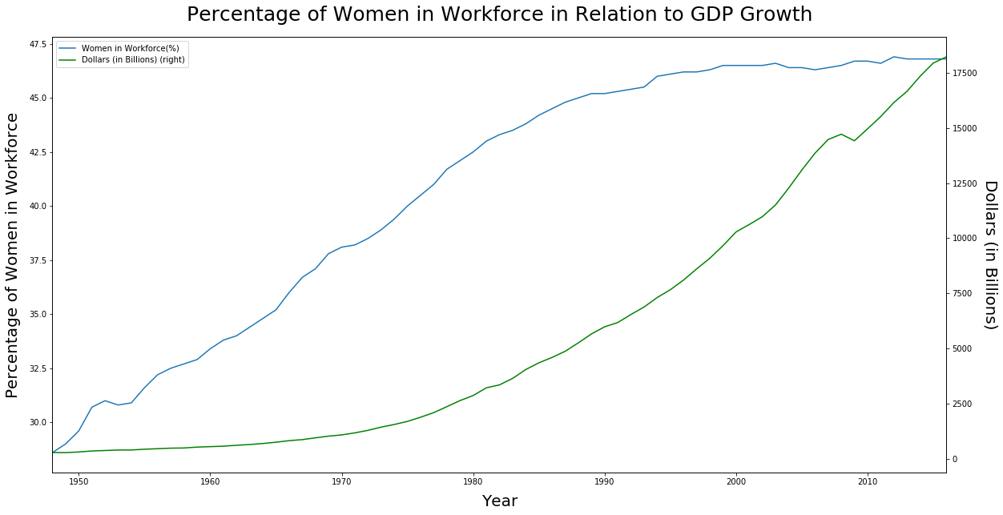
How has the GDP been impacted (if at all)?
GDP has increased as more women join the workforce.
“…women's participation in the economy is critical because when women are able to fulfill their economic potential, GDP goes up and poverty goes down”
– US News

Slide 7
How has the birth rate been impacted (if at all)?
Birth rates have been declining since the 1960s.
Though there maybe other contributing factors, women in the workforce is one of them.
“Economics, alternative lifestyles, waiting to find the optimal partner, building a career — these all factor into delaying childbirth or couples having fewer children.”
- Dr. James Grifo

Slide 8

Soaring pet Expenditure Rates
Birth rates are going down but pet expenditure rates are going up…
What does this imply?
Are people replacing children with pets?

Slide 9
Data Cleanup
Pain Points:
Finding credible data sources with sufficient amount of data to analyze.
How did we fix it?
Cleaning up the data to get uniform, compatible formats.
How did we fix it?
Merging percentage of women in the workforce & growing GDP into one graph.
How did we fix it?
Trouble with API call.
How did we fix it?
Once we pulled the API data, we found it to be very nested.
How did we fix it?
“I have not failed. I've just found 10,000 ways that won't work.” - Thomas Edison

Slide 10
IF we had more time we would…
Explore what other factors have contributed to a declining birth rate.
Explore what other factors have contributed to an increase in GDP.
Dive into the demographics of pet owners.
Identify what other factors have contributed to increased pet expenditure.
Explore Urbanization and how it relates to women in the workforce.

Slide 11
Questions?

