Slide 1
Women in the Workforce
What are the effects of increased
women in the workforce?
Tamara Najjar, mohammed sajid khan, Kathleen graham

Slide 2
Questions:
What are the effects of increased women in the workforce?
How has the GDP been impacted (if at all)?
How has the birth rate been impacted (if at all)?
How does this data vary across demographics and regions?
Are there other unrelated societal changes that could potentially mimic the same trends?

Slide 3

OVERVIEW
Since the 1960s, there has been a noticeable influx of women in the workforce.
There are a number of variables that have been impacted by an increased percentage of women in the workforce and in this presentation we will discover what those variables are.

Slide 4
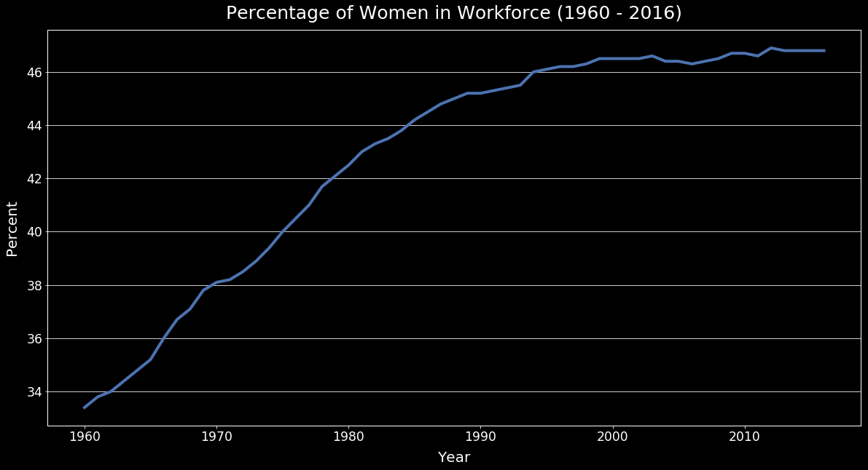
https://fred.stlouisfed.org/

Slide 5
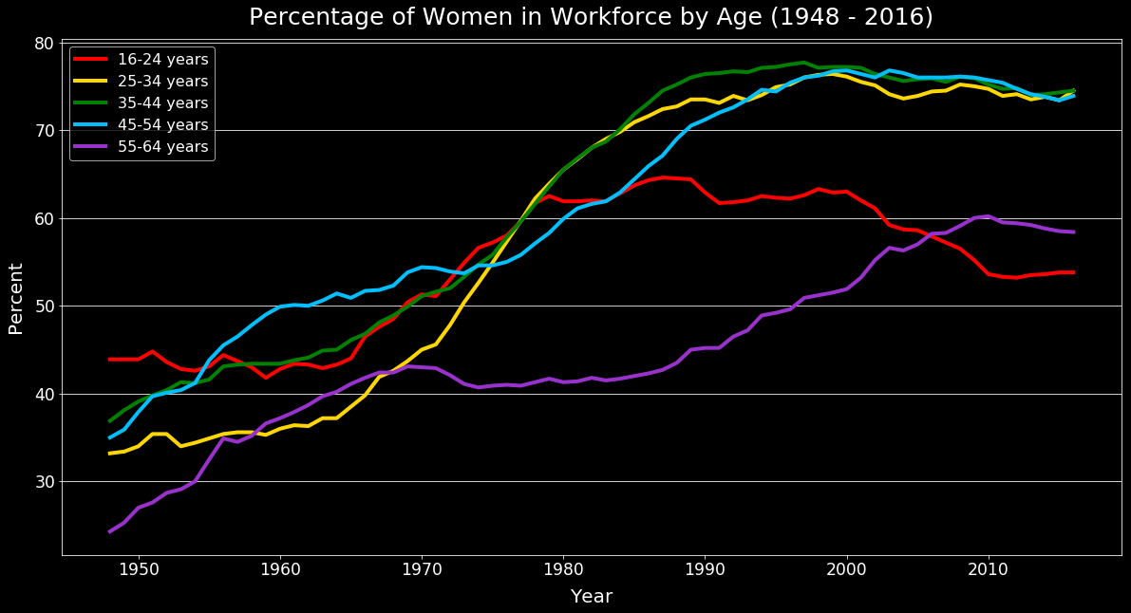
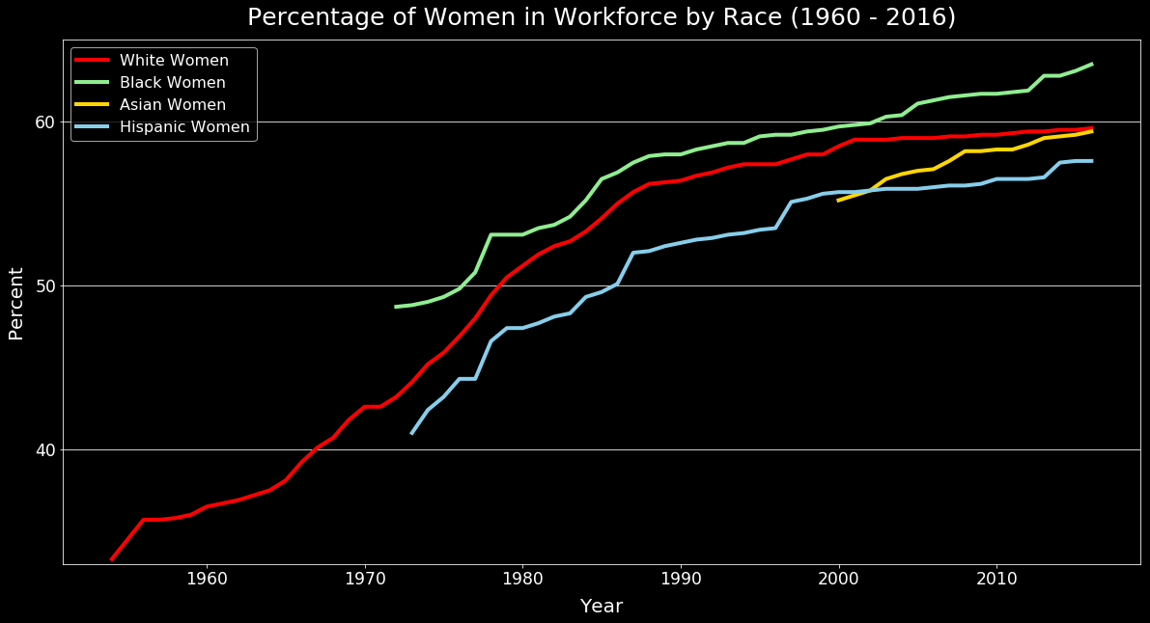
Taking a closer look
How does this vary across different age groups?
How does this vary across different races?
https://statusofwomendata.org/
https://statusofwomendata.org/

Slide 6
Exploration
The search for credible data sources with sufficient amounts of data.
https://fred.stlouisfed.org/ (Federal Reserve Bank of St. Louis, Eight District)
https://www.dol.gov/ (U.S. Department of Labor)
https://statusofwomendata.org/ (Institute for Women’s Policy Research)
https://yhoo.it/2XJ4JvL (Yahoo Finance)
https://catalog.data.gov/ (U.S. Department of Labor, Bureau of Labor Statistics)
Gathering data from multiple sources is not without its challenges…

Slide 7




Data Cleanup
Resources:
Expected:
Messy or lengthy column names
Unnecessary rows
Tick locations
Legend manipulation

Slide 8
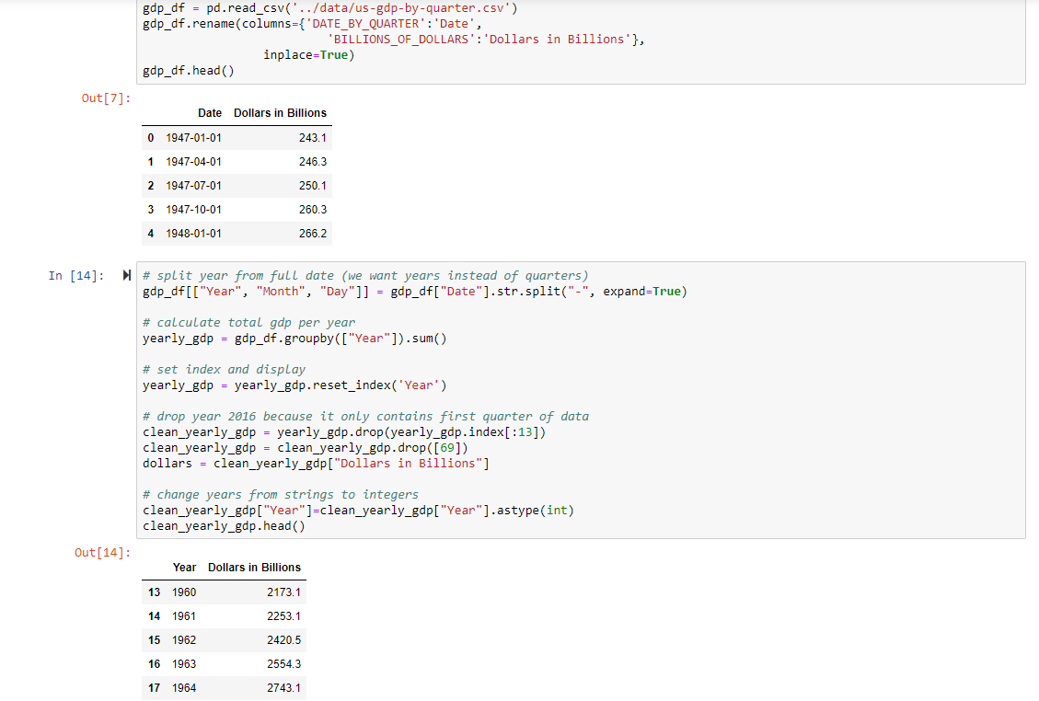
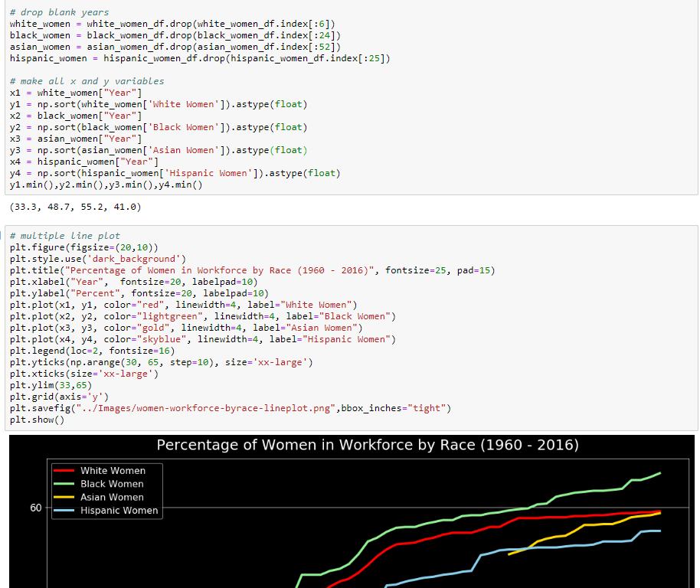
Unexpected:
Merging multiple data frames
Changing types of numbers
Parsing dates from mm/dd/yyyy into separate strings
Multiline plot
Limit on number of API calls
Nested lists and dictionaries

Slide 9
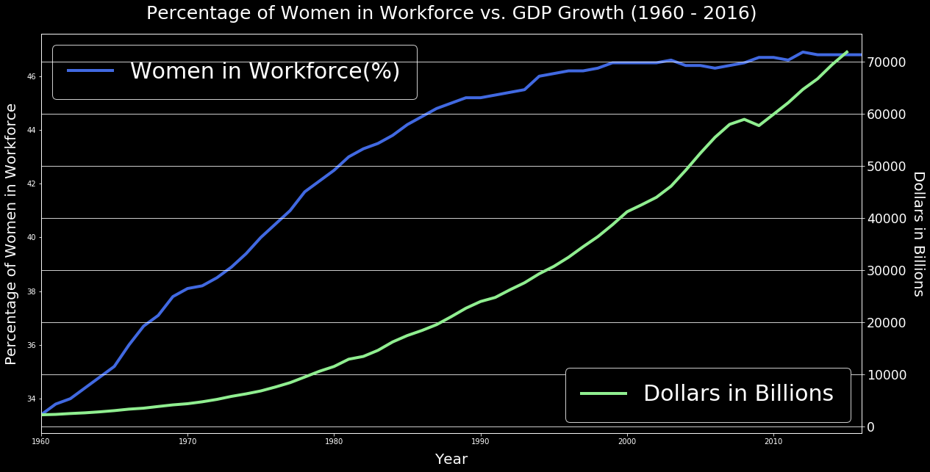
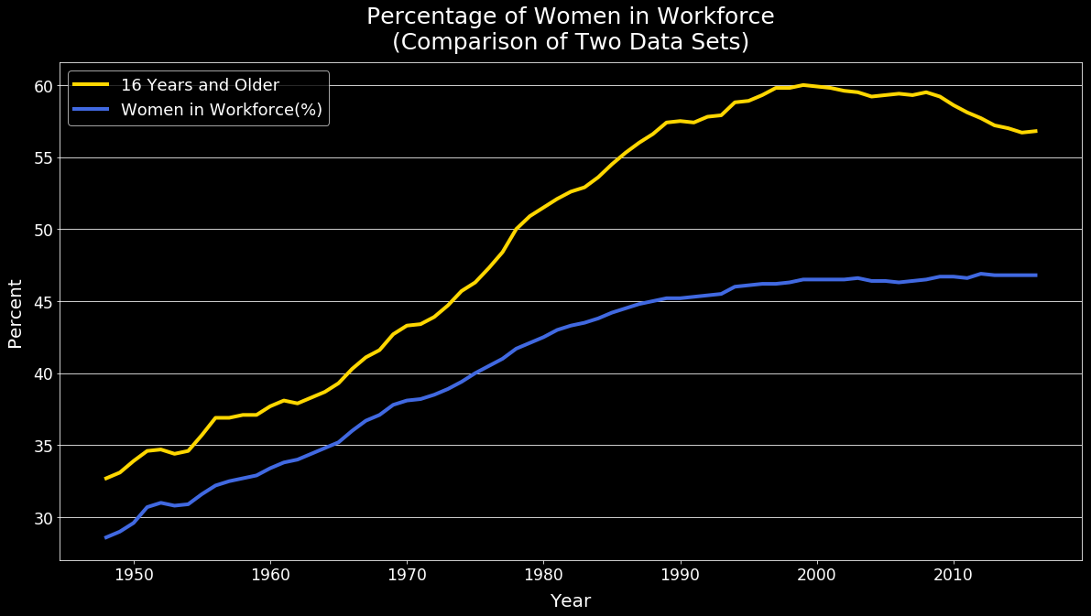
Plotting a secondary y axis with separate legends:
Comparison of different data sets with “same” information:
https://fred.stlouisfed.org/
https://fred.stlouisfed.org/
https://statusofwomendata.org/
Takeaways:
Best practice – when stuck, look at length and type.
“I have not failed. I've just found 10,000 ways that won't work.” - Thomas Edison

Slide 10


What are the effects of increased women in the workforce? Why does it matter?
Growing GDP
Declining Birth Rates

Slide 11
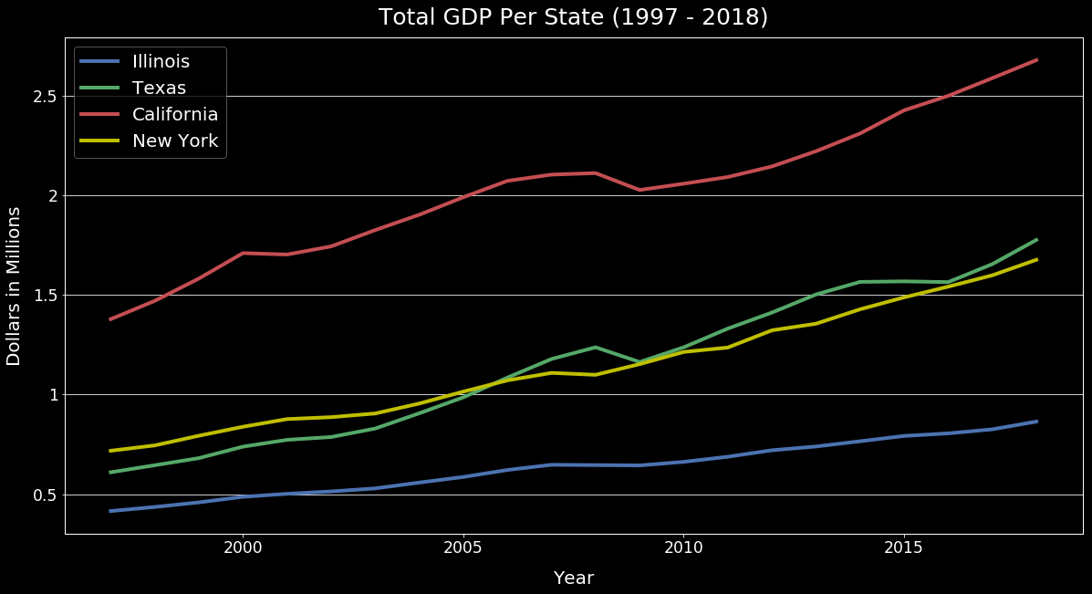
How has the GDP been impacted (if at all)?
GDP has increased as more women join the workforce.
“…women's participation in the economy is critical because when women are able to fulfill their economic potential, GDP goes up and poverty goes down”
– US News
https://fred.stlouisfed.org/
https://fred.stlouisfed.org/

Slide 12
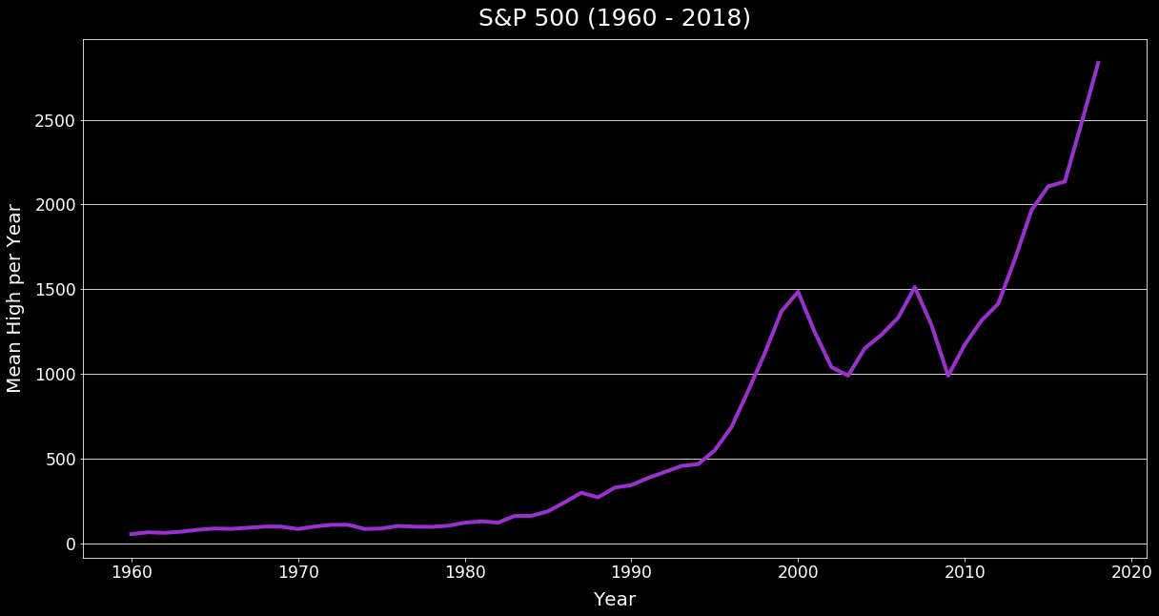
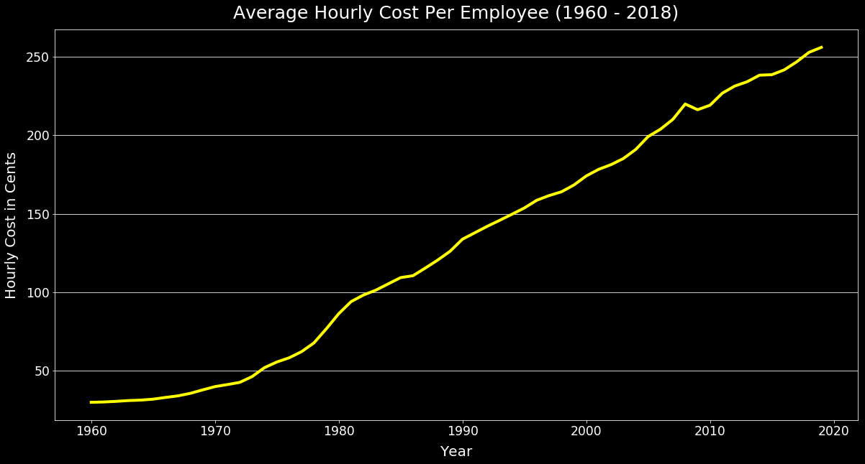
Taking a closer look
The market cap of S&P 500 companies has seen an increase which signifies a healthy economy.
But aren’t employees more expensive now? FALSE.
https://yhoo.it/2XJ4JvL
https://catalog.data.gov/

Slide 13
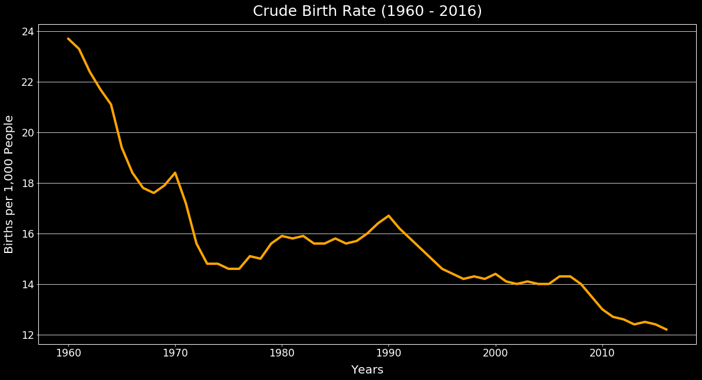
How has the birth rate been impacted (if at all)?
Birth rates have been declining since the 1960s.
Though there may be other contributing factors, women in the workforce is one of them.
“Economics, alternative lifestyles, waiting to find the optimal partner, building a career — these all factor into delaying childbirth or couples having fewer children.”
- Dr. James Grifo
https://fred.stlouisfed.org/

Slide 14
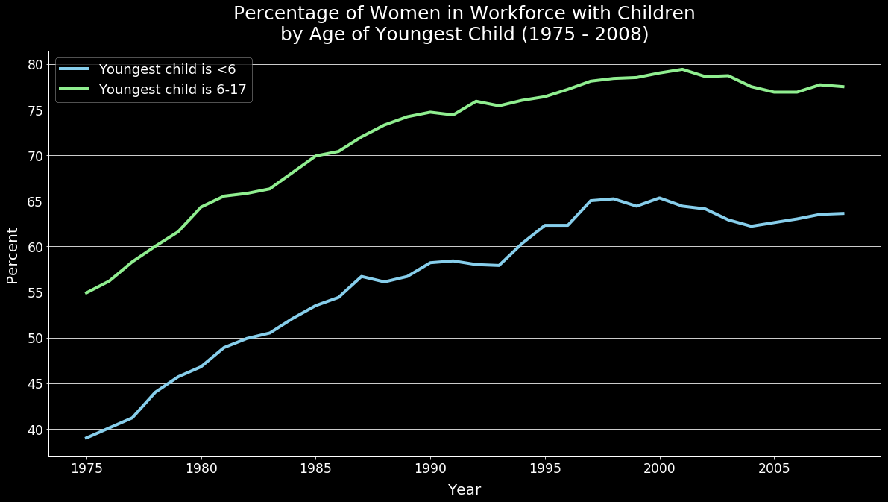
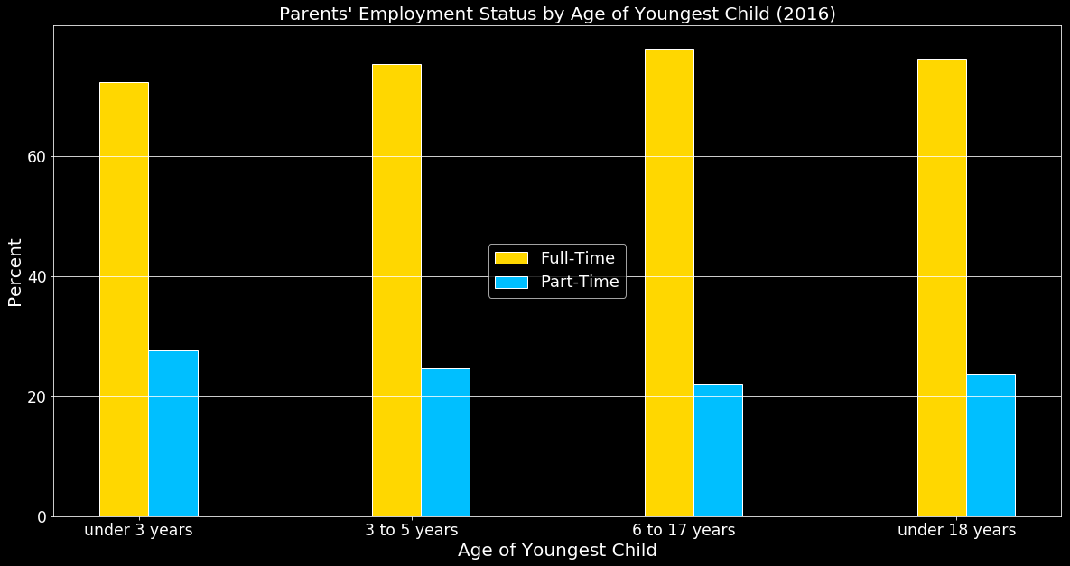

Naysayers might suggest…
“Women are not coming back to work after having children.”
FALSE.
“…if they are, they’re only part time.”
FALSE.
https://statusofwomendata.org/
https://statusofwomendata.org/

Slide 15
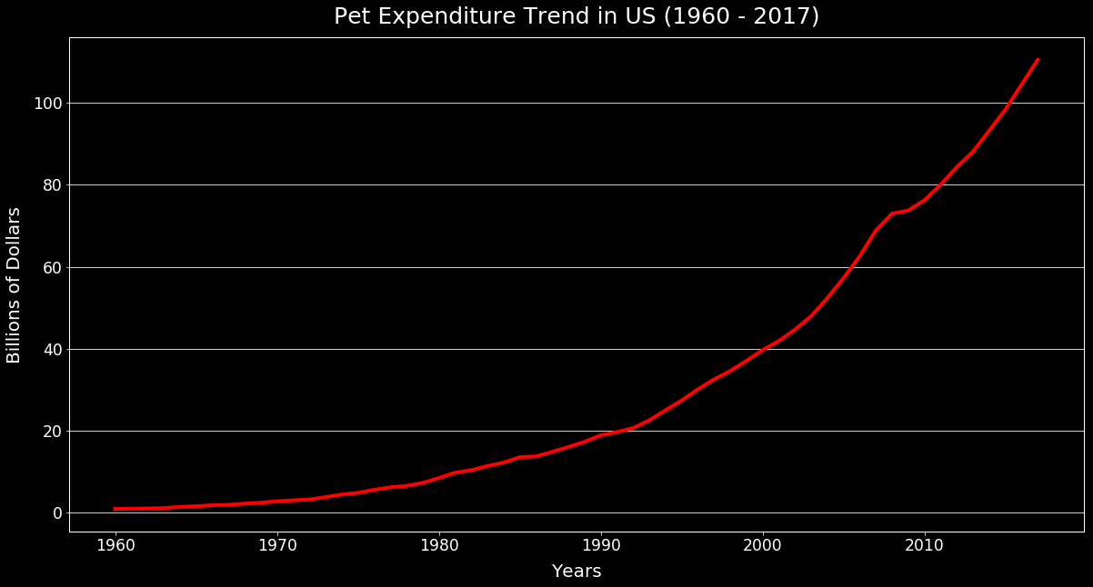
Are there other unrelated societal changes that could potentially mimic the same trends?
Birth rates are going down but pet expenditure rates are going up…
What does this imply?
https://fred.stlouisfed.org/

Slide 16


Are people replacing children with pets?

Slide 17
IF we had more time we would…
Dive into the demographics of pet owners (i.e. age, income, etc.)
Identify what other factors have contributed to increased pet expenditure.
Explore additional functionality of Python, pandas, NumPy, Matplotlib, and other libraries.
Explore ways to present more data at one time (i.e. state data over time).
Explore what other factors have contributed to a declining birth rate (i.e. accessibility to birth control).
Explore what other factors have contributed to an increase in GDP (i.e. technology/automation).
Explore additional effects of increased women in the workplace (i.e. divorce rates, average age of women at marriage, etc.)
Explore if there are any contributing health factors to increased women in the workplace (i.e. mental health, physical health, etc.)

Slide 18
Questions?

