Slide 1

PROJECT NAME: Leaner Accademy
Developed BY Manoj Kumar K

Slide 2
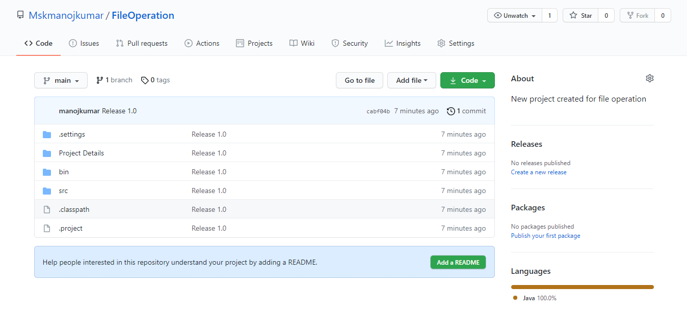
Github link
https://github.com/Mskmanojkumar/FileOperation

Slide 3
Overview
This Project to perform File Operation such as Sorting file name in ascending order, Add a file to the existing directory list, Delete a user specified file from the existing directory list, Search a user specified file from the main directory. This is a small prototype of the application. The user interaction will be via a command line.

Slide 4
Flow Chart

Slide 6
Documentation
Tools and Programming Language used in this Project
Eclipse
Git hub
Java

Slide 7
Documentation
Tools and Programming Language used in this Project
Java Servlet
JSP
MYSQL

Slide 8

Sprint Planning
Task Name | Start Date | End Date | Estimated Points | Pending | Completed | Status | PRIORITY
Designing Login Webpage | 20-Jul-21 | 21-Jul-21 | 3 points |  | 3 points | Completed | MEDIUM
Creating Database and performing Sql Query | 22-Jul-21 | 23-Jul-21 | 6 points |  | 6 points | Completed | HIGH
Connecting to database , add delete and edit date into database | 25-Jul-21 | 26-Jul-21 | 5 points |  | 5 points | Completed | MEDIUM
Assigning Relation to Datafields | 29-Jul-21 | 30-Jul-21 | 9 points |  | 9 points | Completed | HIGH
Genrating Class Report | 31-Jul-21 | 31-Jul-21 | 7 points |  | 7 points | Completed | HIGH
Testing | 01-Aug-21 | 01-Aug-21 | 8 points |  | 8 points | Completed | MEDIUM

Slide 9

Core Concept and algorithm
JSP
ArrayList
Exception handling
Servlet
MVC
JDBC

Slide 10
How to execute
Run Home.java Program file Location (\Learner_Academy\src)

Slide 11
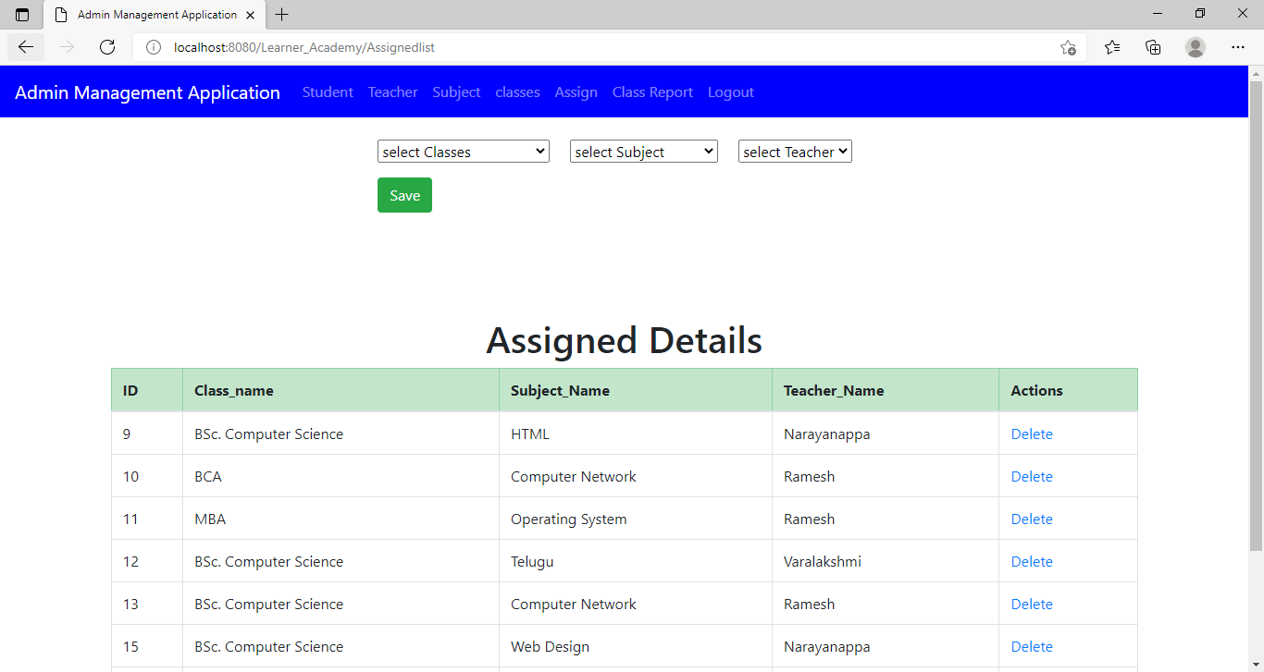
Sample Output 1

Slide 12
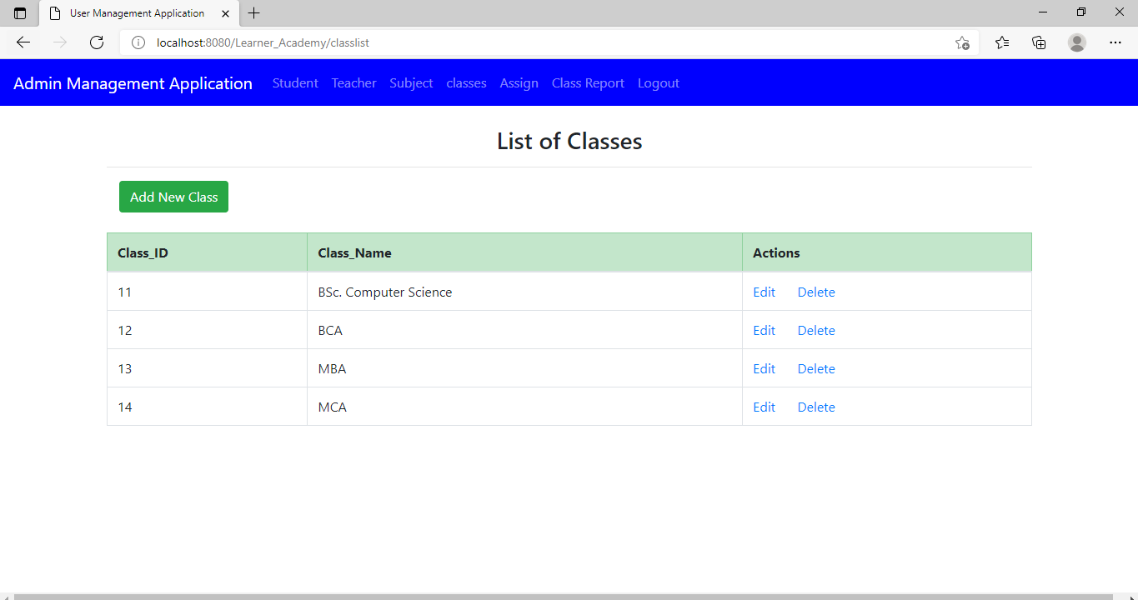
Sample Output 2

Slide 13
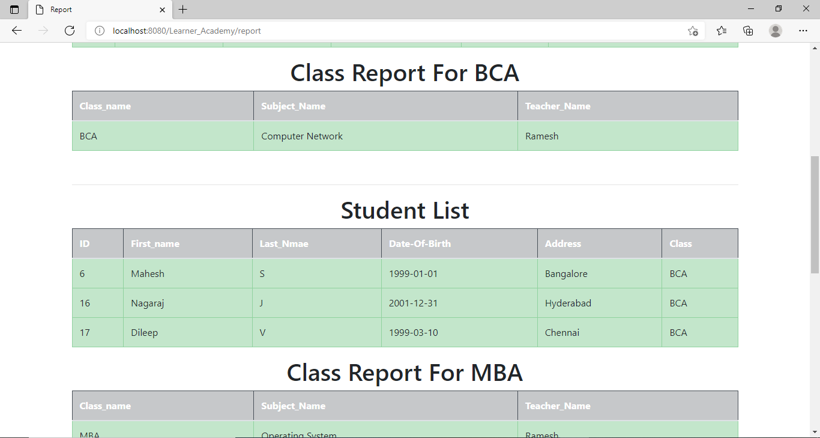
Sample Output 3

Slide 14
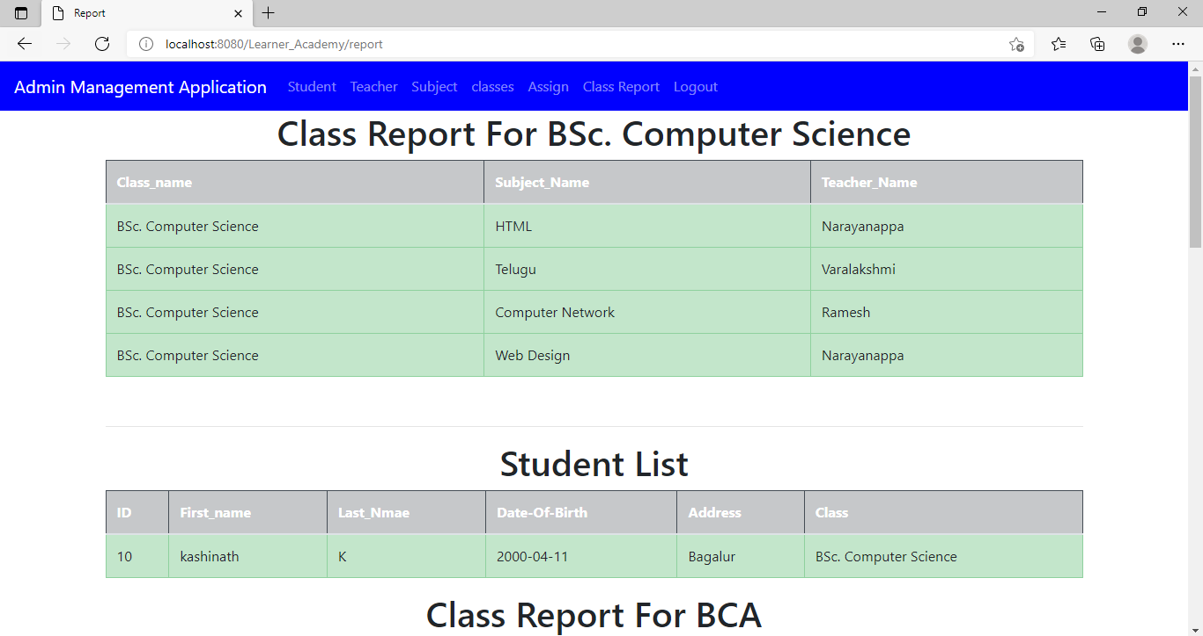
Sample Output 4

Slide 15
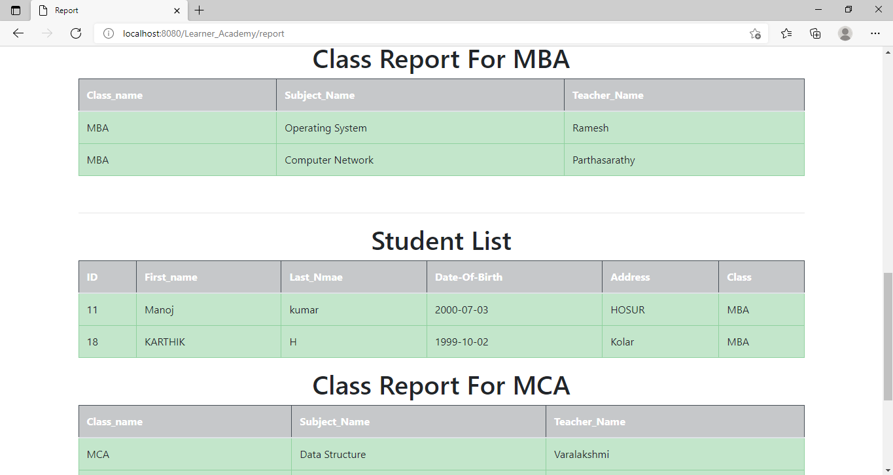
Sample Output 5

Slide 16
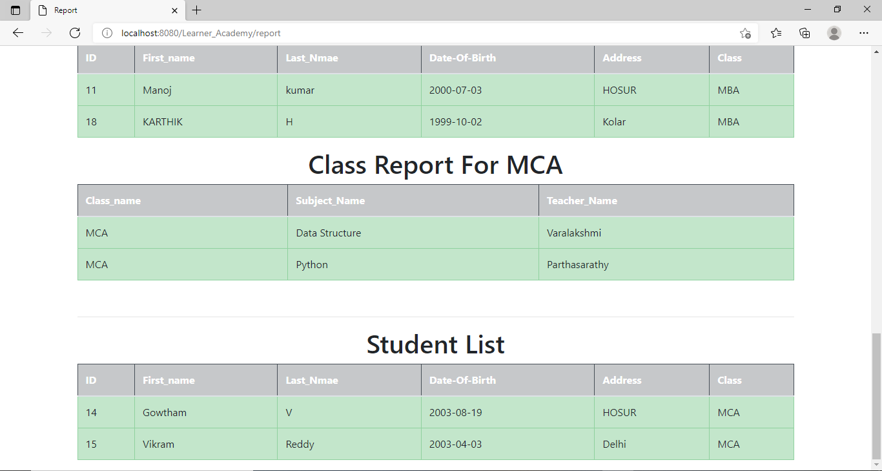
Sample Output 6

Slide 17
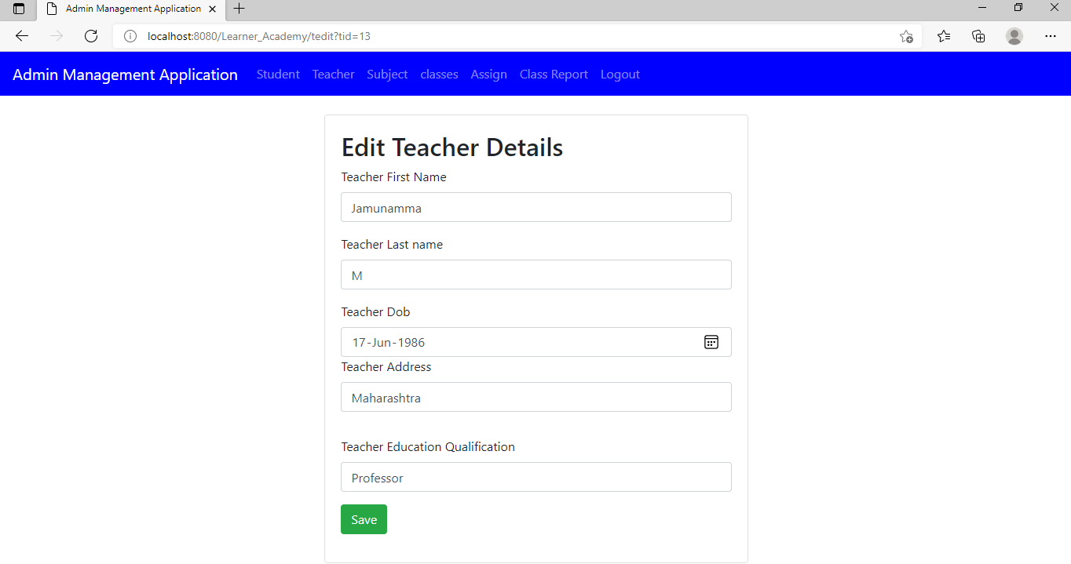
Sample Output 7

Slide 18
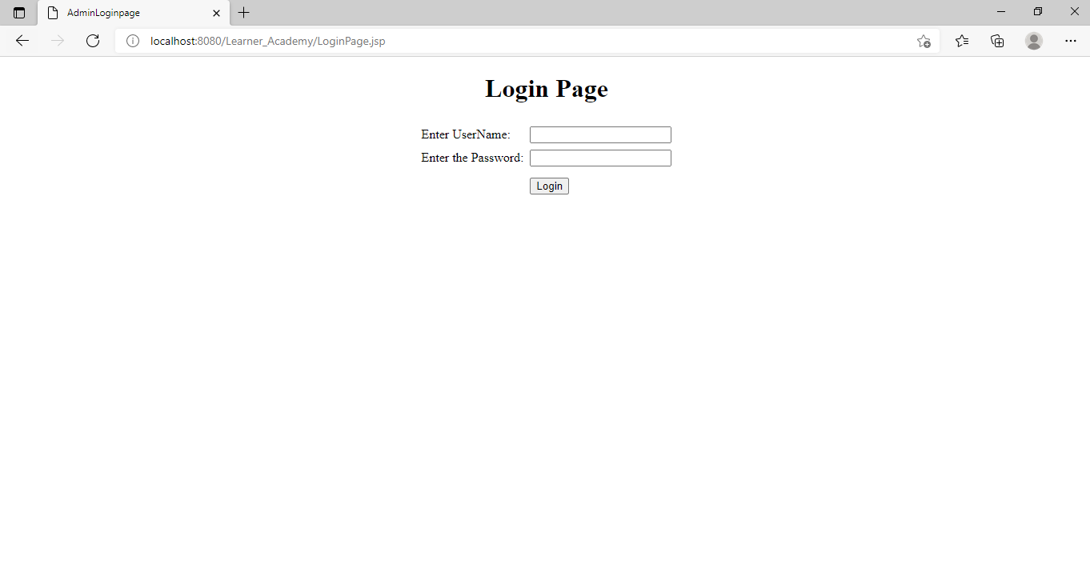
Sample Output 8

Slide 19
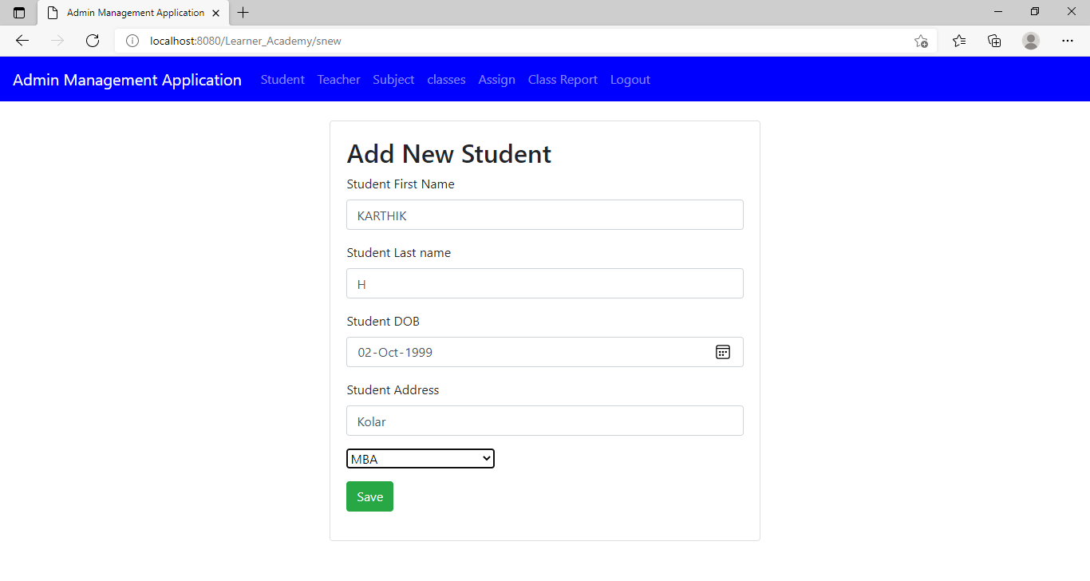
Sample Output 9

Slide 20
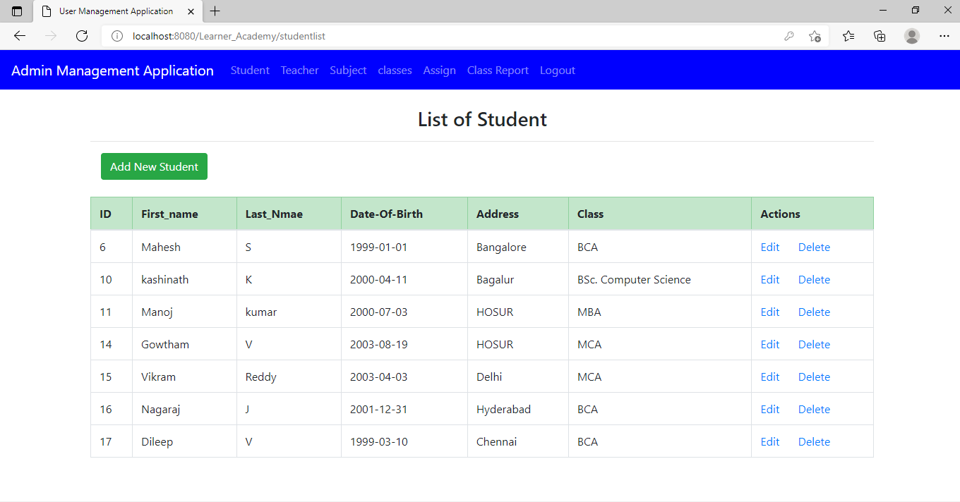
Sample Output 10

Slide 21
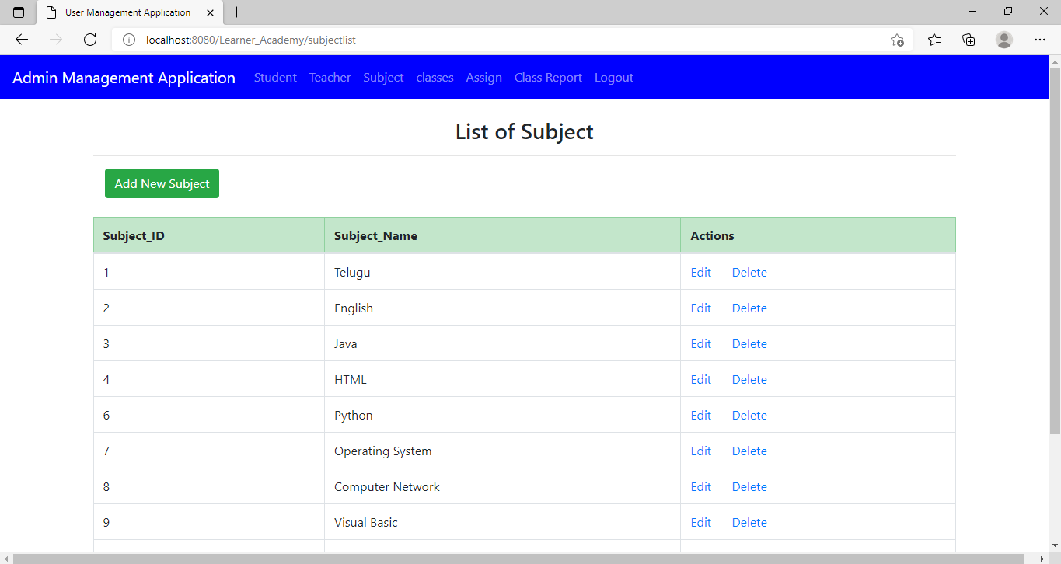
Sample Output 11

Slide 22
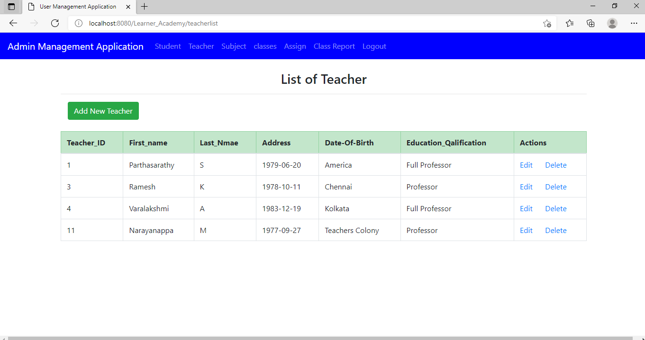
Sample Output 12

Slide 23

Thank You
Name : Manoj kumar k
Phone no: 7200663142
manojkumar720066@Gmail.com

